Slide 1

Java Programming Language SE – 6
Module 13: Handling GUI-Generated Events

Slide 2

Objectives
Define events and event handling
Examine the Java SE event model
Describe GUI behavior
Determine the user action that originated an event
Develop event listeners
Describe concurrency in Swing-based GUIs and
describe the features of the SwingWorker class

Slide 3
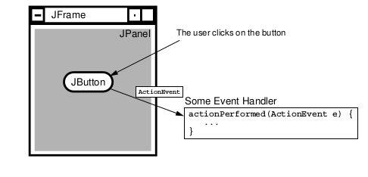
What Is an Event?
Events – Objects that describe what happened
Event sources – The generator of an event
Event handlers – A method that receives an event object, deciphers it, and processes the user’s interaction

Slide 4
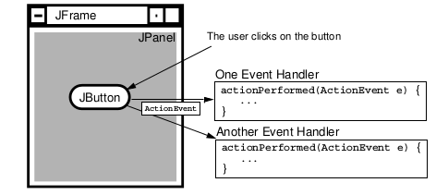
Delegation Model
An event can be sent to many event handlers.
Event handlers register with components when they are interested in events generated by that component.

Slide 5

Delegation Model
Client objects (handlers) register with a GUI component that they want to observe.
GUI components trigger only the handlers for the type of event that has occurred.
Most components can trigger more than one type of event.
The delegation model distributes the work among multiple classes.

Slide 6
A Listener Example
public class TestButton {
private JFrame f;
private JButton b;
public TestButton() {
f = new JFrame("Test");
b = new JButton("Press Me!");
b.setActionCommand("ButtonPressed");
}
public void launchFrame() {
b.addActionListener(new ButtonHandler());
f.add(b,BorderLayout.CENTER);
f.pack();
f.setVisible(true);
}

Slide 7
A Listener Example
public static void main(String args[]) {
TestButton guiApp = new TestButton();
guiApp.launchFrame();
}}
Code for the event listener looks like the following:
import java.awt.event.*;
public class ButtonHandler implements ActionListener {
public void actionPerformed(ActionEvent e) {
System.out.println("Action occurred");
System.out.println("Button’s command is: "
+ e.getActionCommand());
}
}

Slide 8
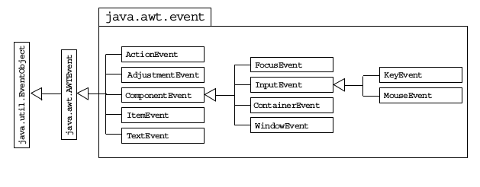
Event Categories

Slide 9
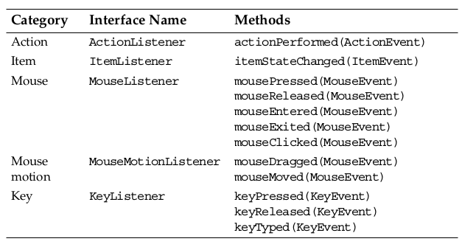
Method Categories and
Interfaces

Slide 10
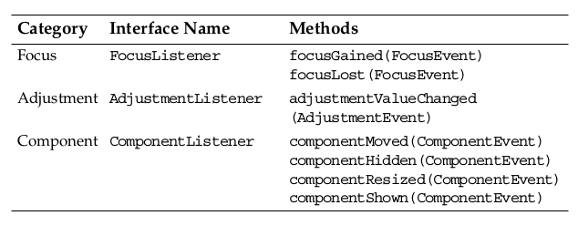
Method Categories and
Interfaces

Slide 11
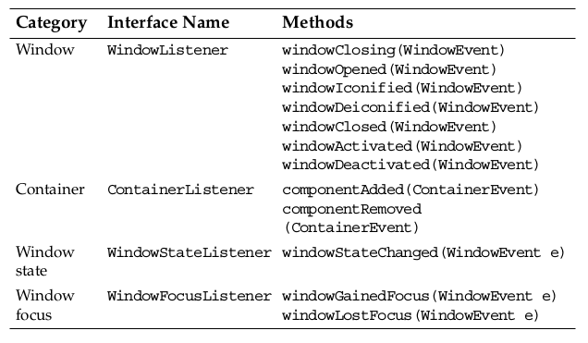
Method Categories and
Interfaces

Slide 12
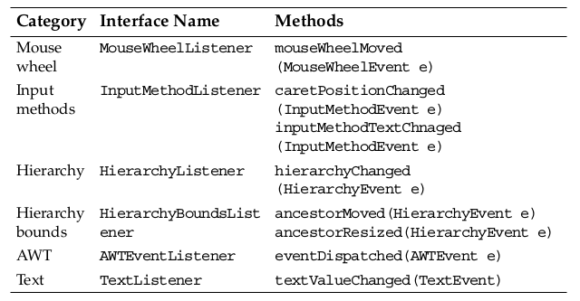
Method Categories and
Interfaces

Slide 13
Complex Example
import java.awt.*;
import java.awt.event.*;
import javax.swing.*;
public class TwoListener
implements MouseMotionListener, MouseListener {
private JFrame f;
private JTextField tf;
public TwoListener() {
f = new JFrame("Two listeners example");
tf = new JTextField(30);}

Slide 14
Complex Example
public void launchFrame() {
JLabel label = new JLabel("Click and drag the mouse");
// Add components to the frame
f.add(label, BorderLayout.NORTH);
f.add(tf, BorderLayout.SOUTH);
// Add this object as a listener
f.addMouseMotionListener(this);
f.addMouseListener(this);
// Size the frame and make it visible
f.setSize(300, 200);
f.setVisible(true);
}

Slide 15
Complex Example
// These are MouseMotionListener events
public void mouseDragged(MouseEvent e) {
String s = "Mouse dragging: X = " + e.getX()
+ " Y = " + e.getY();
tf.setText(s);
}
public void mouseEntered(MouseEvent e) {
String s = "The mouse entered";
tf.setText(s);
}
public void mouseExited(MouseEvent e) {
String s = "The mouse has left the building";
tf.setText(s);
}

Slide 16
Complex Example
// Unused MouseMotionListener method.
// All methods of a listener must be present in the
// class even if they are not used.
public void mouseMoved(MouseEvent e) { }
// Unused MouseListener methods.
public void mousePressed(MouseEvent e) { }
public void mouseClicked(MouseEvent e) { }
public void mouseReleased(MouseEvent e) { }
public static void main(String args[]) {
TwoListener two = new TwoListener();
two.launchFrame();
}
}

Slide 17
Multiple Listeners
Multiple listeners cause unrelated parts of a program to react to the same event.
The handlers of all registered listeners are called when the event occurs.

Slide 18
Event Adapters
The listener classes that you define can extend adapter classes and override only the methods that you need.

Slide 19
Event Adapters Example
import java.awt.*;
import java.awt.event.*;
import javax.swing.*;
public class MouseClickHandler extends MouseAdapter {
// We just need the mouseClick handler, so we use
// an adapter to avoid having to write all the
// event handler methods
public void mouseClicked(MouseEvent e) {
// Do stuff with the mouse click...
}
}

Slide 20
Event Handling Using
Inner Classes
import java.awt.*;
import java.awt.event.*;
import javax.swing.*;
public class TestInner {
private JFrame f;
private JTextField tf; // used by inner class
public TestInner() {
f = new JFrame("Inner classes example");
tf = new JTextField(30);
}
class MyMouseMotionListener extends MouseMotionAdapter {
public void mouseDragged(MouseEvent e) {
String s = "Mouse dragging: X = "+ e.getX()
+ " Y = " + e.getY();
tf.setText(s);
}}

Slide 21
Event Handling Using
Inner Classes
public void launchFrame() {
JLabel label = new JLabel("Click and drag the mouse");
// Add components to the frame
f.add(label, BorderLayout.NORTH);
f.add(tf, BorderLayout.SOUTH);
// Add a listener that uses an Inner class
f.addMouseMotionListener(new MyMouseMotionListener());
f.addMouseListener(new MouseClickHandler());
// Size the frame and make it visible
f.setSize(300, 200);
f.setVisible(true);
}
public static void main(String args[]) {
TestInner obj = new TestInner();
obj.launchFrame();
}}

Slide 22
Event Handling Using
Anonymous Classes
import java.awt.*;
import java.awt.event.*;
import javax.swing.*;
public class TestAnonymous {
private JFrame f;
private JTextField tf;
public TestAnonymous() {
f = new JFrame("Anonymous classes example");
tf = new JTextField(30);
}
public static void main(String args[]) {
TestAnonymous obj = new TestAnonymous();
obj.launchFrame();
}

Slide 23
Event Handling Using
Anonymous Classes
public void launchFrame() {
JLabel label = new JLabel("Click and drag the mouse");
// Add components to the frame
f.add(label, BorderLayout.NORTH);
f.add(tf, BorderLayout.SOUTH);
// Add a listener that uses an anonymous class
f.addMouseMotionListener(new MouseMotionAdapter() {
public void mouseDragged(MouseEvent e) {
String s = "Mouse dragging: X = "+ e.getX()
+ " Y = " + e.getY();
tf.setText(s);
}
}); // <- note the closing parenthesis
f.addMouseListener(new MouseClickHandler()); // Not shown
// Size the frame and make it visible
f.setSize(300, 200);
f.setVisible(true);
}}

Slide 24
Concurrency In Swing
To handle a GUI efficiently, the Swing program needs different threads to:
Execute the application code (current threads)
Handle the events that arise from the GUI (event dispatch threads)
Handle background tasks that might be time consuming (worker threads)
Each task in a worker thread is represented by an instance of javax.swing.SwingWorker.

Slide 25
The SwingWorker Class
The SwingWorker class has methods to service the following requirements:
To provide communication and coordination between worker thread tasks and the tasks on other threads:
  Properties: state and progress
To execute simple background tasks:
  doInBackground method
To execute tasks that have intermediate results:
  publish method
To cancel the background threads:
  cancel method

Slide 26



Stay connected
About us: Emertxe is India’s one of the top IT finishing schools & self learning kits provider. Our primary focus is on Embedded with diversification focus on Java, Oracle and Android areas
Emertxe Information Technologies,
No-1, 9th Cross, 5th Main,
Jayamahal Extension,
Bangalore, Karnataka 560046
T: +91 80 6562 9666
E: training@emertxe.com
https://www.facebook.com/Emertxe
https://twitter.com/EmertxeTweet
https://www.slideshare.net/EmertxeSlides

Slide 27
Thank You

