Slide 1

Java Programming Language SE – 6
Module 14: GUI-Based Applications

Slide 2

Objectives
Describe how to construct a menu bar, menu, and menu items in a Java GUI
Understand how to change the color and font of a component

Slide 3
Relevance
You now know how to set up a Java GUI for both graphic output and interactive user input. However, only a few of the components from which GUIs can be built have been described. What other components would be useful in a GUI?
How can you create a menu for your GUI frame?

Slide 4
How to Create a Menu
1. Create a JMenuBar object, and set it into a menu container, such as a JFrame.
2. Create one or more JMenu objects, and add them to the menu bar object.
3. Create one or more JMenuItem objects, and add them to the menu object.

Slide 5
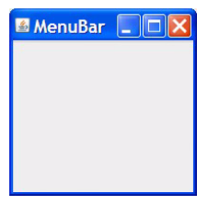
Creating a JMenuBar
f = new JFrame("MenuBar");
mb = new JMenuBar();
f.setJMenuBar(mb);

Slide 6
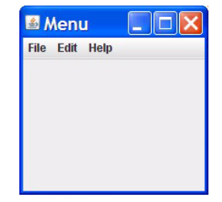
Creating a JMenu
f = new JFrame("Menu");
mb = new JMenuBar();
m1 = new JMenu("File");
m2 = new JMenu("Edit");
m3 = new JMenu("Help");
mb.add(m1);
mb.add(m2);
mb.add(m3);
f.setJMenuBar(mb);

Slide 7
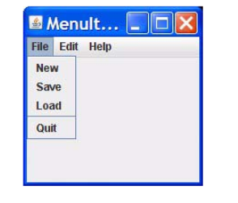
Creating a JMenuItem
mi1 = new JMenuItem("New");
mi2 = new JMenuItem("Save");
mi3 = new JMenuItem("Load");
mi4 = new JMenuItem("Quit");
mi1.addActionListener(this);
mi2.addActionListener(this);
mi3.addActionListener(this);
mi4.addActionListener(this);
m1.add(mi1);
m1.add(mi2);
m1.add(mi3);
m1.addSeparator();
m1.add(mi4);

Slide 8
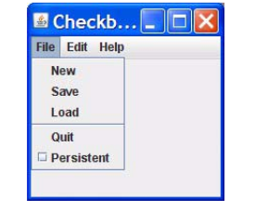
Creating a
JCheckBoxMenuItem
f = new JFrame("CheckboxMenuItem");
mb = new JMenuBar();
m1 = new JMenu("File");
m2 = new JMenu("Edit");
m3 = new JMenu("Help");
mb.add(m1);
mb.add(m2);
mb.add(m3);
f.setJMenuBar(mb);
...........
mi5 = new JCheckBoxMenuItem("Persistent");
mi5.addItemListener(this);
m1.add(mi5);

Slide 9
Controlling Visual Aspects
Commands to control visual aspects of the GU include:
Colors:
  setForeground()
  setBackground()
Example:
  Color purple = new Color(255, 0, 255);
  JButton b = new JButton(“Purple”);
  b.setBackground(purple);

Slide 10



Stay connected
About us: Emertxe is India’s one of the top IT finishing schools & self learning kits provider. Our primary focus is on Embedded with diversification focus on Java, Oracle and Android areas
Emertxe Information Technologies,
No-1, 9th Cross, 5th Main,
Jayamahal Extension,
Bangalore, Karnataka 560046
T: +91 80 6562 9666
E: training@emertxe.com
https://www.facebook.com/Emertxe
https://twitter.com/EmertxeTweet
https://www.slideshare.net/EmertxeSlides

Slide 11
Thank You

