Slide 1
JDBC

Slide 2
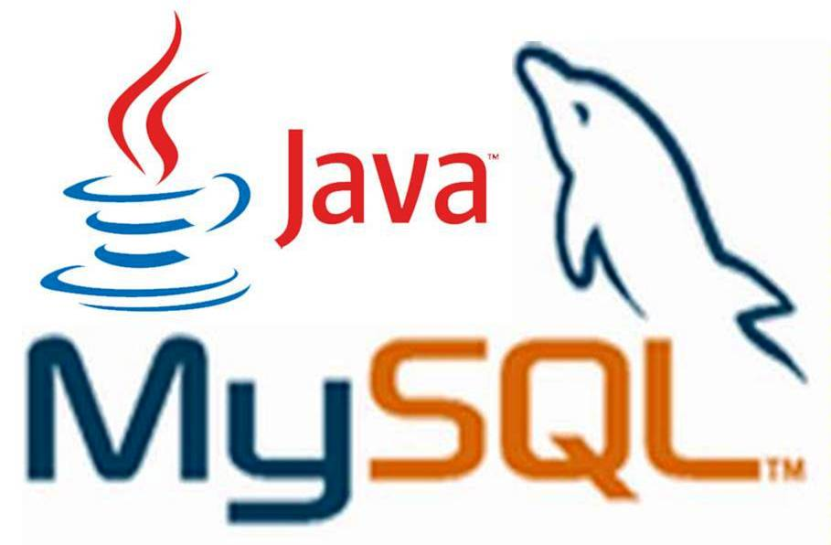
What is JDBC?

Slide 3
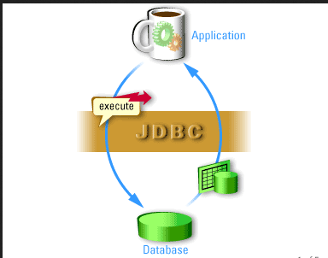
Definition
JDBC is a Java-based data access technology (Java Standard Edition platform) from Oracle Corporation.
This technology is an API for the Java programming language that defines how a client may access a database.
It provides methods for querying and updating data in a database.

Slide 4
JDBC History

Slide 5
JDBC History
Before JDBC, ODBC API was used to connect and execute query to the database.
But ODBC API uses ODBC driver that is written in C language which is platform dependent and unsecured.
That is why Sun Micro System has defined its own API (JDBC API) that uses JDBC driver written in Java language.

Slide 6
JDBC History
Sun Microsystems released JDBC as part of JDK 1.1 on February 19, 1997.
The JDBC classes are contained in the Java package java.sql and javax.sql
The latest version, JDBC 4.2, and is included in Java SE 8.

Slide 7
What is API

Slide 8
API
The Java API is the set of classes included with the Java Development Environment. These classes are written using the Java language and run on the JVM. The Java API includes everything from collection classes to GUI classes.
JDBC is also an API.

Slide 9
JDBC Drivers

Slide 10
JDBC Drivers
JDBC Driver is a software component that enables java application to interact with the database.There are 4 types of JDBC drivers:
  Type 1: JDBC-ODBC bridge driver
  Type 2: Native-API driver (partially java driver)
  Type 3: Network Protocol driver (fully java driver)
  Type 4: Thin driver (fully java driver)

Slide 11
  Type 1:
  JDBC-ODBC Bridge Driver
The JDBC-ODBC bridge driver uses ODBC driver to connect to the database. This is now discouraged because of thin driver.

Slide 12
  Type 2:
  Native-API Driver
The Native API driver uses the client-side libraries of the database.
It is not written entirely in Java.

Slide 13
  Type 3:
  Network Protocol Driver
The Network Protocol driver uses middle ware (application server).
It is fully written in Java.

Slide 14
  Type 4: Thin Driver
The thin driver converts JDBC calls directly into the vendor-specific database protocol.
That is why it is known as thin driver.
It is fully written in Java language.
Better performance than all other drivers.
No software is required at client side or server side.
Disadvantage: Drivers depends on the Database.

Slide 15
Steps to Connect to the
Database in Java
JDBC Drivers

Slide 16
Steps to Connect to
Database
There are 5 steps to connect any java application with the database in java using JDBC. They are as follows:
Register the driver class
Creating connection
Creating statement
Executing queries
Closing connection

Slide 17
Registering the
Driver
The forName() method of Class class is used to register the driver class.
Class.forName("com.mysql.jdbc.Driver");

Slide 18
Creating
Connection Object
The getConnection() method of DriverManager class is used to establish connection with the database.
Connection con=DriverManager.getConnection( "jdbc:mysql://localhost:3306","root","password");

Slide 19
Creating Statement
Object
The createStatement() method of Connection interface is used to create statement. The object of statement is responsible to execute queries with the database.
Statement stmt=con.createStatement();

Slide 20
Execute Query
The executeQuery() method of Statement interface is used to execute queries to the database. This method returns the object of ResultSet that can be used to get all the records of a table.
ResultSet rs=stmt.executeQuery("select * from emp");
while(rs.next()){
System.out.println(rs.getInt(1)+" "+rs.getString(2));
}

Slide 21
Closing Connection
By closing connection object statement and ResultSet will be closed automatically. The close() method of Connection interface is used to close the connection.
con.close();

Slide 22
Connecting to the MySQL Database
JDBC Drivers

Slide 23
Connect to MySQL
Database
Driver class: com.mysql.jdbc.Driver.
Connection URL: jdbc:mysql://localhost:3306/db_name
Username: The default username for the mysql database is root.
Password: Given by the user at the time of installing the mysql database
Example:
Connection con=DriverManager.getConnection(
"jdbc:mysql://localhost:3306/sonoo","root","root");

Slide 24
Loading the .jar
Download the MySQL connector.jar from mysql.com
Paste the mysqlconnector.jar in the lib folder of source directory.
Set the classpath

Slide 25
DriverManager class
The DriverManager class acts as an interface between user and drivers.
It keeps track of the drivers that are available and handles establishing a connection between a database and the appropriate driver.
Connection con = null; con=DriverManager.getConnection( "jdbc:mysql://localhost:3306","root","password");
DriverManager.registerDriver().

Slide 26
Connection
Interface
A Connection is the session between Java application and database.
The Connection interface is a factory of Statement and PreparedStatement.
Object of Connection can be used to get the object of Statement and PreparedStatement.

Slide 27
Connection
Interface
Methods of Connection interface:
public Statement createStatement(): creates a statement object that can be used to execute SQL queries.
public void commit(): saves the changes made since the previous commit/rollback permanent.
public void close(): closes the connection and Releases a JDBC resources immediately.

Slide 28
Statement Interface
The Statement interface provides methods to execute queries with the database.
The statement interface is a factory of ResultSet.
It provides factory method to get the object of ResultSet.

Slide 29
Statement Interface
Methods of Statement interface:
public ResultSet executeQuery(String sql): is used to execute SELECT query. It returns the object of ResultSet.
public int executeUpdate(String sql): is used to execute specified query, it may be create, drop, insert, update, delete etc.
public boolean execute(String sql): is used to execute queries that may return multiple results.

Slide 30
Statement Interface
Example:
Statement stmt=con.createStatement();
int result=stmt.executeUpdate("delete from table where id=xy");
System.out.println(result+" records affected");
con.close();

Slide 31
ResultSet interface
The object of ResultSet maintains a cursor pointing to a particular row of data.
Initially, cursor points to before the first row.

Slide 32
ResultSet Interface
Methods of ResultSet interface:
public boolean next(): is used to move the cursor to the one row next from the current position.
public boolean previous():is used to move the cursor to the one row previous from the current position.
public boolean first(): is used to move the cursor to the first row in result set object.
public boolean last():is used to move the cursor to the last row in result set object.

Slide 33
ResultSet Interface
Methods of ResultSet interface:
public int getInt(int columnIndex): is used to return the data of specified column index of the current row as int.
public int getInt(String columnName): columnName): is used to return the data of specified column name of the current row as int.
public String getString(int columnIndex): is used to return the data of specified column index of the current row as String.
public String getString(String columnName): is used to return the data of specified column name of the current row as String.

Slide 34
ResultSet Interface
Example:
ResultSet rs=stmt.executeQuery("select * from table");
//getting the record of 3rd row
rs.absolute(3);
System.out.println(rs.getString(1)+" "+rs.getString(2)+" "+rs.getString(3));
con.close();

Slide 35
PreparedStatement
Interface
The PreparedStatement interface is a sub interface of Statement.
It is used to execute parameterized query.
Example of parameterized query:
  String sql="insert into emp values(?,?,?)";

Slide 36
PreaparedStatement
Interface
Methods of PreparedStatement:
public void setInt(int paramIndex, int value): sets the integer value to the given parameter index.
public void setString(int paramIndex, String value): sets the String value to the given parameter index.
public void setFloat(int paramIndex, float value): sets the float value to the given parameter index.

Slide 37
PreparedStatement
Interface
Methods of PreparedStatement:
public void setDouble(int paramIndex, double value): sets the double value to the given parameter index.
public int executeUpdate(): executes the query. It is used for create, drop, insert, update, delete etc.
public ResultSet executeQuery(): executes the select query. It returns an instance of ResultSet.

Slide 38
PreparedStatement
Interface
Example:
PreparedStatement stmt=con.prepareStatement("insert into Emp values(?,?)");
stmt.setInt(1,101);//1 specifies the first parameter in the query
stmt.setString(2,"Ratan");
int i=stmt.executeUpdate();
System.out.println(i+" records inserted");

Slide 39
Questions
Write a program to implement CRUD in a table.
Write a program to implement PreparedStatement?

Slide 40



Stay connected
About us: Emertxe is India’s one of the top IT finishing schools & self learning kits provider. Our primary focus is on Embedded with diversification focus on Java, Oracle and Android areas
Emertxe Information Technologies,
No-1, 9th Cross, 5th Main,
Jayamahal Extension,
Bangalore, Karnataka 560046
T: +91 80 6562 9666
E: training@emertxe.com
https://www.facebook.com/Emertxe
https://twitter.com/EmertxeTweet
https://www.slideshare.net/EmertxeSlides

Slide 41
Thank You

