Slide 1
RDBMS Concepts

Slide 2
What is RDBMS?

Slide 3


Slide 4
Definition
RDBMS stands for Relational Database Management System. RDBMS is the basis for SQL, and for all modern database systems like MS SQL Server, IBM DB2, Oracle, MySQL, and Microsoft Access.
A Relational database management system (RDBMS) is a database management system (DBMS) that is based on the relational model as introduced by E. F. Codd.
The data in RDBMS is stored in database objects called tables.

Slide 5
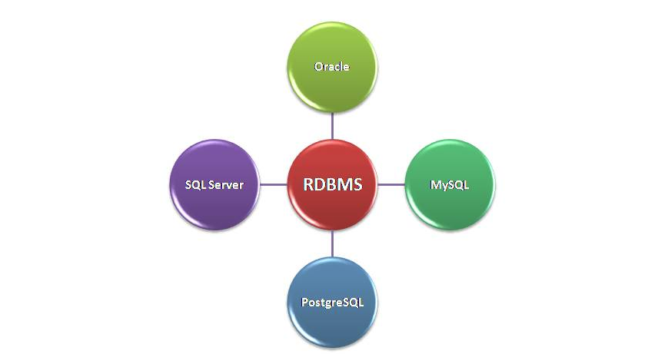
Different RDBMS Technology

Slide 6
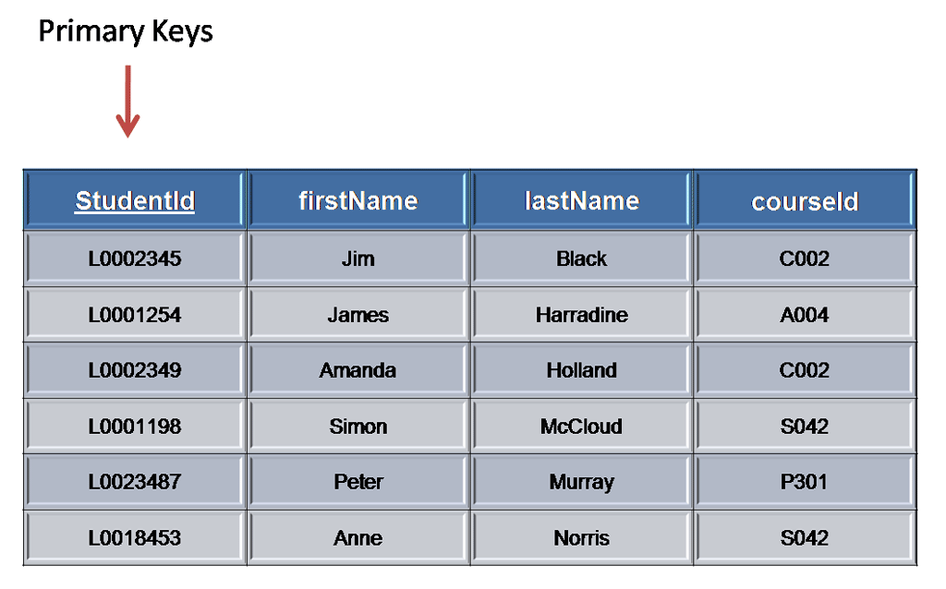
Creating Table

Slide 7
Creating Table
The data in RDBMS is stored in database objects called tables. The table is a collection of related data entries and it consists of columns and rows.
Remember, a table is the most common and simplest form of data storage in a relational database.

Slide 8
Field, Record or
Row
Every table is broken up into smaller entities called fields. The fields in the CUSTOMERS table consist of ID, NAME, AGE, ADDRESS and SALARY.
A record, also called a row of data, is each individual entry that exists in a table. For example there are 7 records in the above CUSTOMERS table.

Slide 9
Column
A column is a vertical entity in a table that contains all information associated with a specific field in a table.

Slide 10
Null Value
A NULL value in a table is a value in a field that appears to be blank, which means a field with a NULL value is a field with no value.

Slide 11
SQL

Slide 12
SQL
SQL is a standard language for accessing databases.
SQL stands for Structured Query Language
SQL lets you access and manipulate databases
SQL is an ANSI (American National Standards Institute) standard

Slide 13
Benefit of SQL
SQL can execute queries against a database
SQL can retrieve data from a database
SQL can insert records in a database
SQL can update records in a database
SQL can delete records from a database

Slide 14
Benefit of SQL
SQL can create new databases
SQL can create new tables in a database
SQL can create stored procedures in a database
SQL can create views in a database
SQL can set permissions on tables, procedures, and views

Slide 15
Using SQL in your
Project
To build an application that shows data from a database, you will need:
An RDBMS database program (i.e. MS Access, SQL Server, MySQL)
To use a server-side scripting language, like Java, PHP or ASP
To use SQL to get the data you want
To use HTML / CSS

Slide 16
Important SQL
Commands
SELECT - extracts data from a database
UPDATE - updates data in a database
DELETE - deletes data from a database
INSERT INTO - inserts new data into a
database
CREATE DATABASE - creates a new database

Slide 17
Important SQL
Commands
SELECT - extracts data from a database
UPDATE - updates data in a database
DELETE - deletes data from a database
INSERT INTO - inserts new data into a
database
CREATE DATABASE - creates a new database

Slide 18
Important SQL
Commands
ALTER DATABASE - modifies a database
CREATE TABLE - creates a new table
ALTER TABLE - modifies a table
DROP TABLE - deletes a table

Slide 19
SQL Syntax
CREATE DATABASE
  CREATE DATABASE dbname;
CREATE TABLE
  CREATE TABLE Persons(PersonID int,LastName varchar(255),FirstName varchar(255),Address varchar(255),City varchar(255)
  );

Slide 20
SQL Syntax
SQL SELECT Statement
  SELECT * FROM table_name;
SELECT Column Example
  SELECT CustomerName,City FROM Customers;
SELECT DISTINCT Statement
  SELECT DISTINCT column_name,column_name
  FROM table_name;

Slide 21
SQL Syntax
SQL WHERE Clause
  SELECT * FROM Customers
  WHERE Country='Mexico';;

Slide 22
SQL Syntax
Operators in the where clause:
=, >,<,>=,<=, BETWEEN, LIKE, IN
SQL AND Operators
  SELECT * FROM Customers
  WHERE Country='Germany'
  AND City='Berlin';
OR Operator Example
  SELECT * FROM Customers
  WHERE City='Berlin'
  OR City='Munchen';

Slide 23
SQL Syntax
Combining AND & OR
  SELECT * FROM Customers
  WHERE Country='Germany'
  AND (City='Berlin' OR City='München');

Slide 24
ORDER BY Keyword
The ORDER BY keyword is used to sort the result-set by one or more columns.
The ORDER BY keyword sorts the records in ascending order by default. To sort the records in a descending order, you can use the DESC keyword.

Slide 25
ORDER BY Keyword
  SELECT column_name,column_name
  FROM table_name
  ORDER BY column_name,column_name ASC|DESC;
  SELECT * FROM Customers ORDER BY Country;
  SELECT * FROM Customers ORDER BY Country DESC;
  SELECT * FROM Customers ORDER BY Country,CustomerName;

Slide 26
INSERT INTO
Statement
INSERT INTO table_name
VALUES (value1,value2,value3,...);
INSERT INTO table_name (column1,column2,column3,...)
VALUES (value1,value2,value3,...);
INSERT INTO Customers (CustomerName, ContactName, Address, City, PostalCode, Country)
VALUES ('Cardinal','Tom B. Erichsen','Skagen 21','Stavanger','4006','Norway');

Slide 27
Update Statement
The UPDATE statement is used to update existing records in a table.
UPDATE table_name
SET column1=value1,column2=value2,...
WHERE some_column=some_value;
UPDATE Customers SET ContactName='Alfred Schmidt', City='Hamburg' WHERE CustomerName='Alfreds Futterkiste';

Slide 28
DELETE Statement
The DELETE statement is used to delete records in a table.
DELETE FROM table_name WHERE some_column=some_value;
DELETE FROM Customers WHERE CustomerName='Alfreds Futterkiste' AND ContactName='Maria Anders';

Slide 29

DELETE Statement
Delete All Data
DELETE FROM table_name;
or
DELETE * FROM table_name;

Slide 30

Between Operators

Slide 31
BETWEEN
Operator
SELECT column_name(s) FROM table_name WHERE column_name BETWEEN value1 AND value2;
SELECT * FROM Products WHERE Price BETWEEN 10 AND 20;
NOT BETWEEN
SELECT * FROM Products WHERE Price NOT BETWEEN 10 AND 20;
BETWEEN Operator with IN
SELECT * FROM Products WHERE (Price BETWEEN 10 AND 20) AND NOT CategoryID IN (1,2,3);

Slide 32
BETWEEN
Operator
BETWEEN Operator with Text Value
  SELECT * FROM Products WHERE ProductName BETWEEN 'C' AND 'M';
NOT BETWEEN Operator with Text Value
  SELECT * FROM Products WHERE ProductName NOT BETWEEN 'C' AND 'M';
BETWEEN Operator with Date Value
  SELECT * FROM Orders WHERE OrderDate BETWEEN #07/04/1996# AND #07/09/1996#;

Slide 33
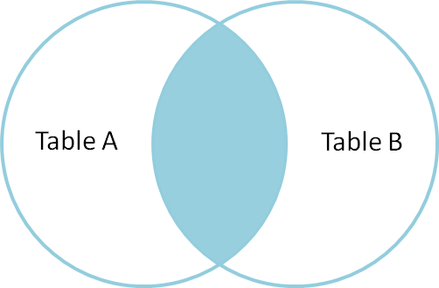
SQL Joins

Slide 34
SQL Joins
An SQL JOIN clause is used to combine rows from two or more tables, based on a common field between them.

Slide 35
SQL Joins
The different SQL JOINs you can use:
  INNER JOIN: Returns all rows when there is at least one match in BOTH tables
  LEFT JOIN: Return all rows from the left table, and the matched rows from the right table
  RIGHT JOIN: Return all rows from the right table, and the matched rows from the left table
  FULL JOIN: Return all rows when there is a match in ONE of the tables

Slide 36
SQL Joins
The most common type of join is: SQL INNER JOIN (simple join). An SQL INNER JOIN return all rows from multiple tables where the join condition is met.

Slide 37
SQL Joins
Let's look at a selection from the "Orders" table:
OrderID CustomerID OrderDate
10308 2 1996-09-18
10309 37 1996-09-19
10310 77 1996-09-20

Slide 38
SQL Joins
Have a look at a selection from the "Customers" table:
CustomerID CustomerName ContactName Country
1 Alfreds Futterkiste Maria Anders Germany
2 Ana Trujillo Trujillo Mexico
3 Antonio Moreno Moreno Mexico
Notice that the "CustomerID" column in the "Orders" table refers to the customer in the "Customers" table. The relationship between the two tables above is the "CustomerID" column.

Slide 39
SQL Joins
Example:
SELECT Orders.OrderID, Customers.CustomerName, Orders.OrderDate
FROM Orders
INNER JOIN Customers
ON Orders.CustomerID=Customers.CustomerID;
It will produce the following:
OrderID CustomerName OrderDate
10308 Ana Trujillo 9/18/1996

Slide 40

SQL Constraints
SQL constraints are used to specify rules for the data in a table.
Constraints can be specified when the table is created (inside the CREATE TABLE statement) or after the table is created (inside the ALTER TABLE statement).

Slide 41
SQL Constraints
SQL CREATE TABLE + CONSTRAINT Syntax
CREATE TABLE table_name(
column_name1 data_type(size) constraint_name,
column_name2 data_type(size) constraint_name,
column_name3 data_type(size) constraint_name,
....
);

Slide 42
SQL Constraints
In SQL, we have the following constraints:
NOT NULL - Indicates that a column cannot store NULL value
UNIQUE - Ensures that each row for a column must have unique value
PRIMARY KEY - A combination of a NOT NULL and UNIQUE. Ensures that a column (or combination of two or more columns) have an unique identity which helps to find a particular record in a table more easily and quickly

Slide 43
SQL Constraints
FOREIGN KEY - Ensure the referential integrity of the data in one table to match values in another table
CHECK - Ensures that the value in a column meets a specific condition
DEFAULT - Specifies a default value when specified none for this column

Slide 44
SQL Drop
DROP TABLE
  The DROP TABLE statement is used to delete a table.
  DROP TABLE table_name
DROP DATABASE
  The DROP DATABASE statement is used to delete a database.
  DROP DATABASE database_name
ALTER TABLE
  The ALTER TABLE statement is used to add, delete, or modify columns in an existing table.
  ALTER TABLE table_name ADD column_name datatype

Slide 45

SQL Drop
TRUNCATE TABLE
  What if we only want to delete the data inside the table, and not the table itself?
  TRUNCATE TABLE table_name

Slide 46
SQL AUTO
INCREMENT
Very often we would like the value of the primary key field to be created automatically every time a new record is inserted.
We would like to create an auto-increment field in a table.
CREATE TABLE Persons(ID int NOT NULL AUTO_INCREMENT,LastName varchar(255) NOT NULL,FirstName varchar(255),Address varchar(255),
City varchar(255),PRIMARY KEY (ID))

Slide 47
SQL AUTO
INCREMENT
By default, the starting value for AUTO_INCREMENT is 1,and it will increment by 1 for each new record.
To let the AUTO_INCREMENT sequence start with another value, use the following SQL statement:
  ALTER TABLE Persons AUTO_INCREMENT=100
To insert a new record into the "Persons" table, we will NOT have to specify a value for the "ID" column (a unique value will be added automatically):
  INSERT INTO Persons (FirstName,LastName) VALUES ('Lars','Monsen')

Slide 48
MYSQL
Data Types
In MySQL there are three main types : text, number, and Date/Time types.

Slide 49
MySQL Datatypes
Text Types:
  CHAR(size):(can contain letters, numbers, and special characters).Can store up to 255 characters
  VARCHAR(size):can contain letters, numbers, and special characters).Can store up to 255 characters.
  TEXT: Holds a string with a maximum length of 65,535 characters
  BLOB: For BLOBs (Binary Large OBjects). Holds up to 65,535 bytes of data

Slide 50
MySQL Data Types
Number types:
  INT(size)
  FLOAT(size,d)
  DOUBLE(size,d)

Slide 51

MySQL Data Types
Date types:
  DATE(): A date. Format: YYYY-MM-DD
  DATETIME(): A date and time combination. Format: YYYY-MM-DD HH:MM:SS
  TIME(): A time. Format: HH:MM:SS
  YEAR(): A year in two-digit or four-digit format.

Slide 52
Thank You

