Slide 1
Spring Framework
One stop shop for building enterprise applications
Team Emertxe

Slide 2

Spring Core

Slide 3
Objectives of Spring
Framework
  Introduction to Spring 3.0
  Steps to use Spring Framework in applications
  Understanding Dependency Injection and IOC
  Understanding the bean life-cycle – Auto wiring and bean scopes
  Annotation-based dependency injection
  Aspect Oriented Programming
  Introducing data access with Spring – JDBC through spring
  Transactions in a Spring environment

Slide 4

What is Spring

Slide 5
What is Spring
It is a light weight solution and a potential one-step-shop for building your enterprise -ready application.
It is a open source Java platform which is developed by Rod Johnson and first released under Apache 2.0 licence in June 2003.
Spring framework targets to make J2EE development easier to use and promote good programming practice by enabling a POJO-based programming model.
It supports declarative transaction management, remote access to your logic through RMI or web services.
It offers full featured MVC framework and enables you to integrate AOP(Aspect Oriented Programming) transparently in to your software.

Slide 6
Features of the Spring Framework
IoC container : It contains the assembler code that handles the configuration management of application objects.
Data access framework : Allows the developer to use persistence APIs, such as JDBC and Hibernate for storing persistence data in database.
Spring MVC Framework : Allows you to build web application based on MVC architecture.

Slide 7
Features of the Spring Framework
Transaction management : It helps in handling transaction management of an application without affecting its code. This framework uses Java Transaction API (JTA) for global transactions managed by an application server.
Spring TestContext framework : It provides the facility of unit and integration testing for the spring application.

Slide 8
Spring Modules

Slide 9
Spring Modules
Spring AOP
Spring ORM
Spring Web
Flow
Spring Web
MVC
Spring DAO
Spring
Context
Spring Core

Slide 10
IOC or Dependency Injection
The basic concept of IOC (Dependency of Injection) is that you do not create your objects but describe how they should be created.
You don’t directly connect your component and services together in code but describe which services are needed by which component in configuration file.
You just need to describe the dependency, the Spring container is then responsible for hooking it all up.

Slide 11
Environmental set up Of Spring Framework
Download and install jdk1.6 .
Download and Install Apache Common logging API from http://commons.apache.org/logging
Download spring-framework-3.1.0.m2.tz( for unix) , antlr-runtime -3.0.1.jar from http://WWW Springsource.org

Slide 12
Building Spring Application

Slide 13
Example using Eclipse
Create java Project and give any name
Right click on jre of project and select Build path->Configure Build Path->Libraries->Add External Jars-> and select spring -framework-3.1.0 and antlr-runtime -3.0.1.jar files.
Next right click on src and create new java classes
Right click on src and create Bean Configuration file
Finally run the project by ctrl+f11.

Slide 14
Questions
What is Spring ?
What are features of spring?
How many modules are there in spring? What are they?

Slide 15
Dependency Injection

Slide 16
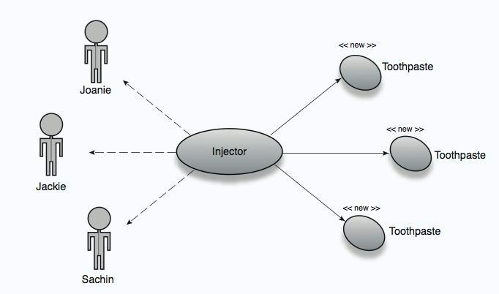
Dependency Injection

Slide 17
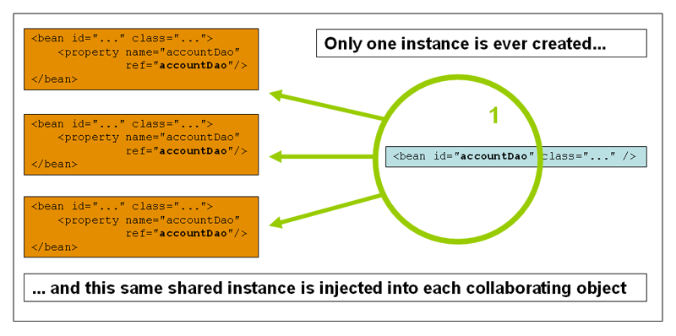
Dependency Injection

Slide 18
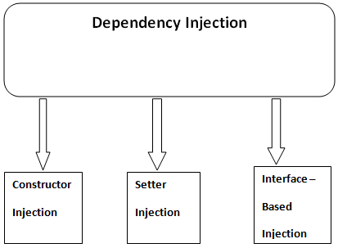
Dependency Injection

Slide 19
Dependency Injection
Dependency Injection (DI) is a design pattern that removes the dependency from the programming code so that it can be easy to manage and test the application.
There are two ways to perform dependency injection in Spring Framework.
      By Constructor : The <constructor-arg> subelement of <bean> is used for constructor injection.
<bean id="e" class="com.Emertxe.Employee">
<constructor-arg value="10" type="int"></constructor-arg>
<constructor-arg value="park"></constructor-arg>
</bean>

Slide 20
Dependency Injection
Constructor injection in Collection
<bean id="S" class="com.javatpoint.Study">
<constructor-arg value="1"></constructor-arg>
<constructor-arg value="What is spring?"></constructor-arg>
<constructor-arg>
<list>
<value>Spring is a frame work</value>
<value>Spring is a platform</value>
<value>Spring is an Island</value>
</list>
</constructor-arg>
</bean>

Slide 21
Dependency Injection
      By Setter methods : The <property> subelement of <bean> is used for setter injection.
<bean id="ex" class="com.emertxe.Employee">
<property name="id">
<value>1</value>
</property>
<property name="name">
<value>Lee</value>
</property>
<property name="city">
<value>Korea</value>
</property>
</bean>

Slide 22
Constructor Injection with Dependent Object
If there is HAS-A relationship between the classes, we create the instance of dependent object (contained object) first then pass it as an argument of the main class constructor. Here, our scenario is Employee HAS-A Address. The Address class object will be termed as the dependent object.

Slide 23
Dependency Injection
Setter injection with collection
<bean id="ex" class="com.emertxe.Study">
<property name="id" value="1"></property>
<property name="name" value="What is Spring?"></property>
<property name="answers">
<list>
<value>Spring is a frame work</value>
<value>Spring is a platform</value>
<value>Spring is an Island</value>
</list>
</property>
</bean>

Slide 24

Annotation Based Dependency Injection

Slide 25
Annotation Based DI
Instead of using XML to describe a bean wiring, you can move the bean configuration into the component class itself by using annotations on the relevant class, method, or field declaration.
We need to enable annotation auto wiring in our spring configuration file to use annotation wiring.

Slide 26
Annotation Based DI
Annotations :
@Required : This applies to bean property setter methods.
@Autowiried :This applies to bean property setter methods, non-setter methods, constructors and properties.
@Qualifier : The @Qualifier annotation along with @Autowired can be used to remove the confusion by specifiying which exact bean will be wired.
JSR-250 Annotations : It includes @Resource, @PostConstruct and @PreDestroy annotations.

Slide 27
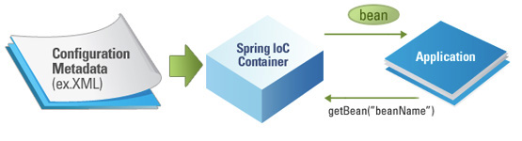
IOC Container

Slide 28
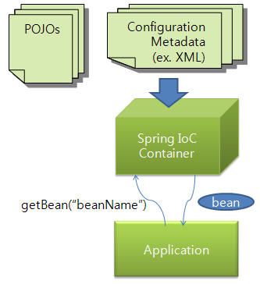
IOC Containers

Slide 29
IOC Containers
It will create objects, wire them together, configure them, and manage their complete life cycle from creation till destruction.
It uses DI to manage the components that will make up an application.
The Spring IoC Container makes use of Java POJO classes and configuration meta data to produce fully configured and executable application.
Java POJO classes
Meta data
The Spring Container
Final Result
Ready to use Application

Slide 30
Types of IOC Containers
1. BeanFactory
2. ApplicationContext
The BeanFactory and the ApplicationContext interfaces acts as the IoC container.

Slide 31
Application Context and BeanFactory
The ApplicationContext interface is subinterface of BeanFactory interface. It adds some extra functionality than BeanFactory such as simple integration with Spring's AOP, message resource handling.
BeanFactory provides the configuration framework and basic functionality, and the ApplicationContext adds more enterprise-specific functionality.
In Spring, the objects that form the backbone of your application and that are managed by the Spring IoC container are called beans.

Slide 32

Questions
What are the types of Dependency Injection Spring supports?
What are benifits of IoC?
Explain DI with setter methods?

Slide 33

Bean Life Cycle

Slide 34
Bean Life Cycle
A bean is an object that is instantiated, assembled and otherwise managed by Spring IoC Containers.
The two important methods of spring bean lifecycle are
      init-method : It specifies a method that is to be called on the bean immediately upon instantiation.
      destroy-method : It specifies a method that is called just before a bean is removed from the container.
<bean id="sample"
class="samples.SampleBean" init-method="init"/>
bean id="sample" class="samples.SampleBean"
destroy-method="destroy"/>

Slide 35

Auto Wiring

Slide 36
Spring Beans Auto Wiring
The Spring container can autowire relationships between collaborating beans without using <constructor-arg> and <property> elements.
It helps cut down on the amount of XML configuration you write for a big Spring based application.
Autowiring modes
no : this means there is no auto-wiring and you should use explicit bean reference for wiring.
byName : If the name of a bean is same as the name of other bean property, auto wire it.
<bean id="stu" class="com.emertxe.Student"
autowire="byName" />

Slide 37
Spring Beans Auto Wiring
byType : Auto wiring by property data type. If data type of a bean is compatible with the data type of other bean property, auto wire it.
constructor : It is similar to byType mode,but type applies to constructor argument.
autodetect : If a default constructor is found, use “autowired by constructor”. Otherwise, use “autowire by type”.
Limitations of Autowiring :
There is a possibility to override autowiring.
We cannot use primitive data types.
It has confusing nature.

Slide 38
Bean Scopes

Slide 39
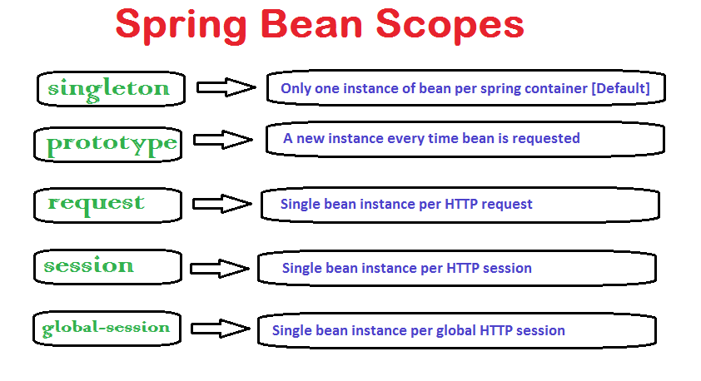
Bean Scope
Note: request, session, global-session are only valid in the context
of a web-aware Spring ApplicationContext.

Slide 40
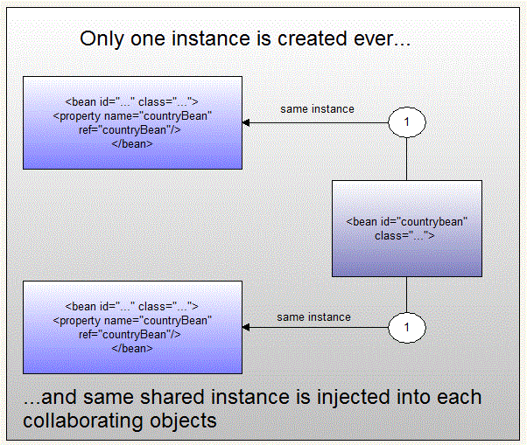
Bean Scope: Singleton

Slide 41
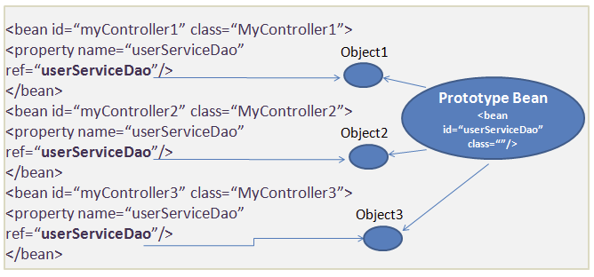
Bean Scope: Prototype

Slide 42
Bean Scope
Bean definition with singleton scope.
Bean Definition with prototype scope.
<bean id="..." class="..." scope="singleton">
--------------------------------------------------------------
</bean>
<bean id="..." class="..." scope="prototype">
--------------------------------------------------------------
</bean>

Slide 43
Questions
What is Bean Factory?
What are the limitaions of auto-wiring?
What is default scope of bean in Spring framework?
Are Singleton beans thread safe in Spring Framework?
Can you inject null and empty string values in Spring?

Slide 44
Spring AOP

Slide 45
Aspect Oriented Programming
Aspect oriented programming complements object oriented programming by providing another way of programming model structure.

Slide 46
Aspect Oriented Programming(AOP)
AOP is one of the key component of Spring framework.
It breaks down the program logic into distinct parts called concerns. It is used to increase modularity by cross-cutting concerns.
The functions that span multiple points of an application are called cross-cutting concerns.
AOP helps you decouple cross-cutting concerns from the objects that they affect.
AOP is like triggers in programming languages such as Java, .NET and others.
The key unit of modularity in OOP is the class, whereas in AOP the unit of modularity is the aspect.

Slide 47
AOP Concepts
Join point
Advice
Pointcut
Introduction
Target Object
Aspect
AOP Proxy
Weaving

Slide 48
AOP Concepts
Join point : It is any point in your program such as method execution, exception handling, field access etc. Spring supports only method execution join point.
Advice : It represents an action taken by an aspect at a particular join point. The different types of advices are given below.

Slide 49
AOP Concepts
    Before Advice: it executes before a join point.
    After Returning Advice: it executes after a joint point completes normally.
    After Throwing Advice: it executes if method exits by throwing an exception.
    After (finally) Advice: it executes after a join point regardless of join point exit whether normally or exceptional return.
    Around Advice: It executes before and after a join point.

Slide 50
AOP Concepts
Pointcut : This is set of one or more join points where an advice should be executed.
Introduction : It allows us to add new methods or attributes to existing classes.
Target Object : It is advised by one or more aspects It is also known as proxied object in spring because Spring AOP is implemented using runtime proxies.
Aspect : It is a class that contain advices and joinpoints.
AOP Proxy : It is used to implement aspect contracts, created by AOP framework.
Weaving : It is the process of linking aspect with other application types or objects to create an advised object. Weaving can be done at compile time, load time or runtime.

Slide 51
Spring AOP
Spring AOP is implemented in 3 ways.
Spring 1.2 old-style(DTD).
AspectJ annotation-style.
Spring XML configuration-style.
AspectJ annotation-style approach is most widely used.

Slide 52
Questions
How do you turn on annotation wiring?
What does @Required annotation mean?
What are the JSR-250 Annotations?
What is the difference between concern and cross-cutting concern in Spring AOP?
What are the different points where weaving can be applied?

Slide 53
Spring JDBC

Slide 54
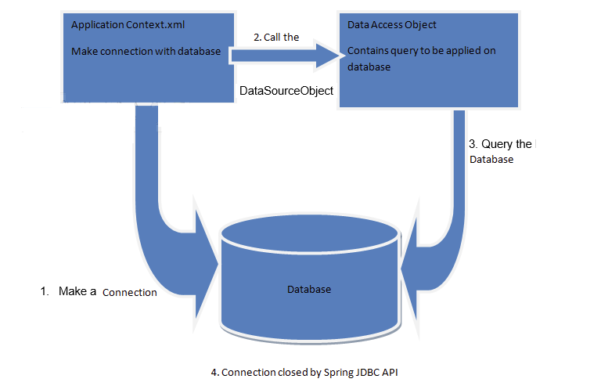
Data Access Using Spring

Slide 55
Data Access Using Spring
When we access data from database using JDBC, we have to write code to handle exceptions, opening the connection and closing the connection.
But with Spring Framework it takes care of all the low-level details starting from opening the connection, prepare and execute the SQL statement etc.

Slide 56
Data Access Using Spring
Spring framework provides following approaches for JDBC database access :
JdbcTemplate
NamedParameterJdbcTemplate
SimpleJdbcTemplate
SimpleJdbcInsert and SimpleJdbcCall

Slide 57
JDBC Template Class
This class is the central class of Spring JDBC support classes which takes the responsibilty of creating, closing connection objects.
It handles the exceptions by the help of exception classes defined in the org.springframework.dao package.
Jdbc Template class can perform all Jdbc operations such as insertion, deletion, updation and retrieval of data from database.
It internally uses JDBC api, but eliminates a lot of problems of JDBC API.
It provides you methods to write the queries directly, so it saves a lot of work and time.

Slide 58
JDBC Template Class Operations
// Create one property for Jdbc template
public void setJdbcTemplate(JdbcTemplate jdbcTemplate)
{
this.jdbcTemplate = jdbcTemplate;
}
//inserting data in to student table
public int saveStudent(Student s)
{
String query="insert into student values(
'"+e.getId()+"','"+e.getName()"')";
return jdbcTemplate.update(query);
}

Slide 59
JDBC Template Class
Operations
//updating data to student table
public int updateStudent(Student e)
{
String query="update student set
name='"+e.getName()+"' where id='"+e.getId()+"' ";
return jdbcTemplate.update(query);
}
//deleting data from student table
public int deleteStudent(Student e)
{
String query="delete from Student where id='"+e.getId()+"' ";
return jdbcTemplate.update(query);
}

Slide 60
Prepared Statement in Spring JDBC Template
The execute() method of Jdbc template class executes the parameterized queries.
To use parameterized query, we pass the instance of PreparedStatementCallback in the execute method.
PreparedStatementCallback has only one method doInPreparedStatement.
public T execute(String sql,PreparedStatementCallback<T>);
public T doInPreparedStatement(PreparedStatement ps)
throws SQLException, DataAccessException

Slide 61
Prepared Statement in
Spring JDBC Template
public Boolean saveStudentByPreparedStatement(final Student s)
{
String query="insert into student values(?,?)";
return jdbcTemplate.execute(query,
new PreparedStatementCallback<Boolean>()
{
@Override
public Boolean doInPreparedStatement(PreparedStatement ps)
throws SQLException, DataAccessException
{
ps.setInt(1,s.getId());
ps.setString(2,s.getName());
return ps.execute();
}
});
}

Slide 62
Retrieve Records By
Spring JDBCTemplate
The query() method of Jdbc template class is used to fetch the records from database.
To fetch records, we pass the instance of ResultSetExtractor in the query() method.
ResultSetExtractor has only one method extractData that accepts ResultSet instance as a parameter.
public T query(String sql,ResultSetExtractor<T> rse)
public T extractData(ResultSet rs)throws
SQLException,DataAccessException

Slide 63
Retrieve Records By
Spring JDBC Template
public List<Student> getAllStudents()
{
return template.query("select * from student",
new ResultSetExtractor<List<Student>>()
{
@Override
public List<Student> extractData(ResultSet rs) throws SQLException, DataAccessException
{
List<Student> list=new ArrayList<Student>();
while(rs.next()){
Student s=new Student();
s.setId(rs.getInt(1));
s.setName(rs.getString(2));
list.add(s);
}
return list;
}
});
}

Slide 64
Fetch Records By Spring Jdbc Template using RowMapper
The query() method of Jdbc template class is used to fetch the records from database.
To fetch records, we pass the instance of RowMapper in the query() method.
RowMapper interface allows to map a row of the relations with the instance of user-defined class. It iterates the ResultSet internally and adds it into the collection.
Advantage of RowMapper over ResultSetExtractor.
public T query(String sql,RowMapper<T> rm)
RowMapper reduces the burden of written lot of code becuase
it internally adds the data of ResultSet into the collection.

Slide 65
Fetch records by Spring Jdbc
Template using RowMapper
public List<Student> getAllStudentsRowMapper()
{
return template.query("select * from student",
new RowMapper<Student>()
{
@Override
public Student mapRow(ResultSet rs, int rownum) throws SQLException
{
Student s=new Student();
s.setId(rs.getInt(1));
s.setName(rs.getString(2));
return s;
}
});
}

Slide 66
NamedParameter JDBC Template
This is another way to insert the data into the database. Here we use name instead of ?. So, it is better to remember the data for the columns.
execute method of NamedParameterJdbcTemplate class
insert into student values(:id, :name, :cellno);
pubic T execute(String sql,Map map,PreparedStatementCallback psc)

Slide 67
NamedParameter JdbcTemplate
public void save (Stu s)
{
String query="insert into student values (:id,:name)";
Map<String,Object> map=new HashMap<String,Object>();
map.put("id",s.getId());
map.put("name",s.getName());
template.execute(query,map,new PreparedStatementCallback()
{
@Override
public Object doInPreparedStatement(PreparedStatement ps)
throws SQLException, DataAccessException
{
return ps.executeUpdate();
}
});
}

Slide 68
SimpleJdbcTemplate
It wraps the Jdbc template class and provides update method where we can pass random number of argments.
Syntax:
Create a table with name student(id, name) in database.
Create a class Student with constructor, setter and getter methods.
int update(String sql, object.....parameters)

Slide 69
Simple JDBC Template
public class StuDao
{
SimpleJdbcTemplate template;
public StuDao(SimpleJdbcTemplate template)
{
this.template = template;
}
public int update (Stu s)
{
String query="update student set name=? where id=?";
return template.update(query,s.getName(),s.getId());
}
}

Slide 70
Questions
How JDBC can be used more efficiently in spring framework?
What is the advantage of RowMapper over ResultSetExtractor?
Name the method present in PreparedStatementCallback interface?

Slide 71
Spring Transaction

Slide 72
Why Transaction
To ensure data integrity and consistency.
The transaction management can be described by following ACID properties.
          Atomicity
          Consistency
          Isolation
          Durability

Slide 73
ACID Properties
Atomicity : The Atomicity of a transaction ensures that either the entire sequence of operations are successfull or unsuccessfull.
Consistenct : Data and resources will be in consistent state that confirms to bussiness rules.
Isolation: There may be many transactions processing with the same data set at the same time, each transaction should be isolated from others to prevent data corruption.
Durability: Once a transaction has completed, the results of this transaction have to be made permanent and cannot be erased from the database due to system failure.

Slide 74
Types of Transaction Management
According to Spring Framework there are two types of transaction management.
Programmatic transaction management: Here transactions are managed with the help of programming. That gives you extreme flexibility, but it is difficult to maintain.
Declarative transaction management: Here transactions are managed with the help of annotaions or XML based configuration.This means you separate transaction management from the business code.

Slide 75
Transaction Management
Configuration
JDBC
<bean id="transactionManager"class="org.springframework.jdbc. datasource.DataSourceTransactionManager"> <propertyname="dataSource"ref="dataSource"/>
</bean>
Hibernate
<bean id="transactionManager" class="org.springframework. orm.hibernate3.HibernateTransactionManager"> <propertyname="sessionFactory"ref="sessionFactory"/>

Slide 76
Transaction Attribute-Propagation
It tells the transaction manager if a new transaction should be started or can use the transaction which is already existed.
Types of Propagation
PROPAGATION_MANDATORY : It throw an exception if no current transaction exists.
PROPAGATION_NESTED : If a current transaction exists, it executes with a nested transactions.
PROPAGATION_NEVER: It throw an exception if a current transaction exists.

Slide 77
Transaction Attribute-
Propagation
PROPAGATION_REQUIRED : It creates a new Transaction if it does not exist.
PROPAGATION_REQUIRES_NEW : It suspends the current transaction and creates new one.
PROPAGATION_SUPPORT : It supports current transaction.
PROPAGATION_NOT_SUPPORTED : It doesnot support current transaction.

Slide 78
Questions
What are the types of the transaction management Spring supports?
Name the ACID properties?
What is the use of PROPAGATION_REQUIRED ?

Slide 79



Stay connected
About us: Emertxe is India’s one of the top IT finishing schools & self learning kits provider. Our primary focus is on Embedded with diversification focus on Java, Oracle and Android areas
Emertxe Information Technologies,
No-1, 9th Cross, 5th Main,
Jayamahal Extension,
Bangalore, Karnataka 560046
T: +91 80 6562 9666
E: training@emertxe.com
https://www.facebook.com/Emertxe
https://twitter.com/EmertxeTweet
https://www.slideshare.net/EmertxeSlides

Slide 80
Thank You

