Slide 1
Spring Framework
Understanding Model View Controller (MVC)

Slide 2


Spring MVC

Slide 3
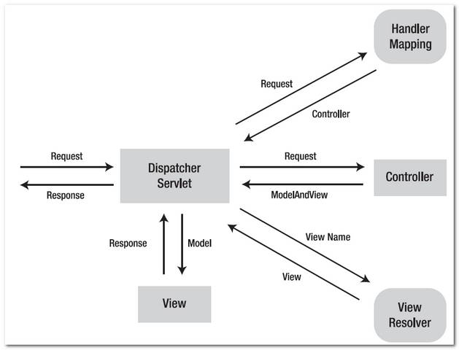
Spring Architecture

Slide 4
Exploring Spring
MVC Framework
The Spring Web MVC framework is built on generic Servlet known
as a DispatcherServlet class(Front Controller).
The DispatcherServlet class sends the request to the handlers with
configurable handler mappings, theme resolution, locale and view
resolution along with file uploading.

Slide 5
Exploring Spring's
Web MVC Framework
The handleRequest(request, response) method is given by the default handler called Controller interface.
The application controller implementation classes of the controller interface are as follows:
– AbstractController
– AbstractCommandController
– SimpleFormController.

Slide 6
Spring MVC
Features
Powerful configuration of both framework and application classes.
Separation of roles.
Flexibility in choosing subclasses.
Model transfer flexibility.
No need of duplication of code.
Specific validation and binding.
Specific local and theme resolution.
Facility of JSP form tag library.

Slide 7
Flow of Spring MVC

Slide 8
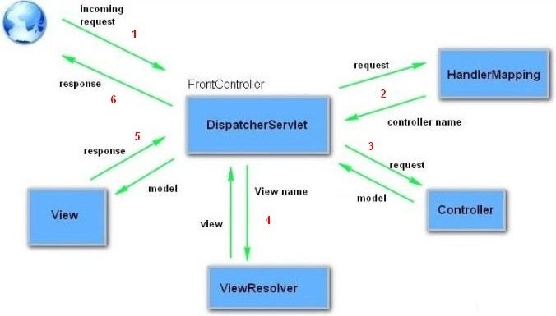
Flow of Spring MVC

Slide 9
DispatcherServlet

Slide 10
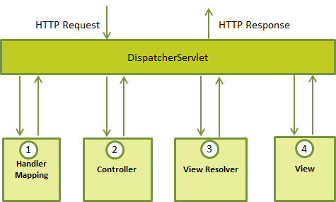
DispatcherServlet

Slide 11
DispatcherServlet
The DispatcherServlet class is important part of
spring Web MVC framework.
It is used for dispatching the request to application
controllers.
The DispatcherServlet class is configured in web.xml
file of a web application.
Map the request using Uniform Resource Locator
(URL) mapping in the same web.xml file to handle
any request

Slide 12
HadlerMapping/Controller
/ViewResolver
Handler mapping : Manages the execution of controllers, provided they match the specified criteria.
Controller : It handles the client's request.
View resolver : Resolves view names to view used by the DispatcherServlet.

Slide 13

Creating Spring MVC
Application

Slide 14
Creating Spring MVC
Application
Create the request page (optional)
Create the controller class
Provide the entry of controller in the web.xml file
Define the bean in the XML file
Display the message in the JSP page
Load the spring core and MVC jar files
Start server and deploy the project

Slide 15

Controller Class
@Controller
public class HelloWorldController
{
@RequestMapping("/samplepage")
public ModelAndView helloSpring()
{
String message = "Welcome to Spring MVC";
return new ModelAndView("samplepage", "message",
message);
}
}

Slide 16

Controller
Annotation
The @Controller annotation defines the class as a
Spring MVC controller.
The @RequestMapping annotation is used to map
URLs like '/hello' onto an entire class or a particular
handler method.
@RequestMapping(method = RequestMethod.GET)
is used to declare the printHello() method as the
controller's default service method to handle HTTP
GET request.

Slide 17
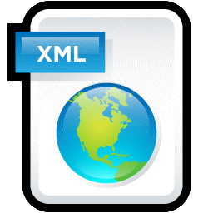
web.xml File
<servlet>
<servlet-name>spring</servlet-name>
<servlet-class>
org.springframework.web.servlet.DispatcherServlet
</servlet-class>
<load-on-startup>1</load-on-startup>
</servlet>
<servlet-mapping>
<servlet-name>spring</servlet-name>
<url-pattern>*.html</url-pattern>
</servlet-mapping>

Slide 18
spring-servlet.xml
<context:component-scan basepackage="com.sample"/>
<bean class="org.springframework.web.servlet.view.
InternalResourceViewResolver">
<property name="prefix" value="/WEB-INF/jsp/" />
<property name="suffix" value=".jsp" />
</bean>

Slide 19
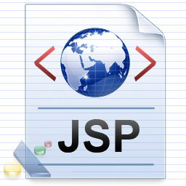
JSP Page
Message is: ${message}//sample.jsp
This is the simple JSP page, displaying the message returned by the Controller.
It must be located inside the WEB-INF/jsp directory .
Finally load the jar files and run.

Slide 20

Spring Exception Handling

Slide 21
Spring Exception
@ExceptionHandler only handles exception getting raised from the controller where it is defined.
It will not handle exceptions getting raised from other controllers. @ControllerAdvice annotation solves this problem.
@ControllerAdvice annotation is used to define @ExceptionHandler, @InitBinder, and @ModelAttribute methods that apply to all @RequestMapping methods.

Slide 22
Spring Exception
import org.springframework.web.bind.annotation.ControllerAdvice;
@ControllerAdvice
public class ExceptionControllerAdvice
{
@ExceptionHandler(Exception.class)
public String exception(Exception e)
{ return "error";}
}

Slide 23
Spring Interceptor

Slide 24
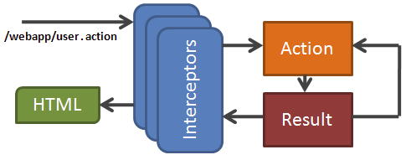
Spring Interceptor

Slide 25
Spring Interceptor
Spring MVC provides a powerful mechanism to intercept an http request
Each interceptor you define must implement org.springframework.web.servlet.HandlerInterceptor interface.
HandlerInterceptor – an interface, which must be implemented by the Spring interceptor classes, has the following three methods.
– preHandle(...) – called just before the controller
– postHandle(...) – called immediately after the controller
– afterCompletion(...) – called just before sending response to view

Slide 26
Spring Interceptor
HandlerInterceptorAdaptor – an implementation class of HandlerInterceptor interface provided by Spring as a convenient class. By extending this we can override only the necessary methods out of the three.

Slide 27

Spring Validation

Slide 28
Spring Validation
Spring provides a simplified set of APIs and supporting classes for validating domain objects.
Spring features a Validator interface that you can use to validate objects. The Validator interface works using an Errors object so that while validating, validators can report validation failures to the Errors object.

Slide 29
Spring Validation
public class UserLoginValidator implements Validator
{
public boolean supports(Class clazz)
{
//.............................
}
public void validate(Object target, Errors errors)
{
//.........................................
}
}

Slide 30
Spring's Form Tag Library

Slide 31
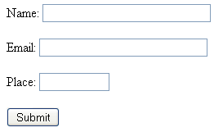
Spring Form
Tag Lib

Slide 32
Spring Form
Tag Lib
Spring MVC provides a JSP tag library for making it easier to bind form elements to Model data.
Spring Framework also provides you with some tags for evaluating errors, setting themes and outputting internationalized messages.
Syntax:
<%@taglib uri="http://www.springframework.org/tags/form"
prefix="form">

Slide 33
Spring Form Tag
Tag <form:form> tag, replaces html tag form.
It takes the addition attribute <modelAttribute> which is the name of the form object whose properties are used to populate the form.
It may specify any attribute added to the Model object by the controller handler that selects the form view.
<form:form method="POST" action="url-path" modelAttribute="a">
...
</form:form>

Slide 34
Text Input and
Output Tags
The tag <form:input> is used for text
input, and replaces the HTML tag input.
It introduces the extra attribute path that
specifies the field or field path to be
accessed.
It is similar to the attribute value in HTML.
<form:input path="prop1" />

Slide 35
Multi-Option
Selection Tags
Multiple option selection is declared with tag <form:select>. This tag is usually rendered as a combo-box.
Example:
<form:select path="a">
<form:option label="5" value="5" />
<form:option label="10" value="10" />
</form:select>

Slide 36
Integrating Spring And
Hibernate

Slide 37
Spring with
Hibernate
When we integrate the hibernate application with spring, we don't need to create the hibernate.cfg.xml file. We can provide all the information in the applicationContext.xml file.
It saves lots of code.
We don't need to follow so many steps like create Configuration, BuildSessionFactory, Session, beginning and committing transaction etc.
Student s1=new Student(1,"park",25000);
hibernateTemplate.save(s1);

Slide 38
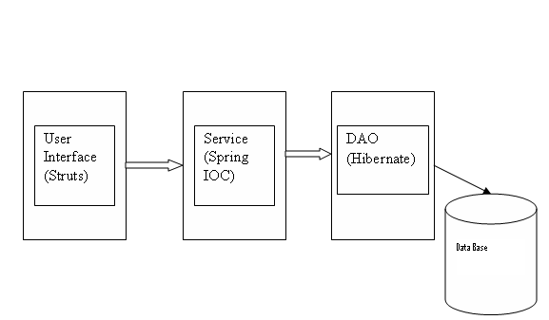
Struts, Spring and
Hibernate

Slide 39

Questions
What are Features of spring?
What is Controller?
Explain DispatcherServlet?

Slide 40



Stay connected
About us: Emertxe is India’s one of the top IT finishing schools & self learning kits provider. Our primary focus is on Embedded with diversification focus on Java, Oracle and Android areas
Emertxe Information Technologies,
No-1, 9th Cross, 5th Main,
Jayamahal Extension,
Bangalore, Karnataka 560046
T: +91 80 6562 9666
E: training@emertxe.com
https://www.facebook.com/Emertxe
https://twitter.com/EmertxeTweet
https://www.slideshare.net/EmertxeSlides

Slide 41
Thank You

