Slide 1
Java Server Pages(JSP)
Team Emertxe

Slide 2

JSP

Slide 3
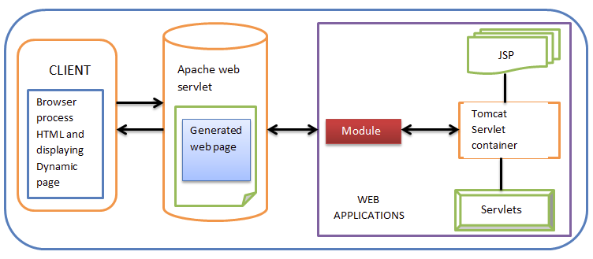
JSP

Slide 4
JSP
JSP Stands for Java Server Pages, which allows easy creation and maintenance of server side HTML pages.
JSP can be easily managed because we can easily separate our business logic with presentation logic.
In servlet technology, we combine our business logic with the presentation logic.
JSP consists of HTML tags and JSP tags.
Each and every JSP will be translated into the corresponding servlet.

Slide 5
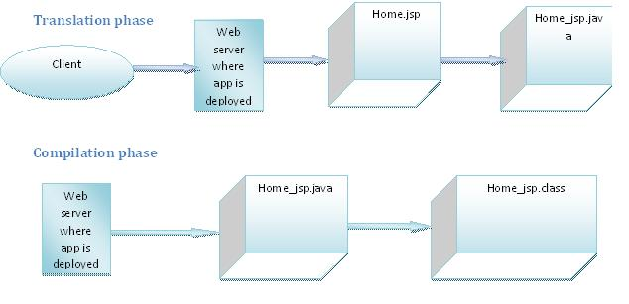
JSP Life Cycle

Slide 6
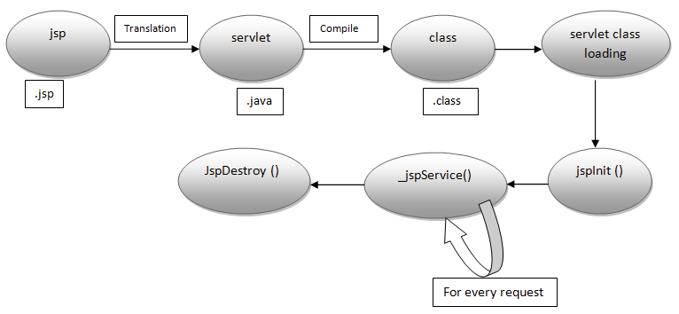
JSP Life Cycle

Slide 7
Life cycle of JSP
jspInit() :
The container calls the jspInit() to initialize the servlet instance. It is
called before any other method, and is called only once for a servlet
instance.
_jspservice():
The container calls this method for each request, passing it the request and response object.
jspDestroy() :
The container calls this when it decides and take the instance out of
service. It is the last method called in the servlet instance.

Slide 8

JSP First Example

Slide 9
JSP First Example
<html>
<body>
<% out.print("welcome to jsp"); %>
</body>
</html>

Slide 10
JSP Scripting Elements
In JSP, Java code is written inside the HTML.
There are three types of scripting elements:
  Scriptlet tag// <% --------%>
  Expression tag//<%=------------%>
  Declaration tag//<%!----------------%>

Slide 11
JSP Scriptlet Tag
<html>
<body>
<% out.print("welcome to jsp"); %>// JSP Scriptlet Tag
</body>
</html>

Slide 12
JSP Expression Tag
<html>
<body>
<% =”Welcome to JSP” %>// JSP Expression Tag
</body>
</html>

Slide 13
JSP Declaration Tag
<html>
<body>
<%! int a =5 %>// JSP Declaration Tag
</body>
</html>

Slide 14

JSP Implicit Objects

Slide 15
Implicit Objects
Implicit objects are created by the web container that are available to all JSP pages.These are used to simplify the expressions.
There are 9 implicit objects. They are as follows:
Object | Type
out | JspWriter
request | HttpServletRequest
response | HttpServletResponse
session | HttpSession
application | ServletContext
config | ServetConfig
pageContext | PageContext
page | Object
exception | Throwable

Slide 16

JSP Directive Elements

Slide 17
JSP Directives
Page directive
Include directive
Taglib directive
Syntax:
<%@ directive attribute="value" %>

Slide 18

JSP Page Directives

Slide 19
JSP Page Directive
<%@ page attribute="value" %>
Attributes of JSP page directives:
import
contentType
extends
info
buffer
language
isELIgnored
isThreadSafe
autoFlush
session
pageEncoding
errorPage
isErrorPage

Slide 20
JSP Page Directive:
Import
The import attribute is used to import class,interface or all the members of a package.It is similar to import keyword in java class or interface:
<%@ page import="java.util.Date" %>
Today is: <%= new Date() %>

Slide 21
JSP PageDirective:
contentType
The contentType attribute defines the MIME(Multipurpose Internet Mail Extension) type of the HTTP response.The default value is "text/html;charset=ISO-8859-1".
<%@ page contentType=application/msword %>
Today is: <%= new java.util.Date() %>

Slide 22
JSP Page Directive:
isELIgnored
We can ignore the Expression Language (EL) in jsp by the isELIgnored attribute. By default its value is false i.e. Expression Language is enabled by default. We see Expression Language later.
<%@ page isELIgnored="true" %>//Now EL will be ignored

Slide 23
JSP Page Directive:
errorPage
The errorPage attribute is used to define the error page, if exception occurs in the current page, it will be redirected to the error page
<%@ page errorPage="myerrorpage.jsp" %>
<%= 100/0 %>

Slide 24
JSP PageDirective:
isErrorPage
The isErrorPage attribute is used to declare that the current page is the error page:
<%@ page isErrorPage="true" %>

Slide 25
JSP Include Directives

Slide 26
JSP Include Directive
The include directive is used to include the contents of any resource it may be jsp file, html file or text file.
<%@ include file="header.html" %>
Today is: <%= java.util.Calendar.getInstance().getTime() %>

Slide 27
JSP Taglib Directive

Slide 28
JSP Taglib Directive
The JSP taglib directive is used to define a tag library that defines many tags.
We use the TLD (Tag Library Descriptor) file to define the tags.
Syntax:
<%@ taglib uri="uriofthetaglibrary" prefix="prefixoftaglibrary" %>

Slide 29
Example of Tag Library
<%@ taglib uri="http://www.javatpoint.com/tags" prefix="mytag" %>
<mytag:currentDate/>
In the above example, we are using our tag named currentDate. To use this tag we must specify the taglib directive so the container may get information about the tag.

Slide 30
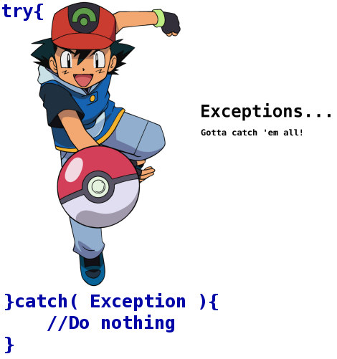
Exception Handling in JSP

Slide 31
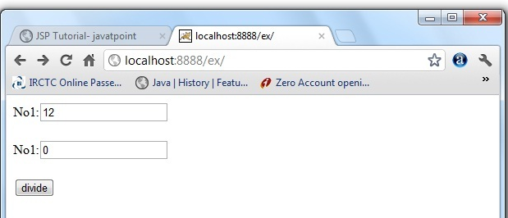
Exception Handling in JSP

Slide 32
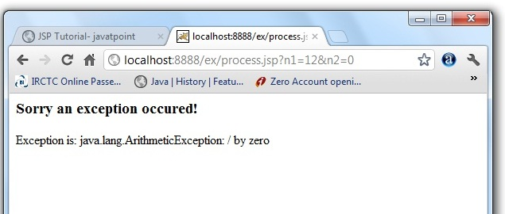
Exception Hadnling in JSP

Slide 33
Exception Handling In JSP
<%@ page errorPage="error.jsp" %>
<%
String num1=request.getParameter("n1");
String num2=request.getParameter("n2");
int a=Integer.parseInt(num1);
int b=Integer.parseInt(num2);
int c=a/b;
out.print("division of numbers is: "+c);
%>

Slide 34
Exception Handling In JSP
<%@ page isErrorPage="true" %>
<h3>Sorry an exception occured!</h3>
Exception is: <%= exception %>

Slide 35

Exception Handling in JSP By web.xml

Slide 36
Exception Handling In JSP by web.xml
web.xml file if you want to handle any exception:
<web-app>
<error-page>
<exception-type>java.lang.Exception</exception-type>
<location>/error.jsp</location>
</error-page>
</web-app>

Slide 37
Exception Handling In JSP by web.xml
web.xml file if you want to handle the exception for a specific error code:
<web-app>
<error-page>
<error-code>500</error-code>
<location>/error.jsp</location>
</error-page>
</web-app>

Slide 38

JSP Action Tag

Slide 39
JSP Action Tag
The action tags are used to control the flow between pages and to use Java Bean.
List of Action Tag:
jsp:forward action tag
jsp:include
jsp:useBean
jsp:setProperty
jsp:getProperty
jsp:plugin
jsp:param
jsp:fallback

Slide 40

Expression Language

Slide 41
JSTL

Slide 42
Custom Tag

Slide 43

THANK YOU

