Slide 1
Building Web Application Using Servlet

Slide 2


History of web application

Slide 3
History of Web Application
Earlier in client- server computing, each application had its own client program and it worked as a user interface and need to be installed on each user's personal computer.
Most web applications use HTML/XHTML that are mostly supported by all the browsers and web pages are displayed to the client as static documents.
A web page can merely displays static content and it also lets the user navigate through the content, but a web application provides a more interactive experience.

Slide 4
Common Gateway Interface (CGI)

Slide 5
Common Gateway Interface
(CGI)
The Common Gateway Interface, which is normally referred as CGI, was one of the practical technique developed for creating dynamic content.
By using the CGI, a web server passes requests to an external program and after executing the program the content is sent to the client as the output.
In CGI when a server receives a request it creates a new process to run the CGI program, so creating a process for each request requires significant server resources and time, which limits the number of requests that can be processed concurrently.

Slide 6
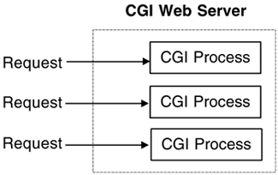
Common Gateway Interface
(CGI)
CGI applications are platform dependent.
There is no doubt that CGI played a major role in the explosion of the Internet but its performance, scalability issues make it less than optimal solutions.

Slide 7
Java Servlets

Slide 8
Java Servlets
Unlike CGI, Servlets don't use multiple processes to handle separate request.
Servets can be handled by separate threads within the same process. Servlets are also portable and platform independent.
Servlets are used with web servers and run inside a Java Virtual Machine (JVM) on the server so these are safe and portable.

Slide 9
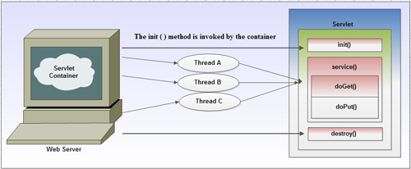
Java Servlets

Slide 10
Server

Slide 11
Types of Server
Web Server
Application Server

Slide 12
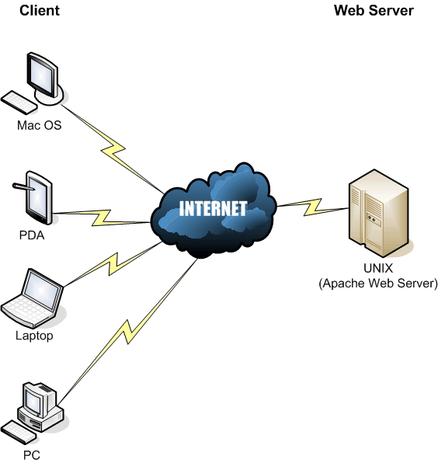
Web Server

Slide 13
Web Server
A Web server is a program that, using the client/server model and the World Wide Web's Hypertext Transfer Protocol( HTTP ), serves the files that form Web pages to Web users.
Web server has only one container called web container.
Example: Tomcat

Slide 14
Application Server
Application server has two container, web container and EJB container.
Application server is heavier than web server.
Example: Glass Fish Server, Jboss, Weblogic Server, Web Sphere

Slide 15
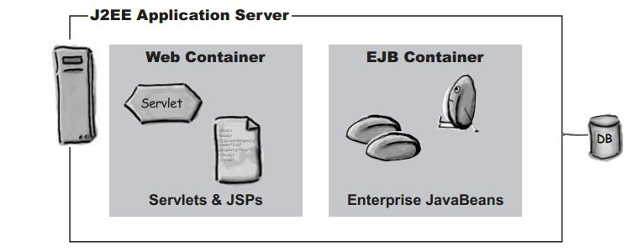
Application Server

Slide 16
Servlet Container

Slide 17
Servlet Container
A Servlet container is nothing but a compiled, executable program.
The main function of the container is to load, initialize and execute Servlets.
A container handles large number of requests as it can hold many active Servlets, listeners etc.
It is interesting to note here that the container and the objects in a container are multi threaded.
So each object must be thread safe in a container as the multiple requests are being handled by the container due to the entrance of more than one thread to an object at a time.

Slide 18
Servlet Container
The servlet container loads the servlet class and calls the init method of the servlet as soon as the servlet is called for the first time.
Then this container makes an instance of javax.servlet.ServletRequest and javax.servlet.ServletResponse for each request.
Then it passes the ServletRequest and ServletResponse objects by invoking the servlet's service method.
Finally, it calls the destroy method and unload the servlet class when the servlet class is to be shut down.

Slide 19
What Is Servlet

Slide 20
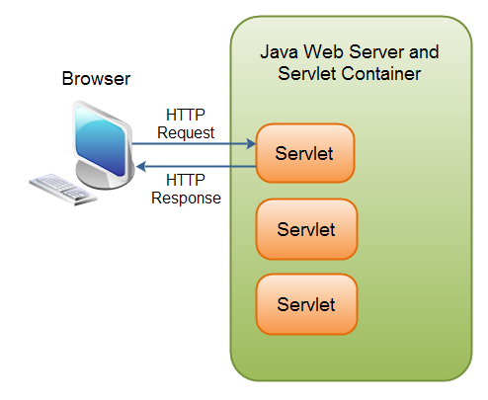
What is Servlet
A Java Servlet is a Java object that responds to HTTP requests. It runs inside a Servlet container.

Slide 21
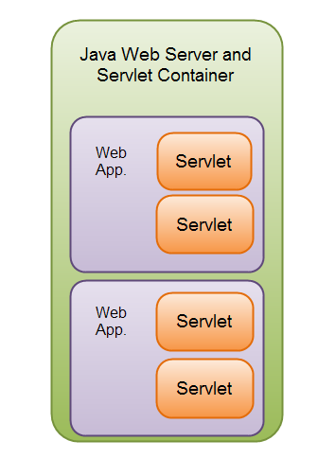
What is Servlet
A Servlet is part of a Java web application. A Servlet container may run multiple web applications at the same time, each having multiple Servlets running inside.
Note: A Java web application can contain other components than Servlets. It can also contain Java Server Pages (JSP), Java Server Faces (JSF) and Web Services.

Slide 22
Servlet API
The javax.servlet and javax.servlet.http packages represent interfaces and classes for servlet API.
The javax.servlet package contains many interfaces and classes that are used by the servlet or web container.
The javax.servlet.http package contains interfaces and classes that are responsible for http requests only.

Slide 23
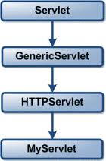
Servlet API

Slide 24
Servlet API Methods
A GenericServlet class contains the following five methods:
1. init()
public void init(ServletConfig config) throws ServletException
  The init() method is called only once by the servlet container throughout the life of a servlet. By this init() method the servlet get to know that it has been placed into service.

Slide 25
Servlet API Methods
A GenericServlet class contains the following five methods:
2. service()
public void service(ServletRequest req, ServletResponse res) throws ServletException, IOException
  Once the servlet starts getting the requests, the service() method is called by the servlet container to respond. The servlet services the client's request with the help of two objects. These two objects javax.servlet.ServletRequest and javax.servlet.ServletResponse are passed by the servlet container.

Slide 26
Servlet API Methods
A GenericServlet class contains the following five methods:
3. getServletConfig()
public ServletConfig getServletConfig()
  This method contains parameters for initialization and startup of the servlet and returns a ServletConfig object.

Slide 27
Servlet API Methods
A GenericServlet class contains the following five methods:
4. getServletInfo()
public String getServletInfo()
  The information about the servlet is returned by this method like version, author etc. This method returns a string which should be in the form of plain text and not any kind of markup.

Slide 28
Servlet API Methods
A GenericServlet class contains the following five methods:
5. destroy()
public void destroy()
  This method is called when we need to close the servlet.

Slide 29
Life Cycle of Servlet

Slide 30
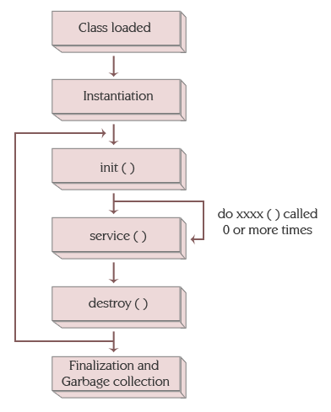
Servlet Life Cycle

Slide 31
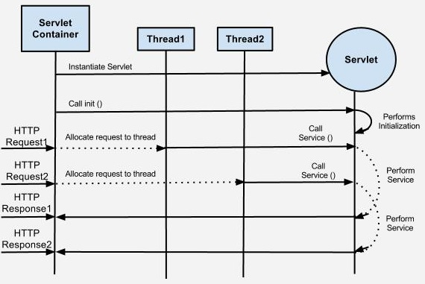
Servlet Life Cycle

Slide 32
Servlet Versions

Slide 33
Servlet 2.5
Released in September 2005
Platform sported JEE 5 and JSE 5
Important change was annotation

Slide 34
Servlet 3.1
Released in May 2013
Platform sported JEE 7 and JSE 7
Important change was HTTP protocol upgrade mechanism

Slide 35
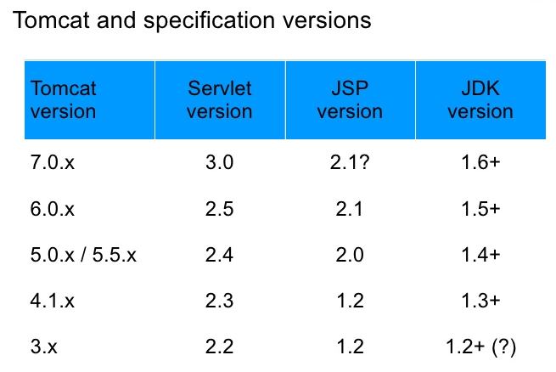
Servlet Versions With
Tomcat

Slide 36
Advantages of Java
Servlets
Portability
Powerful
Efficiency
Safety
Integration
Extensibility
Inexpensive

Slide 37
Advantage of Java Servlet
Over CGI
Platform Independence
Performance
Extensibility
Safety
Secure

Slide 38
Installation, Configuration And Running Servlets

Slide 39
Installation Configuration and Running Tomcat
Installation of Tomcat Server and JDK
Configuring Tomcat Server
  Set JAVA_HOME variable.
  Specify the server port.
Run Tomcat Server
  http://localhost:8080/ (If your port is 8080)

Slide 40
Writing Servlet Hello World

Slide 41
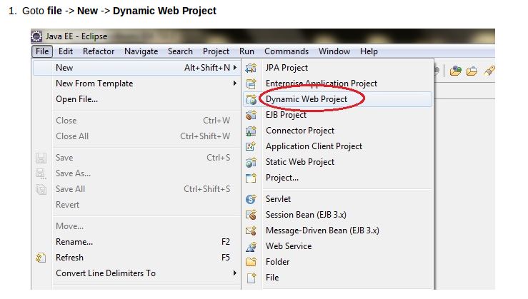
Writing Servlet Hello World

Slide 42
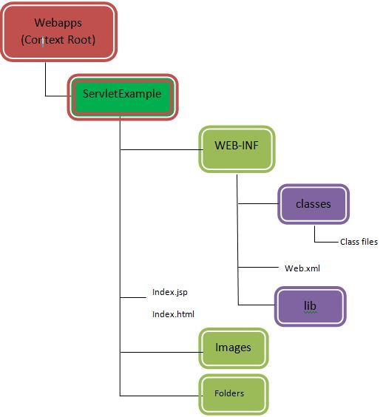
Web Application
Architecture

Slide 43
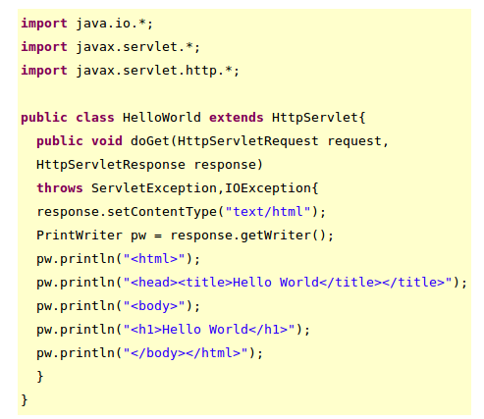
Writing Servlet Hello World

Slide 44
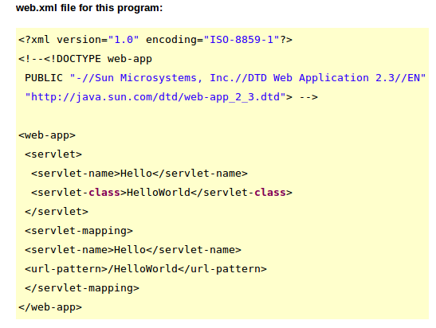
Writing Servlet Hello World

Slide 45
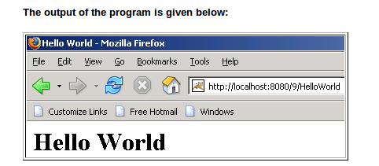
Writing Servlet Hello World

Slide 46
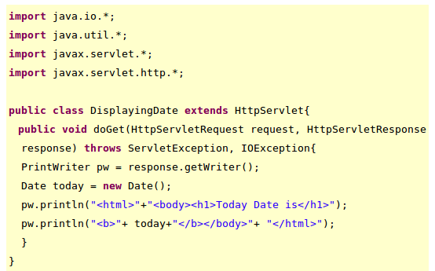
Displaying Date in Servlet

Slide 47
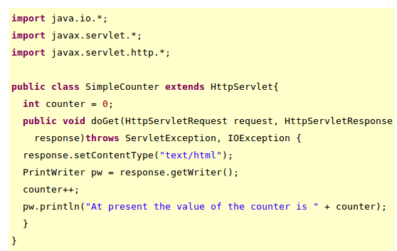
Simple Counter in Servlet

Slide 48
Getting Init Parameter
Names
In this example we are going to retreive the init paramater values which we have given in the web.xml file.

Slide 49
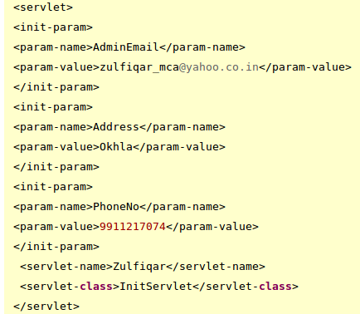
Getting Init Parameter
Names

Slide 50
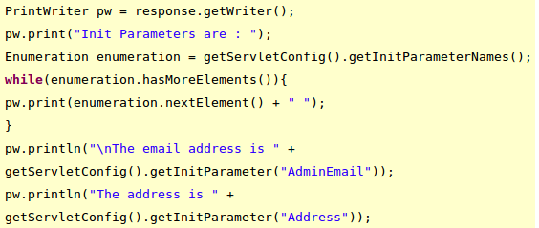
Getting Init Parameter
Names
The code to access the last web.xml file:

Slide 51
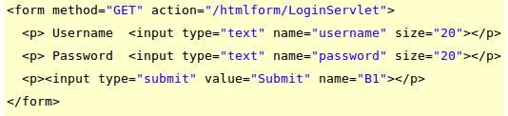
Passing Parameter Using
HTML Form

Slide 52

Passing Parameter Using
HTML Form

Slide 53
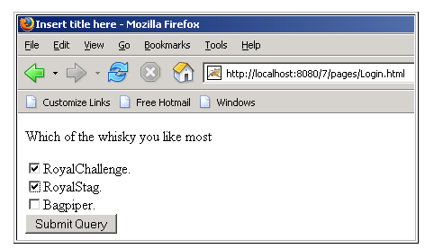
Multiple Values For A Single
Parameter

Slide 54
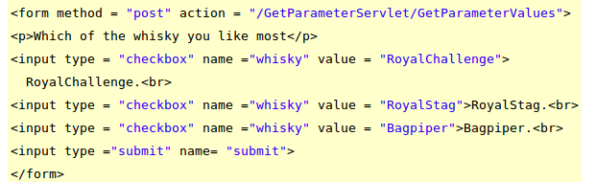
Multiple Values For A Single
Parameter

Slide 55
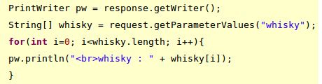
Multiple Values For A Single
Parameter

Slide 56
Listeners In Servlet

Slide 57
Servlet Chaining

Slide 58
RequestDispatcher
The RequestDispacher interface provides the facility of dispatching the request to another resource it may be html, servlet or jsp.
This interface can also be used to include the content of antoher resource also.

Slide 59
Method of
RequestDispatcher
public void forward(ServletRequestrequest,ServletResponse response)throws ServletException,java.io.IOException:
  Forwards a request from a servlet to another resource (servlet, JSP file, or HTML file) on the server.
public void include(ServletRequest request,ServletResponse response)throws ServletException,java.io.IOException:
  Includes the content of a resource (servlet, JSP page, or HTML file) in the response.

Slide 60
Example of
RequestDispatcher
RequestDispatcher rd=request.getRequestDispatcher("servlet2");
rd.forward(request, response);//method may be include or forward

Slide 61
sendRedirect
Method
When we want that someone else should handle the response of our servlet, then there we should use sendRedirect() method.
response.sendRedirect("/servlet2");

Slide 62
Session Tracking

Slide 63
Session Tracking
URL Rewriting
Hidden Form Field
Cookies
HttpSession

Slide 64
HTTP Protocol

Slide 65
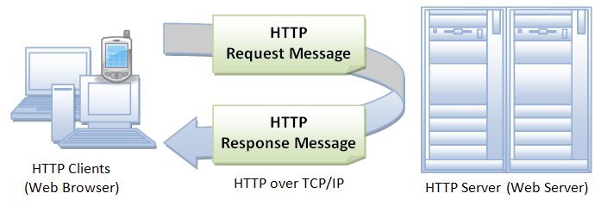
HTTP Protocol
HTTP is a TCP/IP potocol.
The Hypertext Transfer Protocol (HTTP) is an application protocol for distributed, collaborative, hypermedia information systems.
HTTP is the foundation of data communication for the World Wide Web.

Slide 66
HTTP Methods
GET
POST
HEAD
PUT
DELETE
OPTIONS
CONNECT

Slide 67
GET
GET requests can be cached
GET requests remain in the browser history
GET requests can be bookmarked
GET requests should never be used when dealing
with sensitive data
GET requests have length restrictions
GET requests should be used only to retrieve data

Slide 68
POST
POST requests are never cached
POST requests do not remain in the browser history
POST requests cannot be bookmarked
POST requests have no restrictions on data length

Slide 69
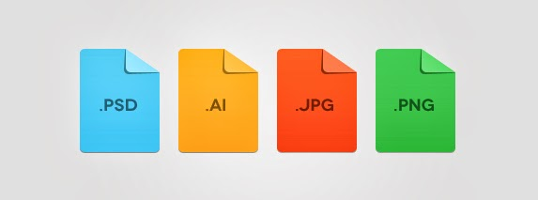
MIME Type
MIME types form a standard way of classifying file types on the Internet.

Slide 70
Thank You

