Slide 1
Advance Core Java

Slide 2
AWT

Slide 3
AWT
Java AWT (Abstract Windowing Toolkit) is an API to develop GUI or window-based application in java.
Java AWT components are platform-dependent i.e. components are displayed according to the view of operating system. AWT is heavyweight i.e. its components uses the resources of system.
The java.awt package provides classes for AWT api such as TextField, Label, TextArea, RadioButton, CheckBox, Choice, List etc.

Slide 4
Classes in AWT API
Container:The Container is a component in AWT that can contain another components like buttons, textfields, labels etc. The classes that extends Container class are known as container such as Frame, Dialog and Panel.
Window:The window is the container that have no borders and menu bars. You must use frame, dialog or another window for creating a window.

Slide 5
Classes in AWT
Panel:The Panel is the container that doesn't contain title bar and menu bars. It can have other components like button, textfield etc.
Frame:The Frame is the container that contain title bar and can have menu bars. It can have other components like button, textfield etc.

Slide 6
Useful Methods of
Component class
public void add(Component c):
  inserts a component on this component.
public void setSize(int width,int height)
  sets the size (width and height) of the component.
public void setLayout(LayoutManager m)
  defines the layout manager for the component.
public void setVisible(boolean status)
  changes the visibility of the component, by default false.

Slide 7
AWT Example
To create simple awt example, you need a frame. There are two ways to create a frame in AWT.
By extending Frame class (inheritance)
By creating the object of Frame class (association)

Slide 8
Example of AWT by
Inheritance
import java.awt.*;
class First extends Frame{
First(){
Button b=new Button("click me");
b.setBounds(30,100,80,30);// setting button position
add(b);//adding button into frame
setSize(300,300);//frame size 300 width and 300 height
setLayout(null);//no layout manager
setVisible(true);//now frame will be visible, by default not visible
}
public static void main(String args[]){
First f=new First();
}}

Slide 9
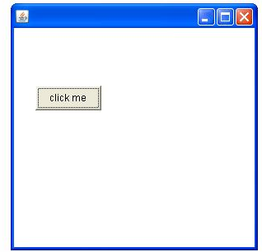
Example of AWT

Slide 10
Example of AWT by
Association
import java.awt.*;
class First2{
First2(){
Frame f=new Frame();
Button b=new Button("click me");
b.setBounds(30,50,80,30);
f.add(b);
f.setSize(300,300);
f.setLayout(null);
f.setVisible(true);
}
public static void main(String args[]){
First2 f=new First2();
}}

Slide 11
Event and Listener
(Event Handling)
Changing the state of an object is known as an event. For example, click on button, dragging mouse etc. The java.awt.event package provides many event classes and Listener interfaces for event handling.

Slide 12
Event Classes
ActionEvent
MouseEvent
MouseWheelEvent
KeyEvent
ItemEvent
TextEvent
AdjustmentEvent
WindowEvent
ComponentEvent
ContainerEvent
FocusEvent

Slide 13
Listener Interfaces
ActionListener
MouseListener and MouseMotionListener
MouseWheelListener
KeyListener
ItemListener
TextListener
AdjustmentListener
WindowListener
ComponentListener
ContainerListener
FocusListener

Slide 14
Steps to perform
EventHandling
Following steps are required to perform event handling:
Implement the Listener interface and overrides its methods
Register the component with the Listener

Slide 15
Steps to perform
EventHandling
For registering the component with the Listener, many classes provide the registration methods. For example:
Button
  public void addActionListener(ActionListener a){}
Checkbox
  public void addItemListener(ItemListener a){}
MenuItem
  public void addActionListener(ActionListener a){}

Slide 16
EventHandling Codes
We can put the event handling code into one of the following places:
Same class
Other class
Annonymous class

Slide 17
Event handling within class
import java.awt.*;
import java.awt.event.*;
class AEvent extends Frame implements ActionListener{
//class code
//public static void main(String args[]){
new AEvent();
}
}

Slide 18
Event handling within class
//class code
TextField tf;
AEvent(){ tf=new TextField(); tf.setBounds(60,50,170,20);
Button b=new Button("click me");
b.setBounds(100,120,80,30); b.addActionListener(this);
add(b);add(tf); setSize(300,300);
setLayout(null); setVisible(true);
public void actionPerformed(ActionEvent e){
tf.setText("Welcome");
}
}

Slide 19
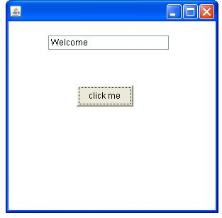
Event handling within class

Slide 20
Swing

Slide 21
Swing
Java Swing is a part of Java Foundation Classes (JFC) that is used to create window-based applications. It is built on the top of AWT (Abstract Windowing Toolkit) API and entirely written in java.
Unlike AWT, Java Swing provides platform-independent and lightweight components.
The javax.swing package provides classes for java swing API such as JButton, JTextField, JTextArea, JRadioButton, JCheckbox, JMenu etc.

Slide 22
Difference between AWT and Swing
Java AWT:
AWT components are platform-dependent.
AWT components are heavyweight.
AWT doesn't support pluggable look and feel.
AWT provides less components than Swing.
AWT doesn't follows MVC(Model View Controller) where model represents data, view represents presentation and controller acts as an interface between model and view.

Slide 23
Difference between AWT and Swing
Java Swing
Java swing components are platform-independent.
Swing components are lightweight.
Swing supports pluggable look and feel.
Swing provides more powerful components such as tables, lists, scrollpanes, colorchooser, tabbedpane etc.
Swing follows MVC.

Slide 24
Java Swing Example
There are two ways to create a frame:
By creating the object of Frame class (association)
By extending Frame class (inheritance)
We can write the code of swing inside the main(), constructor or any other method.

Slide 25
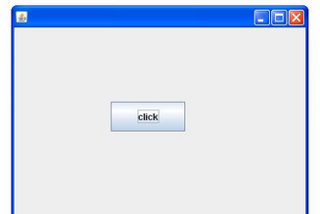
Swing Example

Slide 26
Swing Example
import javax.swing.*;
public class FirstSwingExample {
public static void main(String[] args) {
JFrame f=new JFrame();//creating instance of JFrame
JButton b=new JButton("click");//creating instance of JButton
b.setBounds(130,100,100, 40);//x axis, y axis, width, height
f.add(b);//adding button in JFrame
f.setSize(400,500);//400 width and 500 height
f.setLayout(null);//using no layout managers
f.setVisible(true);//making the frame visible } }

Slide 27
Swing API Classes
Jbutton
JradioButton
ButtonGroup
JtextArea
JtextField
JcomboBox
Jtable
JcolorChooser
JprogressBar
JSlider

Slide 28
Question
Create a digital clock in swing.
Create a program to display graphics in Swing.
Write a program to display image in Swing.
Write a program to create edit menu for notepad.
WAP to create a open dialogue box.
Online exam project in Swing without database.

Slide 29
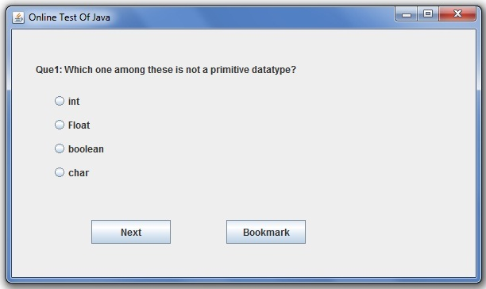
Online Exam Project without database

Slide 30
Layout Manager

Slide 31
Layout Managers
BorderLayout
GridLayout
FlowLayout
BoxLayout
GardLayout

Slide 32
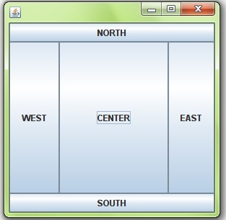
BorderLayout

Slide 33
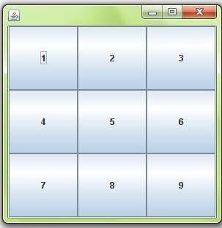
GridLayout

Slide 34
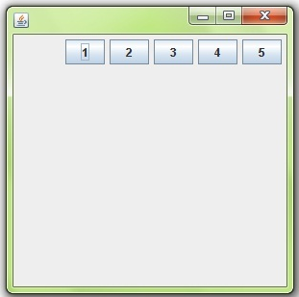
FlowLayout

Slide 35
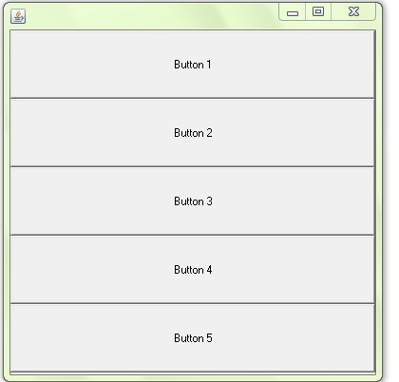
BoxLayout

Slide 36
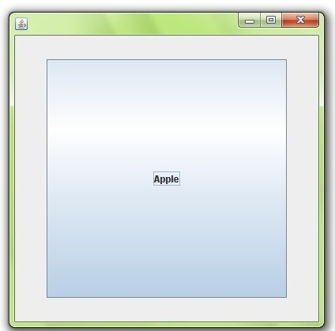
CardLayout

Slide 37

Applet

Slide 38
Applet
Applet is a special type of program that is embedded in the web page to generate the dynamic content. It runs inside the browser and works at client side.

Slide 39
Applet
There are many advantages of applet. They are as follows:
It works at client side so less response time.
Secured
It can be executed by browsers running under many platform, including Linux, Windows, Mac Os etc.

Slide 40
Applet
Drawback of Applet:
Plug-in is required at client browser to execute applet.

Slide 41
Applet
There are some important differences between an applet and a standalone Java application, including the following:
An applet is a Java class that extends the java.applet.Applet class.
A main() method is not invoked on an applet, and an applet class will not define main().
Applets are designed to be embedded within an HTML page.
When a user views an HTML page that contains an applet, the code for the applet is downloaded to the user's machine.

Slide 42
Applet
A JVM is required to view an applet. The JVM can be either a plug-in of the Web browser or a separate runtime environment.
The JVM on the user's machine creates an instance of the applet class and invokes various methods during the applet's lifetime.

Slide 43
Applet
Applets have strict security rules that are enforced by the Web browser. The security of an applet is often referred to as sandbox security, comparing the applet to a child playing in a sandbox with various rules that must be followed.
Other classes that the applet needs can be downloaded in a single Java Archive (JAR) file.

Slide 44
Applet
Life Cycle of an Applet:
Init(): This method is intended for whatever initialization is needed for your applet. It is called after the param tags inside the applet tag have been processed.
start(): This method is automatically called after the browser calls the init method. It is also called whenever the user returns to the page containing the applet after having gone off to other pages.
paint: Invoked immediately after the start() method, and also any time the applet needs to repaint itself in the browser. The paint() method is actually inherited from the java.awt.

Slide 45
Applet
stop(): This method is automatically called when the user moves off the page on which the applet sits. It can, therefore, be called repeatedly in the same applet.
destroy(): This method is only called when the browser shuts down normally. Because applets are meant to live on an HTML page, you should not normally leave resources behind after a user leaves the page that contains the applet.

Slide 46
Applet Life Cycle
The Component class provides 1 life cycle method of applet.
public void paint(Graphics g): is used to paint the Applet. It provides Graphics class object that can be used for drawing oval, rectangle, arc etc.

Slide 47
Applet: question
Who is responsible to manage the life cycle of an applet?
  Java plug-in softwrae
How to run an Applet?
  There are two ways to run an applet
  By html file.
  By appletViewer tool (for testing purpose)

Slide 48
Applet Example by HTML
//First.java
import java.applet.Applet;
import java.awt.Graphics;
public class First extends Applet{
public void paint(Graphics g){
g.drawString("welcome",150,150);
} }
Note: class must be public because its object is created by Java Plug-in software that resides on the browser.

Slide 49
Applet Example by HTML
//first.html
<html>
<body>
<applet code="First.class" width="300" height="300">
</applet>
</body>
</html>

Slide 50
Example of Applet by
Appletviewer Tool
To execute the applet by appletviewer tool, create an applet that contains applet tag in comment and compile it. After that run it by: appletviewer First.java. Now Html file is not required but it is for testing purpose only.

Slide 51
Example of Applet by
Appletviewer Tool
//First.java
import java.applet.Applet;
import java.awt.Graphics;
public class First extends Applet{
public void paint(Graphics g){
g.drawString("welcome to applet",150,150); } }
/*
<applet code="First.class" width="300" height="300">
</applet>
*/

Slide 52
How to Execute Applet
c:\>javac First.java
c:\>appletviewer First.java

Slide 53
Applet Question
Write a program to display Graphics in Applet.
Write a program to display Image in Applet.
WAP to display animation in applet.
WAP to handle event in applet.

Slide 54
Networking/
Socket Programming

Slide 55
Networking

Slide 56
Networking
Networking is a concept of connecting two or more computing devices together so that we can share resources.
Advantage:
sharing resources
centralize software management

Slide 57
What will be learn?
Networking and Networking Terminology
Socket Programming (Connection-oriented)
URL class
Displaying data of a webpage by URLConnection class
InetAddress class
DatagramSocket and DatagramPacket (Connection-less)

Slide 58
Networking Terminology
IP Address
Protocol
Port Number
MAC Address
Connection-oriented and connectionless protocol
Socket

Slide 59
Networking Terminology
IP Address: IP address is a unique number assigned to a node of a network e.g. 192.168.0.1 . It is composed of octets that range from 0 to 255.
Protocol:A protocol is a set of rules basically that is followed for communication. For example:
  TCP
  FTP
  Telnet
  SMTP
  POP etc.

Slide 60
Socket Programming

Slide 61
Socket Programming
Socket programming is performed for communication between the machines. Socket programming can be connection-oriented or connectionless. Socket and ServerSocket classes are used for connection-oriented socket programming. The client in socket programming must know two information:
IPaddress of Server, and
Port number.

Slide 62
Socket Class
A socket is simply an endpoint for communications between the machines. The Socket class can be used to create a socket.
Commonly used methods of Socket class:
  public InputStream getInputStream(
  public OutputStream getOutputStream()
  public synchronized void close()

Slide 63
ServerSocket Class
The ServerSocket class can be used to create a server socket. This object is used to establish communication with the clients.
Commonly used methods of ServerSocket class:
  public Socket accept()
  public InputStream getInputStream()
  public OutputStream getOutputStream()
  public synchronized void close()

Slide 64
Example of Socket
Programming
//Server class
import java.io.*;
import java.net.*;
public class MyServer {
public static void main(String[] args){
try{ ServerSocket ss=new ServerSocket(6666);
Socket s=ss.accept();//establishes connection
DataInputStream dis=new DataInputStream(s.getInputStream());
String str=(String)dis.readUTF();
System.out.println("message= "+str); ss.close(); }catch(Exception e){System.out.println(e);} } }

Slide 65
Example of Socket
Programming
//Client class
import java.io.*;
import java.net.*;
public class MyClient {
public static void main(String[] args) {
try{ Socket s=new Socket("localhost",6666);
DataOutputStream dout=new DataOutputStream(s.getOutputStream());
dout.writeUTF("Hello Server");
dout.flush(); dout.close(); s.close(); }
catch(Exception e){System.out.println(e);} } }

Slide 66
URL class
The URL class represents a URL. URL is an acronym for Uniform Resource Locator. It points to a resource on the World Wide Web. For example:
http://www.emertxe.com/

Slide 67
URL Class
A URL contains many informations:
Protocol: In this case, http is the protocol.
Server name or IP Address: In this case, www.emertxe.com is the server name.
Port Number: It is an optional attribute. If we write http//ww.emrtxe.com:80/index.jsp/ , 80 is the port number.
File Name or directory name: In this case, index.jsp is the file name.

Slide 68
URL Class
Commonly used methods of URL class:
public String getProtocol(): it returns the protocol of the URL.
public String getHost(): it returns the host name of the URL.
public String getPort(): it returns the Port Number of the URL.
public String getFile(): it returns the file name of the URL.

Slide 69
Example of URL class
import java.io.*;
import java.net.*;
public class URLDemo{
public static void main(String[] args){
try{ URL url=new URL("http://www.javatpoint.com/index.jsp");
System.out.print("Protocol: "+url.getProtocol());
System.out.print("Host Name: "+url.getHost());
System.out.print("Port Number: "+url.getPort());
System.out.print("File Name: "+url.getFile());
}catch(Exception e){System.out.println(e);} } }

Slide 70
Example of URL Class
Output:Protocol: http
Host Name: www.emertxe.com
Port Number: -1
File Name: /index.jsp

Slide 71
URLConnection Class
The URLConnection class represents a communication link between the URL and the application. This class can be used to read and write data to the specified resource referred by the URL.

Slide 72
Question
Write a program to display all the data of a web page by URLConnecton class.

Slide 73
URLConnecton Example
import java.io.*;
import java.net.*;
public class DisplayData {
public static void main(String[] args){
try{ URL url=new URL("http://www.javatpoint.com/sonoojaiswal/");
URLConnection urlcon=url.openConnection();
InputStream stream=urlcon.getInputStream();
int i;
while((i=stream.read())!=-1){
System.out.print((char)i);
} }catch(Exception e){System.out.println(e);} } }

Slide 74
InetAddress class
The java.net.InetAddress class represents an IP address. The Inet Address class provides methods to get the IP of any host name.

Slide 75
InetAddress class
Commonly used methods of InetAddress class:
public static InetAddress getByName(String host) throws UnknownHostException: it returns the IP of the given host.
public static InetAddress getLocalHost() throws UnknownHostException: it returns the LocalHost IP and name.
public String getHostName(): it returns the host name of the IP address.
public String getHostAddress(): it returns the IP address in string format.

Slide 76
Example of InetAddress
Class
import java.io.*;
import java.net.*;
public class InetDemo{
public static void main(String[] args){
try{ InetAddress ip=InetAddress.getByName("www.emertxe.com");
System.out.println("Host Name: "+ip.getHostName());
System.out.println("IP Address: "+ip.getHostAddress());
}catch(Exception e){System.out.println(e);} } }

Slide 77
Example of InetAddress
Class
Output:
Host Name: www.emertxe.com
IP Address: 64.14.68.159

Slide 78
DatagramSocket and DatagramPacket (Networking)

Slide 79
DatagramSocket Class
The DatagramSocket class represents a connection-less socket for sending and receiving datagram packets. Datagram is basically an information but there is no guarantee of its content, arrival or arrival time. The DatagramSocket and DatagramPacket classes are used for connection-less socket programming.

Slide 80
DatagramPacket Class
The DatagramPacket is message that can be sent or received. If you send multiple packet, it may arrive in any order. Moreover, packet delivery is not guaranteed.

Slide 81
Sending DatagramPacket by DatagramSocket
import java.net.*;
public class DSender{
public static void main(String[] args) throws Exception {
DatagramSocket ds = new DatagramSocket();
String str = "Welcome java";
InetAddress ip = InetAddress.getByName("127.0.0.1");
DatagramPacket dp = new DatagramPacket(str.getBytes(), str.length(), ip, 3000);
ds.send(dp);
ds.close(); } }

Slide 82
Receiving DatagramPacket by DatagramSocket
import java.net.*;
public class DReceiver{
public static void main(String[] args) throws Exception {
DatagramSocket ds = new DatagramSocket(3000);
byte[] buf = new byte[1024];
DatagramPacket dp = new DatagramPacket(buf, 1024);
ds.receive(dp);
String str = new String(dp.getData(), 0, dp.getLength());
System.out.println(str);
ds.close(); } }

Slide 83

Java Mail API

Slide 84
Java Mail API
To send an e-mail using your Java Application is simple enough but to start with you should have JavaMail API and Java Activation Framework (JAF) installed on your machine.
You can download latest version of JavaMail (Version 1.2) from Java's standard website.
You can download latest version of JAF (Version 1.1.1) from Java's standard website.
You need to add mail.jar and activation.jar files in your CLASSPATH.

Slide 85
Java Mail API
Send a simple email
Send an HTML email
Send attachment in email

Slide 86
Annotations

Slide 87

Reflections

Slide 88
Reflection
In computer science, reflection is the ability of a computer program to examine (see type introspection) and modify the structure and behavior (specifically the values, meta-data, properties and functions) of the program at runtime.

Slide 89
Reflection
The Reflection API is mainly used in:
IDE (Integrated Development Environment) e.g. Eclipse, MyEclipse, NetBeans etc.
Debugger
Test Tools etc.

Slide 90
Reflections
How many ways we can get the instance of Class class ?
How to access the private method from outside the class ?
How to create Appletviewer tool?
How to create javap tool?

Slide 91
Reflection
java.lang.Class class
The java.lang.Class class performs mainly two tasks:
  provides methods to get the metadata of a class at run time.
  provides methods to examine and change the run time behavior of a class.

Slide 92
Reflection
How to get the object of Class class?
forName() method of Class class
getClass() method of Object class
the .class syntax

Slide 93
Reflection
forName() method of Class class
is used to load the class dynamically.
returns the instance of Class class.
It should be used if you know the fully qualified name of class.This cannot be used for primitive types.

Slide 94
Reflection
example of forName() method
class Simple{}
class Test{
public static void main(String args[]){
Class c=Class.forName("Simple");
System.out.println(c.getName());
}
}

Slide 95
Reflection
getClass() method of Object class: It returns the instance of Class class. It should be used if you know the type. Moreover, it can be used with primitives.

Slide 96
Reflection
getClass() method of Object class:
class Simple{}
class Test{
void printName(Object obj){
Class c=obj.getClass();
System.out.println(c.getName());
}
Public static void main(String[] args){
// next slide
}
}

Slide 97
...Reflection
public static void main(String args[]){
Simple s=new Simple();
Test t=new Test();
t.printName(s);
}

Slide 98
Reflection
The .class syntax
If a type is available but there is no instance then it is possible to obtain a Class by appending ".class" to the name of the type.It can be used for primitive data type also.

Slide 99
Reflection
The .class syntax.
class Test{
public static void main(String args[]){
Class c = boolean.class;
System.out.println(c.getName());
Class c2 = Test.class;
System.out.println(c2.getName()); } }
Output:
  boolean
Test

Slide 100
Reflection: Determining the class Object
public boolean isInterface(): determines if the specified Class object represents an interface type.
public boolean isArray(): determines if this Class object represents an array class.
public boolean isPrimitive(): determines if the specified Class object represents a primitive type.

Slide 101
Reflection: Determining the class Object Example
class Simple{}
interface My{}
Class Test{
Public static void main(String[] args){
// code in next slide
}
}

Slide 102
Reflection: Determining the class Object Example
public static void main(String args[]){
try{
    Class c=Class.forName("Simple"); System.out.println(c.isInterface());
Class c2=Class.forName("My");
System.out.println(c2.isInterface()); }
  catch(Exception e){System.out.println(e);} }
  Output:false
      true

Slide 103
Reflection: newInstanceMethod()
The newInstance() method of Class class and Constructor class is used to create a new instance of the class.
The newInstance() method of Class class can invoke zero-argument constructor whereas newInstance() method of Constructor class can invoke any number of arguments. So Constructor class is preferred over Class class.

Slide 104
Reflection: newInstanceMethod() Example
class Simple{
void message(){System.out.println("Hello Java");} }
class Test{
public static void main(String args[]){
try{ Class c=Class.forName("Simple");
Simple s=(Simple)c.newInstance();
s.message(); }
catch(Exception e){System.out.println(e);} } }
Output:Hello java

Slide 105
Thank You

