Slide 1







Stack OverFlow Developer survey 2019
Hady Hassan
27/10/23

Slide 2



OUTLINE
Executive Summary
Introduction
Methodology
Results
Visualization – Charts
Dashboard
Discussion
Findings & Implications
Conclusion
Appendix

Slide 3

EXECUTIVE SUMMARY
Data contextualization and analysis goal.
Description
Methodology
Data collecting.
Data analysis.
Data visualizations.
Presenting results with graphs and trends.
Discussion of findings and implications regarding the results.
Final conclusions of the research.

Slide 4

INTRODUCTION
• Stack Overflow's annual Developer Survey is the largest and most comprehensive survey of people who code around the world.
• Results don't represent everyone in the developer community evenly.
• Nearly 90,000 developers.
• Trends to predict where the developers are going.
• Characterization of developers around the globe.

Slide 5

METHODOLOGY
Gathering data
Web scrapping
Api
Request Library
Data preprocessing
Exploratory Data analysis
Data visualization
Show relationships, distribution of data and comparison of data
Dashboard

Slide 6

RESULTS

Slide 7
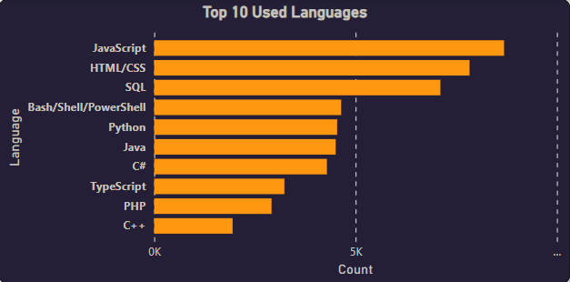
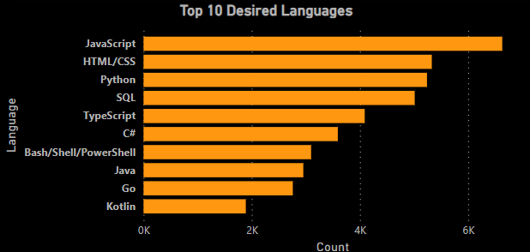
PROGRAMMING LANGUAGE TRENDS
Current Year
Next Year

Slide 8
PROGRAMMING LANGUAGE TRENDS - FINDINGS & IMPLICATIONS
Findings
JavaScript still 1st choice for developers.
Python is growing fast.
Typescript very interesting
Implications
Developers may go to Typescript instead of JavaScript.

Slide 9
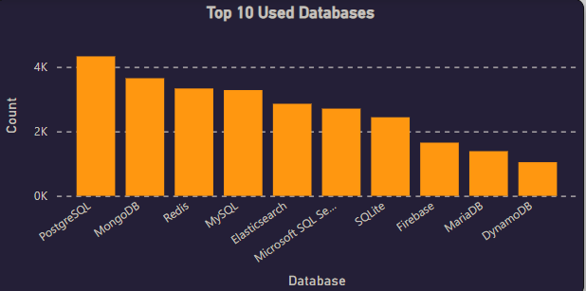
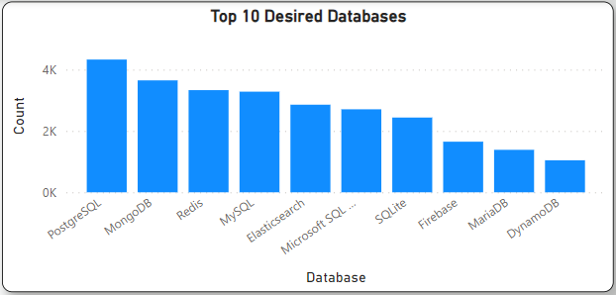
DATABASE TRENDS
Current Year
Next Year

Slide 10
DATABASE TRENDS - FINDINGS & IMPLICATIONS
Findings
PostgreSQL as most used database.
Lack of interest in Microsoft SQL Server and SQLite.
Increasing interest MongoDB.
Implications
Microsoft SQL Server and SQLite losing ground in the market.
PostgreSQL and MongoDB establishment in the market.

Slide 11
DASHBOARD
https://alexuuni-my.sharepoint.com/:u:/g/personal/cds_hadyhassan66274_alexu_edu_eg/ESlz7t0bAcZLj9Myekd_5dQBsJLWkJoKfJvWgWNbO4HfHg?e=OMtvkv

Slide 12
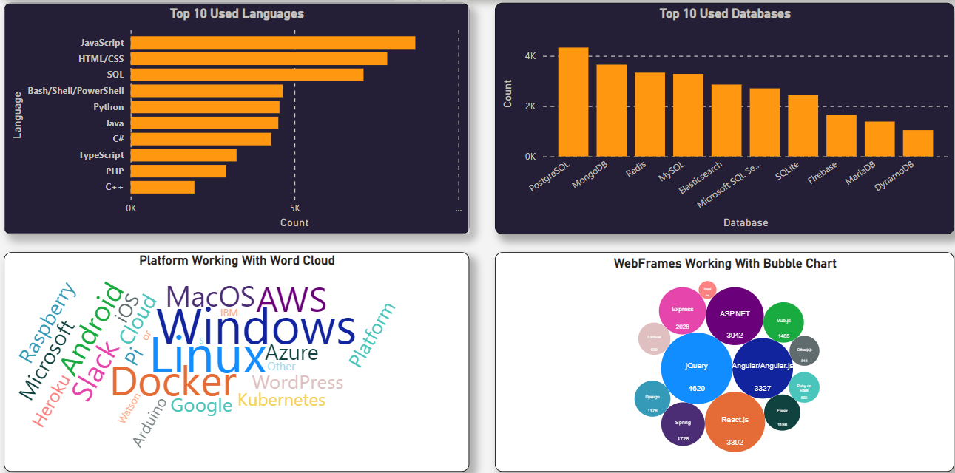
Current Technology Usage

Slide 13
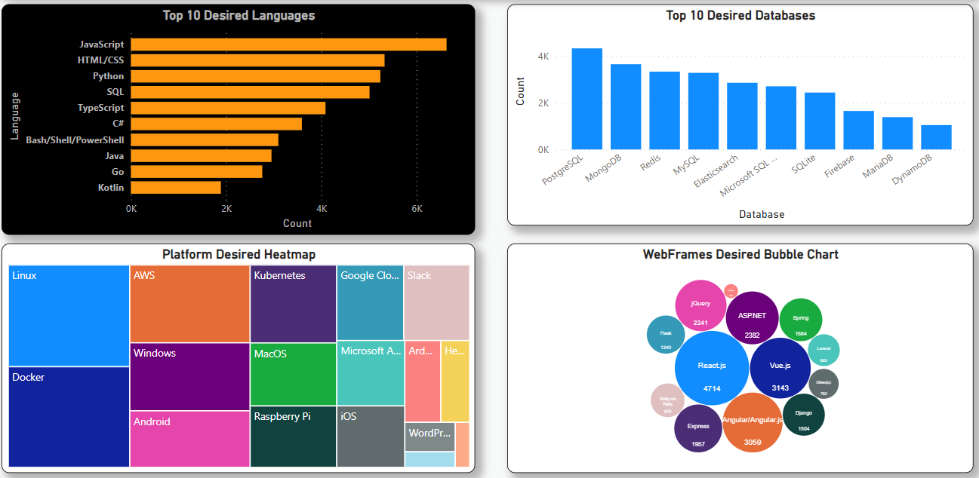
Future Technology Trend

Slide 14
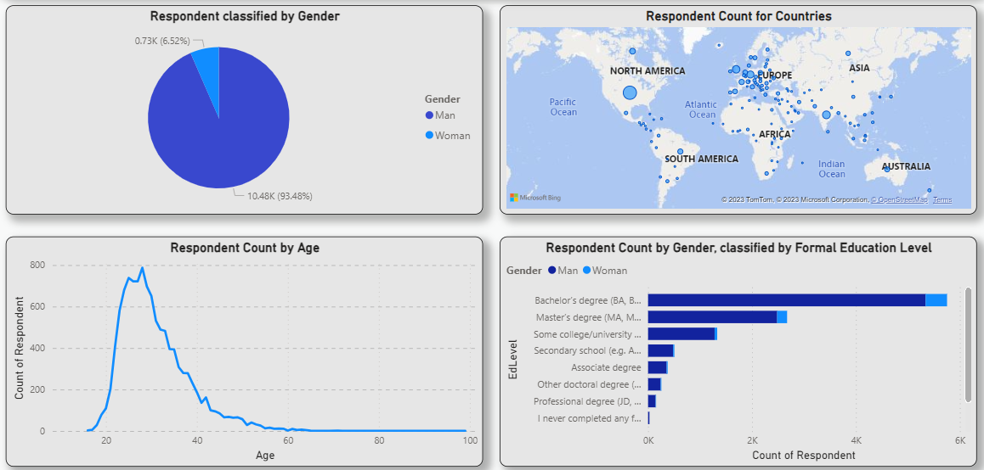
Demographics

Slide 15
DISCUSSION

Slide 16
OVERALL FINDINGS & IMPLICATIONS
Findings
Python users number is increasing really fast
JavaScript widely used and TypeScript getting popular.
Developers mostly located in developed countries.
Implications
Young developers without postgrad studies on its majority.

Slide 17

CONCLUSION
Developers are people with very marked characteristics.
A good idea of popularity trends of different tools, platforms and languages can be obtained.
There is a job to be done to spread accessibility of this labor market to countries in development.

Slide 18

APPENDIX

Slide 19
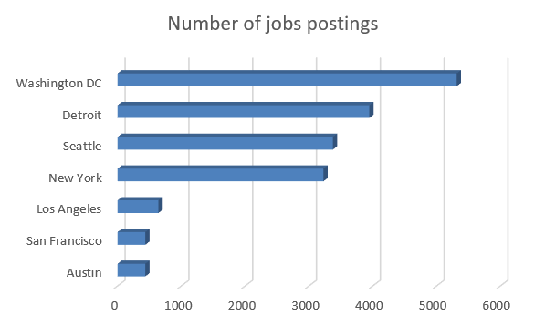
JOB POSTINGS

Slide 20
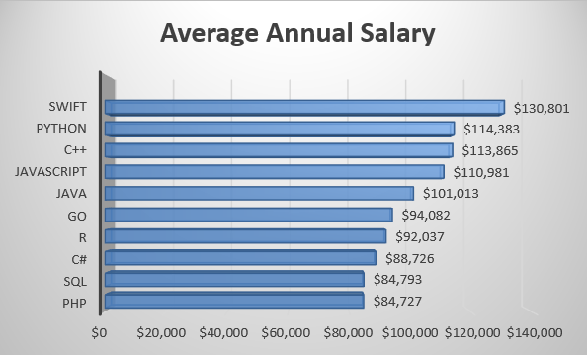
POPULAR LANGUAGES

