Slide 1
PERFORMANCE ANALYTICS
Adidas Sales &
Profit Analysis
FY 2020 – 2021
Comprehensive overview of revenue, profitability, product mix and channel performance
Hady Amr
April , 2026

Slide 2
Goals of our discussion
Monthly Sales & Profitability Trend Analysis:
Show peak and decline months in sales and profit across the month and forecasting sales and profit.
Product Optimization:
Knowing the sales, profits and quantities of each product in analytical period.
Sales and profit distribution:
Visualizing sales and profit by distribution methods

Slide 3
KEY PERFORMANCE INDICATORS
2021 (vs 2020)
TOTAL SALES
OPERATING PROFIT
UNITS SOLD
899.9 M
332.13M
2,478,861
▲ +294.23%
▲ +324.07%
Quantity of All Products
Combined 2020–2021
Combined 2020–2021
Combined 2020–2021
FY 2021 DATA
FY 2021 DATA
FY 2021 DATA
Key Insights
Exceptional Revenue Growth: Sales achieved a massive surge with a growth rate of 294.23%, indicating significant market share expansion or a highly successful sales strategy.
High Operational Efficiency: Operating profit growth (324.07%) outperformed sales growth, demonstrating improved cost management and enhanced profit margins.
Strong Quantitative Performance: Approximately 2.48 million units were sold, reflecting robust production and logistical capabilities that fueled this financial growth during FY 2021.

Slide 4
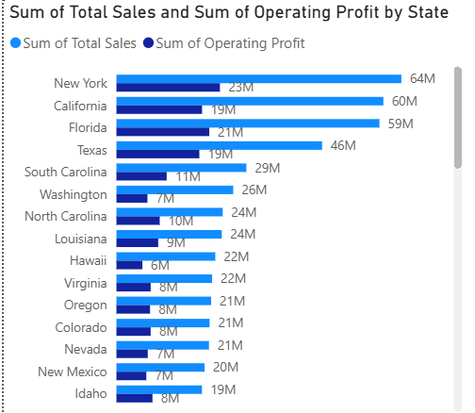
Count of states in 2020 is 9
Count of states in 2021 is 50

Slide 5
MONTHLY SALES & PROFIT TRENDS By Millions
Source: Adidas Monthly Sales Dashboard

Slide 6
PRODUCT PERFORMANCE BREAKDOWN
TOTAL SALES (2020–2021)
OPERATING PROFIT (2020–2021)
Product | Total Sales | Units Sold
Men's Street Footwear | $208.8M | 593,320
Women's Apparel | $179.0M | 433,827
Men's Athletic Footwear | $153.7M | 435,526
Women's Street Footwear | $128.0M | 392,269
Men's Apparel | $123.7M | 306,683
Women's Athletic Footwear | $106.6M | 317,236
TOTAL | $899.9M | 2,478,861
Product | Op. Profit
Men's Street Footwear | $82.8M
Women's Apparel | $68.7M
Men's Athletic Footwear | $51.8M
Women's Street Footwear | $45.1M
Men's Apparel | $44.8M
Women's Athletic Footwear | $39.0M
TOTAL | $332.1M
★ Men's Street Footwear leads both sales and profit across both years

Slide 7
SALES CHANNEL DISTRIBUTION
BY SALES CHANNEL
BY PROFIT METHOD
In-store is the dominant channel (~39%), followed closely by Outlet (~33%) and Online (~27-29%) for both metrics

Slide 8
2022 FORECASTING OUTLOOK
SALES PROJECTION (Millions)
PROFIT PROJECTION (Millions)
Forecasts indicate continued upward momentum into H1 2022 across all product lines

Slide 9
KEY INSIGHTS & TAKEAWAYS
01
REVENUE GROWTH
02
PROFIT SURGE
Total sales grew by 294% YoY, from ~$183M (2020) to ~$717.8M (2021), driven by product diversification and channel expansion.
Operating profit jumped 324% in 2021 vs 2020, with operating margin improving significantly. Men's Street Footwear is the star performer ($82.8M profit).
03
CHANNEL MIX
04
2022 FORECAST
In-store remains the dominant channel at ~39%, but Online is gaining momentum at ~27–29%, signaling a digital shift in consumer behavior.
Projections indicate sustained growth with monthly sales forecasted between $100–120M and profit around $35–45M in early 2022.

Slide 10
adidas
Impossible Is Nothing
Data Period: FY 2020 – FY 2021
All figures in USD | Adidas Data Intelligence Team
THANK YOU

