Slide 1
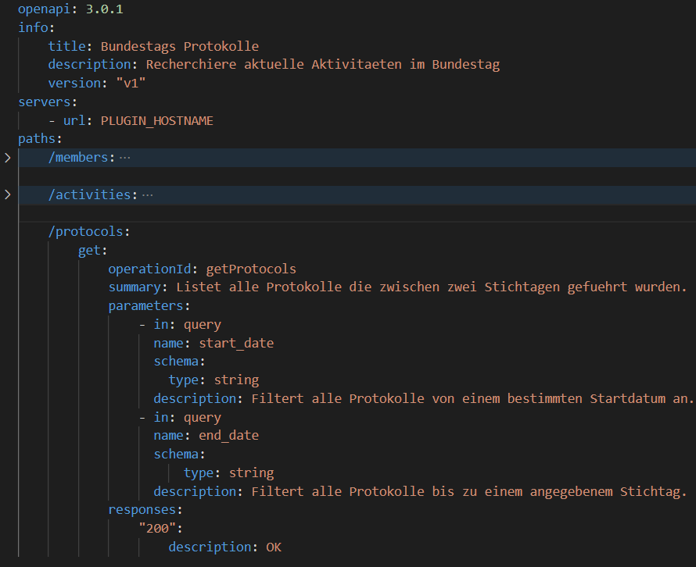
ChatGPT plugin structure
Ingredients:
a REST API
a manifest file
a YAML file
a program entry
Instruct GPT in YAML on how to use your plugin
Define paths
Summary field
Description field
Page 1
Armin Hadzalic © Data-Science Meetup 2023

Slide 2
ChatGPT plugin structure
Ingredients:
a REST API
a manifest file
a YAML file
a program entry
Instruct GPT in YAML on how to use your plugin
Define paths
Summary field
Description field

Slide 3
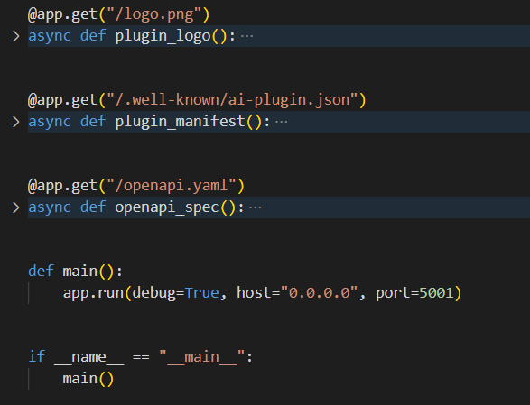
ChatGPT plugin “main.py”
Responsibilities:
Path to the logo
Path to manifest file
Path to YAML file
Your methods / functions

Slide 4
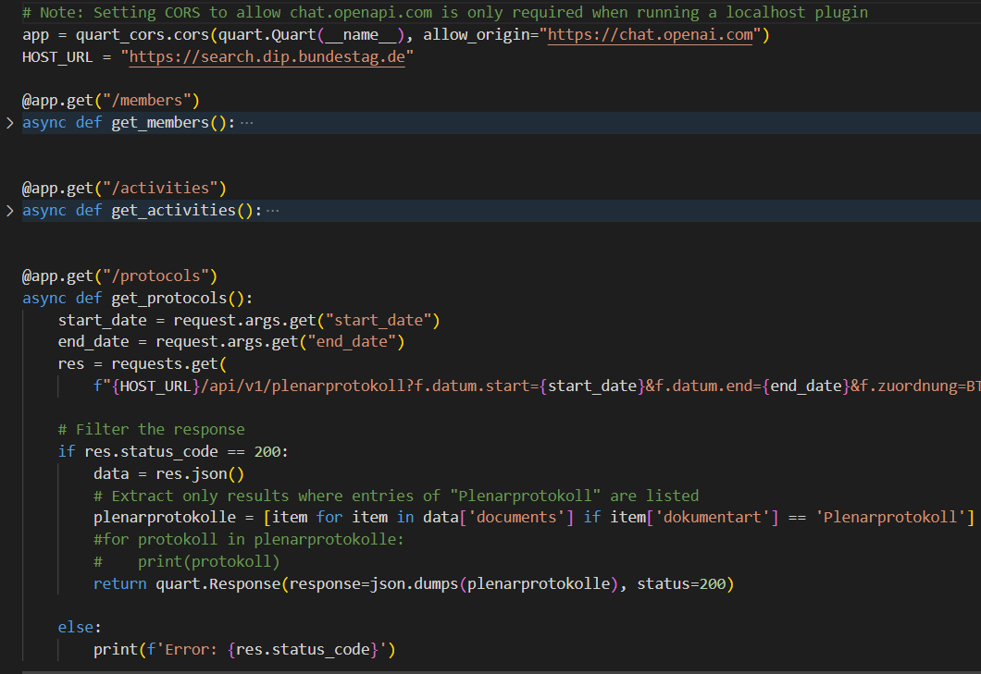
ChatGPT plugin “main.py”
1
Your domain logic:
Define the Host-URL
Adapt the variable input
Send the request
Get the response
Do the extraction, if needed
2
3

