Slide 1

TRAVELTIDE
REWARD PROGRAM
PRESENTED BY ELISABETH HADZIC

Slide 2
AGENDA
Introduction
Rewards Program
Active Users
User Segmentation
User Groups
Groups and Perks
Insights & Recommendations

Slide 3

INTRODUCTION

Slide 4
ABOUT THE
TRAVEL TIDE REWARDS PROGRAM
1 million users
5.4 million unique app sessions
MAIN GOAL:
identify active users and find good rewards/perks for each
To incentivize users to stay active, TravelTide wants to implement a rewards program
Lead: Elena
20
24

Slide 5
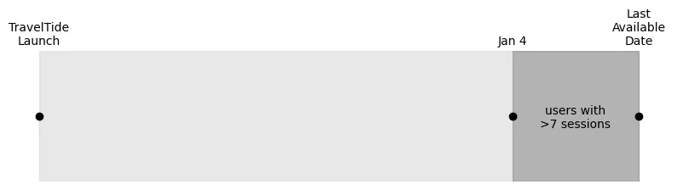
ACTIVE USERS
01
02
03
Over 1 million users, but not all active lately
Elena suggested to include users with more than 7 sessions since Jan 4, 2023
5998 users eligible
"Finance is the spearhead of a company."
20
22

Slide 6
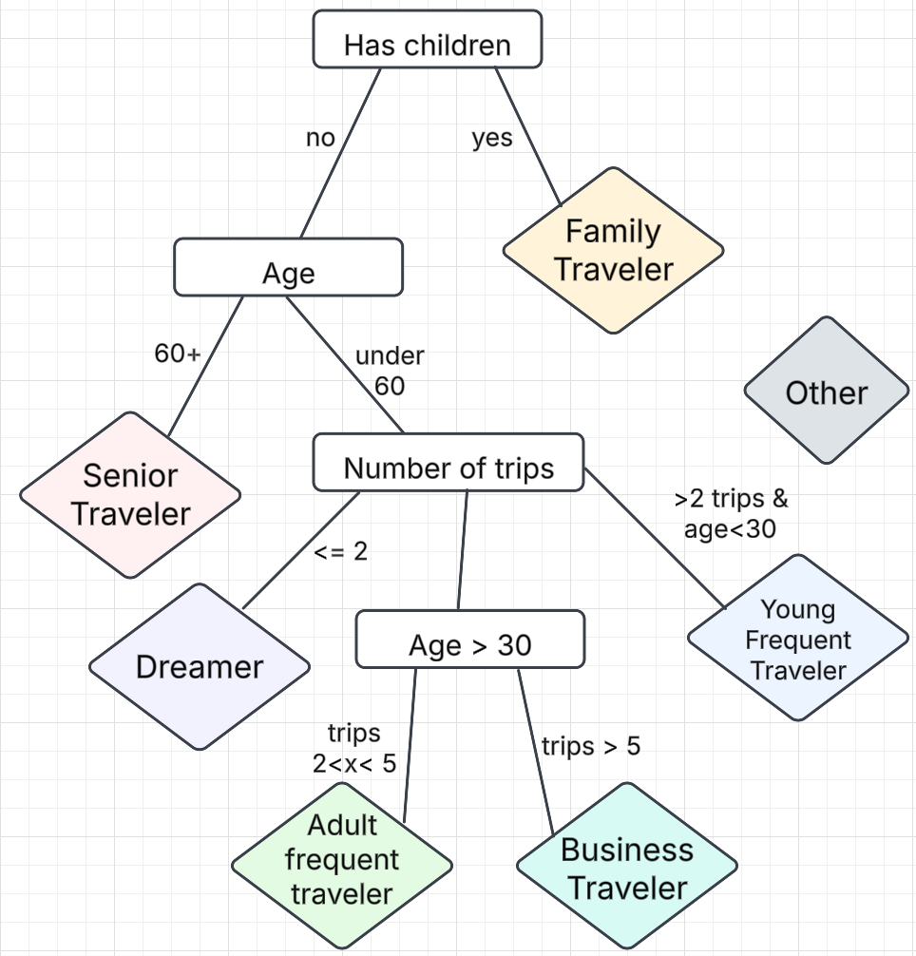
USER SEGMENTATION
To get an individual perk for each customer we used segmentation into groups and decision trees
After analysis, 7 groups
20
22

Slide 7
USER GROUPS

Slide 8
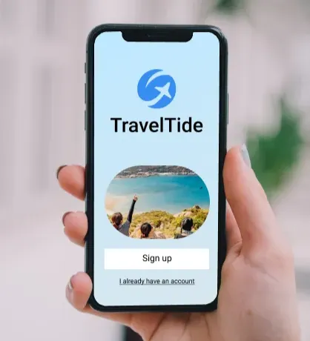
USER GROUPING
Explored customer demographics
Metrics:
Session behavior
Trip behavior
Customer demographics
Grouped customers by similarity in these metrics
GROUPING

Slide 9
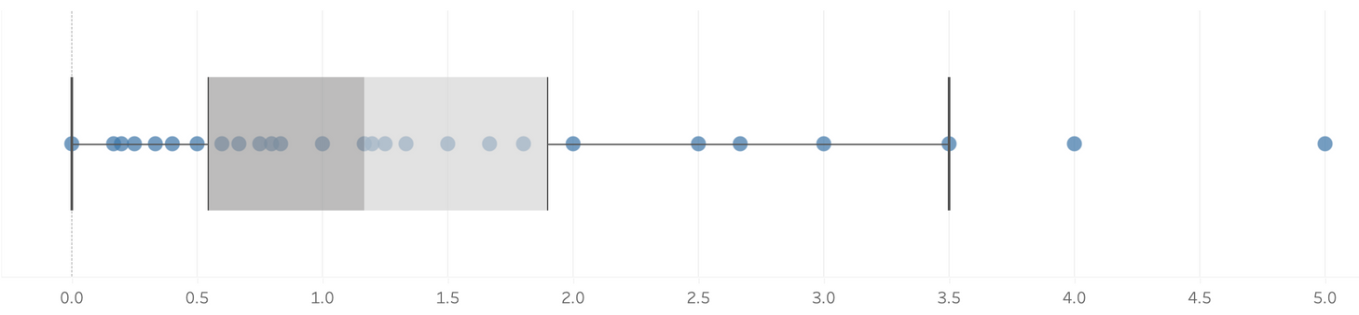
FAMILY
All Family travelers have children
More travelers = more luggage
High avg. bags
Popular with international travel: 1,075 trips
Tend to have more luggage
TRAVELERS
Avg. Bags
PERK
Free checked bag
Travel with children
Travel for longer or farther

Slide 10

SENIOR
TRAVELERS
Enjoy longer trips
Avg. trip length: 6 days
Avg. hotel stay: 5.8 nights
Mr. & Mrs. Smith
78, 74 years old, married since 1970
Users since 2022
6 travels, 12 flights with us
PERK
Free Hotel Meal

Slide 11
BUSINESS
Travel mainly for work
Company usually pays for flight and hotel
Example: User ******
Lots of trips and flights
8 trips, 12 flights since Jan 4, 2023
Short and domestic flights
1,362 avg. km flown
All in USA
TRAVELERS
PERK
Airport lounge access
Premium, quiet spot for work, business, and food
Lots of time spent in and out of airports
LEARN MORE

Slide 12
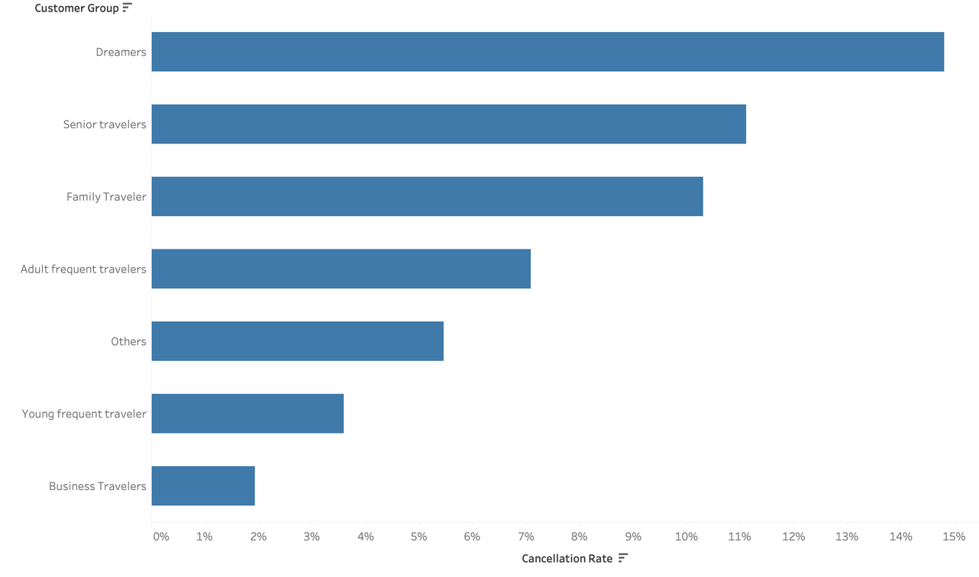
THE
DREAMERS
Active users who do not book travels with us or follow through with a trip
1,587(26%) users fall into this category
PERK
Highest cancellation rate, 14.81%
Book trips but don’t follow through
Discount on first travel
Incentive to travel

Slide 13
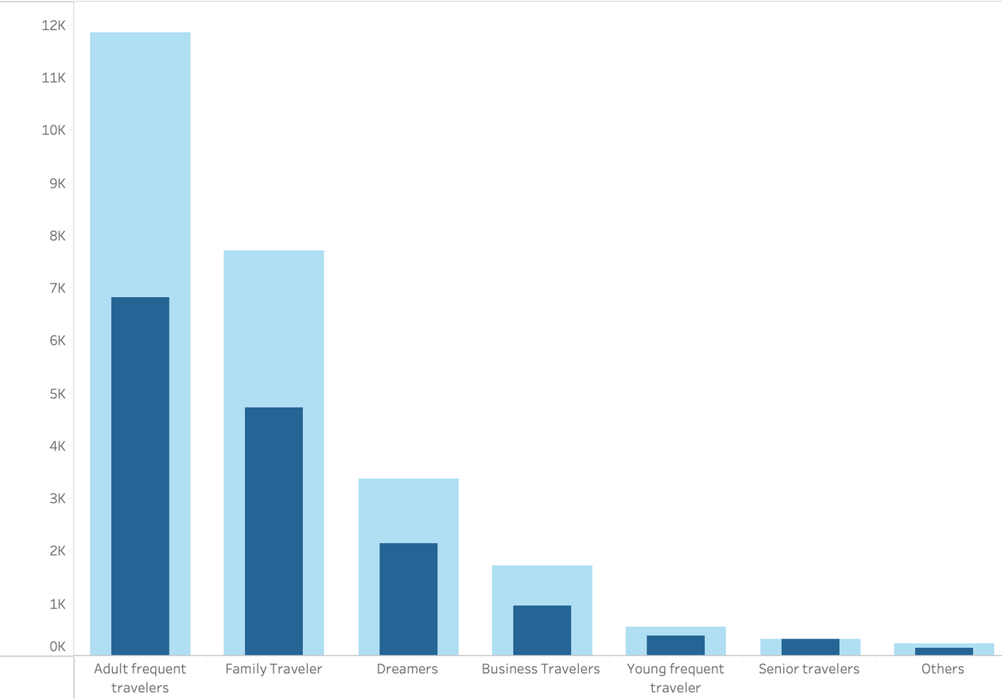
Number of trips & flights per group
ADULT FREQUENT
TRAVELERS
Travel often
Largest # of trips(6,822) and flights(11,851)
2nd farthest avg distance flown
2,132 km
LEARN MORE
PERK
Free flight/seat upgrade

Slide 14
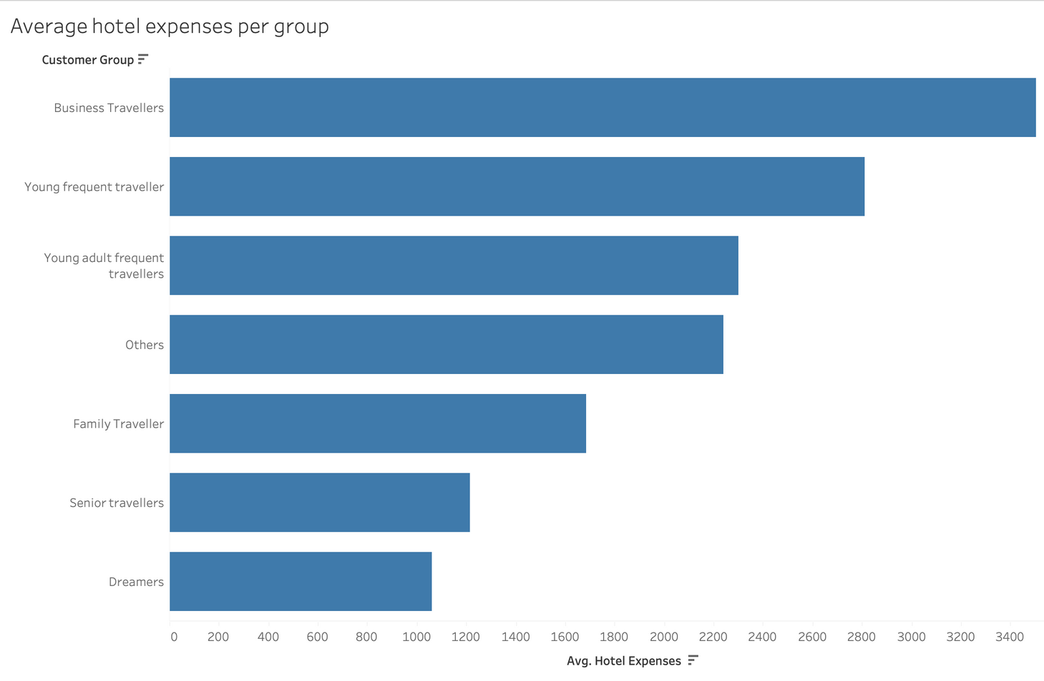
YOUNG FREQUENT
TRAVELERS
Spend the most money on average for hotel expenses($2813), excluding business travelers
Avg. trip length: 4 days
Avg. 3 - 4 trips per traveler
LEARN MORE
PERK
1 free hotel night with flight

Slide 15
OTHER
Travelers who do not fall under the other groups
55 (<1%) travelers fall into this category
156 trips
Avg. trips: 2.8
Mostly female, mix of single and married
Predominately older, 45+
TRAVELERS
PERK
Free seat selection
Good for non-frequent travel
Comfort and control
Maximize personal space

Slide 16
INSIGHTS & RECOMMENDATIONS

Slide 17
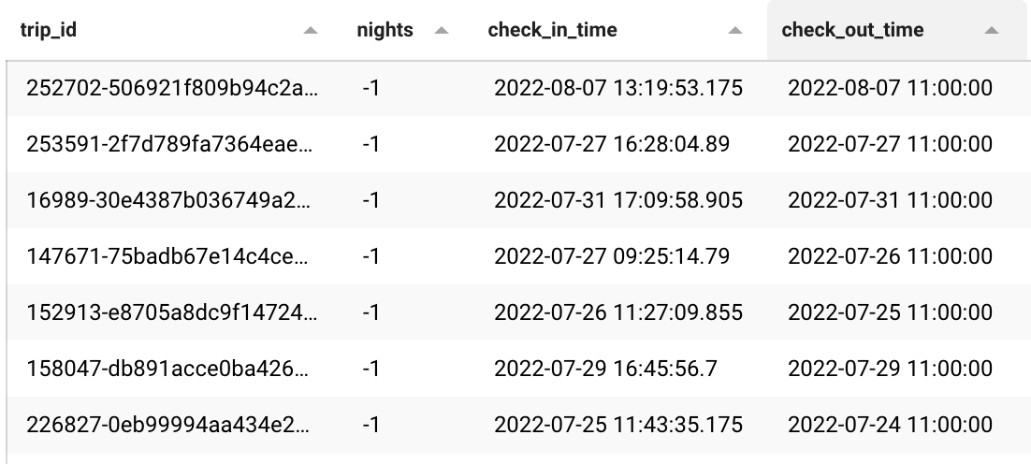
INSIGHT:
NEGATIVE NIGHTS
12,067 trips with negative nights
check_out_time before check_in_time
Looks like a default value
Create a different method or default for filling check_out_time

Slide 18
THANK YOU

