Slide 1
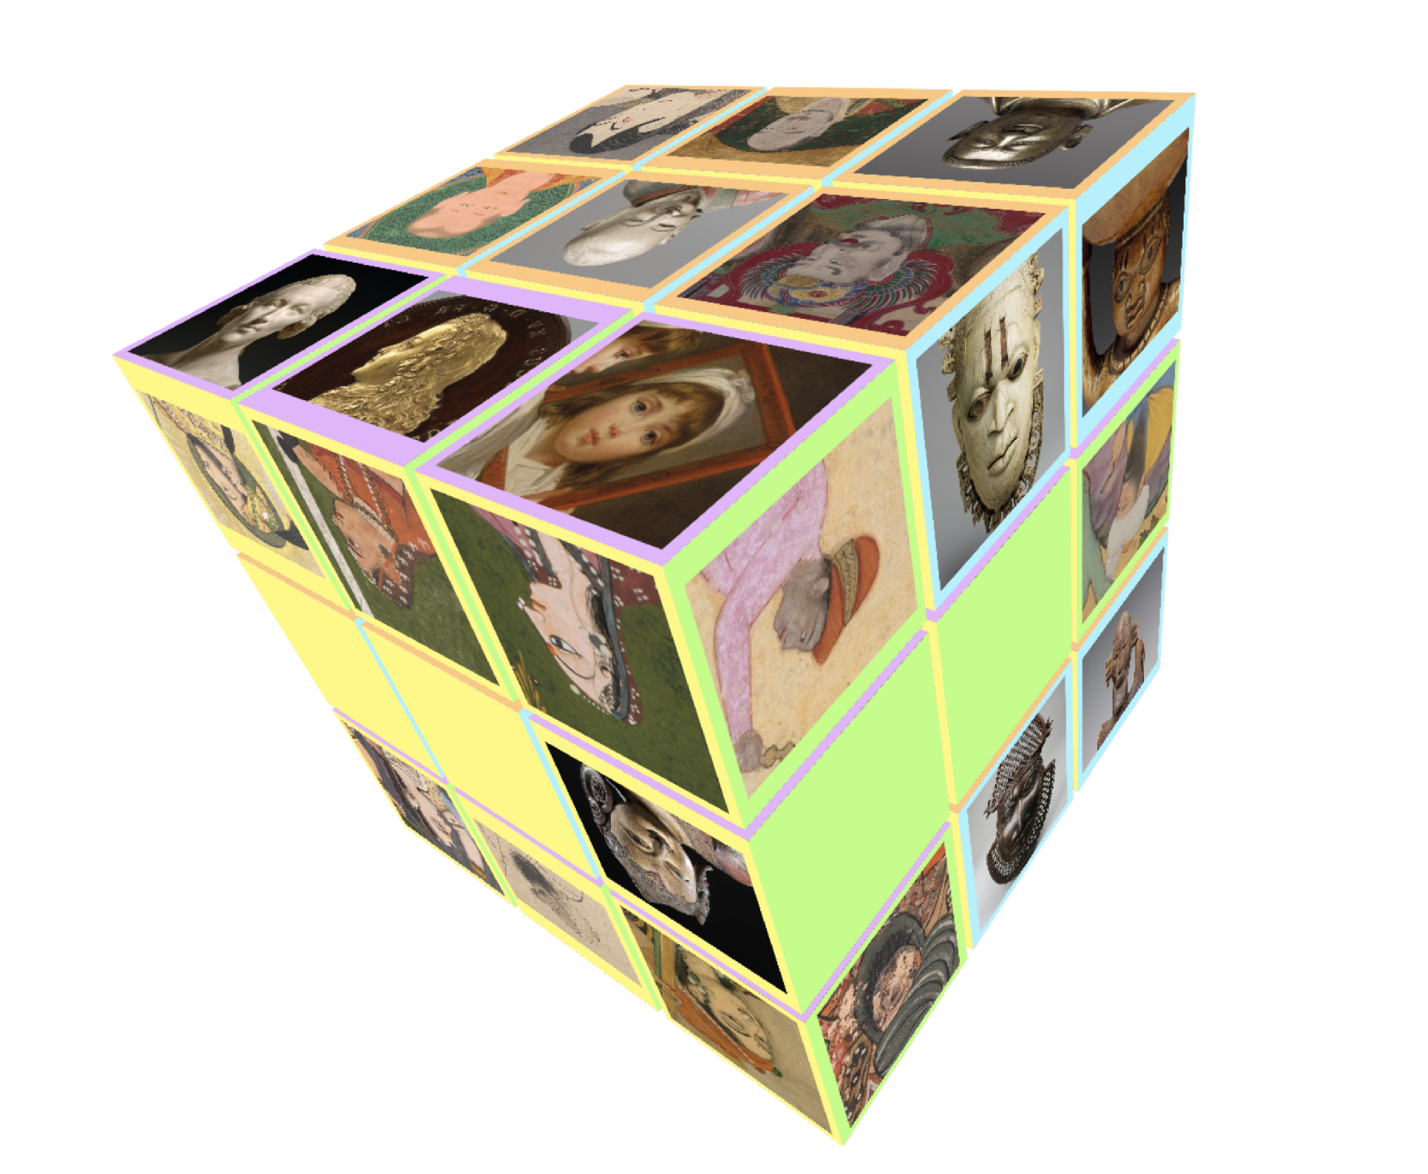
Have you MET These faces ?
21S Cultural Data Sculpting / EPFL
Haeeun Kim

Slide 2
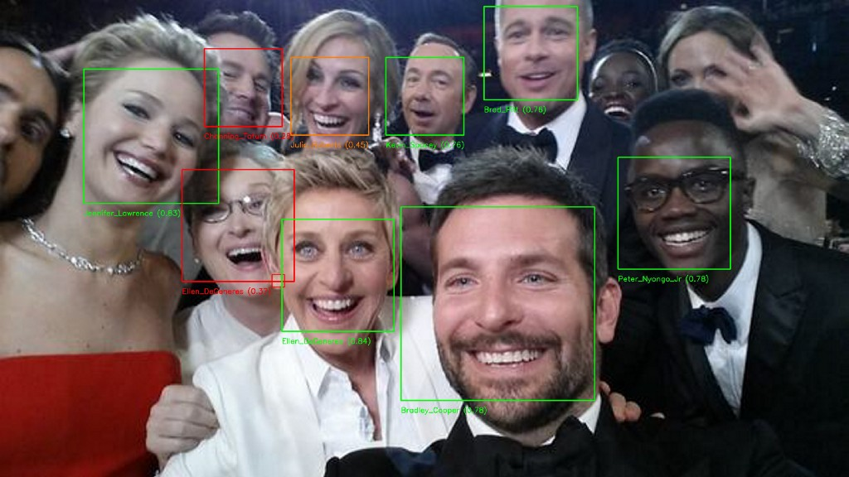
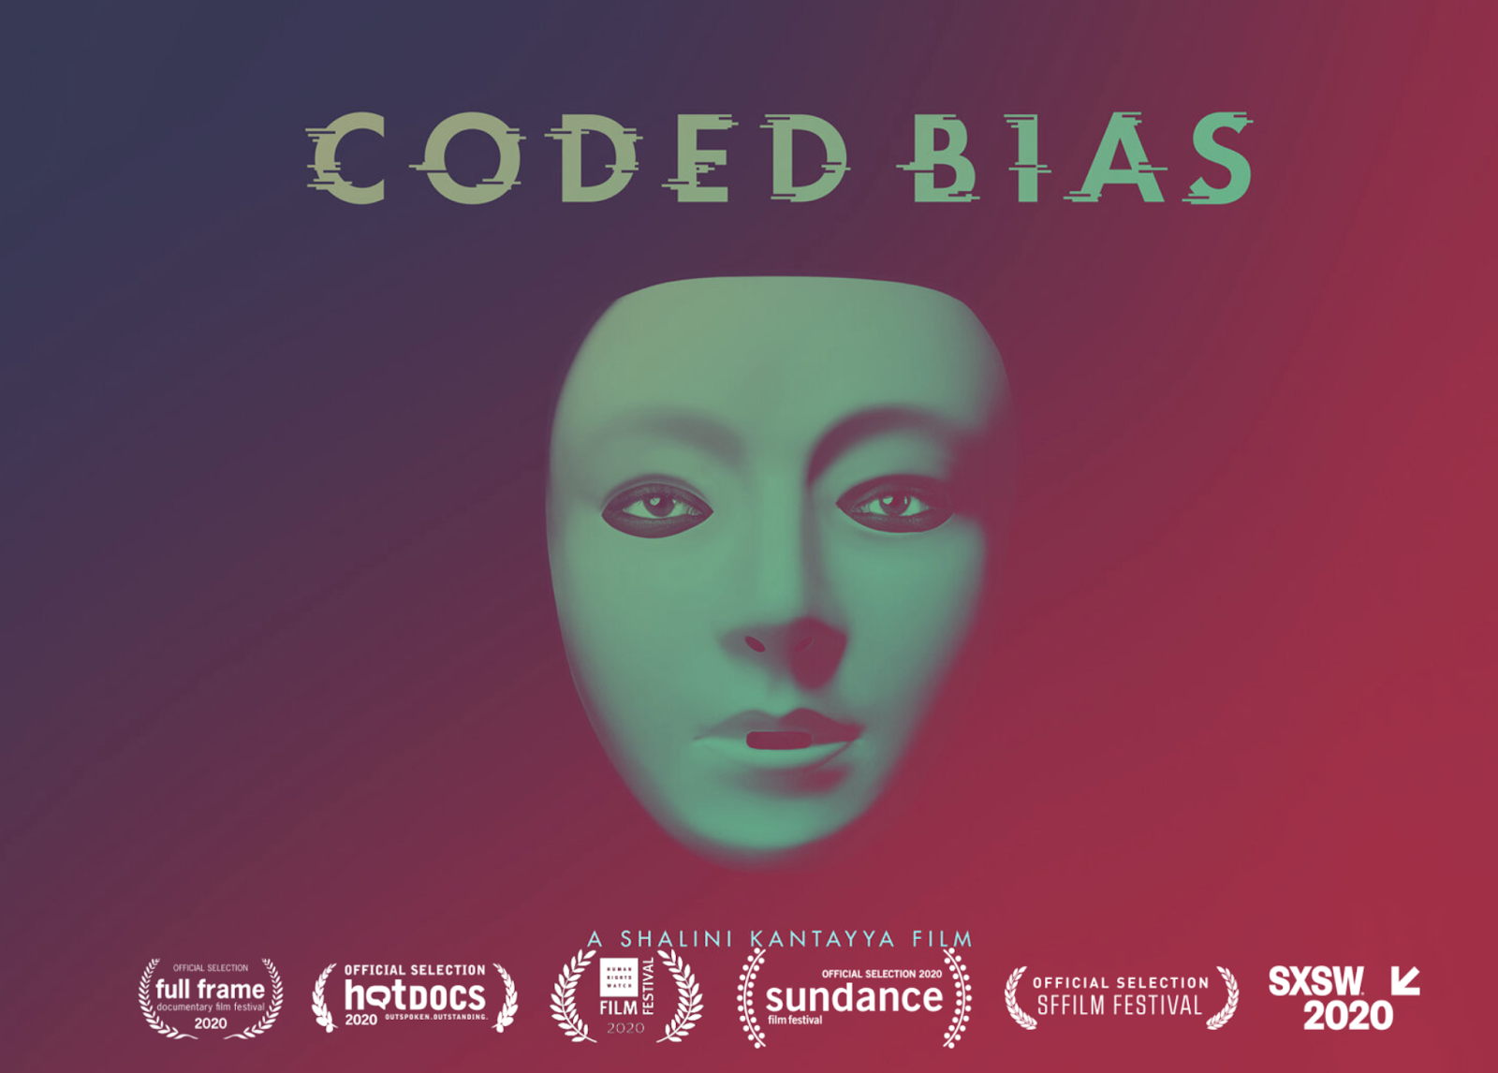
Modern technologies know human faces
(except when they don’t)
https://laptrinhx.com/an-intro-to-deep-learning-for-face-recognition-1809043462
https://www.codedbias.com/

Slide 3

It’s not pleasant to ‘not be detected’

Slide 4
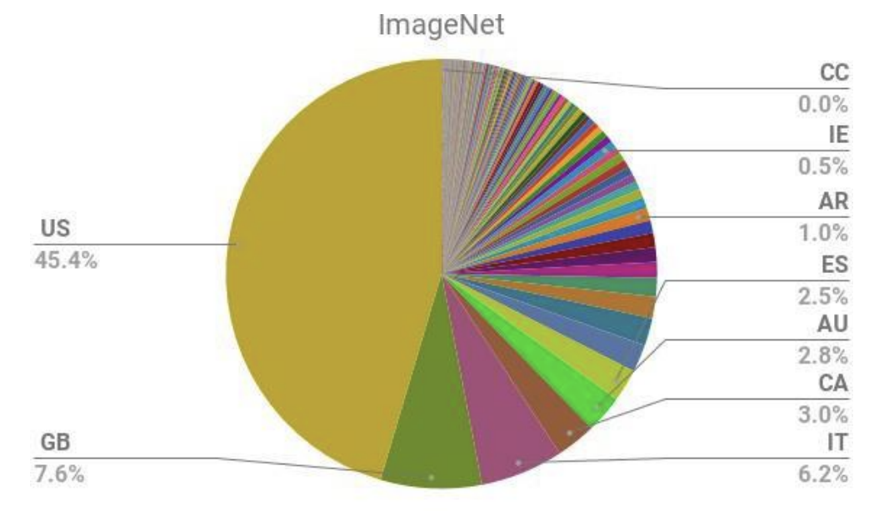

Can we fix this by debiasing the dataset?
Yes (the dataset is heavily biased)
and No (the bias is inherent to the photography)
https://www.boisestatepublicradio.org/post/martin-luther-king-jrs-legacy-idaho#stream/0
Freney B el at., 2020, Profiling and Convention 108+ : Report on developments after the adoption of Recommendation (2010)13 on profiling. 15 p.

Slide 5
Q. Before photography,
how did people depict faces?

Slide 6
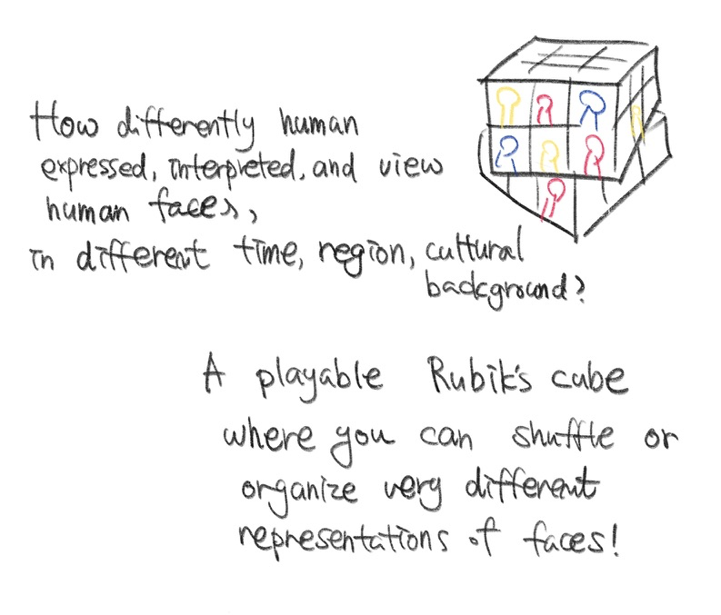



Have You MET
These Faces?
Data: The Metropolitan Museum of Art
Data Retrieval: MET official API
Interactive visualization : cables.gl
Image storage: Cloudinary
Initial sketch of the idea

Slide 7
Rubik’s Cube?
A tangible link to the real-life experience
One color, one group
Narrative impact by reversing the rule
Many “faces” :p
https://de.wikipedia.org/wiki/Zauberw%C3%BCrfel

Slide 8
Variation on the Cube
Switch the cube by adjusting the period
Two modes: “playing with the cube” and “browse the faces”
Naturally connect the visual experience with the contextual information

Slide 9
Data wrangling
Searched the list of MET collection by relevant tags - search method didn’t work :(
  ‘Human figure’, ‘face’, ‘portrait’, ‘men’, ‘female’, etc
Grouped into six regions for each period - department, culture, country, creationDate
East Asia (mainland China), West Asia (Hinduism and Buddhism),
North Africa and Far-West Asia (Ottoman Empire) Sub-Saharan Africa,
Europe (Western Roman Empire), Central America
Connect with metadata: creation date, detailed location, medium
Randomly sampled the collection, leave the image empty if not enough

Slide 10
Implementation Design
Disposition
Static?
Rotating?
Finishing?
CubePosition 0: CubeMap0, [face_detail0_0, …. face_detail0_5]
;
;
CubePosition 26: CubeMap26, [face_detail26_0, …. face_detail26_5]
Rotation
Rotation axis

Slide 11
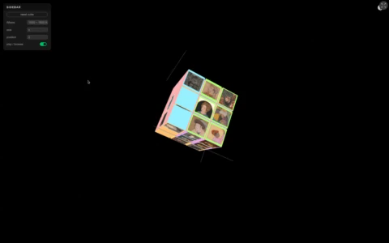

Slide 12
Drawing on a surface was not a universal way.

Slide 13
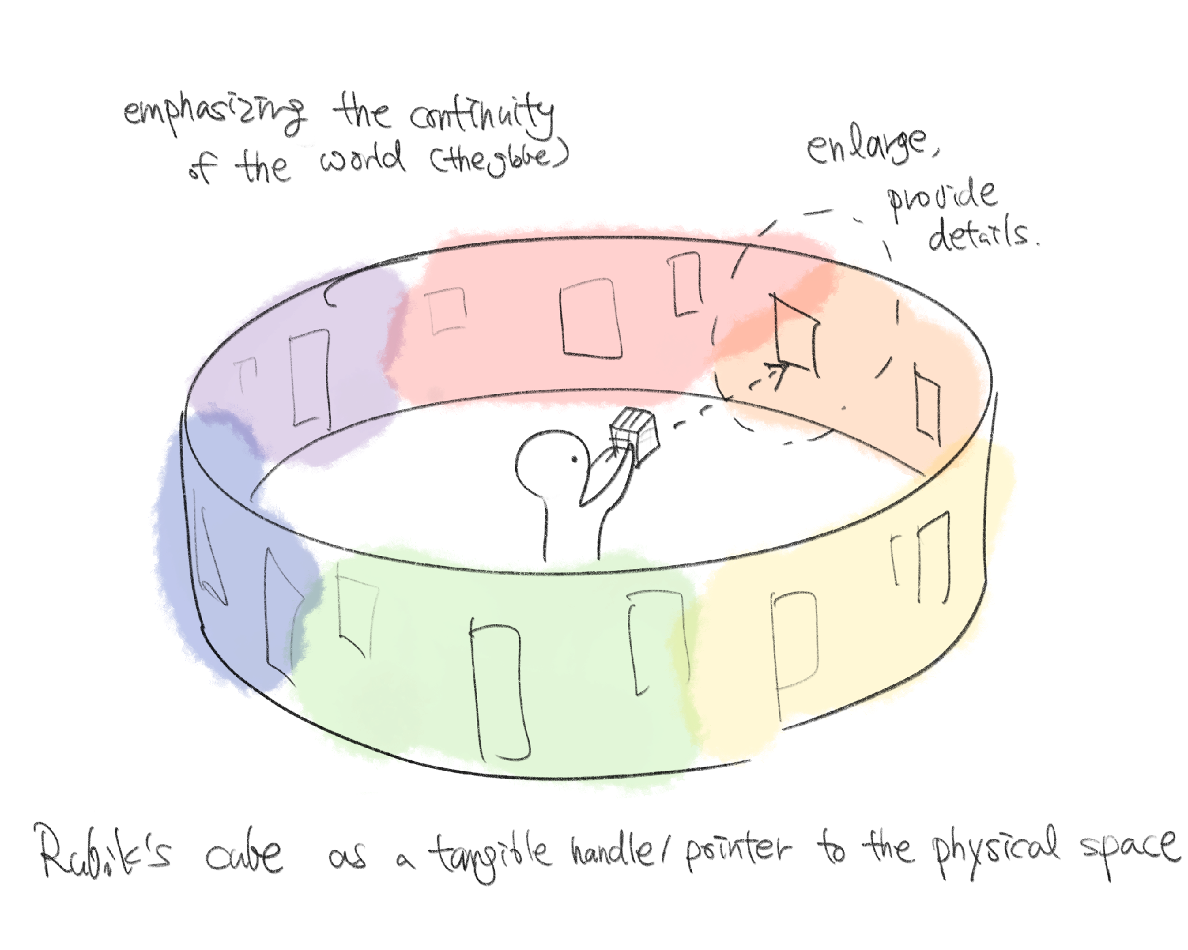
Future Aspirations
Improve state handling
Link to a physical, panoramic installation
Redefine the ‘cultural regions’

Slide 14
Thank you!
Any questions?

Slide 15
Looking back on CDS2021 in general
Experiencing the whole process alone (data + narrative + implementation) was tough…
Experiencing the whole process alone (data + narrative + implementation) was fun!!
Felt like wrapping up my master studies at EPFL in general.
Great to get to know awesome ideas of all the other course participants!

