Slide 1
Lab 9
Dynamic Linking

Slide 2
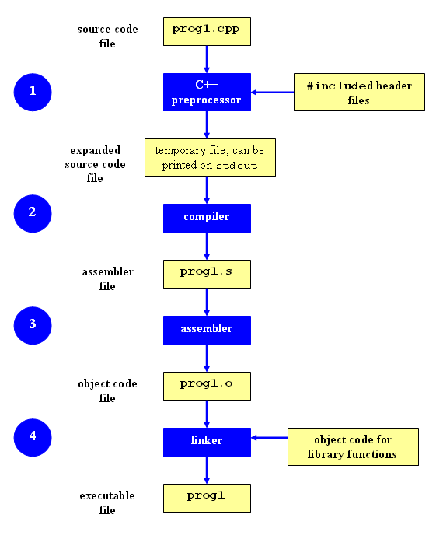
Compilation Process

Slide 3
Libraries
Pre-compiled object files that are packaged together and provide similar functionality
Made available to other developers to enable modular programming
Linux supports 2 types of libraries
Static: *.a files
Shared: *.so files

Slide 4
Static Libraries vs. Shared Libraries
Static Libraries
statically-linked: the linker copies all library routines used in the program into the final executable image at compile-time
Shared Libraries
The linking process is deferred until run time
The name of the library is placed in the final executable file while the actual linking takes place at run time when both executable file and library are placed in the memory
dynamically-linked: Linux is responsible for loading library upon execution.
dynamically-loaded: library is used under program control. Program has to selectively call functions within the library.

Slide 5
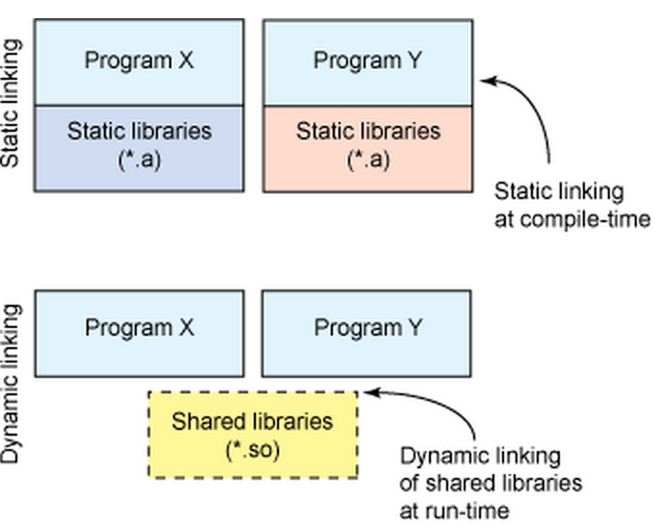
Static Shared
Executable fast & portable
does not require the presence of the library on the system where it runs
Takes more space on disk and in memory
Large executables
every running program has its own copy of the library
Performance hit
Need to load shared objects
reduce the memory footprint of a program
a single library can be shared among multiple programs
Adaptive executables
When shared libraries are updated, executables using them don’t need to be recompiled

Slide 6
Size comparison
$ gcc -static hello.c -o hello-static
Will generate linker error if static library does not exist on your system
$ gcc hello.c -o hello-dynamic
$ ls –l to get file size
hello.c -> 74 bytes
hello-dynamic -> ~ 14 KB
hello-static -> ~ 2 MB

Slide 7
Static Libraries: Example
add.h sub.h
add.c sub.c
add.o sub.o
int add(int, int);
int sub(int, int);
int add(int num1, int num2)
{
return (num1 + num2);
}
int sub(int num1, int num2)
{
return (num1 - num2);
}
gcc –c add.c
gcc –c sub.c

Slide 8
Static Libraries: Example
Create a new header file with both signatures
mymath.h
Execute command to create static library
ar rs libmymath.a add.o sub.o
-s: write the object files into the archive
-r: insert files with replacement if they already exist
int add(int, int);
int sub(int, int);

Slide 9
Static Libraries: Example
include the mymath library in main.c
gcc -I . -c main.c
gcc -o example main.o libmymath.a (OR)
gcc -o example -L . main.o -lmymath
#include <mymath.h>
#include <stdio.h>
int main()
{
int x = 10, y = 20;
printf(“\n%d + %d = %d”, x, y, add(x,y) );
printf(“\n%d - %d = %d”, x, y, sub(x,y) );
return 0;
}
Notes:
The -I option adds the directory dir to the list of directories to be searched for header files. Directories named by -I are searched before the standard system include directories. (echo | cpp -Wp,-v shows default include path)
The -L option tells the linker to search for libraries in the following argument on top of standard system directories

Slide 10
Dynamic Libraries: Example
Using same example as before (add and sub)
Regenerate object files, but compile with –fPIC flag
gcc –Wall -fPIC -c add.c
gcc –Wall -fPIC -c sub.c
Build the shared library
gcc -shared -o libmymath.so add.o sub.o
To use a shared library, it has to be installed first
Copy the library into one of the standard directories (/usr/lib)
ldconfig /usr/lib
Use the library
gcc -o example2 main.o libmymath.so OR
gcc -o example2 main.o –lmymath
Notes:
The LD_LIBRARY_PATH environment variable defines where to look for the available shared objects.

Slide 11
List Shared Library Dependencies
The ldd command lists all shared libraries that an executable depends on
ldd <executable_name>
Example: ldd example2
libmymath.so => /usr/lib/libmymath.so (0x00002b19378fa000) libc.so.6 => /lib64/libc.so.6 (0x00002b1937afb000) /lib64/ld-linux-x86-64.so.2 (0x00002b19376dd000)

Slide 12
Lab 9
Write and build simple program in C
Your program should compute cos(0.5) and print the result using printf format “%.17g”
Use ldd to investigate which dynamic libraries program loads
Use strace to investigate which system calls your program makes
Use ls /usr/bin | awk 'NR%101==SID%101' to find ~30 Linux commands to use ldd on
Record output for each one in your log and investigate any errors you might see
From all dynamic libraries you find, create a sorted list
remove the duplicates

