Slide 1
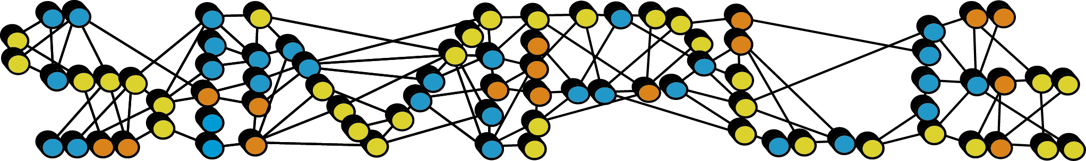
SIMPLE Git Repo Onboarding
Developer orientation: map, docs, wiki, and build environment
May 21, 2026

Slide 2
What SIMPLE Is
High-performance cryo-EM image processing and reconstruction platform.
Turns movies, micrographs, and particle images into 2D class averages, 3D reconstructions, symmetry analysis, and structural models.
Supports batch workflows, streaming pipelines, single workstations, and distributed HPC environments.

Slide 3
First Pass Through the Repo
README.md: project purpose, installation flow, release links, and update notes.
src/: Fortran library and domain implementation.
production/: executables plus executable tests.
scripts/: generated runtime helpers, install helpers, and utility scripts.
nice/: NICE Django GUI, classic batch GUI, stream GUI, and local launcher support.
doc/: developer guides, policies, code map, how-tos, tutorials, release notes.
build/: generated local build artifacts; useful for inspection, not source.

Slide 4
Mental Model
Infrastructure and platform services sit at the base: definitions, I/O, external libraries, system wrappers.
Domain objects and numerical engines live in the middle: images, volumes, orientations, projects, CTF, motion, search, reconstruction, filtering.
Commanders orchestrate workflows: they parse typed parameters, assemble context, dispatch strategies, and update project state.
Executables are thin entry points around SIMPLE, SINGLE, stream, private, and test workflows.
GUI code is a launcher, monitor, and project browser around the Fortran executables.

Slide 5
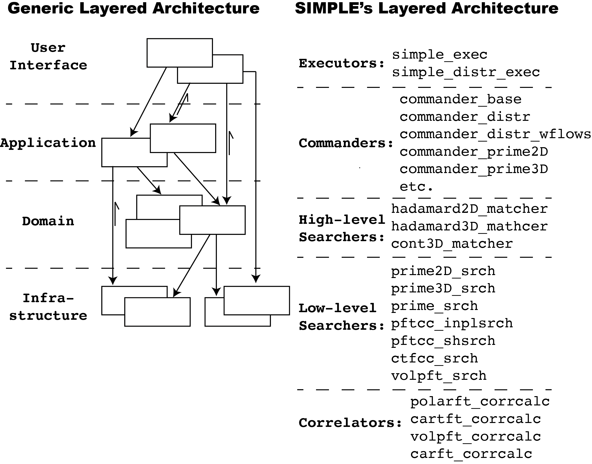
Architecture at a Glance

Slide 6
Codebase Map Is Your Index
Start with doc/code_overview/code_base_map.md.
Use it to find module ownership before searching manually.
It names major directories, executable entry points, commanders, strategies, tests, GUI utilities, and queue-system utilities.
Treat its vocabulary as the shared map: builder, parameters, commander, strategy, sp_project, image, volume, ori, oris.

Slide 7
Developer Docs in /doc: Start Here
Folder | What New Developers Get
code_overview/ | Code base map in Markdown and Word formats.
for_developers/ | Developer guide, architecture/design guide, performance refactoring guide, GUI onboarding, probability/projection notes, templates, diagrams, logos.
policies/ | Scientific and architectural policies: refine3D, abinitio2D, nonuniform filtering, automasking, interpolation, persistent workers, sigma, picking, fractional updates.
how2s/ | Short recipes for git, gdb, Fortran debugging, FFTW installation, and SLURM arrays.

Slide 8
More /doc Resources
Folder | What To Use It For
algorithms/ | Focused algorithm notes such as motion correction and NU filter/Potts prior material.
microchunk_and_rejection/ | Microchunk/rejection model integration, model class-average rejection, and policy docs.
refactoring_notes/ | Design records for CMake, global-state removal, PFTC ranges, image/string/exec notes, and probability-neighborhood refactors.
simple_tutorials/ | Tutorial source and workflow figures for examples and user-facing walkthroughs.
release_notes/ | Historical release notes.
README_old.txt | Legacy installation/reference material; useful when comparing older instructions.

Slide 9
Build & Compilation Environment
Current checkout is CMake-first: root CMakeLists.txt is the entry point and exports compile_commands.json.
This checkout requires CMake 3.25+ and GCC/GFortran 14+ in the active CMake path.
Required dependencies include FFTW3, TIFF/JPEG/ZLIB, libcurl; NICE work also needs the Python/Django web stack.
Defaults: USE_OPENMP=ON, BUILD_TESTS=ON, NICE=OFF, local install prefix under build/.
Optional paths: NICE=ON, USE_OPENMP_OFFLOAD=ON, USE_OPENACC, USE_COARRAYS, USE_MPI.
mkdir build cd build cmake .. cmake --build . --parallel cmake --install .

Slide 10
Build Scripts You Will See
compile_clean.sh: clean release-style build.
compile_debug.sh: debug build.
compile_gpu.sh: OpenMP offload build.
compile_gui.sh: NICE-enabled build.
compile_conda.sh: conda-provisioned GCC/GFortran, FFTW, TIFF, JPEG, Python, and CMake environment.
compile_csbclust.sh: module-based HPC build.
After install: source build/add2.bashrc, or add build/bin, build/scripts, and SIMPLE_PATH manually.

Slide 11
Wiki, CI, and Team Workflow
Repo: https://github.com/hael/SIMPLE
Wiki: https://github.com/hael/SIMPLE/wiki
CI: GitHub Actions build/test workflow is linked from README.md.
Use local /doc for implementation-level guidance; use the wiki for project-level orientation.
Before changing scientific behavior, read the nearest policy or refactoring note.
For new command-line parameters, add typed support through src/main/simple_parameters.f90 and downstream params%... usage.
Add or run the closest executable tests under production/tests.

Slide 12
Suggested First-Day Path
Build once with manual CMake or the closest helper script.
Read README.md, doc/code_overview/code_base_map.md, and the relevant developer guide.
Trace one command from src/main/ui to commander, strategy/domain code, and project output.
Keep doc/policies/ open when touching scientific behavior.
Use doc/how2s/ for day-to-day mechanics: git, gdb, Fortran debugging, FFTW, SLURM.

