Slide 1
CS50 Section 7 Somewhere In Between
Annaleah Ernst, TF

Slide 2
Agenda
Introducing Web Based
Chmod
TCP/IP
Ports
HTTP
HTML & CSS
Resources!
Coding up a Webpage!
Instructions on Using the IDE to view webpages!

Slide 3
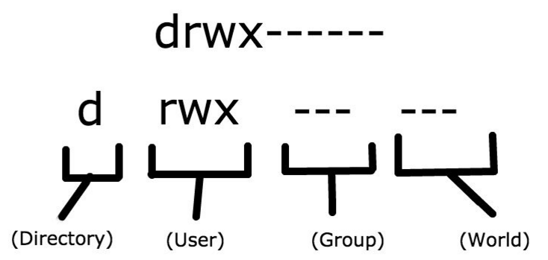
chmod
Unix system call to change file permissions
Use ls –l to see what permissions a file has
Notes:
4 is read
2 is write
1 is execute

Slide 4
chmod
We use chmod to change the permissions the file has
chmod --- <filename> (where each dash is a number from 0 to 7)
r : 4 : readable
w : 2 : writeable
x : 1 : executable
So that means rwx = r + w + x = 7
The three dashes represent the numeric value of the permission assigned to
The user
The group
The world
Notes:
4 is read
2 is write
1 is execute
Each of there number here (repped by dashes) is related to a different set of users the

Slide 5
chmod
chmod <who>+<permissions>
+ adds permissions
- takes away permissions
Permissions
rwx, ---, etc
Who
u : user or owner
g : group
o : others
a : all
Or…
chmod ---
Where each dash is a number between 0 and 7
Eg, 444, 711
Used for giving potentially different permissions to all three groups at the same time
Notes:
4 is read
2 is write
1 is execute

Slide 6
Your turn!
Recall that rwx --- --- can also be represented as 700
What permissions would the following line grant:
chmod 444 <filename>
What’s another way we could write this?
Universally readable
chmod a+r <filename>
Notes:
4 is read
2 is write
1 is execute

Slide 7
Your turn! Translate
Translate the following into the chmod syntax
chmod 555
chmod a+rx
chmod u+x
chmod 100
chmod 640
chmod u+rw
chmod g+r
Notes:
4 is read
2 is write
1 is execute
So, 5 is the sum of 4 and 1, thus it’s read and execute, and it’s applied to all
Chmod u+x is applied just to the user, so it’s 100
Chmod 640 is a little tricky – you need two chmod expressions to handle it.
First, we need to change the user, then the group

Slide 8
chmod – common cases
chmod 711 <directory>
For any directory
chmod 644 <file>.txt
For any non Python file
chmod 600 <file>.php
For Python files
These are going to be particularly in a couple weeks when we make our own websites
Notes:
711:
rwx --x –x
644
rw- r-- r—
600
rw- --- ---

Slide 9
TCP/IP
Transmission Control Protocol / Internet Protocol
Means of ensuring data delivery
Gives set of standards that govern how data should be routed and received
Increases odds of a data actually getting where you want it to go\
Recall David’s example from lecture
Notes:
Remember David:
One ip address for you, one address for me
with tcp,
It cuts up the data into packets and says “1/4” “2/4”…
So this way, the computer can tell that it doesn’t have all the data
And lets you know you’re missing a piece of data (and which piece)

Slide 10
Ports
Need to tell our destination what type of data is in our packets
Remember, computers aren’t dedicated video players – they can do lots of stuff
Packets might be routed in various ways/paths
Ports are a way to figure out what type of data is being transmitted
Common ports:
21 : FTP (File Transfer Protocol)
25 : SMTP (email)
53 : DNS (Domain Name System)
What is the IP address of a domain name?
80 : HTTP (webpage)
443: HTTPS (secure webpage)
Notes:
Since there are different rules governing different ports, we can deal with different types of data differently based on where they come in
Each port has a different set of rules
These are ports that were decided upon long ago when the internet was young and even sketchier

Slide 11
HTTP
HyperText Transfer Protocol
Port 80 (from the previous slide)
Let’s dissect this a bit..
HyperText
“Text taken to the next level”
It’s text that gives us more information
Transfer Protocol
How we request information and how the server responds
Governed by specific set of rules\
This way the internet will work no matter where you’re using it from
Notes:
Another set of transfer protocols
Transfer protocol
How we request information from a server and how the server responds to us is governed by this
Request and response have to follow specific set of rules
EX: Handshakes

Slide 12
HTTP – example request
GET / HTTP/1.1
User-Agent: curl/7.24.0
Host: www.apple.com
<name>: <value>
Key
Method Request URI
Protocol Version
Field name
Field value
Notes:
slash: go to root directory

Slide 13
HTTP – example response
HTTP/1.1 200 OK
Server: Apache
Content-Type: text/html; charset=UTF-8
Server: Apache
Content-Length: 16286
Connection: keep-alive
Key
Protocol Version
Status Code
Field name
Field Value
Notes:
Yes everything wen well
Here, you’re going to get some html

Slide 14
HTTP – Status codes
200 – OK
301 – Moved Permanently
302 - Found
404 – Not Found
403 – Forbidden
418 – I’m a Teapot

Slide 15
HTML & CSS
HTML: HyperText Markup Language
You get to practice and experiment :}
Check out http://www.w3schools.com/ for useful tutorials!
Best practices
Close all tags!
Note: real websites often don’t, so if you’re looking at a page’s source for inspiration, be sure not to copy bad habits!
Validate your page withy W3 Validator
https://validator.w3.org/
Separate markup (HTML) and style (CSS)
MCV (Model View Controller) paradigm to come!
Notes:
Best way to learn – learn the syntax, and you’re got it
W3 schools – good way to learn this stuff: it has a split screen so you can code and then see what your changes do to the website.
You’ll get a much more intuitive grasp of html if you spend some time experimenting
Got to a webpage you really like and look through their html – just cite your sources on this. also note: webpages will load without closing tags…but it introduces dangerous variability
Although not strictly necessary, it’s best to separate markup and style. This is similar to how in C we #define certain values we’re going to use frequently. We do this since if we ever need to change said value, it’s easier to change it once, as by altering its defined value, than by going through the entire code and changing its every instance. By separatingHTML (markup) from CSS (style), we get this same kind of versatility.

Slide 16
HTML & CSS
CSS: Cascading Style Sheets
Instead of tags, CSS uses attributes
Selectors will be used to match tags with attributes
Map to tags
Selectors can be
Id: unique
#<idname> in CSS file
Class: can refer to multiple blocks
.<classname> In CSS file
Notes:
In recent years, there has been a push to seperate the functionality of a page from its style. This is, in a sense, the whole concept behind MVC, which we’ll get into more with C$50 Finance. Similarly, while HTML is used to markup a document, much of its stylistic implementation is left up to CSS.

Slide 17
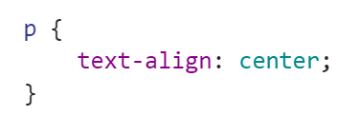
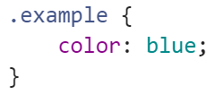
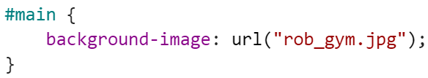
HTML & CSS: selection code
reference a tag directly, such as <p>
reference the class, such as <p class=“example”>
reference its id, such as <p id=“main”>
Notes:
id and class are nearly identical, the only difference being you can have multiple blocks of code with the same class selector but you can only ever have one id selector.

Slide 18
HTML & CSS: Resources
HTML Cheat Sheet
http://lesliefranke.com/files/reference/htmlcheatsheet.html
CSS Cheat Sheet
http://www.lesliefranke.com/files/reference/csscheatsheet.html
W3schools (for HTML and CSS tutorials
http://www.w3schools.com/
W3validator (run this like you would check50 and style50!)
https://validator.w3.org/
Looking at the source code of pretty webpages, as with Google Chrome’s “Inspect Element” tool (just right click on the interesting part of the webpage)

Slide 19
Together…
Let’s code up a webpage! Grab your computers and get ready to Google – syntax is the name of the game.
Check out the attached files for our class website!
Notes:
How to open and close
How to make a header
How to make a title
what is a title? What does it do on the webpage
The body
Headers (h1, h2, h6)
Paragraphs
Images: img src=“lsklskjflsdk”
Paragraph alignment
lists

