Slide 1
CS50 Section 5 Somewhere in Between
Annaleah Ernst, TF

Slide 2
Agenda
Quick recap
Resources
Bitwise Operators
Structs
Linked Lists
Hash Tables
Trees
Tries
Time allowing:
Stacks
Queues
Data Compression
Huffman Coding

Slide 3
Resources
Static resources
CS50 Study - study.cs50.net
CS50 Manual - manual.cs50.net
Reference50 - reference.cs50.net
Style Guide - manual.cs50.net/style/
style50
Walkthroughs && Shorts
man
debug50
valgrind –leak-check=full
Dynamic Resources
CS50 Discuss - cs50.harvard.edu/discuss
Harvard Slack - harvard.slack.com/signup
Office hours
Classmates
Me!

Slide 4
Bitwise operators
Allow us to manipulate individual bits
& AND
gives 1 if both arguments are 1
| OR
gives 1 if at least one argument is 1
~ NOT
flips the given bit
^ XOR
gives 1 if exactly 1 argument is 1
<< left shift
>> right shift
shifts a bit the given number of places in the given direction

Slide 5
You turn! Bitwise
0 & 1
0 & 1 = 0
1 & 1
1 & 1 = 1
0 | 1
0 |1 = 1
1 | 1
1 | 1 = 1
1010 & 0101
0000
0 ^ 1
0 ^ 1 = 1
1 ^ 1
1 ^ 1 = 0
~0
~0 = 1
~1
~1 = 0
1010 | 0101
1111

Slide 6
Pointers
Just variables containing addresses!
They point to other values
To go to what they point to, use the * operator
dereferencing
To get the address of a variable, use the & operator
referencing

Slide 7
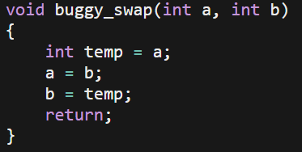
Your turn! – buggy_swap.c
I’ve implemented a swap function…but it doesn’t seem to be working!
When I call this function, my variable up in main remain unswapped!
How can I change this function so that it actually swaps my variables?

Slide 8
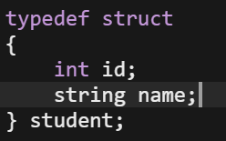
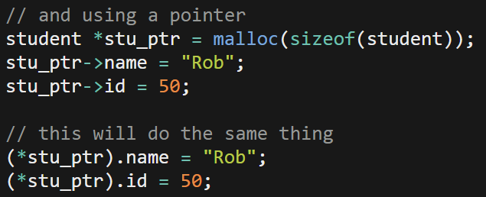
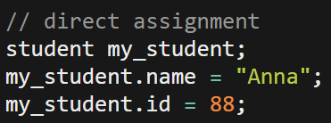
Structs
Create our own special data type
Declare using the struct name as the variable type
Access using the . operator if we have it directly, or the arrow operator if we have a pointer to a struct

Slide 9
Linked Lists
Uses a recursive datatype
A struct that points to another version of itself
Characteristics:
The head – a pointer to the first element in the list
Each element contains a value and a pointer to next element
The last element points to NULL
head
2
6
7
*boxes not drawn to scale!

Slide 10
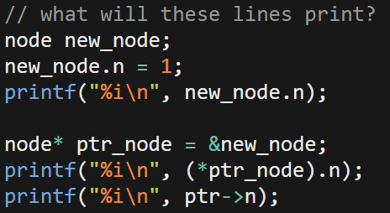
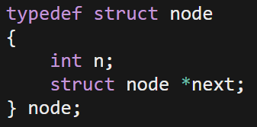
Linked List - Nodes
Made of special structs that contain pointers to the next element
Traditionally, we call these structs “nodes”
Here’s an example of an int linked list, but note that linked lists can be of any data type (how?)

Slide 11
Linked List - Insert
When inserting, order matters!
Eg, the order in which we change what pointers are pointing to
Very easy to accidentally orphan the list
How do we insert?
head
2
6
7
5
*boxes not drawn to scale!
Notes:
If we care about it being sorted, what’s the big O run time?
What if we don’t?

Slide 12
Linked List – Insert (sorted)
head
2
6
7
5
head
2
6
7
5

Slide 13
Linked List - Search
Go through the list node by node and compare to value you’re looking for
What would the difference between sorted and unsorted be?
How can you tell you’ve gotten to the end?
Next points to NULL
head
2
6
7
Value to check
Update this value every step through the list

Slide 14
Linked List - delete
Let’s say we want to delete 6…
head
2
6
7
Item to delete
head
2
6
7
Item to delete
head
2
7
Notes:
We want to make sure we point our last pointer to whatever the item we’re deleting was pointing at before. So we don’t orphan the rest of the list
We sometimes just delete 6, or return it depending on the program. Note that if you used malloc to create nodes, you will need to use free to delete them!

Slide 15
You turn! linked.c
Write a function that…
Prints out the contents of an integer linked list, from head to end

Slide 16
You turn! linked.c
Write a function that inserts a value into a sorted linked list
Keep it sorted from largest to smallest
Don’t insert duplicates
Let the user know if the insert was successful
Assume a global variable called node* head to keep track of the head of the list

Slide 17
linked.c - psuedocode
Create a new node (malloc space, put number in node)
Create prev node pointer and current node pointer
Go through list
If value < this node value
Insert before and return true
If value > this node value
Update pointers
Go to the next node
If value == node
Free and then return false

Slide 18
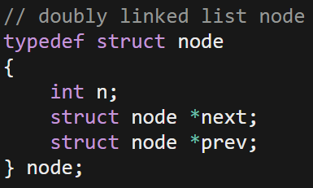
Doubly linked lists
So far, we’ve only been talking about singly linked lists
Next only points in one direction
We can also make doubly linked lists
Keep track of forward and previous
Operations on doubly linked list similar to on singly linked lists, but now there are two pointers to update!

Slide 19
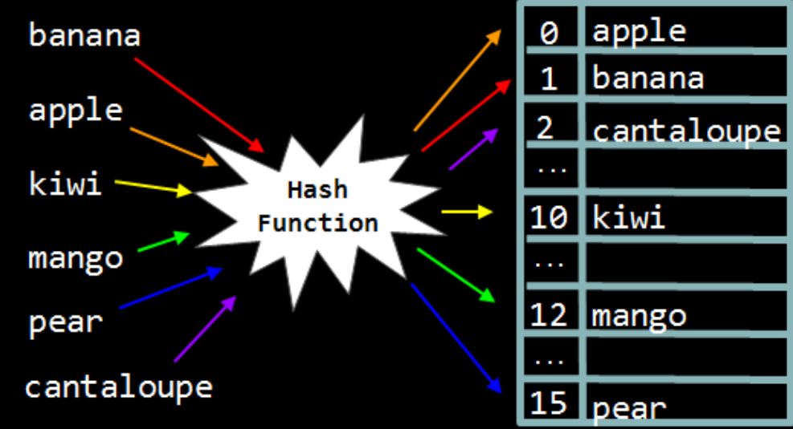
Hash Table
data structure where the position of each element is decided by a hash function
A function that converts the input data into an integer
What makes a good hash function?

Slide 20
Hash Tables
At it’s core, just an array and a function
Function hashes input and assigns them an index
Placed into table based on input
YOU DO NOT HAVE TO WRITE YOUR OWN HASH FUNCTION
It’s easy to write a hash function…very very difficult to write a good one
Low collisions, unique keys
Find one online and treat it as a black box – just cite where it’s coming from
I’ll send out some options
Ideally, a hash table will have very low collisions

Slide 21
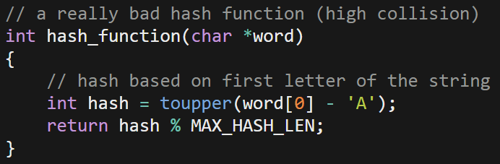
Hash Tables – the Hash function
I repeat, YOU DO NOT HAVE TO WRITE YOUR OWN, just cite where you got it
Any function that accepts a char* and returns an int can be used as a hash function
Ex, hashing on the first letter of a word

Slide 22
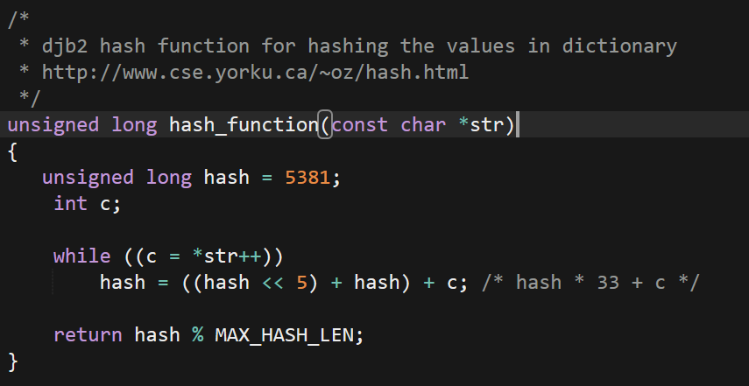
Hash Tables – the Hash function
In this case, you don’t have to understand it to use it
Here’s an example of a professional hash function with high efficiency:
Feel free to use any hash functions at http://www.cse.yorku.ca/~oz/hash.html as long as you cite your sources!

Slide 23
Hash Tables – Resolving Collisions
In an ideal world, there would be no collisions
In this case, we’d get constant lookup time
A couple options:
Chain items
Probe for open index
For chaining:
each bucket of the array is actually another data structure
Eg, a linked list
Ideally, we still want a function with low collisions so that we can take advantage of the speed of a hash table

Slide 24
Hash Tables – lists as Buckets
To resolve collisions, we can just make an array of linked lists
Now we have an array of node pointers
When we have a new key to insert
Create a node* and store the key within
We hash it (call the hash function on it)
Go to that index of the array
If it’s empty, just put in the node
If it’s full insert it into the linked list
Where should we insert it into the list?

Slide 25
Big O – Hash Tables and Linked lists
What’s the big O run time of insertion/deletion in a hash table?
O(n) (Note: the runtime is more like n/k, where k is the number of buckets in the hash table. While asymptotically this is the same, in the real world, it runs better)
In a perfect world, both these operations would be O(1)!
What’s the big O of inserting into an unsorted linked list?
O(1)
What’s the big O of finding a value in a linked list?
O(n)

Slide 26
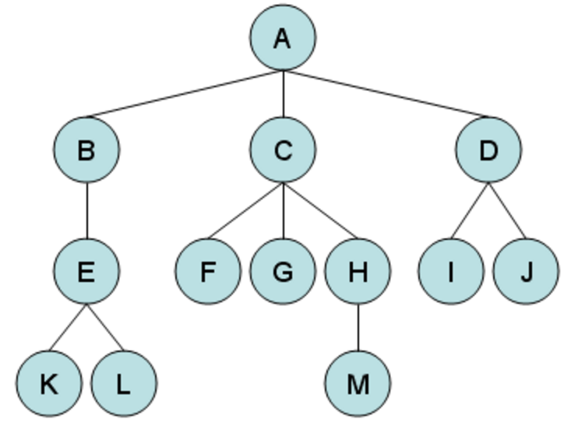
Tree
Trees are hierarchically arranged data structures
Nodes have parents and children
Nodes in trees can have any number of children
Top of the tree is called the root
Bottom of the tree (pointing to nothing) are leaves
https://www.cpp.edu/~ftang/courses/CS241/notes/images/trees/tree1.bmp
Notes:
Draw out some binary trees

Slide 27
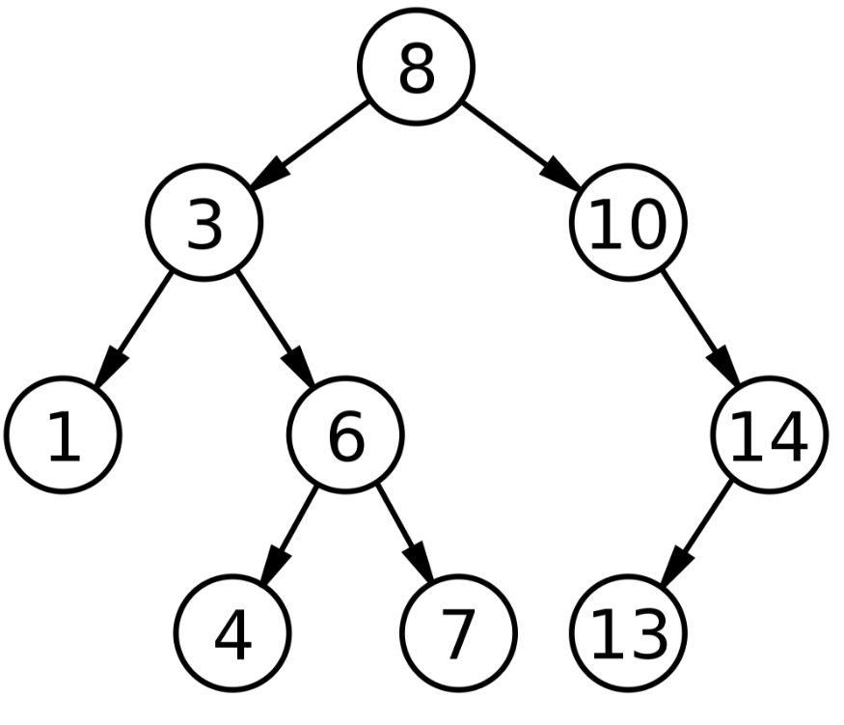
Binary Tree
Ideally we want balanced trees – trees that have the same number of levels to the leaves.
Nodes in binary trees have at most two children
Here we have a binary search tree. How long would it take to find the value 22?
https://upload.wikimedia.org/wikipedia/commons/thumb/d/da/Binary_search_tree.svg/2000px-Binary_search_tree.svg.png
Notes:
Organized such that every parent node can have, at most, 2 child nodes whose positions follow a set pattern, binary search trees greatly simplify data lookup. Here, for example, each left child node is smaller than its parent, while each right node is greater than its parent:

Slide 28
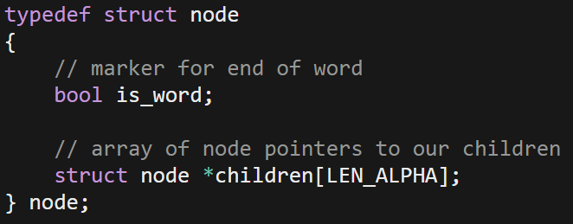
Tries
All tries are trees, but not all trees are tries!
Capitalizes on near constant look up time of arrays – very fast
Trade-off –HUGE amount of space needed
Instead of simply creating a pointer to a new node, it creates and array of pointers:
Notes:
A Trie is a special kind of tree used primarily to store strings. When creating nodes, instead of simply creating a pointer to a new node, it’s necessary to instead create an array full of node pointers, like this:

Slide 29
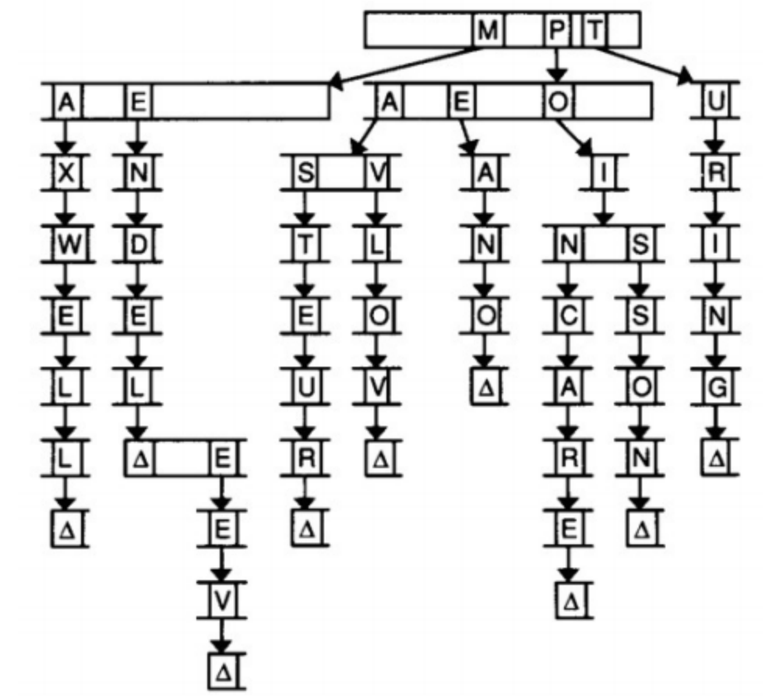
Tries
pro: provide constant time lookup (in theory)
con: use large amounts of memory!
Notes:
A trie is another type of tree structure. The word “trie” comes from the word “retrieval,” but is usually pronounced like “try.” For our purposes, the nodes in a trie are arrays. We might use a trie to store a dictionary of words, as this diagram suggests.
In this trie, each index in the array stands for a letter of the alphabet. Each of those indices also points to another array of letters. In the above, we’re storing the names of famous scientists, e.g. Mendel, Mendeleev, Pavlov, Pasteur, and Turing. The Δ symbol denotes the end of a name. We have to keep track of where words end so that if one word actually contains another word (e.g. Mendeleev and Mendel), we know that both words exist. In code, the Δ symbol could be a Boolean flag in each node.
Let’s take a look at another set of slides for a clearer picture.

Slide 30
Stacks
first-in, last-out (FILO)
elements are successively pushed down as other items are added
elements are pushed on and popped off
keep track of both the size and capacity
you need not keep track of capacity if you use a linked list rather than an array

Slide 31
Queues
first-in, first-out (FIFO)
picture a line!
elements are enqueued and dequeued
keep track of the size, capacity, and head
you need not keep track of capacity if you use a linked list rather than an array

Slide 32
Huffman Coding
Data compression
Typically used for text files
Chars take 8 bits
but if we know the frequency with which letters appear, perhaps we can do better
We can represent the most frequently used chars as less bits!
Let’s do an example…

Slide 33
Huffman Coding
Letter | A | B | C | D | E
Frequency | 0.1 | 0.1 | 0.35 | 0.15 | 0.3
0
0
0
1
1
1
0
1
A
B
D
E
C
Letter | A | B | C | D | E
Encoding | 0000 | 0001 | 1 | 001 | 01

Slide 34
Huffman Coding
All Huffman coded files must adhere to the prefix property
No Huffman code for any character may be the prefix of another character’s code
eg, we can’t have both A = 1 and C = 10 since decoding will be ambiguous!
In order to decompress, we need a frequency table as part of the file
This lets us figure out which codes go to which letters
Cons of encoding
If our text file contains lot’s of diverse characters, Huffman coding might not actually shrink the file size
We have to decode every time we want to use the file

