Slide 1
CS50 Section 10 Somewhere in Between
Annaleah Ernst, TF

Slide 2
Agenda
Javascript
(and HTML)
jQuery
The DOM

Slide 3
Javascript
Dynamic programming language used by web browsers on the client side
As opposed to Python which is on the server side
Allows users to communicate asynchronously with browser
Has characteristics of…
Functional programming
Object-oriented programming
Imperative programming
Seemingly multiparidigm
Like Python, it’s an interpreted language
Like Python, it’s loosely typed (variables signified with var tag)
Ability to use the Document Object Model (DOM) makes it popular
Notes:
Javascript is a dynamic programming language used by web browsers on the client side that allows users to communicate asynchonously with the browser.
What you should focus on is that, while PHP is a server side programming language, JS is client side, meaning it is faster since there is no need to interact with another device.
It’s hard to classify Javascript: it has characteristics offunctional programming, object-oriented programming,imperative programming, etc — it is seemingly multi-paradigm. There are a few basic labels that can be attached to it, though.
Javascript is, like PHP, an interpreted language, meaning there is no need to compile it.
It is dynamically typed with variables signified with the var tag, instead of the $ tag, as in PHP.
And it’s ability to use the DOM (document object model) to dynamically change HTML is one reason why it is so widely used throughout the world wide web.

Slide 4
Javascript
Client-side scripting language
Not compiled or executed on the server (as opposed to php)
Load a Javascript page and it executes on you machine
This is what we mean by client side
Syntax is similar to C, Python
Error check via console
console.log(“stuff”)
Notes:
Loosely typed so we don’t really control the types
Console.log is basically how we error check things

Slide 5
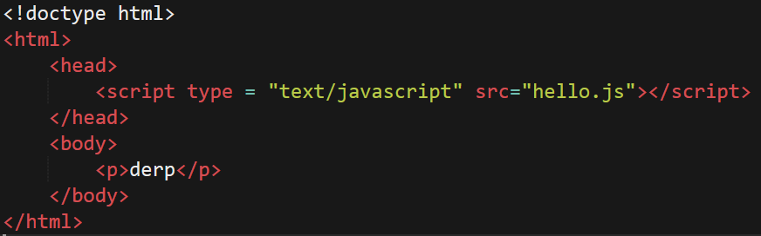

Javascript – A quick example…
index.html
hello.js
Notes:
Normal index.html
Included outside script: hello.js
When we load this page, it automatically generates this box…
All we had to do was alert and then the box happens
Can manipulate page without reloading every time
Looking for events

Slide 6
Javascript - Variable Declarations
Loosely typed (don’t need put type of variable)
var <variable_name> = <value>;
If you leave off the var, you get a globally scoped variable
So if you want something to be in scope, use var, else its global
Easy to change type
Be careful with different types
Take a look at examples.js for some examples of fun with types
Notes:
Type happens at run time, so thing can be for one type at the beginning and a different type at the end
We can just reassign stuff. Just do whatever we want
Like php
go look at examples.js

Slide 7
Javascript - Loops
For loop (the same as C)
for (<initialize> ; <condition> ; <update>)
// do code
While loop (also the same as C)
while (<condition>)
// do code
Do While (also the same as C)
do
// code
while (<condition>);
Concrete examples in the examples.js file

Slide 8
Javascript - Functions
Two ways to do functions:
Option 1: c-like function
function <function_name>(<arguments>)
return <value>;
Option 2: anonymous function
var <variable name> = function(<arguments>)
return <value>;
More examples in the examples.js file!
Notes:
Function – says it’s a function – name of function, inputs
Notice return type is handled automatically
Here, function + inputs;
This is an an anonymous function
Something that shoule be new
Don’t need a name
Here are its inputs, here is what it should do

Slide 9
Javascript - Arrays
Similar to Python list
Don’t care about different types
Zero indexed
Dynamically sized
Get length with .length
var <array_name> = [<value>,<value>,…];
Examples in…you guessed it! examples.js
Notes:
Remember all those segfault strugs you had? Not really a problem in JS!

Slide 10
Javascript - Objects
Similar to structs in C (and dictionaries in Python)
var <object_name> = {};
Two ways to store things in the object:
<object_name>[“<property>”] = <value>;
<object_name>.<property>= <value>;
Two ways to retrieve things:
<object_name>[“<property>”];
<object_name>.<property>;
Actual examples in examples.js!
Notes:
Give me attribute of object, etc
Exactly the same, but just syntax differences.

Slide 11
Javascript – Object, cont
Can also just create and fill an object!
var <object_name> {
“<key>” : value,
“<key>” : value,
…
};
Examples in the same place as allll the other examples about syntax
Notes:
Objects can store different types
Can have object of objects,
Etc…

Slide 12
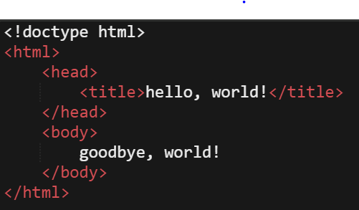
DOM – the document object model
document
html
head
body
title
goodbye
hello
Notes:
The DOM, or document object model, is a hierarchical way of laying out information. If, for example, we have a webpage in HTML like this:
We’d get this
Note, that the dom is pretty trivially easy if you use good indentation

Slide 13
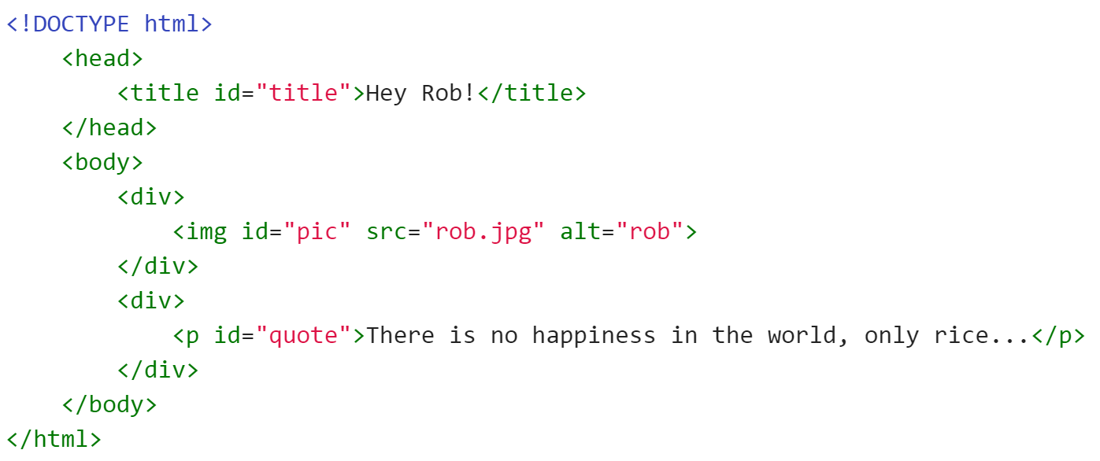
Your turn!
Draw the DOM for the following chunk of code:

Slide 14
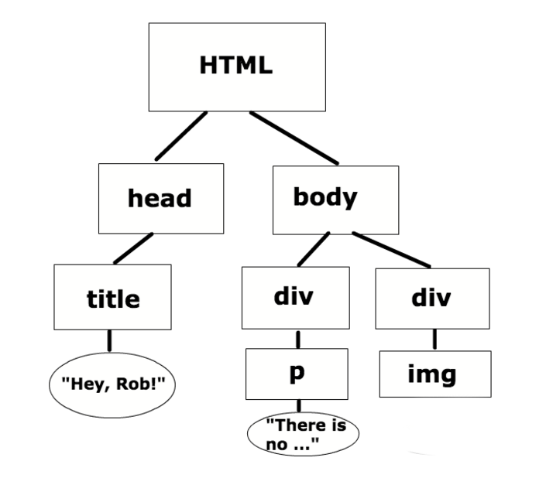
Solution:

Slide 15
Why is JS great with the DOM?
Well, we can change the contents of the dom without reloading the webpage!
Instead of using an outside form like apologize (last week), we can do dynamic alerts

Slide 16
DOM in JS
document is a reserved word in JS
allows us to access the html calling the script
Examples:
document.title
document.body
document.body.innerHTML
Useful functions:
document.getElementById(“<ID>”)
document.getElementByClassName(“<class>”)
document.getElementByTagName(“<tag>”)
Notes:
Document.title // title of
Document.body // what’s in the body tags
Document.body.innerHTML // manipulate stuff within tags
These are really useful but a couple of very very many – there are lots of things!
Go online and look up stuff
Research on your own

Slide 17
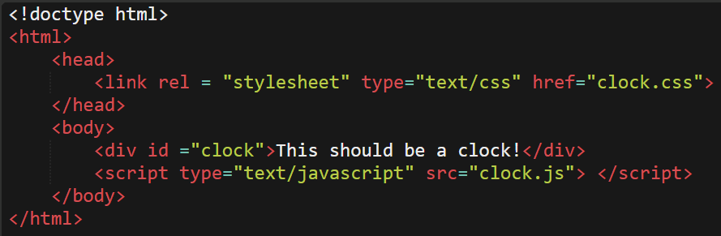
Your turn! clock.js
I’ve made an html webpage, but I can’t seem to figure out how to make it update! Maybe I should use JavaScript…
Help me implement the functionality of my clock in “clock.js”

Slide 18
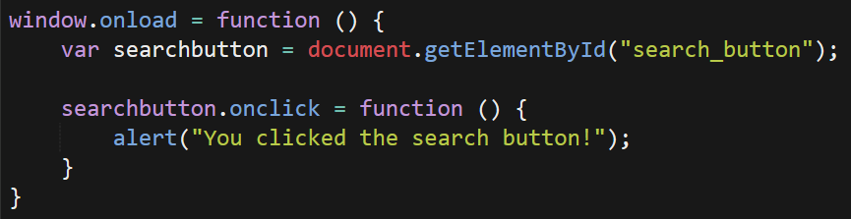
JavaScript Events
Largely built in to JS
User does something, JS responds
Example: respond to load and click

Slide 19
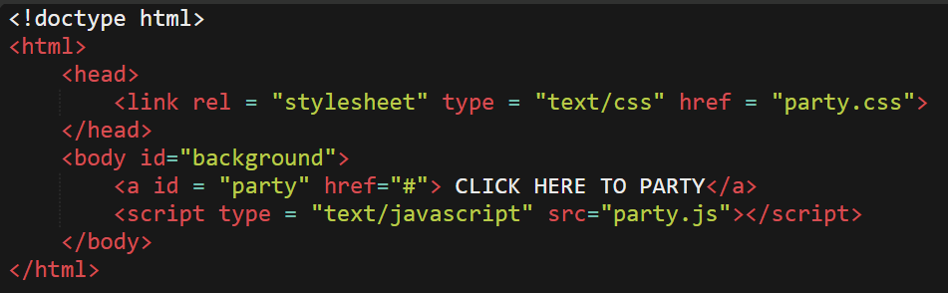
Your turn! party.js
I want to throw a party on my site, but my webpage is boring!
Help me spice things up by changing the background to a random color
Useful functions: Math.random, Math.floor, element.style

Slide 20
JQuery
Library built on top of JS
in your index.html file
<script src = “url_to_js/jquery.js”></script>
<script src = “js/scripts.js”></script>
Really big, so best to link in source from Google
in index.js file
$(document).ready(function() {
// all your code (when using jquery)
});
Note that the $ is essentially shorthand for Jquery
Instinct: “Has someone already implemented this for me in Jquery?”
Notes:
Two things:
Whatever file that’s using it:
Source that has the url to jquery
Don’t want to host it on own computer
Whatever js file you’re using
the .ready function is so that we can not worry about our javascript taking off before the page is loaded!
$ has something to do with jquery
$ (// what goes in here?) – it’s the selectors! Might be document, might be #id or .class
data-somevar = user created thingy

