Slide 1
CS50 Section 2 Somewhere in Between
Annaleah Ernst, TF

Slide 2
The Agenda…
Housekeeping
..and then down to business
Introductions!
About section
Grading
Resources
Office Hours
Quick recap of super-section
Debugging
Arrays
Functions
Command line arguments
Pset 2 – ASCII and modulo (%)

Slide 3
Introductions!
Me! (Your TF)
Annaleah Ernst (feel free to call me by my first name)
Email: annaleahernst@college.harvard.edu
Phone: <redacted>
And now you guys…
Name, Hometown, and…
If you could be any mythical creature what would you be?

Slide 4
About section
Hands on experience
Time for questions/clarifications on lecture material
Meet me halfway! Prepare by…
Watching the lectures
Read the pset spec & think about the problems
Pencil/paper practice recommended

Slide 5
Grading
Submit everything (and try everything!)
9 psets, 2 quizzes, and final project
grade = scope * (3 * correctness + 2 * design + 1 * style)
Grading Breakdown:
Problem sets: 50%, Quizzes: 40%, Final project: 10%
ULTIMATELY, COMMENTS ARE WHAT MATTER
“…what ultimately matters in this course is not so much where you end up relative to your classmates but where you, in Week 12, end up relative to yourself in Week 0.” – the syllabus
NOT curved, NO predetermined cut offs for final grades, sections normalized
Notes:
I tend to grade a little on the harsher side, but it’s because it will help you learn more.
scope – shoot for 5’s
correctness – shoot for 4-5’s
design – expect 3-4
style – shoot for 5

Slide 6
Resources
Static resources (ie, on your own)
CS50 Study - study.cs50.net
CS50 Manual - manual.cs50.net
Reference50 - reference.cs50.net
Style Guide - manual.cs50.net/style/
Walkthroughs && Shorts
help50, check50, style50, debug50
Dynamic Resources (ie, involving interaction with others)
CS50 Discuss - cs50.harvard.edu/discuss
Office hours
Classmates
Me!

Slide 7
Office Hours
Wednesday: 9 – 11, Widener
Thursday: 9 – 11, Widener or Northwest
Sunday: 3 – 5, SOCH or Northwest
7 days a week at HSA (check the calendar)

Slide 8

Let’s get coding!

Slide 9
Review
Linux Commands
Common: pwd, cd, ls, mkdir, rm, cp, mv
Less common: >, <, |, grep
Data types
int, float, double, long long, short, char, string (char*), bool, pointer
Math and Logic
Operators: +, -, *, /, %
Operator Precedence: PEMDAS
Floating point vs Integer math
Boolean expressions: ==, !=, &&, ||

Slide 10
Review (cont)
Conditionals
Switch statements
Ternary operator
condition ? (if true do this) : (else if false do this);
Loops
while, for, do-while
Functions
<return_type> <function_name>(<function_parameters>)
Eg, int main(void)
Include prototypes for functions you write above main!

Slide 11
Magic Numbers
Magic numbers are unexplained numbers in your code
Is there a magic number here?
No – starting a counter at 0 makes intuitive sense
What about here?
Yes – what does this 5 signify? I have no idea.
Two solutions:
Use variables if the value will change
Use #define <NAME> <value> for constants
This goes at the top of the file right after you #includes, eg
#define LEN_ALPHA 26

Slide 12
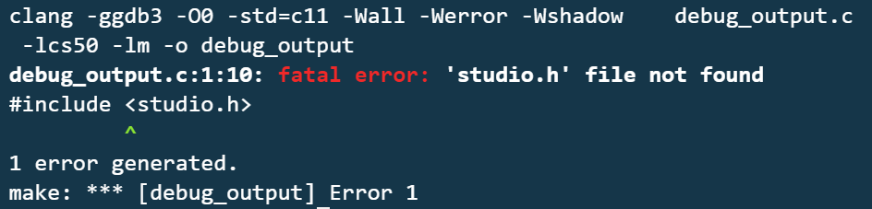
Debugging: help50
step 0: help50
convert cryptic output into something more user friendly
great for compiler errors
EX: make debug_output
help50 make debug_output adds
Notes:
so we have a program with a compiler error
What’s the problem? Where is it?

Slide 13

Debugging: eprintf
eprintf
included in the cs50 library (#include "cs50.h")
print information while debugging
we do this while we’re trying to figure out what’s wrong with a problem set
provides automatic context – which file, which line of code
calls to eprintf should be removed before pset submission
EX: Greedy
check50 is returning all green…except for this case
Now what? Let’s walk through it in the ide
Notes:
eprintf is basically printf with context. It tells the student exactly what line of code in their program triggered the eprintf call as well. And it flushes stdout right away, so no more phantom printf calls that never execute or execute later than they should to be useful!
can I use help50? No. Why not? (no error message to parse) There’s just something wrong with (the correctness of) my code

Slide 14
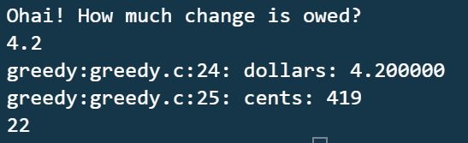
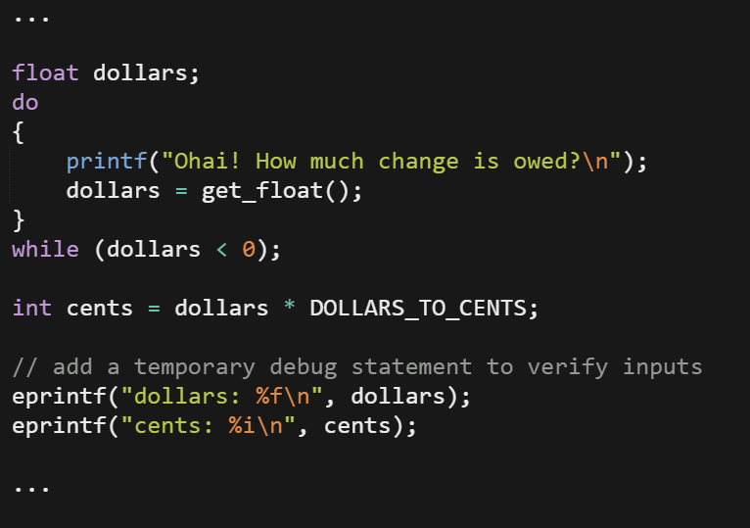
Debugging: eprintf, cont
Let’s use eprintf verify that we’re getting the inputs we expect
What does this output?
cents is 419 when it should be 420! we must be dealing with floating point errors

Slide 15
Debugging: debug50
debug50
run program line by line to pinpoint bugs
set breakpoints in you .c file
lines of code you want to stop on to look at variables, test values, etc
run debug50 with debug50 ./my_program
step into
brings you out of main an into a function
step over
treats the function as a black box and moves to the next line
mouse-over variables to see their values
EX: buggy.c
Notes:
step into
this will being you down into function declarations – careful, or you might end up looking at the code that makes printf!
step over
this will pass over functions so you can focus on your own code. however, if you want to explore a function you’ve written, be sure to step into
display variables
mouseover to see them

Slide 16

Debugging: Duck Debugging
Explain your code to a rubber duck
No, but actually
Often, talking through your code helps you find bugs

Slide 17
Arrays
Data structure
Stores data in one place in memory
Can store pieces of data of the same type
Declaration
<datatype> <name>[<size>]
Eg, char alpha[26]
Question: How could I declare an int array?
Initialization
Notes:
Arrays are
A data structure for data of the same type
Contiguous memory locations
PO Box example
Contiguous space in memory (mail center)
Partioned into ideal sized chunks (mail boxes)
Each chunk can be accessed by index (mailbox number)
0 indexed

Slide 18
Arrays - Declaration
<datatype> <name>[<size>]
How would I declare an array…
called scores of three integers?
int scores[3];
called floaty of six floats?
float floaty[6];
called alpha of twenty six chars?
char alpha[26];

Slide 19
Array - initializing
int scores[3];
scores[0] = 6;
scores[1] = 5;
scores[2] = 4;
What happens if I try to put something at scores[3]?
Alternative method for initializing:
int scores[] = {6, 5, 4};
// OR
int scores[3] = {6, 5, 4};
Notes:
Draw an array on the board
Why did I start at 0?
What type of data does each box hold?
What’s actually in the scores array?
What happens if I try to go to scores[3]?
Error! I’m touching memory that’s not mine
Last index in any array = size – 1
Alternative methods: size based on # of entries

Slide 20
Arrays - iterating
// what’s wrong with this code?
int scores[3] = {6, 5, 4};
for (int i = 0; i <= 3; i++)
{
printf(“%i\n”,scores[i]);
}
How do we fix this?

Slide 21
Arrays - iterating
int scores[3] = {6, 5, 4};
for (int i = 0; i < 3; i++)
{
printf(“%i\n”,scores[i]);
}
Notes:
Remember: The last index in an array is it’s size – 1
Why is it does it make sense for us to use < 3 in this case?

Slide 22
Arrays – your turn! count.c
Write a program that …
Creates an array containing the integers 1 to 5
Iterates through the array and prints one number per line
Notes:
SKIP THIS FOR NOW

Slide 23
Strings
These are just special arrays characters!
Last box reserved for null
string s = “ohai”;
Is equivalent to…
Char s[] = {‘o’, ‘h’, ‘a’, ‘i’, ‘\0’};
Example: arrays.c

Slide 24
Your turn: spell.c
Write a program that…
Asks the user for a string
Prints out each char on a new line
Don’t forget to #include <string.h>

Slide 25
Functions
Black boxes
Take things in (parameters)
Do something (side effect)
Spit something out (return value)
Why use functions?
Organization
Simplification
Reusability
Remember to declare prototypes above main

Slide 26
Functions
<return type> <name>(<parameter list>)
{
<code>
}

Slide 27
Functions: main
int main(void)
{
printf(“ohai \n”);
return 0;
}
Notes:
So, what’s going on with this?
What’s happening behind the scenes with main?
It returns 0 for beginning
If you ever have something that doesn’t return void, you need a different return type

Slide 28
Functions: scope
Every variable has scope
Ie, Where the variable may be referenced
Eg, i in a for loop
“What happens in braces stays in braces.”
int a;
int main(void)
{
int a;
a = 5;
}

Slide 29
Your turn! – hello.c
Write a program in which…
main calls another function that prints out a greeting to the user

Slide 30
Function declaration
// protoype – this is what’s important
void hello(void);
int main(void)
{
hello();
}
void hello(void)
{
printf(“hello world!”);
}

Slide 31
Command-line arguments
One way to pass information into a program!
int main(void) becomes…
int main(int argc, string argv[])
argc – “argument count” (# of arguments)
argv[] – “argument vector” (arguments themselves)
Example:
./ohai cs50 section
argc is 3
argv[0] is “ohai”
argv[1] is “cs50”
argv[2] is “section
argv[0] is always the name of the program
careful! argv is ALWAYS an array of strings

Slide 32
Multidimensional Arrays
Arrays of arrays -> rows and columns
How does this relate to command line arguments?
Argv is an array of strings…what do we know about strings?
Really, argv = array of arrays
Back to previous example:
./ohai cs50 section
argv[1] is “cs50”
argv[1][2] is ‘5’
Notes:
Draw an example! (don’t forget to add the null terminator at the end of the strings
Don’t forget, everything that coms in via the command line is a STRING

Slide 33
Your turn
Modify hello.c such that that…
Takes a user’s name as command line args
two and only two names (first and last) may be given to the program
Print out a greeting using that user’s first name

Slide 34
Pset 2 - Crypto
Caesar cipher
Rotate values in a target word
eg, “Annaleah” rotated by 2 becomes “Cppcngj”
What happens if I rotate by 100?
The solution: use %
Vigenere cipher
Use a key to encrypt a word
eg, “Annaleah” encrypted by “hi” becomes “Hvuismhp”
What if the letters in the target word aren’t divisible by the key?
The solution is still to use mod

Slide 35
Pset 2 - considerations
Why might we need modulo?
What data type are the contents of argv[]?
How do we convert them to int?
atoi()
What do we know about how characters are represented?
ASCII - http://www.asciitable.com/
Eg, ‘A’ is 65, ‘a’ is 97

Slide 36
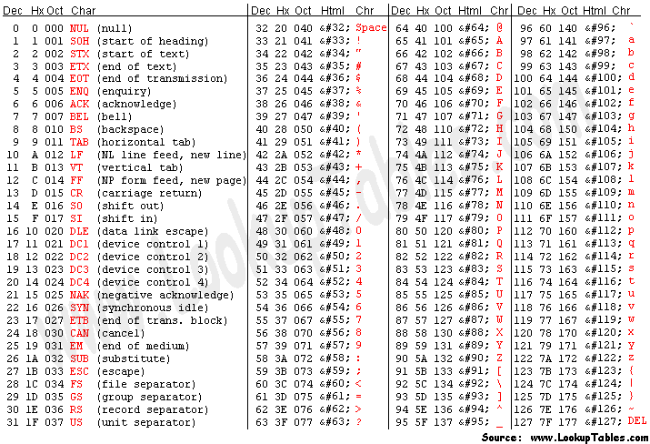
ASCII
characters can be represented as numbers

Slide 37
Last challenge – fruit.c
Get an integer from the user via command line arguments. You may assume that it will be positive and will not be greater than INT_MAX.
Get five pieces of fruit from the user and store them in an array.
Use the integer we got via the command line to index into the array (assuming looping) and tell the user what they selected.
How can we use mod to make sure that the index we select is always inside the list?
Eg, if I wanted the 6th index of an array with 5 members, I would get the element at index 0

Slide 38
#include <cs50.h>
#include <stdio.h>
#define MAX 5
int main(int argc, string argv[])
{
if (argc < 2)
{
return 1;
}
// get user input
int user_in = atoi(argv[1]);
// declare and array
string fruits[MAX];
// fill array with user input
for (int i = 0; i < MAX; i++)
{
printf("Enter a fruit: ");
fruits[i] = GetString();
}
// print the command line argument's index
printf("You input was %d.\n", user_in);
printf("Mod-ing by MAX (%d).\n", MAX);
// get the final index
int final_index = (user_in - 1) % MAX;
printf("The new index is %d.\n", final_index);
printf("Your fruit is %s\n", fruits[final_index]);
}

