Slide 1
CS50 Section 9 Somewhere in Between
Annaleah Ernst, TF

Slide 2
Agenda
Loose ends in Python
Decorators
Flask
SQL
Jinja
HTML
MVC
C$50 Finance!

Slide 3
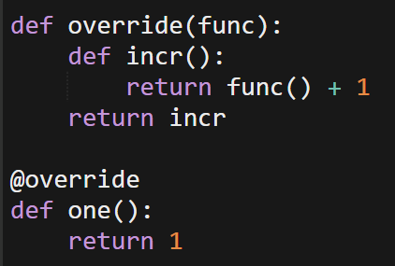


Python: Decorators
A decorator is a function that modifies behavior of other functions
adds additional functionality
You can use this to change the behavior of functions
EX:

Slide 4
Python: Decorators (cont)
In the course, we will be using the @app.route() decorator
Typically to specify the URL associated with a function and what method applies
May also use the @login-required decorator
Use this to ensure that certain functions are only available if the user logged in
eg, buy()

Slide 5
Flask
Python-based microframework
Automates the process of building simple web-apps
Applications typically written in file called application.py
Behavior of whole site springs from here
For C$50 Finance
Vast majority of your code inside of the application.py file
Use this to define routes and behavior
Notes:
If I save, and then visit /sample from my application’s index, I’ll see the new code without having to anything else. In Problem Set 7, students will be writing almost all of their Python code inside of application.py, defining the behavior of what should happen when they visit their sites various routes.

Slide 6


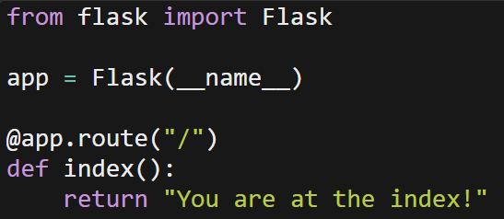
A simple Flask application.py…
To run, from within the directory containing application.py:
flask run
Click on in the top left of the IDE and select
Make sure you’ve run update50 recently!
If you make changes and save, no need to relaunch flask! (though you may want to reload your webpage)
Notes:
To run this application, you need only type flask run from within the directory containing the target application.py. Then click on CS50 IDE in the top left corner of IDE, followed by Web Server. (version 92+)

Slide 7
Jinja
Python inspired templating language
Allows us to interweave HTML markup and Python
Simple layout.html page
Some parts will be “fill-ins” using Jinja syntax
This is the template for your other pages
Other html files will fill in the blanks you left with Jinja
Like code based Mad-Libs!
https://realpython.com/blog/python/primer-on-jinja-templating/

Slide 8
Passing info with HTML
Two ways to pass info between Python and html
GET
Information passed via URL
Ex: youtube uses GET to pass information since you want to copy and share URL
POST
Passes data in the HTTP message body
Consider data to be “hidden” compared to GET requests
FYI, neither of these are considered secure
Notes:
Post is also NOT secure. If someone is intercepting data…
It’s like the difference between the address on an envelop (GET) and what’s written on the paper inside (POST). Sure, it’s easier to just read the envelope, but you can also just open it up and take a look.

Slide 9
SQL
Four basic commands:
UPDATE
Update data in database table
INSERT INTO
Insert certain values into a table
SELECT
Select values to view
DELETE
Delete from table
Go to http://www.w3schools.com/sql/ for more tutorials
Notes:
Update – assumes it’s already there: tell it what you’re updating and where you’re updating
Update <field> where USER ID == 3
INSERT INTO – trying to create some new entry
SELECT – get a certain value from the table
DELETE – remove value from table!

Slide 10
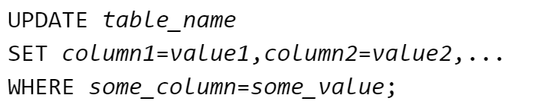
SQL – UPDATE syntax
To update existing records in the table:
Notice the WHERE clause; this is SUPER IMPORTANT
The WHERE clause specifies which record or records should be updated
Without the WHERE clause, all records will be updated!
This is usually not what you want
Notes:
Including the where clause is often really important;
If you don’t you’re likely to get unexpected behavior
UPDATE Customers SET ContactName='Alfred Schmidt', City='Hamburg' WHERE CustomerName='Alfreds Futterkiste';

Slide 11


SQL - INSERT INTO syntax
Two ways to insert into
Option 1: specify both the column names and the values to be inserted:
Option 2: don’t specify the column names where the data will be inserted, only their values:
Notes:
Insert only into specified columns:
INSERT INTO Customers (CustomerName, City, Country) VALUES ('Cardinal', 'Stavanger', 'Norway');
Insert new row into customers:
INSERT INTO Customers (CustomerName, ContactName, Address, City, PostalCode, Country) VALUES ('Cardinal','Tom B. Erichsen','Skagen 21','Stavanger','4006','Norway');

Slide 12
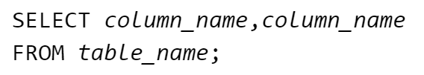

SQL – SELECT syntax
When selecting particular columns in a database:
When selecting all columns in a table:
Notes:
* Is select all
Select columns:
SELECT CustomerName,City FROM Customers;
Select whole database:
SELECT * FROM Customers;

Slide 13
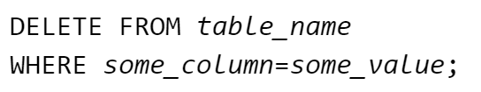
SQL – DELETE syntax
Delete rows in a table:
Notice the WHERE clause; this is SUPER IMPORTANT
It specifies which record/records should be deleted
Without it, like with UPDATE, all records will be deleted
Notes:
The WHERE clause specifies which record or records that should be deleted. If you omit the WHERE clause, all records will be deleted!
DELETE FROM Customers WHERE CustomerName='Alfreds Futterkiste' AND ContactName='Maria Anders';

Slide 14
Your turn! SQL stufffff
How would I insert a person who name was Al and hometown was Boston into a database called CoolCats that included columns titled Name, City, and Pet. Which do you think is going to be this database’s primary key?
INSERT INTO CoolCats (Name, City) VALUES (‘Al', ‘Boston');
How could I update Al’s row include that he has a pet dog?
UPDATE CoolCats SET Pet=‘dog', WHERE Name='Al';
Turns out Al isn’t really a cool cat. How do I delete him from my database?
DELETE FROM CoolCats WHERE Name='Al';
Notes:
If we want to do things with a specific person, we need the column we’re looking at to be either unique or the primary key of this data
Need at least one column in column to be the primary key
Multiple columns can be unique, one will be the primary key?
What’s the difference?
Unique – can’t be duplicated
Primary key – unique and used for identification
What are some examples of these two things?
Email address – unique
Primary key – id number
Why both?

Slide 15
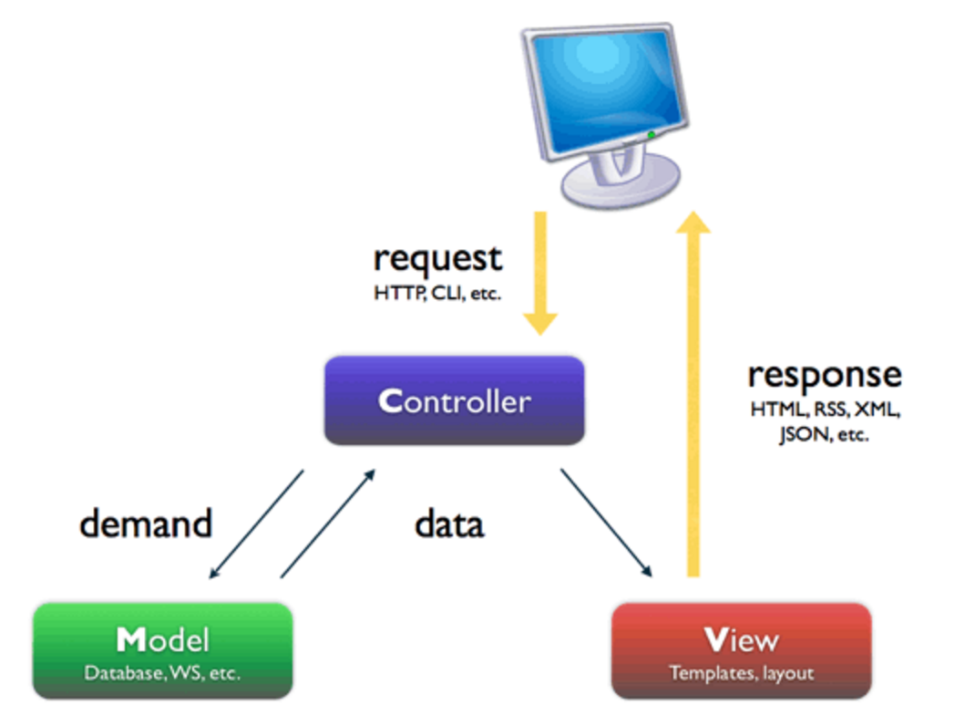
MVC
Model View Controller
design paradigm for creating software applications
Image credit:
http://symfony.com/legacy/doc/jobeet/1_2/en/04?orm=Propel
Notes:
MVC, which stands for Model—View—Controller, is a design paradigm for creating software applications. Put more simply, it's a way of organizing and thinking about code. In this presentation, we'll discuss MVC in the context of web applications, but do note that MVC can apply to software development in general.

Slide 16
MVC (in web design)
Component | Function | Example
Model | -persistent storage of information -managing and organizing data | -MySQL database -data files
View | -presentation of information to user -user interface | -HTML -CSS -Jinja
Controller | -handles user requests -gets information from the model | -Python
Notes:
Model is backend
View – what user sees
Frontend
View should NEVER be talking directly to the model
Controller – getting infor
Controller’s kind of the moderator between them
This is to help prevent the people from

Slide 17
HTML & CSS
HTML: HyperText Markup Language
You get to practice and experiment :}
Check out http://www.w3schools.com/ for useful tutorials!
Best practices
Close all tags!
Note: real websites often don’t, so if you’re looking at a page’s source for inspiration, be sure not to copy bad habits!
Validate your page with W3 Validator
https://validator.w3.org/
Separate markup (HTML) and style (CSS)
MCV (Model View Controller) paradigm to come!
Notes:
Best way to learn – learn the syntax, and you’re got it
W3 schools – good way to learn this stuff: it has a split screen so you can code and then see what your changes do to the website.
You’ll get a much more intuitive grasp of html if you spend some time experimenting
Got to a webpage you really like and look through their html – just cite your sources on this. also note: webpages will load without closing tags…but it introduces dangerous variability
Although not strictly necessary, it’s best to separate markup and style. This is similar to how in C we #define certain values we’re going to use frequently. We do this since if we ever need to change said value, it’s easier to change it once, as by altering its defined value, than by going through the entire code and changing its every instance. By separatingHTML (markup) from CSS (style), we get this same kind of versatility.

Slide 18
HTML & CSS
CSS: Cascading Style Sheets
Instead of tags, CSS uses attributes
Selectors will be used to match tags with attributes
Map to tags
Selectors can be
Id: unique
#<idname> in CSS file
Class: can refer to multiple blocks
.<classname> In CSS file
Notes:
In recent years, there has been a push to seperate the functionality of a page from its style. This is, in a sense, the whole concept behind MVC, which we’ll get into more with C$50 Finance. Similarly, while HTML is used to markup a document, much of its stylistic implementation is left up to CSS.

Slide 19
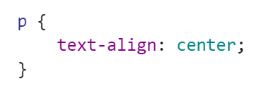
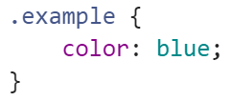
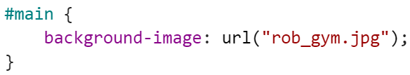
HTML & CSS: selection code
reference a tag directly, such as <p>
reference the class, such as <p class=“example”>
reference its id, such as <p id=“main”>
Notes:
id and class are nearly identical, the only difference being you can have multiple blocks of code with the same class selector but you can only ever have one id selector.

Slide 20
HTML & CSS: Resources
HTML Cheat Sheet
http://lesliefranke.com/files/reference/htmlcheatsheet.html
CSS Cheat Sheet
http://www.lesliefranke.com/files/reference/csscheatsheet.html
W3schools (for HTML and CSS tutorials
http://www.w3schools.com/
W3validator (run this like you would check50 and style50!)
https://validator.w3.org/
Looking at the source code of pretty webpages, as with Google Chrome’s “Inspect Element” tool (just right click on the interesting part of the webpage)

Slide 21
Together…
Let’s code up a webpage! Grab your computers and get ready to Google – syntax is the name of the game.
Check out the attached files for our class website!
Notes:
How to open and close
How to make a header
How to make a title
what is a title? What does it do on the webpage
The body
Headers (h1, h2, h6)
Paragraphs
Images: img src=“lsklskjflsdk”
Paragraph alignment
lists

