Slide 1
CS50 Section 3 Somewhere in Between
Annaleah Ernst, TF

Slide 2
The Agenda…
Quick recap of last week (and expectations)
Asymptotic Notation (O, Ω)
Searches
Binary Search
Sorts
Bubble Sort
Selection Sort
Insertion Sort
Merge Sort
Recursion

Slide 3
Recap & Rules
Last week…
Style and Design
Debugging
help50
eprintf
debug50
Duck Debugging
Arrays
Functions
Scope
Command Line Arguments
ASCII
Comments
Descriptive Variable names
No magic numbers!!!
#define <NAME> <value>

Slide 4
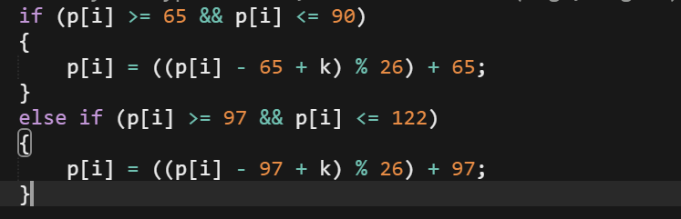
What’s going on here?
No comments
Undescriptive variable names
Magic numbers
Why do we care?
Harder to debug
Harder to understand
Harder to update

Slide 5
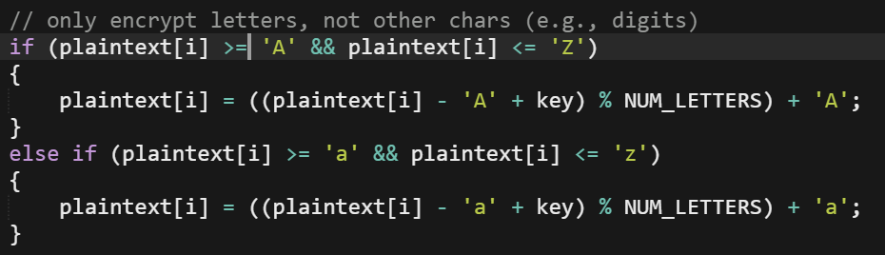
A better implementation:
Comment at top describing the code
Descriptive variable names
No magic numbers
It’s very clear what is going on here

Slide 6
When do we worry (what do we do)
Is there a magic number here?
No – starting a counter at 0 makes intuitive sense
What about here?
Yes – what does this 5 signify? I have no idea.
Two solutions:
Use variables if the value will change
Use #define <NAME> <value> for constants
This goes at the top of the file right after you #includes, eg
#define LEN_ALPHA 26

Slide 7
Asymptotic notation – “Big O”
Describes upper bound on program’s runtime
We usually use it to describe running time with worst case inputs
The method:
Suppress low order terms and constant factors
This is because the limit as n (ie, number of elements to work with) gets very large, the only term that means anything will be the largest order
Some examples to think about:
What’s the worst case run time for finding an element in a list of length n?
What’s the worst case for (naively) sorting a list?
What would their representative Big O be?
O(n), O(n(^2)
Notes:
This is just an upper bound – in CS50, we usually use it to describe worst case run time,
but know that in CS124, you may talk about it as and upper bound on best case or average case.
Big O notation
Upper limit of operations as a function of inputs
Generalized – we can ignore constant terms

Slide 8
Asymptotic Notation - Ω
Ω describes the lower bound
We usually use it to describe best cases
Some examples to think about:
What’s the best case run time for finding an element in a list of length n?
What’s the best case for sorting a list (and making sure it’s sorted)?
What would their representative Ω be?
Ω(1), Ω(n)
Notes:
On the other end of spectrum…
In cs50, we like to assume that our omega functions are describing the best case..
Though, again, in CS124 you might also talk about lower bounds on an algorithm’s average-case, best-case, and amortized running times.

Slide 9
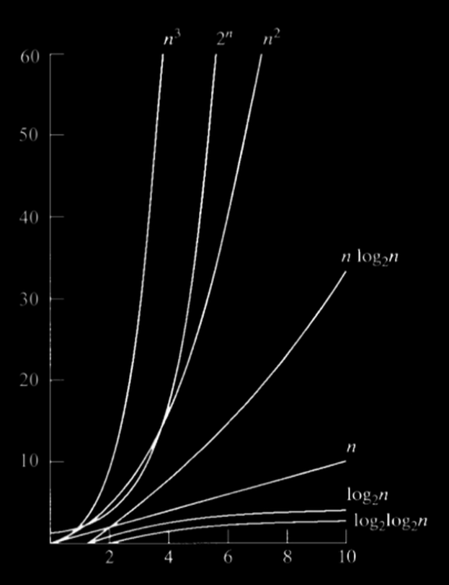
More on Asymptotics
Asymptotic runtime gets more and more important as n goes to infinity
Rate of growth gets really significant

Slide 10
Searching
Linear search – just look at each element
Advantages: doesn’t require array to be sorted
Disadvantage: it’s suuuuper slow
Binary Search
Works for sorted arrays
Check middle of the array
If it’s equal, we’re done
If middle is higher, repeat process on lower half of the list
If middle is lower, repeat on upper half of the list

Slide 11
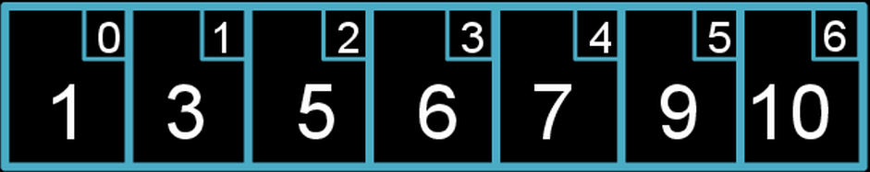
Is 7 in the array?

Slide 12
Finding 7
Is array[3] == 7?
Is array[3] < 7?
Is array[3] > 7?
Notes:
First, check value stored at middle index of the array
Since 6 < 7, we can throw out the entire bottom half
(Like David did with the phone book)

Slide 13
Finding 7
Is array[5] == 7?
Is array[5] < 7?
Is array[5] > 7?
Notes:
Next we check the value of what’s stored in the middle index of what’s left

Slide 14
Finding 7
Is array[4] == 7?
Is array[4] < 7?
Is array[4] > 7?
Notes:
Next we check the value of what’s stored in the middle index of what’s left

Slide 15
Your Turn - Binary Search
Implement the iterative version of binary search using the following declaration:
value: the number we’re searching for
values: the (sorted) integer array we are searching though
n: the length of values
No need to write main, just the loop of binary search

Slide 16
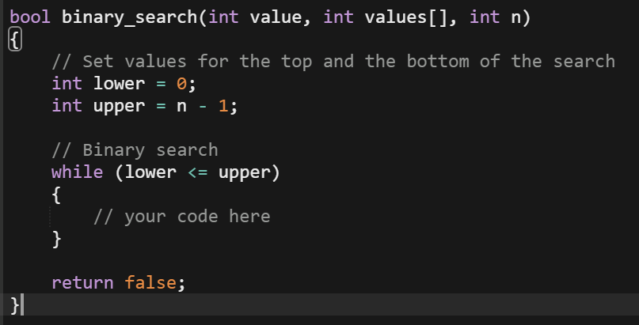
Your Turn – Binary Search
Fill in the contents of the while loop for binary search
Notes:
// if values[middle] is equal
// values middle < than value
// update the lower bound to the current middle plus 1
// else
// update upper bound to the current middle minus 1

Slide 17
Binary Search
What is the asymptotic runtime of binary search? (worst case/best case)
O(log(n))
Ω(1)
Notes:
What’s the big O of linear search?
Hint: it’s name

Slide 18
Sorts
Bubble
Selection
Insertion
Merge

Slide 19
Bubble sort
Works on array of size n by…
Iterating over unsorted part of the array
Swapping adjacent items that are out of place
Large elements “bubble” to the top
Move higher elements generally to the right and lower elements generally to the left
Psuedocode
Set swap counter to a non-zero value
Repeat swap counter is 0:
Reset swap counter to 0
Look at each adjacent pair
If two adjacent elements are not in order, swap them

Slide 20
Bubble Sort
See pdf for example

Slide 21
Bubble Sort
Worst Case: array in reverse order
bubble each of the n elements all the way across the array
only one gets to destination per pass, so we must do this n times
What’s the O runtime for Bubble sort?
O(n^2)
Best case: already sorted
We make no swaps on the first pass
What’s the Ω runtime for Bubble sort?
Ω(n)

Slide 22
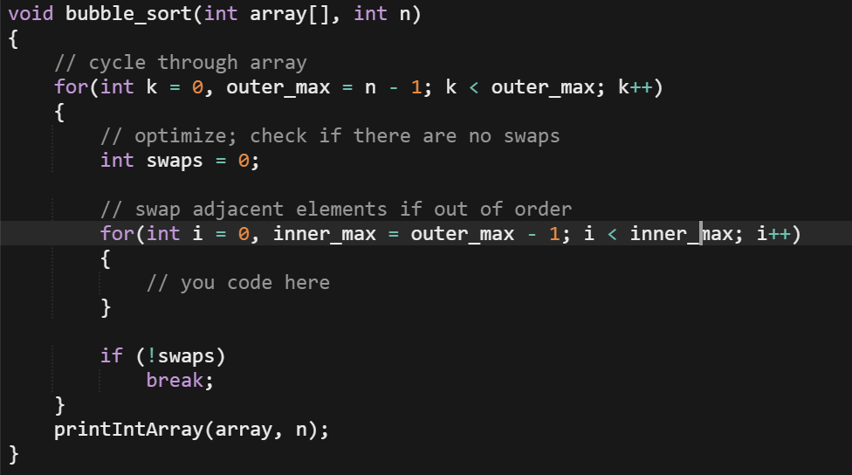
Your Turn!
Implement the inner loop of bubble sort
(Swap adjacent elements if out of order)
Notes:
If array[i] > array [i+1];
Int temp = array[i+1];
Array[I + 1] = array[i];
Array[i] = temp;
Swaps++;

Slide 23
Selection Sort
Works on array of size n by…
Removing the smallest element in unsorted part of array
Placing at the head
Psuedocode:
Repeat until no unsorted elements remain
Search unsorted part of the data to find the smallest value
Swap the smallest found value with the first element of the unsorted part

Slide 24
Selection Sort
See pdf for example

Slide 25
Selection Sort
Worst Case
iterat over each of the n elements in the array to find the smallest unsorted elt
only one gets to destination per pass, so we must do this n times
What’s the O runtime for Selection sort?
O(n^2)
Best case
Exactly the same!
What’s the Ω runtime for Bubble sort?
Ω(n^2)
Since best case and worst case are the same…
ϴ(n^2)

Slide 26
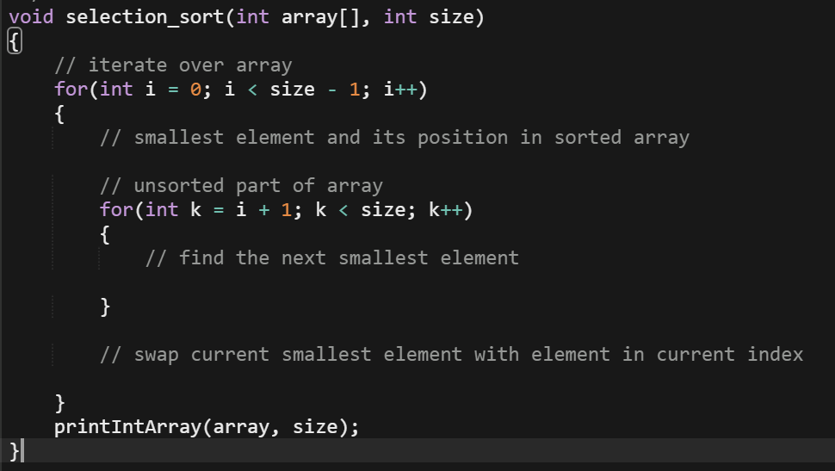
Your turn!
Follow the pseudocode to make selection sort

Slide 27
Insertion Sort
Build your sorted array in place shifting elements as necessary
Pseudocode
Call the first element of the array sorted
Repeat until all elements are sorted:
Look at the next unsorted element
Insert into sorted portion by shifting requisite elements

Slide 28
Insertion Sort
See pdf for example

Slide 29
Insertion Sort
Worst Case: array in reverse order
we have to shift n elements n positions each time we insert
What’s the O runtime for Insertion sort?
O(n^2)
Best case: already sorted
Simply keep moving the line between sorted and unsorted as we examine each elt
What’s the Ω runtime for Bubble sort?
Ω(n)

Slide 30
Your turn
Explain to your neighbor the difference between the three sorts. What are possible tradeoffs?

Slide 31
Recursion
Divide and conquer!
A function that calls itself from within itself
Often used to “elegantly” solve a problem – it’s very pretty
Two cases for recursive functions:
Base case – when triggered, this ends the recursive calls to the function and start returning
Recursive case – we call the function again on a smaller subset of the problem
EX: factorial

Slide 32
Merge Sort
Easiest to implement with recursion!
Runs in O(nlogn)
Power comes from divide and conquer approach
Only has to do n comparisons log(n) times!
The size of the arrays being compared is halved every recursive call
Notes:
Merge sort is very different from the previous three sorting algorithms. It is most easily implemented using recursion instead of iteration
If worried your students might be uncomfortable with recursion, here’s a sample program showing both an iterative and recursive approach to summing integers.
And second, it runs in n_log(_n) time making it significantly faster than the other algorithms. Its power comes from its divide and conquer approach. Think of it like this: whereas the other sorting algorithms take n comparisons n times as they traverse an array, merge sort only has to do n comparisons log(n) times since the size of the array is halved each recursive call (think back to the phone book from binary search!)

Slide 33
Merge Sort
See pdf for example

Slide 34
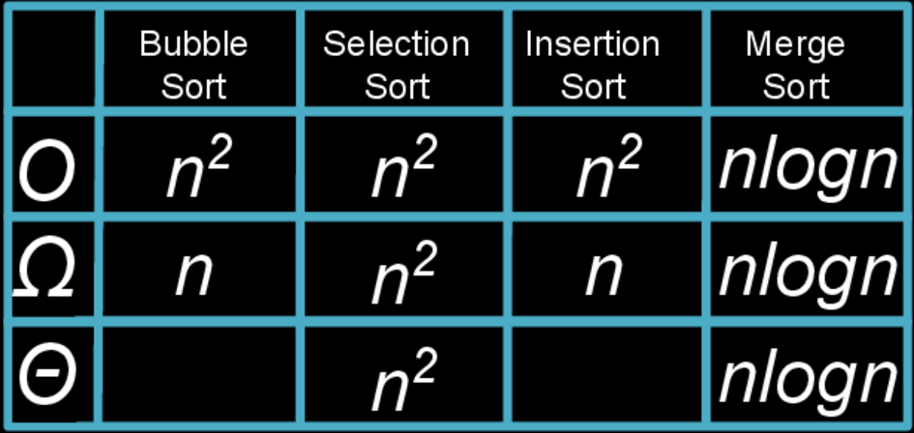
Asymptotic Runtimes of Sorts

Slide 35
GDB (the GNU Debugger)
Works on executable files, allows you to step through your code
Common commands:
gdb ./<program name>
break <function name>, break <line number>
Set breakpoint at beginning of program: break main
run <command line args>
Common commands, cont
next, n
step, s
list
print, p
info locals
continue, c
disable
quit, q
Notes:
Remember! Gdb only works on executables so the first thing you need to do is make your program.
Let’s go over the common commands:
gbd ./<program>name
How we get into gdb
It’ll start the gdb prompt, which looks a lot like regular C, but with (gdb)
Break
Can be abbreviated b
Used to set breakpoints – points near code you want to take a closer look at
Often want to just break at main and start debugging from there
Run
Used to start the program running in gdb
Next
Executes the current line and steps to the next one (steps over functions)
This will step to the next line that will be executed
Eg, if an if condition is not met, we would skip over its contents
Step
Will step into functions
List
List shows a few lines of surrounding code
Allows you to remain in the debugger
Print
Like printf, will show you what a variable equals
Info locals
Special version of print
Shows you all currently available local variables
Continue
Runs program to next breakpoint or the end of the program
Breakpoint is where the code stops and then you can start stepping
Disable
Disable breakpoints
Quit
Gets you out of gdb
Remember: the line you see is the one you haven’t executed yet

