Slide 1
CS50 Section 4 Somewhere in Between
Annaleah Ernst, TF

Slide 2
The Agenda…
Reeeeally quick recap
Hexadecimal
Structs
Pointers
Memory Management
Stack
Heap
malloc()
Command Line Redirection
File I/O

Slide 3
Recap
Asymptotic notation
Big O notation
What’s the big O of the four sorts we talked about last week?
Ω notation
What’s the Ω of the four sorts from last week
Θ notation
What even is this?
It’s when the O and Ω functions are the same
Which of our sorts have a theta function?

Slide 4
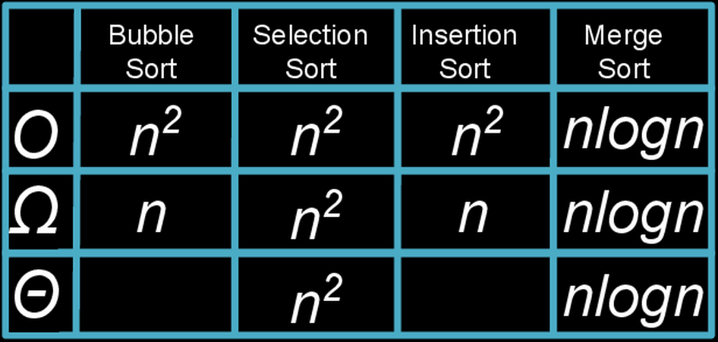
Recap

Slide 5
Sizes of data types
Data Type | Size (bytes)
int | 4
float | 4
double | 8
long long | 8
char | 1
string (char*) | ???

Slide 6
Recap
Recursion
Function calls itself from within itself
HIGHLY RECOMMEND you look at recursion on CS50 Study
https://study.cs50.net/
If you have questions, let me know, we can make time

Slide 7
Data Structures
What have we learned about so far
Arrays
Why do we use arrays?
Store a bunch of things of the same data type
What are some limitations of arrays?
Can only store data of one data type
Notes:
get some suggestions on the board, draw up a list of features of a student

Slide 8
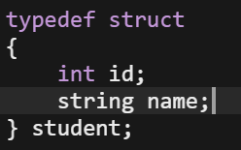
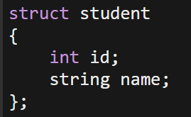
Structs
Allow us to create out own data type to hold data of different type
Recall the student struct from lecture
What’s the difference between these two structs?
This creates a new type called student
To declare:
student stu_1;
This creates a structure called student
To declare:
struct student stu_1;

Slide 9
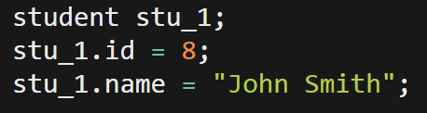
Structs: creating and accessing
Declare using the struct name as the variable type
Access using the . operator

Slide 10
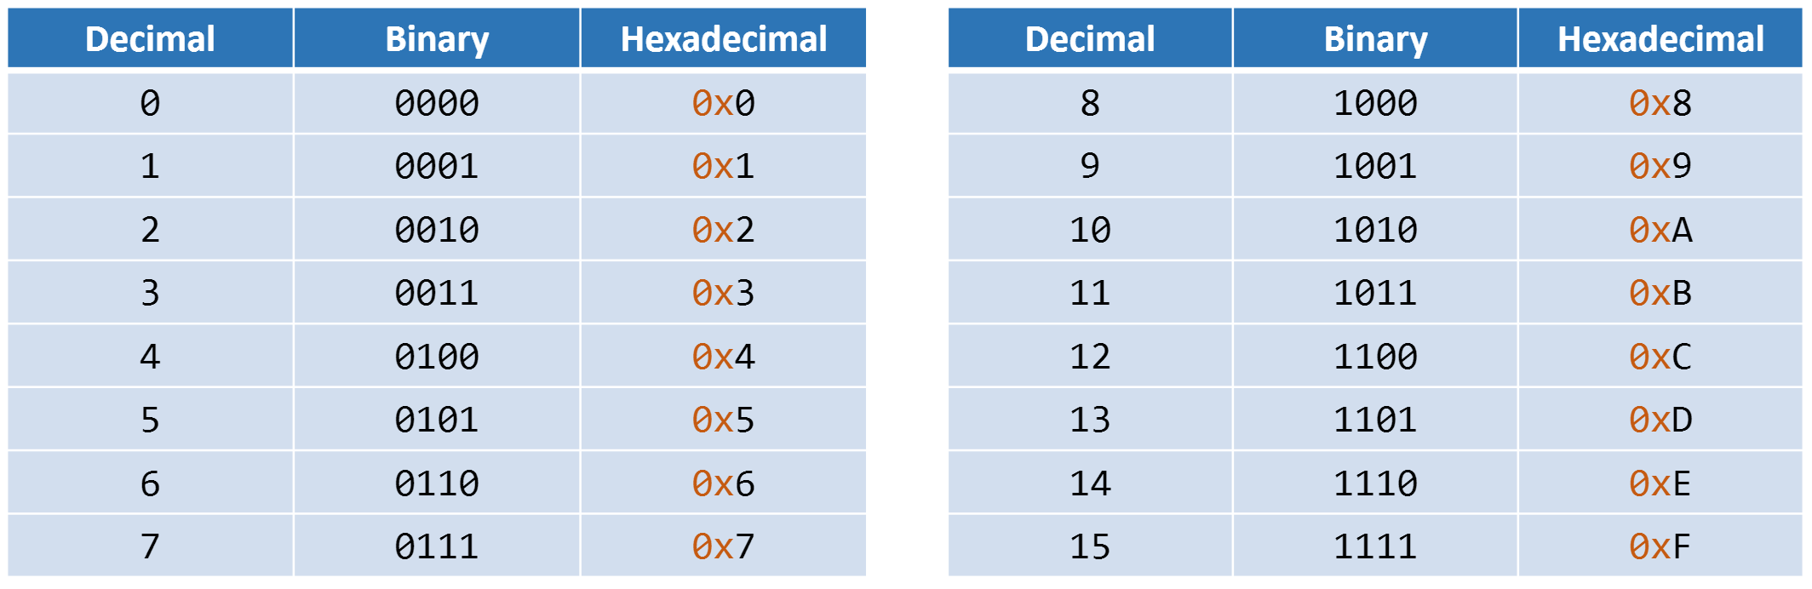
Hexadecimal – base 16
As computer scientists, sometimes we want to see what the computer sees
Looking at long binary strings is tedious, so we often use hexadecimal
Convenient for converting from binary
Each group of four bits is able to make 16 different combinations
Each group of four bits maps onto a single hexadecimal digit
Notes:
Let’s start with base ten
What is 235667 equivalent to writing?
2*10^5 + 3*10^4 + …
Now binary binary. What is 0100111 equivalent to writing?

Slide 11
Hexidecimal
Just like binary or decimal notation, hexadecimal has “places”
Remember elementary school: the 1’s place, 10’s place, 100’s place, etc
We can rephrase that as having a 10⁰’s place, 10¹’s place, 10²’s place, and so on
Instead of being powers of ten or powers of two, hexadecimal has powers of 16
So we have a 16⁰’s place, 16¹’s place, 16²’s place, etc…
How do we tell if a number is hexadecimal?
Preceded by 0x
16³ | 16² | 16¹ | 16⁰
2 | a | 5 | f
0x

Slide 12
Binary to Hex
10
11
13
4
6
A
2
B
9
3
D
0x46A2B93D

Slide 13
Your turn! Base Questions
What is 111111₂ in hexadecimal?
Divide into 4 bit sections: 0011 1111
Convert each section into base 16 value: 3 f
0x3f
What is 0xA5 in binary?
Reverse the above process: A₁₆ = 10₁₀ = 1010₂ , 5₁₆ = 5₁₀ = 0101₂
10100101

Slide 14
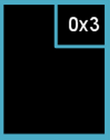
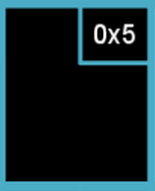
Pointers
Recall that computers have to store data in hardware, and we need to access it
Every variable in memory has an address
Think about arrays and how we use the index as an address
A pointer’s value is an address
Int x = 50;
Int* ptr = &x;
50
0x3

Slide 15
Pointers
Referencing
Get and work with the address of a variable (versus its value)
Passing by reference means you’re passing a variable by its address
Get the address of a variable: &<variable name>
Dereferencing
Use an address to get an actual value
We use this to get the value the address is pointing to
Go to the value held at address: *<pointer name>

Slide 16
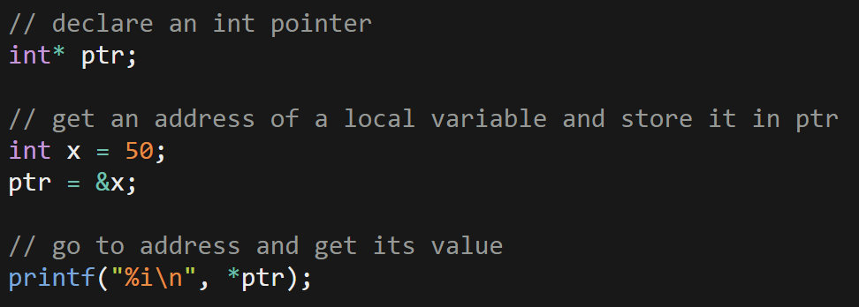
Pointers

Slide 17
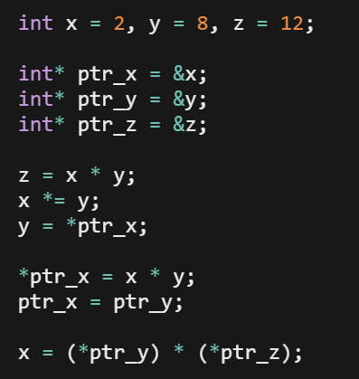
Your turn!
Sketch out what this code does on a piece of paper
Ie, tell me what each of these lines do in concrete terms.
What does each term equal after each step?
Notes:
First line: creates 3 variables
Next three lines: create variables to store the addresses of our first three variables.
Z = x * y // so z = 16
X *= y // so x = 16
Y = *ptr_x // so y is equal to the value stored at the x_ptr: treat the thing stored at x_ptr like an address and go to it
*ptr_x = x * y // we go to what prt_x is pointing at, and there we save the value 256
Ptr_x = ptr_y // change the val of ptr_x to ptr_y…uh oh, we lost a pointer!
X = ptrptr // goes to value at address at ptr_y and address ptr_z and multiplies them , the stores them at x

Slide 18
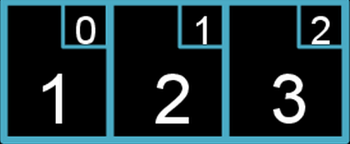
Pointer and arrays
Under the hood, an array is treated like a pointer to the first element
Add the index to initial address to go to the next element
int array[3];
*array = 1;
*(array + 1) = 2;
*(array + 2) = 3;
Based on what we now know why do you think arrays are zero indexed?
Notes:
But wait a minute…different data types have different sizes, so how does this work??
Well, it turns out the computer is pretty smart. That’s why it’s important that we

Slide 19
Sizes of data types
Data Type | Size (bytes)
int | 4
float | 4
double | 8
long long | 8
char | 1
string (char*) | 8 (on 64 bit architecture)

Slide 20
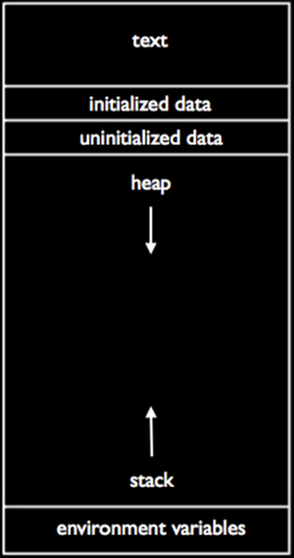
Memory Management
Two basic regions of memory
Heap
Stack

Slide 21
Memory – The Stack
Contiguous block of memory set aside when program starts running
LIFO data structure
Each function gets its own stack frame
Metadata
Variables held in read only memory
Local variable
When we call a function we push it on top of the stack
To get at the contents of earlier frames, we need to pop it off
Ie, we need to return
Size of stack frame largely dependent on local variables
What if we don’t know the number of variables/sizes?
Notes:
Say, for example, main called a function called sum
Stack frame sum would be on top of main
If we want to get at main again, we have to pop sum off by returning
Variables are protected from other functions and localized by scope

Slide 22
Memory – The Heap
We use the heap for memory allocated at runtime
dynamically allocated memory
Region of unused memory that can be allocated with a call to malloc()
Use malloc() to allocate memory on the heap
malloc() allows us to give our pointers something to point to, eg
Notes:
Whenever your program needs fresh storage at run time that must outlast the current function, it can call malloc(), passing it the number of bytes needed. Since the sizes of data types vary from system to system, C provides the sizeof()operator for determining the size of a particular type.
**** Note that sizeof() is considered an operator not a function because it takes any kind of data type and returns the appropriate size, whereas a function must specify what type of argument it takes. ****

Slide 23


Memory – malloc()
Give out pointers some persistent memory to point to, eg
Creates a space for 4 bytes on the heap
Returns a pointer to this space
This space can be passed between functions!!!!
Unlike stack variables, it won’t be lost when a function returns.
Important to check for NULL pointer on call to malloc()
All calls to malloc() MUST be accompanied by a call to free() later in the program, eg
All malloc()’d memory should be freed (but only once) and only malloc()’d memory should be free()’d.
Otherwise, we get memory leaks

Slide 24
Redirection
At the command line, we can use redirection commands to control output
> - output of program to file instead of stdout
Eg, ./hello > output.txt
>> - append to output file instead of writing over data
2> - only print error messages to file
< - input; use contents of file as some input to a program
Eg, ./hello < input.txt
| - pipe; take output of one program and use it as input in another
Eg. A | B
Output of a A becomes the input of B

Slide 25
File I/O
So far, we’ve been printing output to stdout (think printf()), and getting input by prompting the user (think get_string())
It’s just as easy to read and write files!
fopen() - creates a FILE pointer to a FILE struct
Reference gets passed to fread() and fwrite()
fclose() – gets rid of this pointer and prevents memory leaks
We’ll talk more about leaks in memory management

Slide 26
File I/O - Commands
FILE* fopen(<name of file>, <mode>)
fread(<storage ptr>,<elt size>,<number of elts>,<file* stream>)
fwrite(<cont info ptr>,<elt size>,<number of elts>,<file* stream>)
fgets(<storage ptr>, <int size of string>, <file* stream>)
fputs(<const char array>,<file* stream>)
char fgetc(<file pointer>)
fputc(<char c>, <file* stream>)
fclose(<file pointer>)
Notes:
Fopen opens a file called <name of file> in <mode>: “r” is read only, “w” is write, etc
Fread reads <num elts> elements of data that are <size> long from the file indicated by <file pointer> and stores them at the address pointed to by <storage pointer>
Fwrite writes <num elts> of data, each size bytes long, to the file pointed to by <file pointer>, getting them from the location given by <const info ptr>
Fgets reads in at most one less than size chars from the stream and stores them in the buffer pointed to by s. Reading stops after EOF or new line (though a new line will be stored in the buffer). Terminating null byte is stored after the last character in the buffer
Fputs write string to stream without terminating null byte.
Fgetc reads the next char from stream and returns it as an unsigned char, or EOF on end of file/error. Fgetc advances the file pointer to point to the next char in the file.
Fputc writes the char c to the file stream (and advances the file point in doing so)

Slide 27
File I/O - Structure
Open file in appropriate mode (read, write, append)
Check to make sure it opened
<code>
Before the program ends, close the file

Slide 28
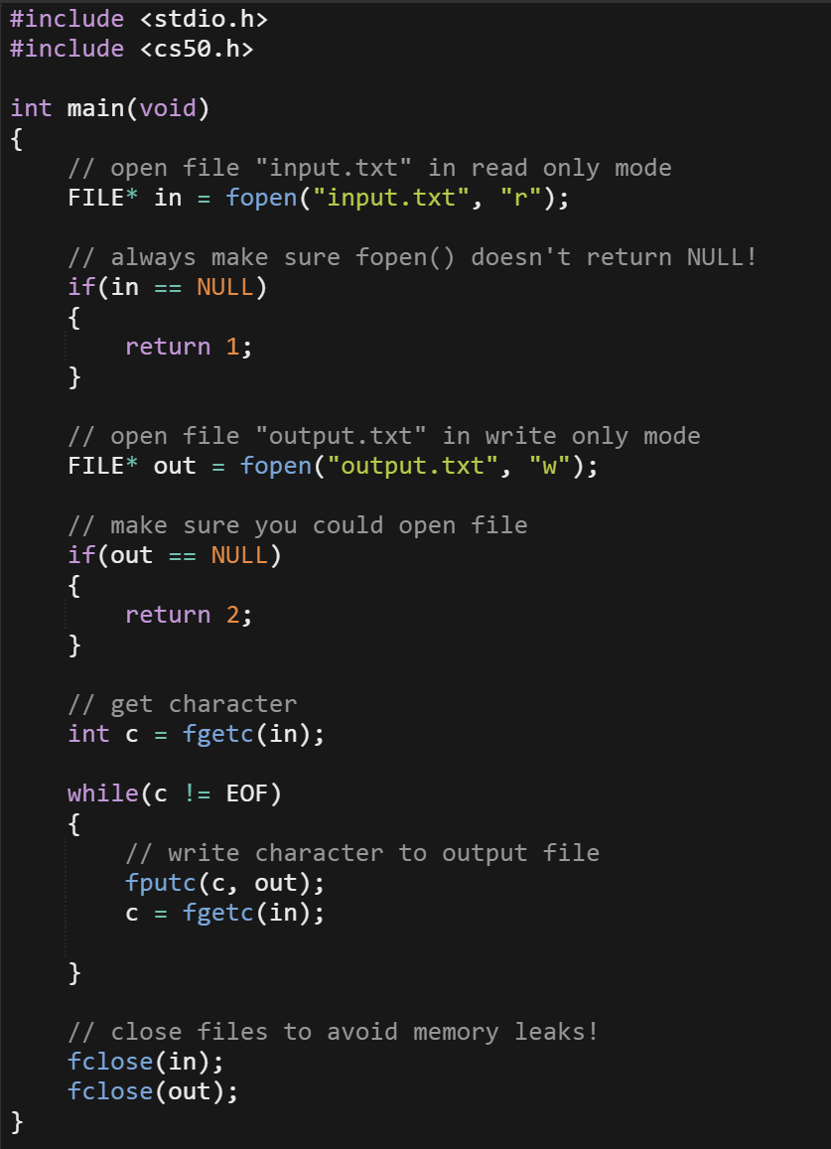
File I/O
Open file in appropriate mode (read, write, append)
Check to make sure it opened
<code>
Before the program ends, close the file

Slide 29
Your turn - iohello.c
Use what we just learned about file I/O to write a textfile called hello.txt that contains the words: “hello, world!”
How could we have done this with redirection?

