Slide 1
CS50 Test Review Somewhere in Between
Annaleah Ernst, TF

Slide 2
Non-Exhaustive Topics
Binary. ASCII. Algorithms. Pseudocode. Source code. Compiler. Object code. Scratch. Statements. Boolean expressions. Conditions. Loops. Variables. Functions. Arrays. Threads. Events.
Linux. C. Compiling. Libraries. Types. Standard output.
Casting. Imprecision. Switches. Scope. Strings. Arrays. Cryptography.
Command-line arguments. Searching. Sorting. Bubble sort. Selection sort. Insertion sort. O. Ω.Θ. Recursion. Merge Sort.
Stack. Debugging. File I/O. Hexadecimal. Strings. Pointers. Dynamic memory allocation.
Heap. Buffer overflow. Linked lists.
Hash tables. Tries. Trees. Stacks. Queues.
Notes:
Re- feeback: I will try to talk slower!

Slide 3
Non-Exhaustive Topics
Data Types and Sizes
Binary and Hex
ASCII (Math)
Floating Point Imprecision
Pointers
Scope
Switches
Pointers
Memory
Recursion
Structs
Linked Lists
Hash Tables
Trees and Tries
Files I/O

Slide 4
Data Types and Sizes
char
1 byte
int
4 bytes
long long
8 bytes
float
4 bytes
double
8 bytes
<type> *
pointer
8 bytes (64 bit architecture)

Slide 5
Binary and Hex
What is binary notation?
Base 2, 1 0
What about hexadecimal?
Base 16 (denoted by 0x at the front)
0 1 2 3 4 5 6 7 8 9 a b c d e f, where f = decimal 15
What do we mean by different bases?
Ex: base 10: What is 356 equivalent to?
3 * 10² + 5 * 10¹ + 6 * 10⁰
Same thing applies to binary (base 2) and hex (base sixteen)
<Value at place> * <base>^{<place>} + … + <Value at place> * <base>^{<1>}
Notes:
Let’s start with base ten
What is 235667 equivalent to writing?
2*10^5 + 3*10^4 + …
Now binary binary. What is 0100111 equivalent to writing?

Slide 6
Your turn! CS 32?
What is 50₁₀ in binary?
1*2⁵ + 1*2⁴ + 0*2³ + 0*2² + 1*2¹ + 0*2⁰ -> 110010
What is 101010₂ in decimal?
1*2⁵ + 0*2⁴ + 1*2³ + 0*2² + 1*2¹ + 0*2⁰ -> 42
What is 111111₂ in hexadecimal?
Divide into 4 bit sections: 0011 1111
Convert each section into base 16 value: 3 f
0x3f
What is 0xA5 in binary?
Reverse the above process: A₁₆ = 10₁₀ = 1010₂ , 5₁₆ = 5₁₀ = 0101₂
10100101
If the title of this slide says CS 50₁₀, what base is it currently in?

Slide 7
ASCII
At a fundamental level, chars are just numbers
They get treated like chars depending on how we use them
ASCII value maps them to chars

Slide 8
Your Turn! ACII Math
What will the following print out?
int first = 65;
int second = ‘A’ + 1;
char third = ‘D’ – 1;
char fourth = 68;
Printf(“%c, %c, %c, %c”, first, second, third, fourth);
A B C D

Slide 9
Floating Point Imprecision
Infinitely many real numbers
Finite bits
-> imprecision
Just something to be aware of – use ints where possible, since they are designed in hardware and are not imprecise.

Slide 10
Scope
The area in which the program has access to a variable
“What happens in braces stays in braces”
Global
Entire program has access
Exists for entire duration of program
Local
Confined to region of code
eg a function, a loop, etc

Slide 11
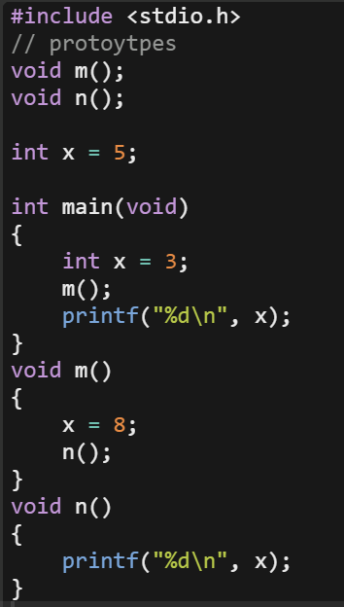
Your turn! Scope.c
What does this program output?
8
3

Slide 12
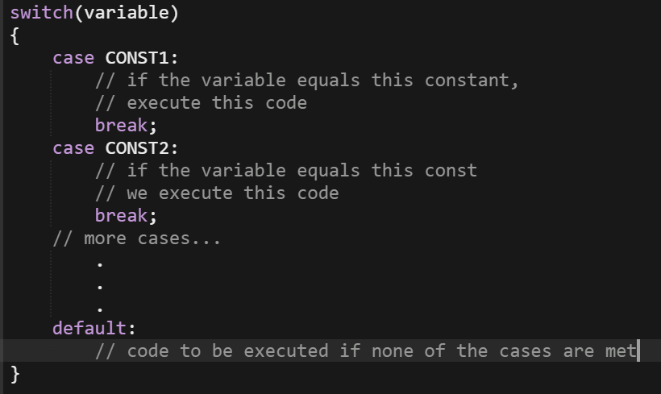
Switches
Value of variable is either an int or a char in this syntax

Slide 13
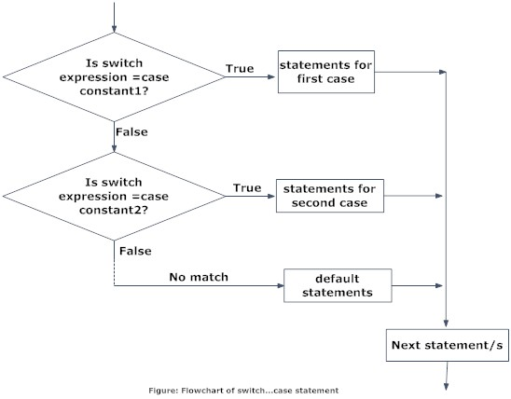
Switches

Slide 14
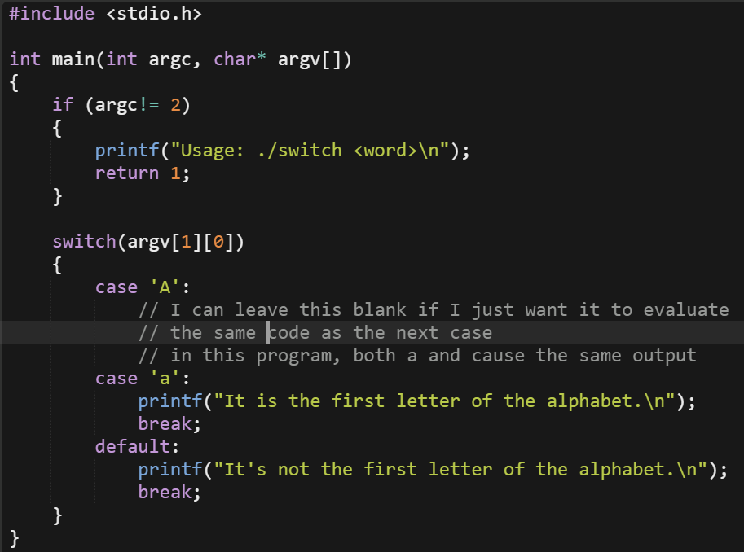
Your Turn! Switch.c
Write a piece of code that uses a switch statement to check the first letter of the first command line argument a user inputs
If the letter is is equal to upper or lower case A , print “It is the first letter”
Else print “It’s not the first letter”

Slide 15
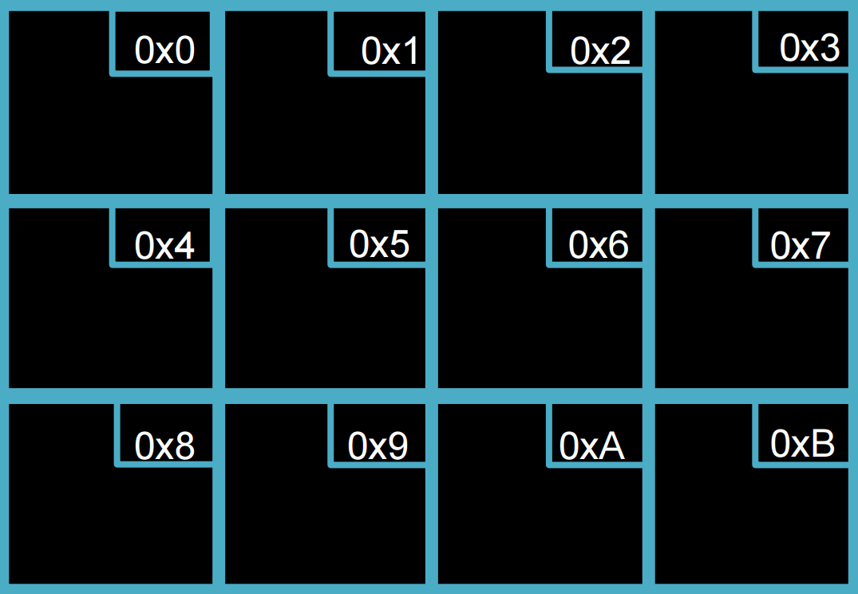
Pointers - Memory
Notes:
Here’s a block of memory
What are it’s values? (trick question: it’s uninitialized)
What are it’s addresses?

Slide 16
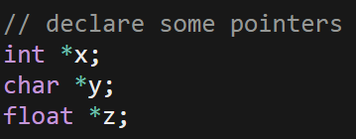
Creating Pointers
<type>* <variable name>;
What are these pointing at right now?

Slide 17
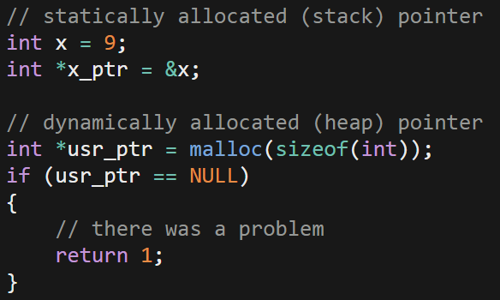
Defining Pointers
Either:
<type>* <pointer name> = &<variable of type>;
<type>* <pointer name> = malloc(sizeof(<type>));

Slide 18
Referencing and Dereferencing
Referencing (ie, address of)
&<variable name>
Dereferencing (ie, go to address)
*<point name>

Slide 19
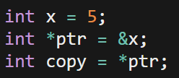
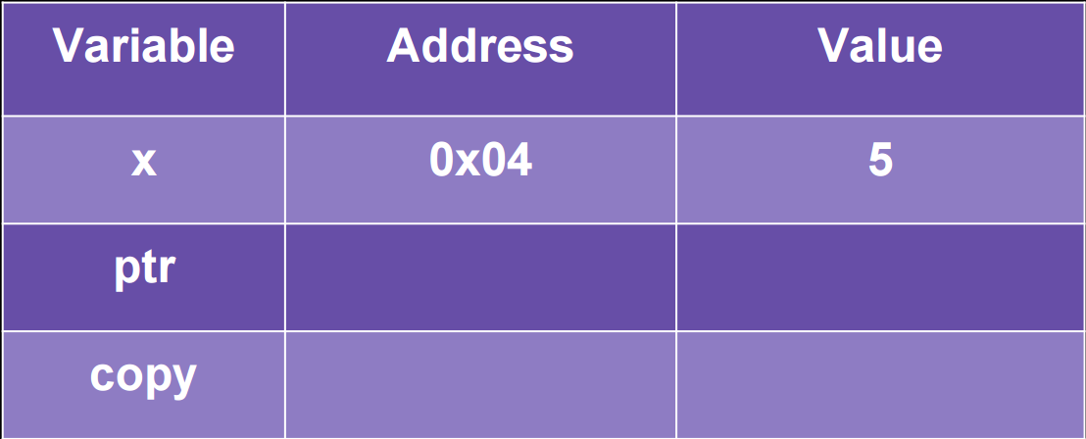
Your turn! Under the hood
Fill in the table below based on this snippit of code.
Feel free to make up addresses if you don’t think they should be the same

Slide 20
Pointer Arithmetic
What happens when I add or subtract the value n from a pointer?
Adjusts pointer by n * sizeof(<pointer type>) bytes
Recall that that’s basically how an array works:
Array[1] = *(array + 1)
which is equivalent to *(array + 1 * sizeof(<array type>))

Slide 21
Your turn! Pointer Math
What happens when I add or subtract the value n from a pointer?
Adjusts pointer by n * sizeof(<pointer type>) bytes
Based on this, fill in this chart. Assume &x = 0x04
 | x | y
int x = 5; | 5 | NULL
int *y = &x; | 5 | 0x04
y += 1; | 5 | 0x08

Slide 22
Pointers – Passing by Reference
Remember how we want to avoid global variables?
We can do that by passing by reference
To explore, let’s look at this buggy swap function

Slide 23
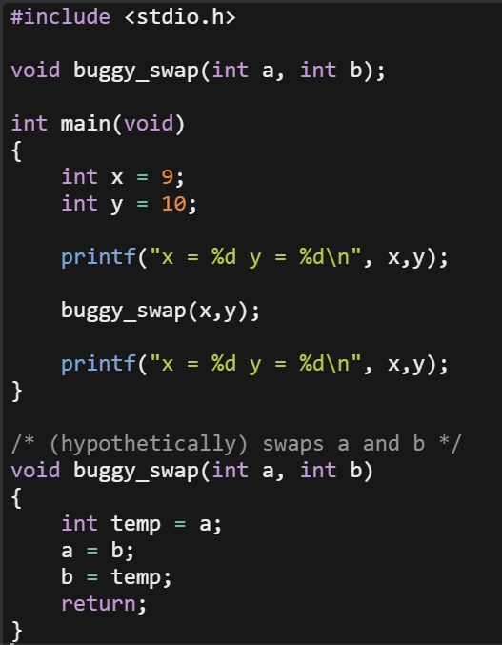
Buggy_swap.c
What happens when I run this program?
How could knowing pointers help with this?
Notes:
Why?
A and b are copies of x and y
They fall out of scope when the function returns

Slide 24
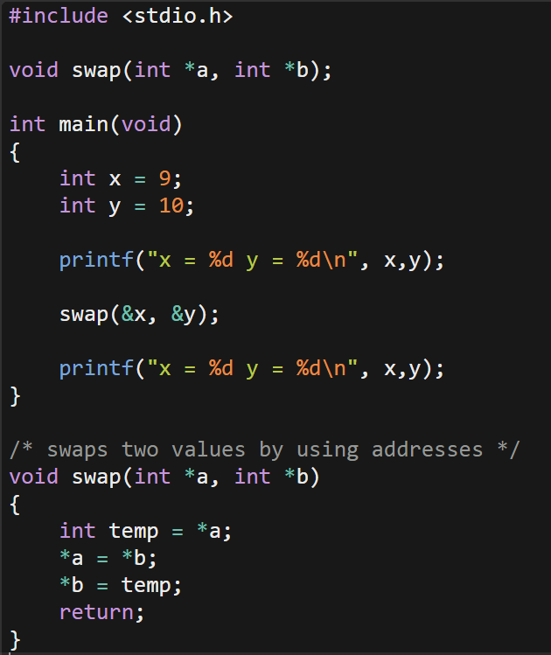
Swap.c
What if we passed our swap function the addresses of the variables we want to swap?
Still passing a copy of information, but this time, we’re passing a copy of an address – the data the address points to is still the same
This is how we avoid using global variables (which are bad) and still get the results we want from another function
This is called passing by reference

Slide 25
Memory
stack: block of memory set aside when a program starts running
each function gets its own stack frame
stack overflow: when the stack runs out of space, results in a program crash
heap: region of unused memory that can be dynamically allocated using malloc (and realloc, etc.)
ALWAYS free ALL dynamically allocated memory to avoid leaks

Slide 26
Recursion
a programming concept whereby a function calls itself
don’t forget to include a base case!
pros:
can lead to more concise, elegant code
some algorithms lend themselves to recursion ■ e.g., merge sort
Cons
Can lead to buffer overflow if there’s an error with the base case

Slide 27
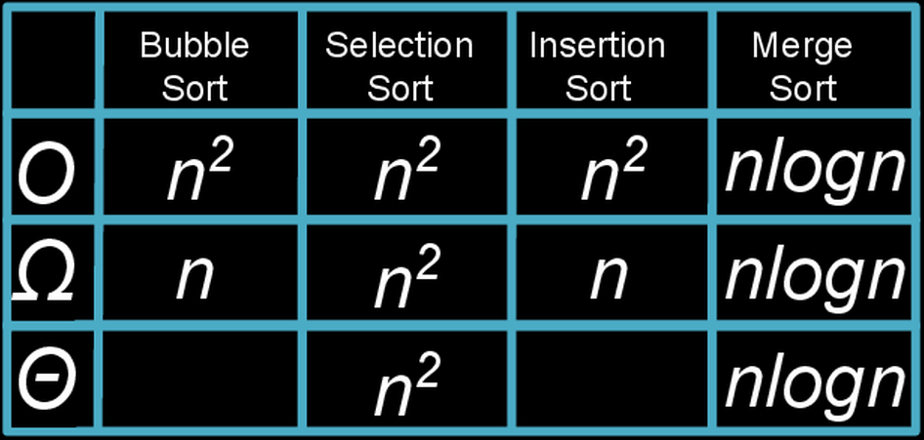
Search and Sort Run Times

Slide 28
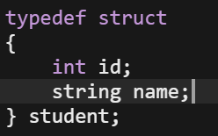
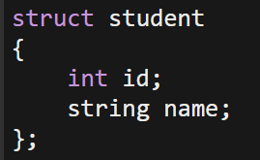
Structs
Allow us to create out own data type to hold data of different type
Recall the student struct from lecture
What’s the difference between these two structs?
This creates a new type called student
To declare:
student stu_1;
This creates a structure called student
To declare:
struct student stu_1;

Slide 29
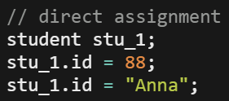
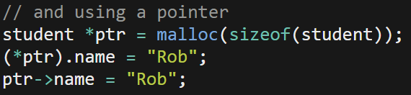
Structs: creating and accessing
Declare using the struct name as the variable type
Access using the . operator
If we have a pointer to a struct, use the arrow notation

Slide 30
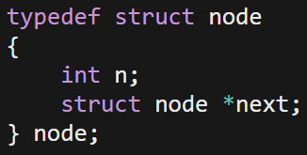
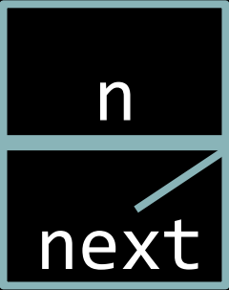
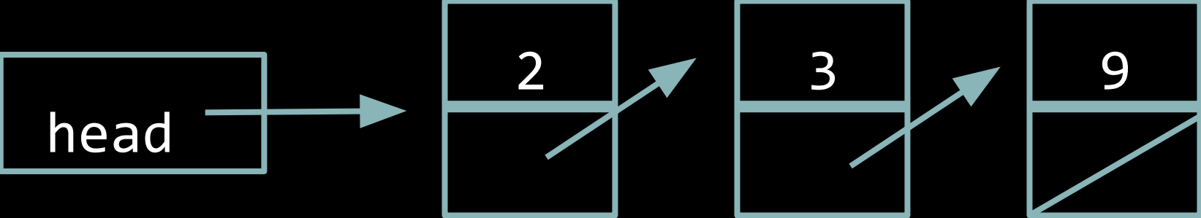
Linked List
Uses a recursive datatype
A struct that points to anther version of itself
How do we search a linked list?
How do we insert into a linked list?
What are advantages and disadvantages of this data structure?

Slide 31
Stacks
first-in, last-out (FILO)
elements are successively pushed down as other items are added
elements are pushed on and popped off
keep track of both the size and capacity
you need not keep track of capacity if you use a linked list rather than an array

Slide 32
Queues
first-in, first-out (FIFO)
picture a line!
elements are enqueued and dequeued
keep track of the size, capacity, and head
you need not keep track of capacity if you use a linked list rather than an array

Slide 33
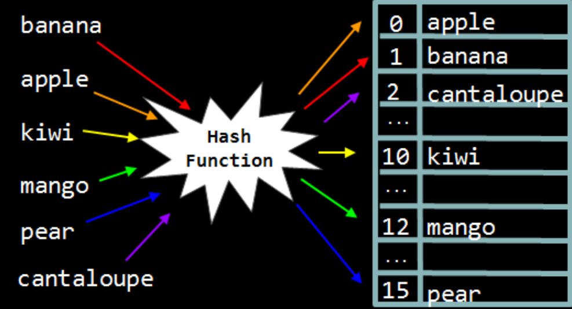
Hash Table
data structure where the position of each element is decided by a hash function
What makes a good hash function?

Slide 34
Hash Table
What do we do when there are collisions?
Linear probing – we could look for nearby empty slots
Separate chaining – we could make each bucket a linked list and insert at the head of that

Slide 35
Trees and Tries
tree: a data structure in which data is organized hierarchically
e.g., binary search tree
trie: special kind of tree that behaves like a multi-level hash table
Notes:
Draw out some binary trees

Slide 36
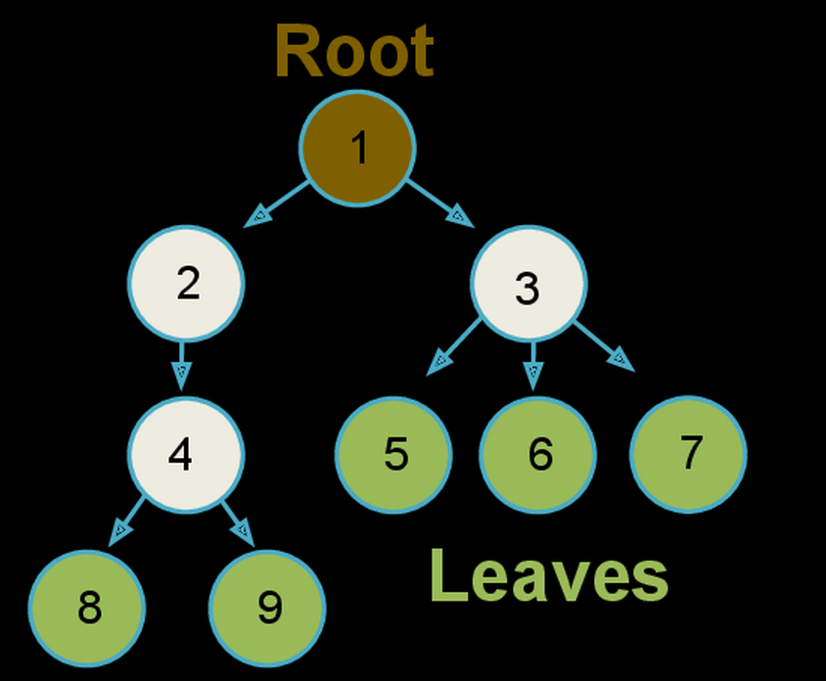
Tree
This is the general structure for a tree
However, randomly arranged like this, it’s not very helpful
Ideally we want balanced trees – trees that have the same number of levels to the leaves.
Notes:
We'll refer to node 1 as the root node, and external nodes like 5, 6, 7, 8, and 9 as leaves.
It's also convention to use the following terms to describe relationships between nodes:
nodes 2 and 3 are siblings of each other
nodes 5, 6, and 7 are children of node 3
node 2 is the parent of node 4

Slide 37
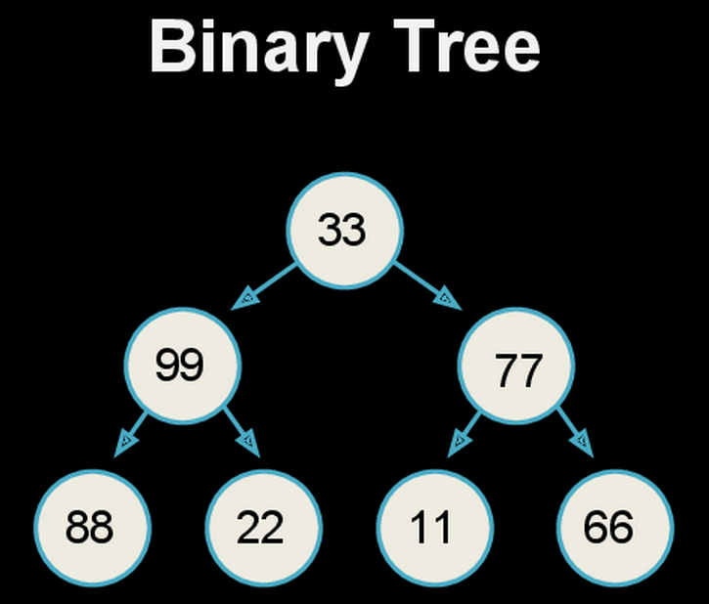
Binary Tree
Enter the binary tree

Slide 38
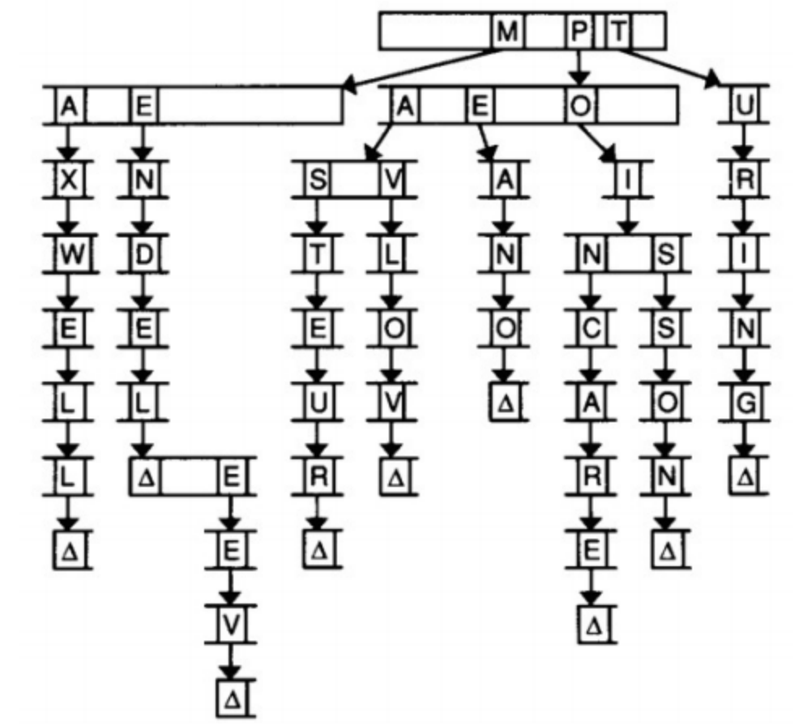
Tries
pro: provide constant time lookup (in theory)
con: use large amounts of memory!
Notes:
A trie is another type of tree structure. The word “trie” comes from the word “retrieval,” but is usually pronounced like “try.” For our purposes, the nodes in a trie are arrays. We might use a trie to store a dictionary of words, as this diagram suggests.
In this trie, each index in the array stands for a letter of the alphabet. Each of those indices also points to another array of letters. In the above, we’re storing the names of famous scientists, e.g. Mendel, Mendeleev, Pavlov, Pasteur, and Turing. The Δ symbol denotes the end of a name. We have to keep track of where words end so that if one word actually contains another word (e.g. Mendeleev and Mendel), we know that both words exist. In code, the Δ symbol could be a Boolean flag in each node.

Slide 39
File I/O
Not something we directly addressed last section, but do take a look over the various file i/o things we learned in class
Every time we open a file, close the file!
Analogous to malloc() and free.

Slide 40
File I/O - Commands
FILE* fopen(<name of file>, <mode>)
fread(<storage ptr>,<elt size>,<number of elts>,<file* stream>)
fwrite(<cont info ptr>,<elt size>,<number of elts>,<file* stream>)
fgets(<storage ptr>, <int size of string>, <file* stream>)
fputs(<const char array>,<file* stream>)
char fgetc(<file pointer>)
fputc(<char c>, <file* stream>)
fclose(<file pointer>)
Notes:
Fopen opens a file called <name of file> in <mode>: “r” is read only, “w” is write, etc
Fread reads <num elts> elements of data that are <size> long from the file indicated by <file pointer> and stores them at the address pointed to by <storage pointer>
Fwrite writes <num elts> of data, each size bytes long, to the file pointed to by <file pointer>, getting them from the location given by <const info ptr>
Fgets reads in at most one less than size chars from the stream and stores them in the buffer pointed to by s. Reading stops after EOF or new line (though a new line will be stored in the buffer). Terminating null byte is stored after the last character in the buffer
Fputs write string to stream without terminating null byte.
Fgetc reads the next char from stream and returns it as an unsigned char, or EOF on end of file/error. Fgetc advances the file pointer to point to the next char in the file.
Fputc writes the char c to the file stream (and advances the file point in doing so)

Slide 41
Previous Quiz Questions to Study
2015: Quiz 0
8, 17, 18, 23
2014: Quiz 0
24
2014: Quiz 1
27
2013: Quiz 0
0, 1, 2, 12, 17, 20, 22
2013: Quiz 1
8, 21, 22

Slide 42
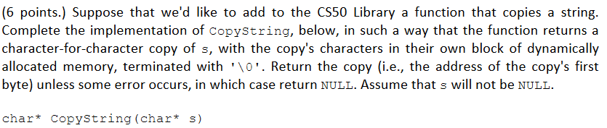
2015: Quiz 0, Problem 8

Slide 43
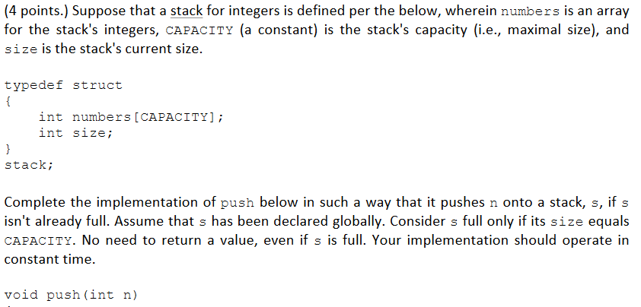
2015: Quiz 0, Problem 17

Slide 44
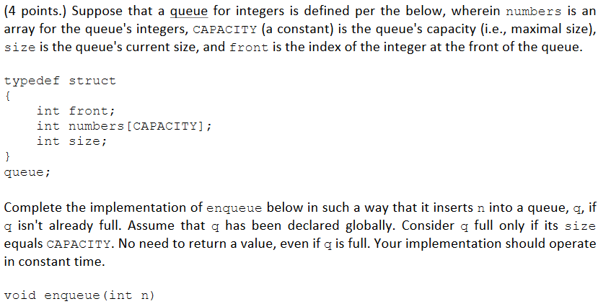
2015: Quiz 0, Problem 18

