Slide 1
Is That An
Insincere Quora Question?
EE 258
InSinSeer - Michael von Pohle & Haely Shah

Slide 2
The Problem
~38 Million questions (as of December 2018)
Many insincere questions
ML plus manual review => ML

Slide 3
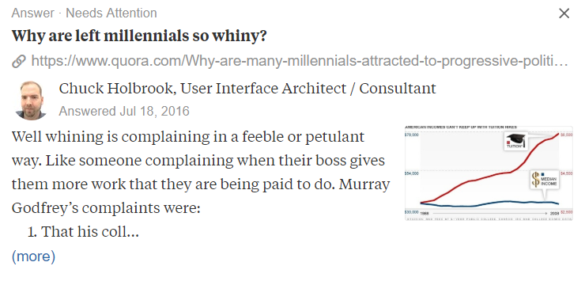
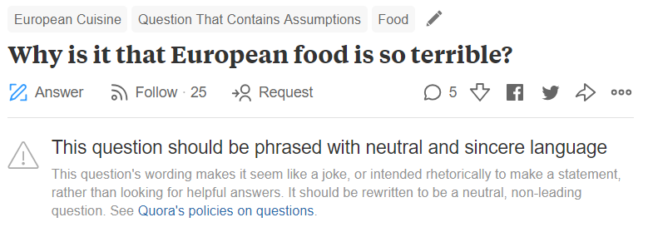
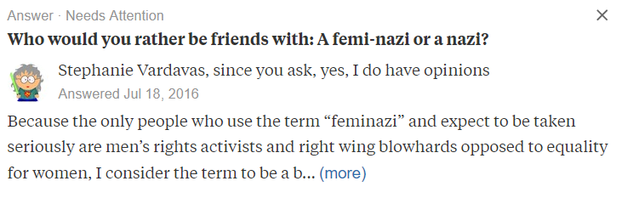
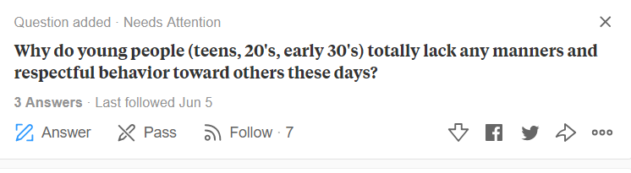
So we do not have questions like

Slide 4
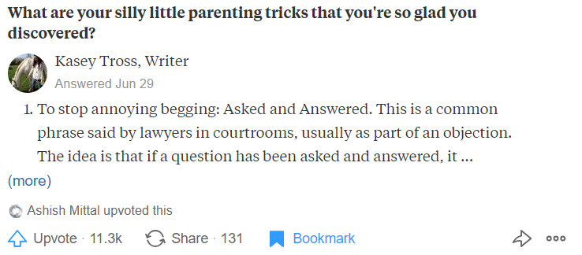

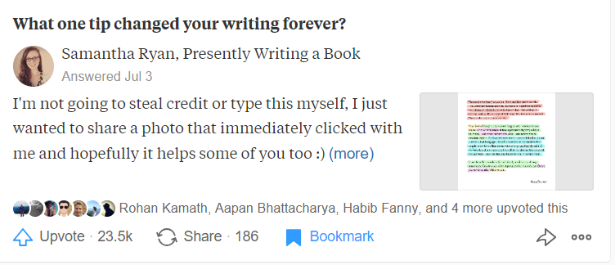
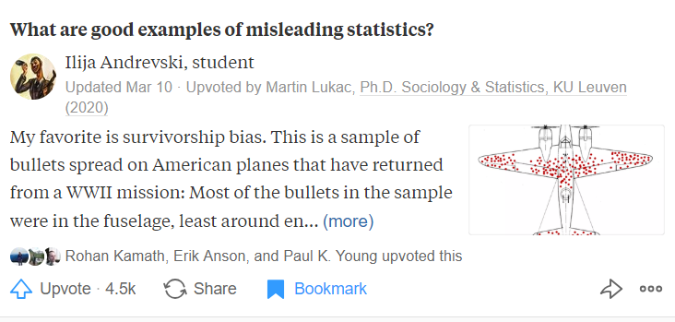
But instead have
Be Nice. Be Respectful.

Slide 5
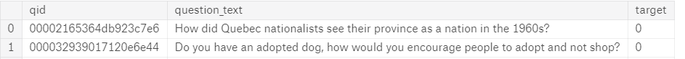
Data Summary
Training & Test data set, embeddings file
Training data:
Total questions: 1306122
Insincere questions: 80810 (6.19%)
Test data:
Total questions: 56370
Notes:
Arrange
No null values

Slide 6
Performance Metric
F1 score with the insincere class representing ~6% of the questions

Slide 7
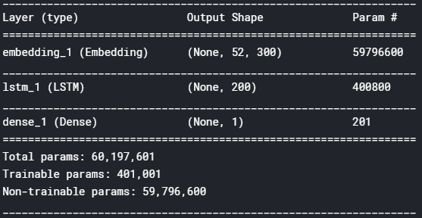
Baseline Model
Data Preprocessing
Convert to lowercase
Remove punctuation
Remove stopwords
Lemmatization
Data Augmentation
Duplicating insincere questions to achieve balanced classes
Keras library with that sweet GPU

Slide 8
Initial Results & Next Steps
Initial Results
F1 = 0.5845
Next Steps
Explore additional models
Modify existing models and their parameters

