Slide 1

Case Study: Predator Prey System Modelling and Simulation Gruppe 5
Christoph Hämmerle
Philipp Ganiu
Jennifer Lumetzberger

Slide 2
Introduction
Population model: deer (x) + foxes (y)
Different approaches:
Difference Equation Model
Cellular Automata

Slide 3
Difference Equation Model
$x\left(n+1\right)=x\left(n\right)+h∗[x\left(n\right)∗\text{α}∗$ (M - x(n) - y(n)) – x(n)*y(n)*β]
y$\left(n+1\right)=y\left(n\right)+h∗[y\left(n\right)∗\text{(}\text{δ}∗\text{x}$(n) - γ]
α…deer growth
β...deer reduction
γ… fox reduction due to starving
δ... fresh meat increase

Slide 4
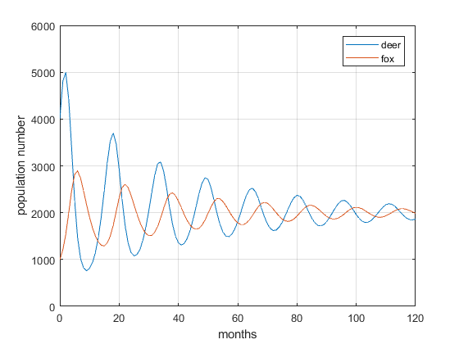
Difference Equation Model

Slide 5
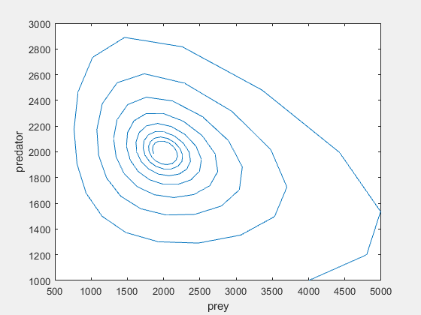
Difference Equation Model

Slide 6
Cellular Automata
Rectangular forest
3 states (0-empty, 1-fox, 2-deer)
Matrix update each month

Slide 7
Cellular Automata
If cell empty → choose one random neighbor and check if cell is prey. If yes → the initial cell becomes prey with probability p₁.
If cell is prey →choose one random neighbor and check if cell is predator. If yes → the neighbor eats up the prey and the cell becomes predator with probability p₂.
If cell is predator → the predator dies with probability p₃.

Slide 8
Live Demo

Slide 9
Thank you for your attention!

