Slide 1
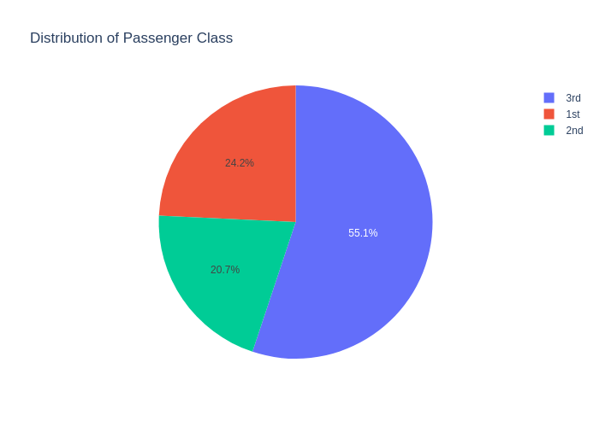
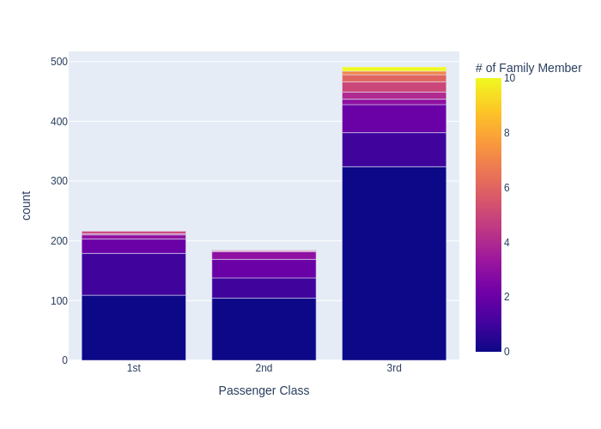
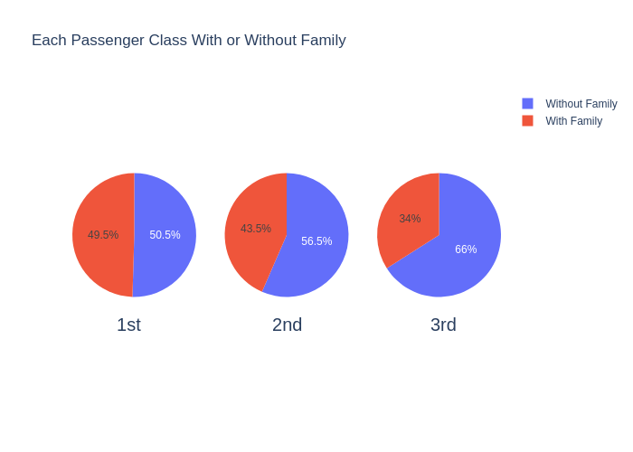
Expected Audience: People who are interested in whether passengers of the Titanic had family members, and whether passenger class had any influence on it
Purpose of Visualisation: To show whether passengers boarded with family, and show the number of family members they boarded with
Why did I choose this tool: Because Python was free, and most comfortable for me, and because I felt that the plotly library was a great tool for showing pie charts
I chose pie charts because I wanted to show the relative numbers of passengers with family, and I chose a bar chart shaped in such way because I wanted to convey 3 variables’ worth of information at the same time
The passengers were mostly 3rd class, with 1st and 2nd classes being relatively equal, though 1st class had more passengers. About half of the first class passengers brought family, whereas it was relatively less for the second and third classes. So, the lower class passenger you were, the less likely you brought family members on board.
I also had a look at how many family members they had, and the largest number of family members for both 1st and 2nd classes was 4, whereas there were even 10 members of family for 3rd class.

