Slide 1
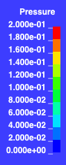
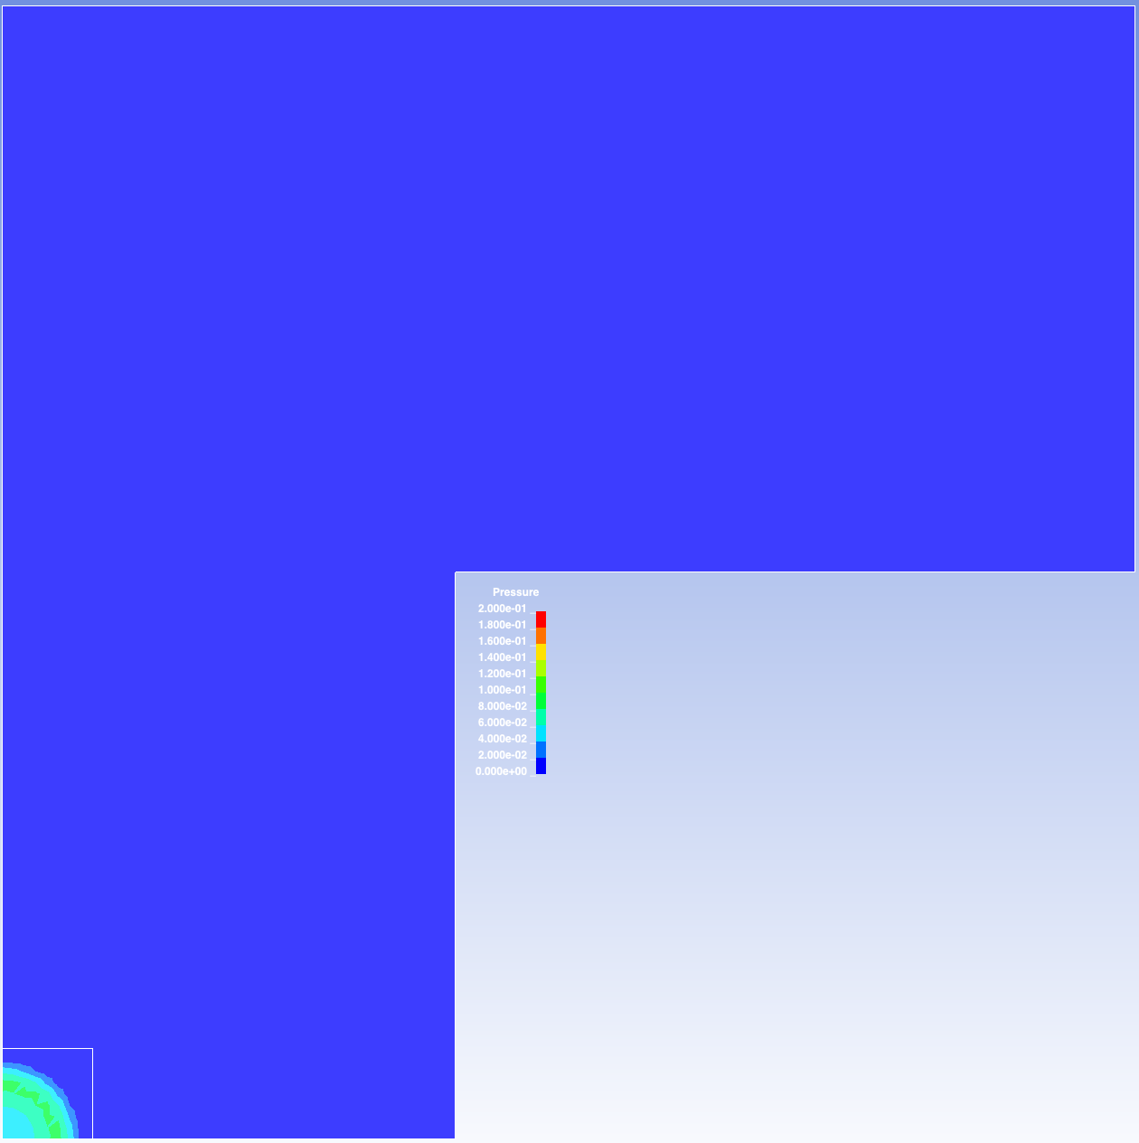
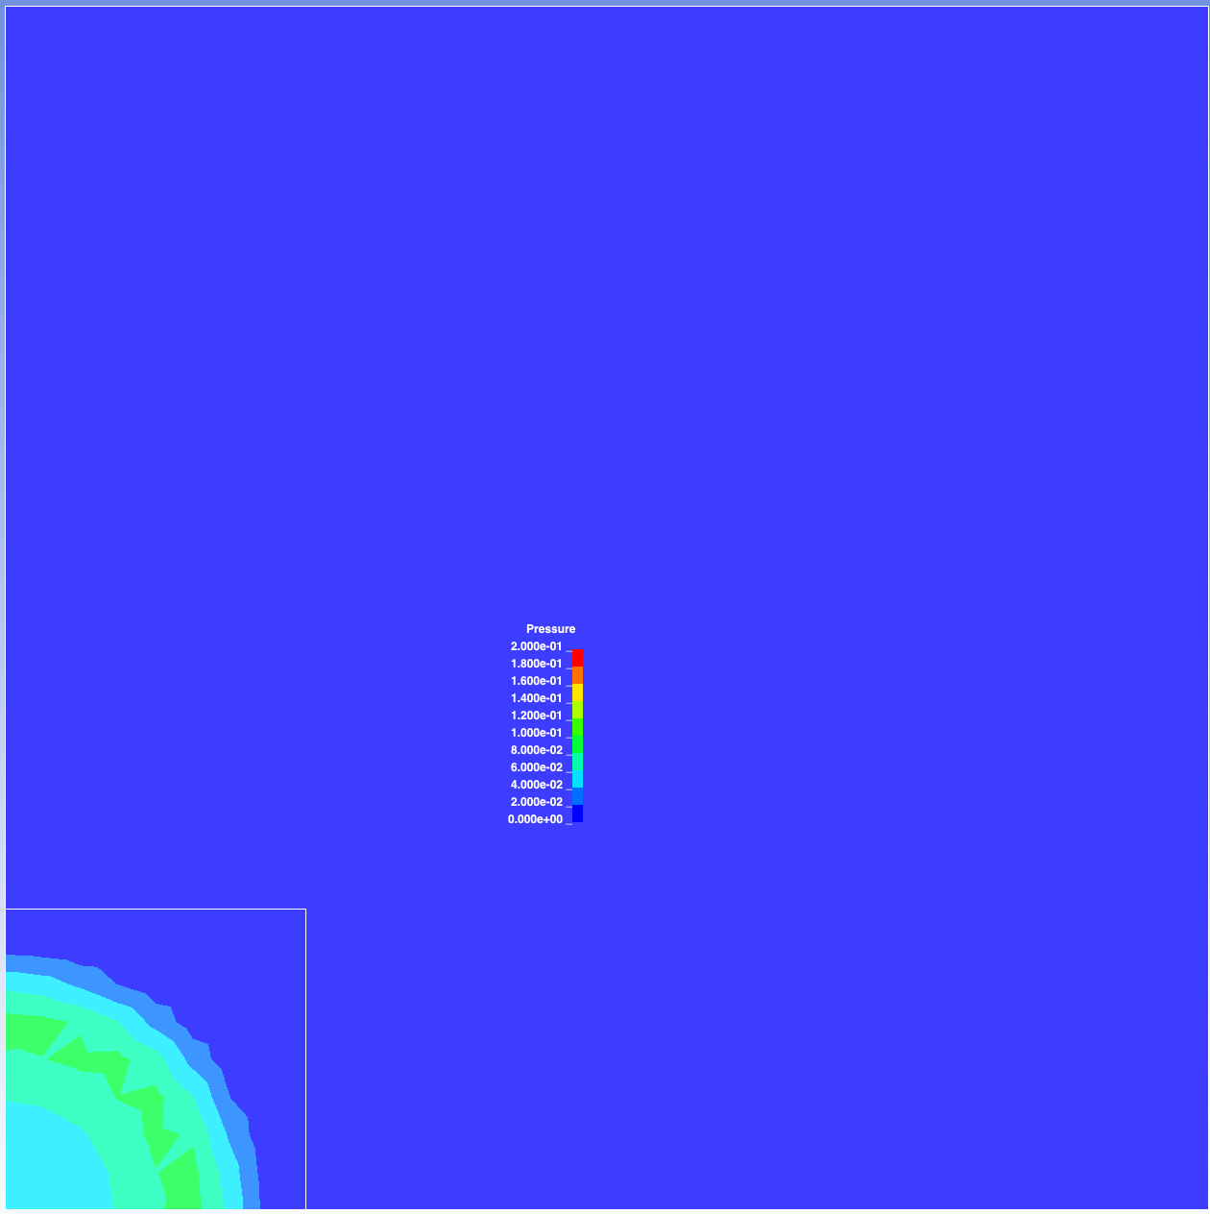
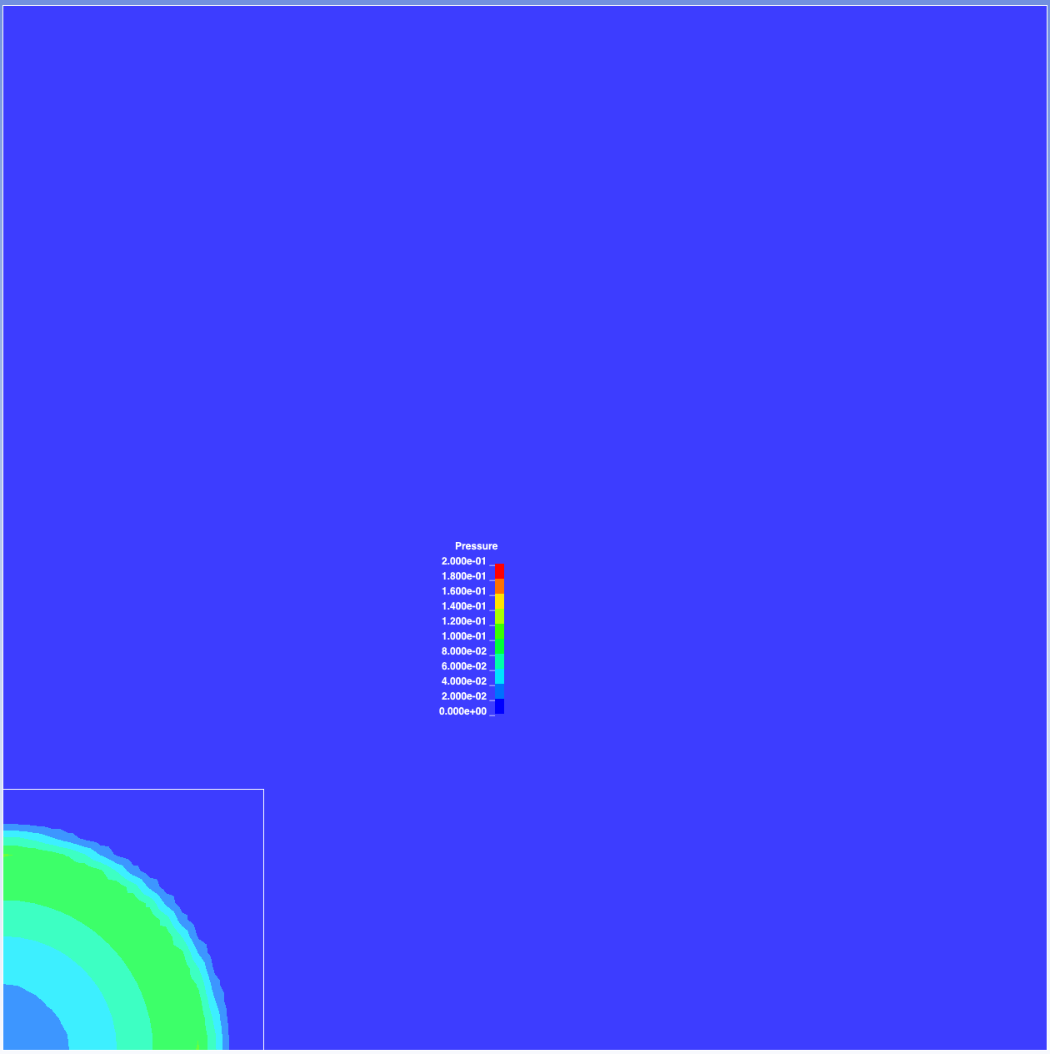
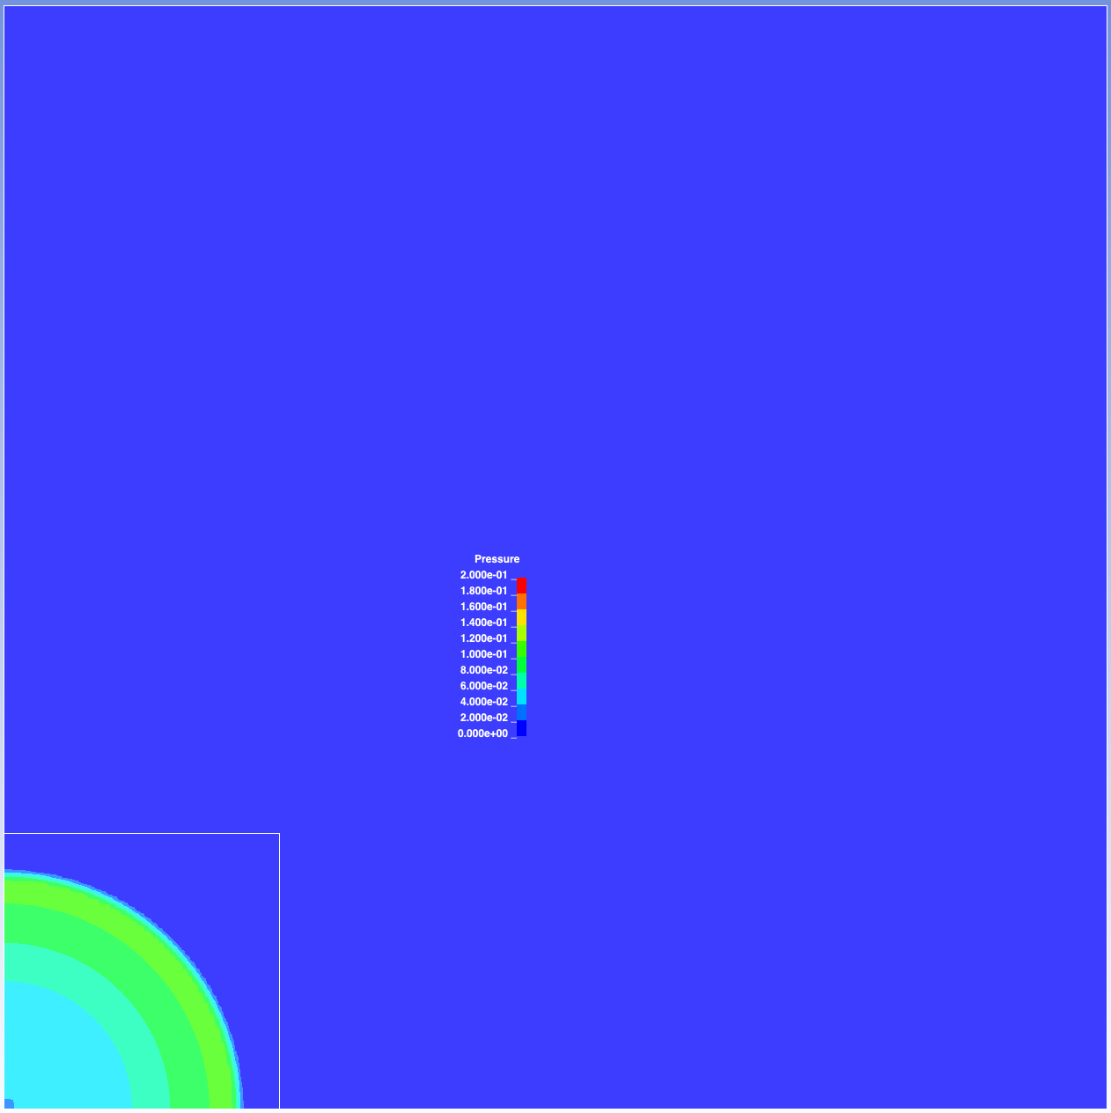
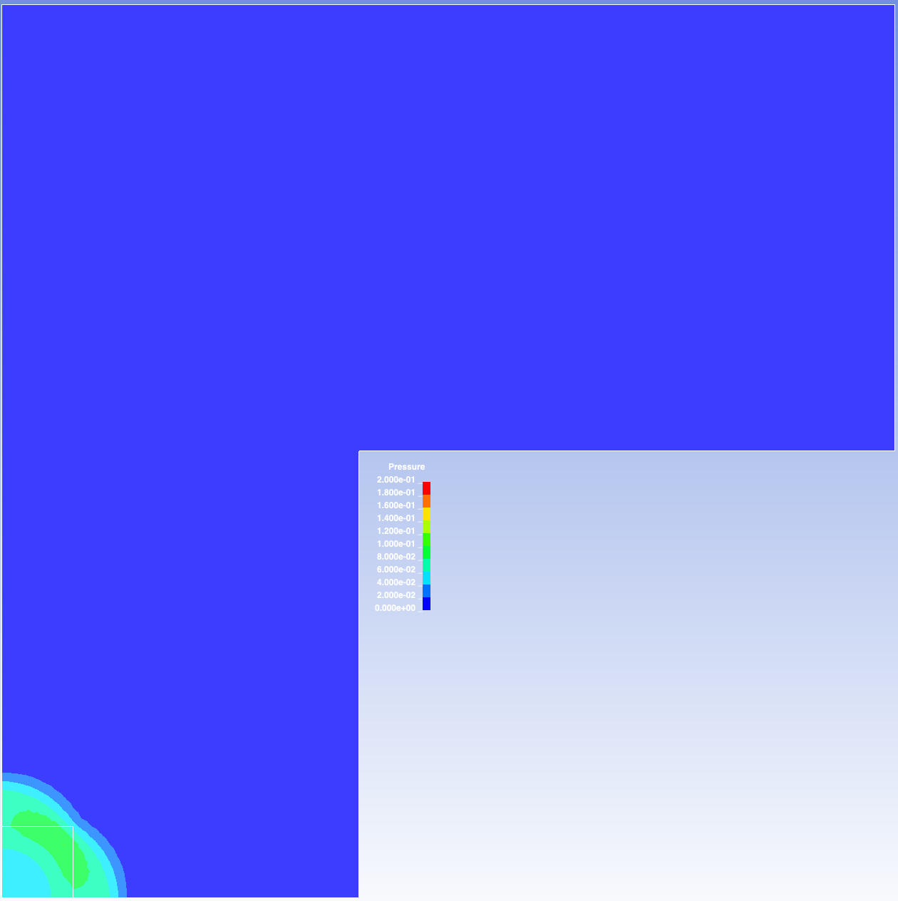
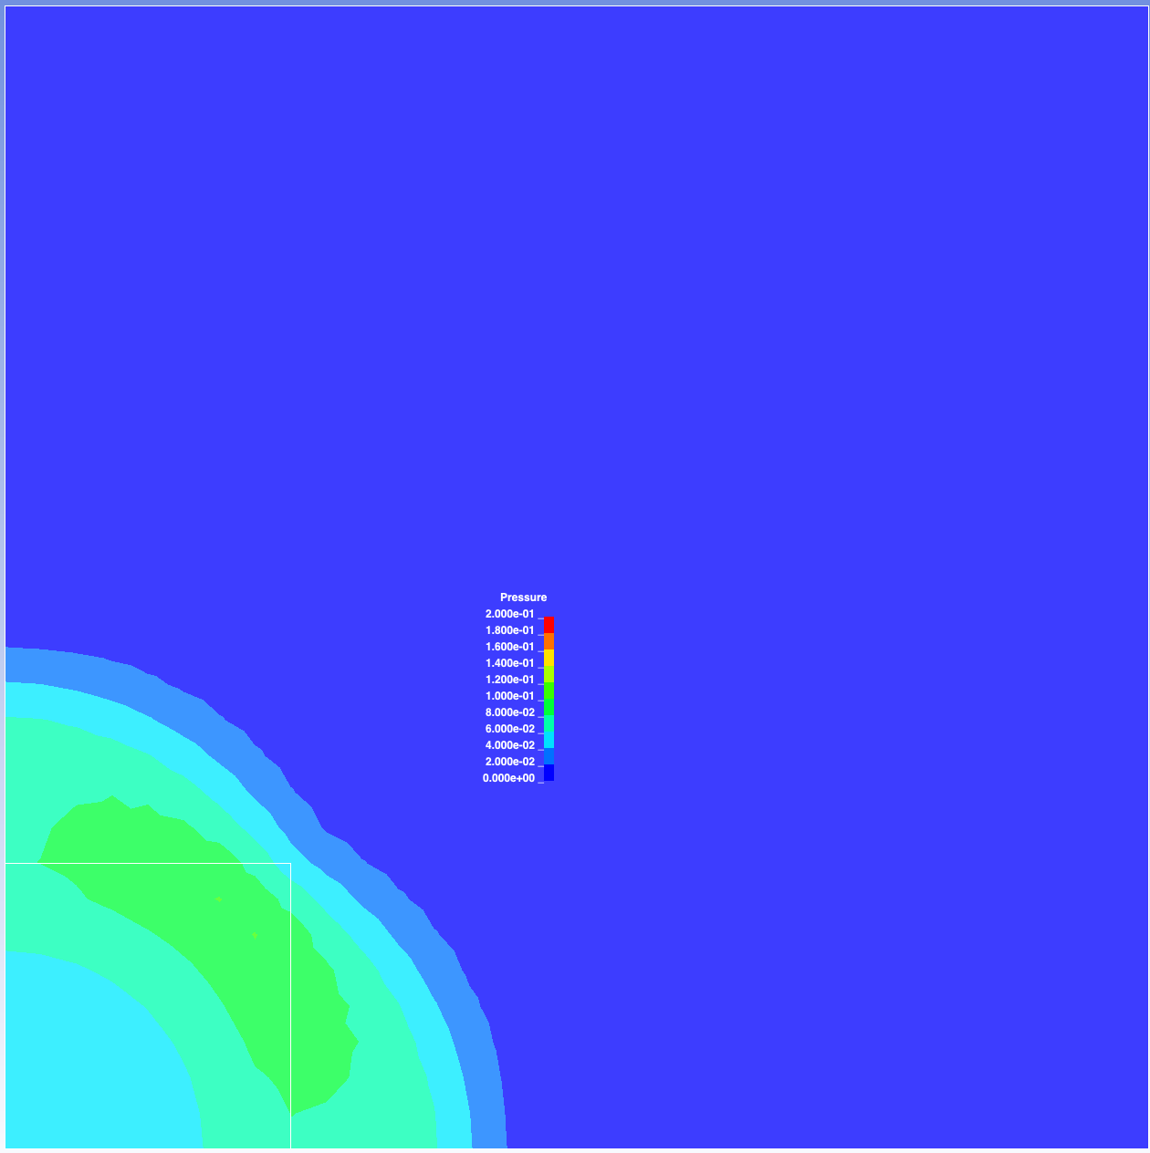
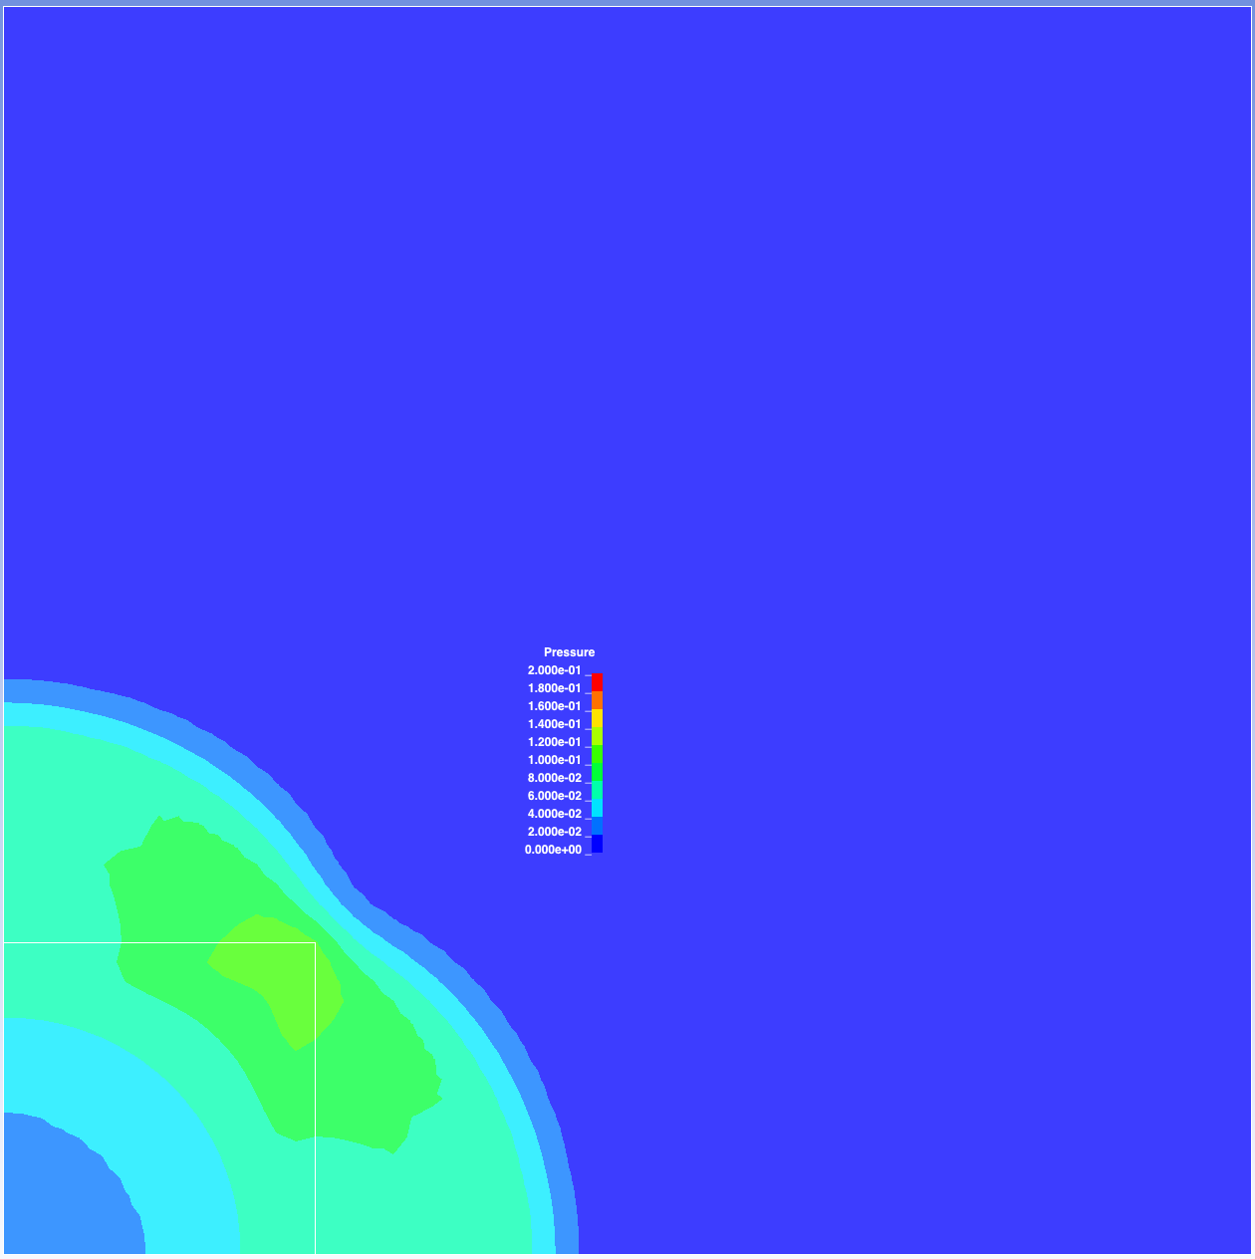
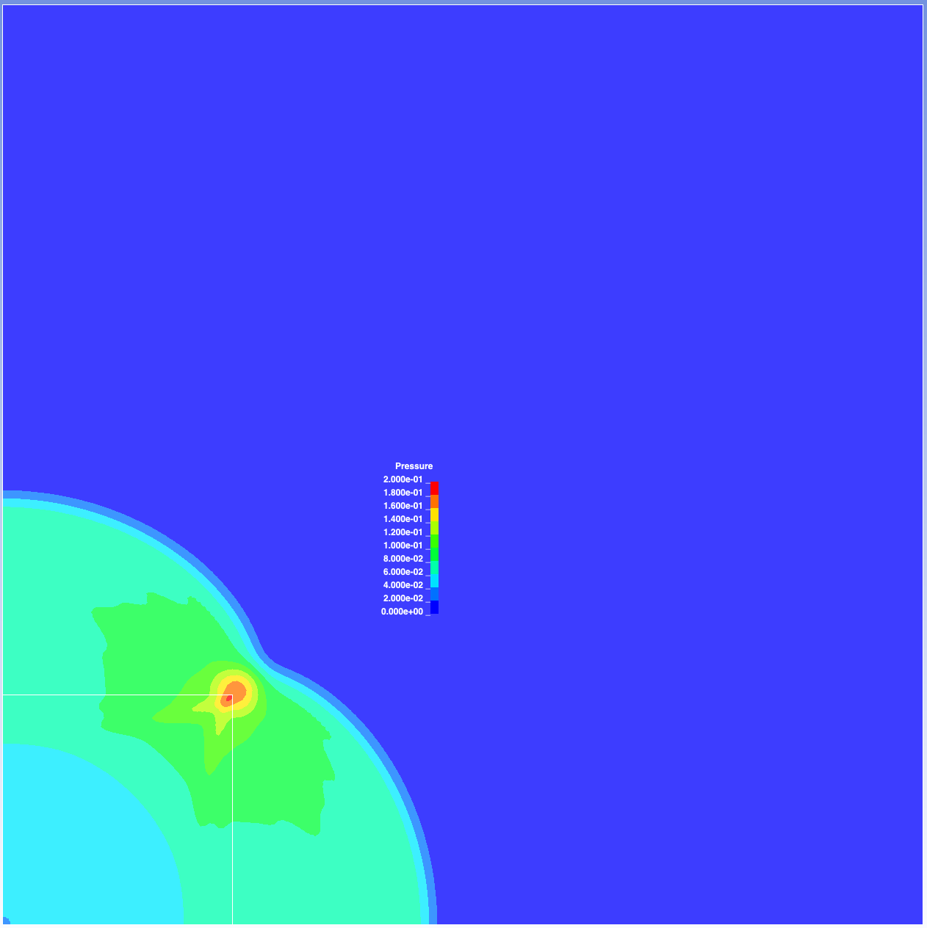
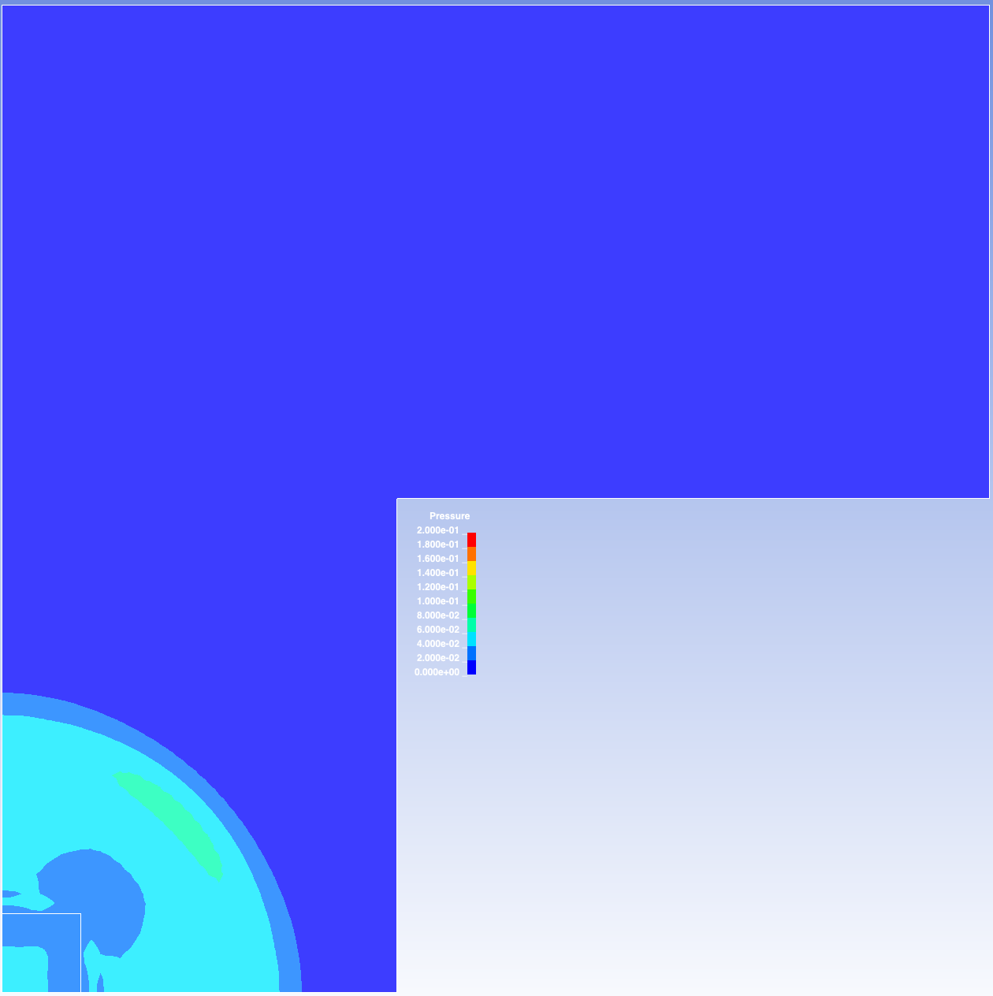
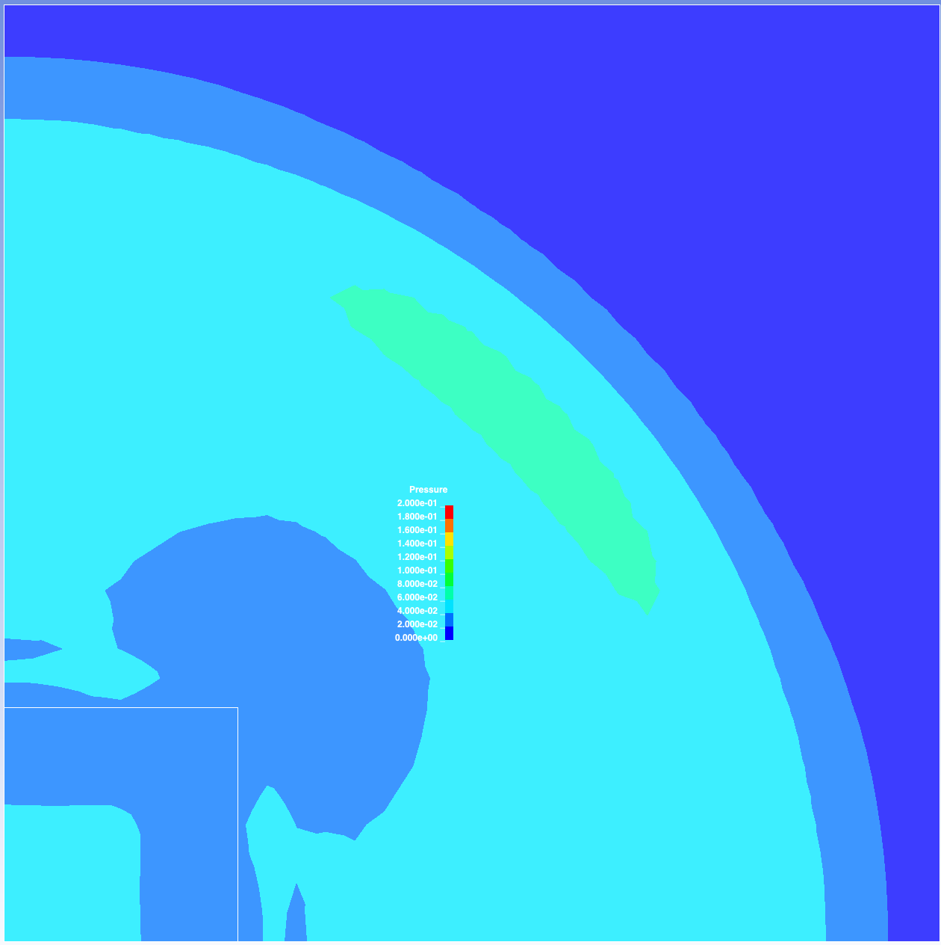
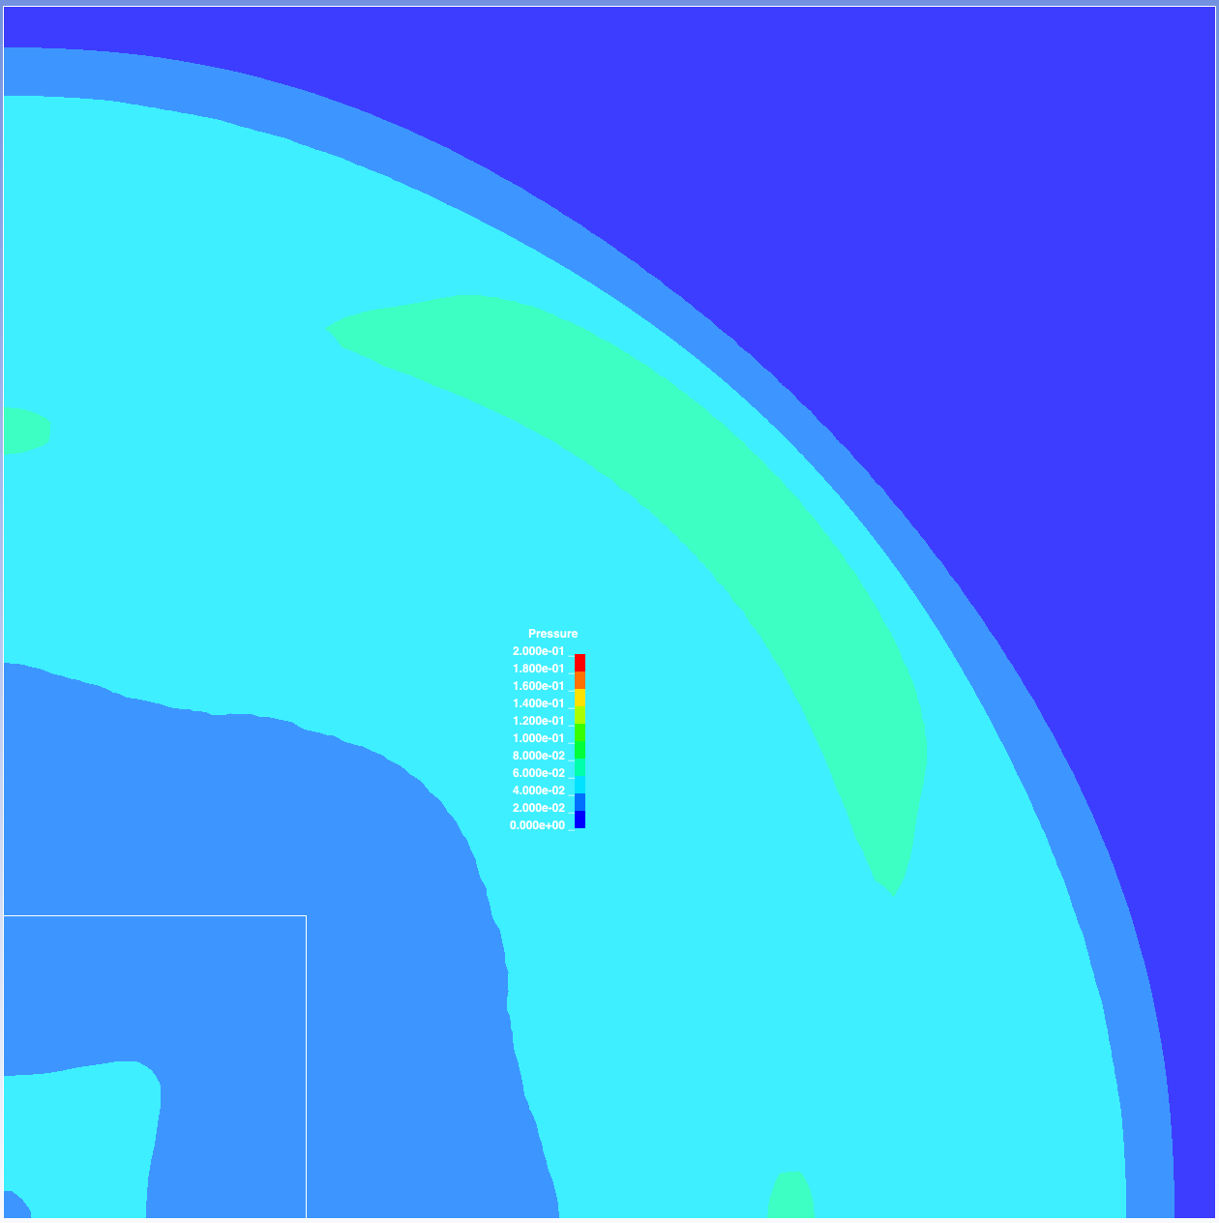
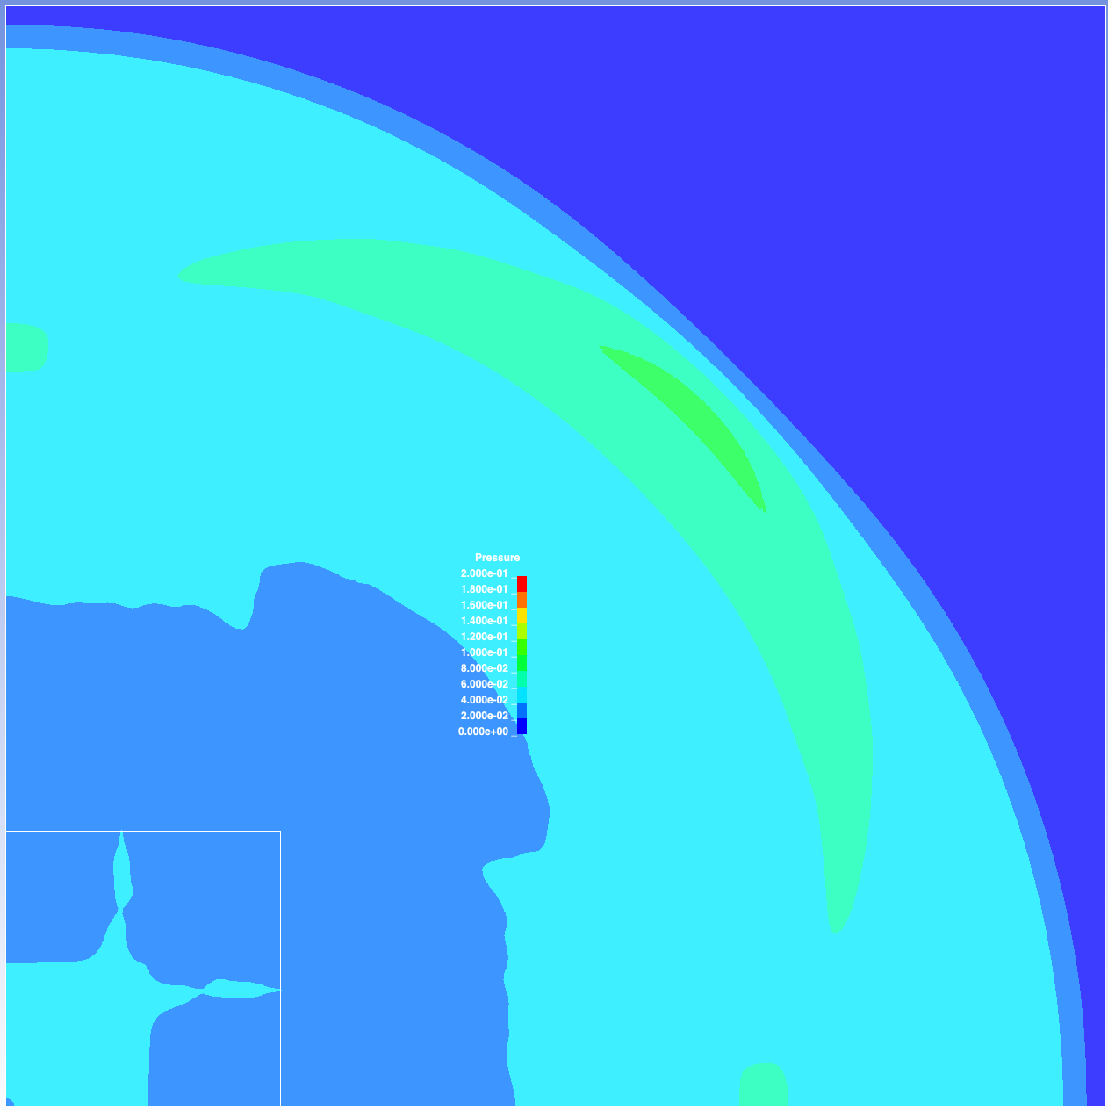
Pressure
Max p set to 0.2
LS-DYNA example
element size = 1
overall max p ~ 0.11
dimensions: 100x100x1
squareMesh32x32
element size = 1
overall max p ~ 0.11
dimensions: 32x32x1
refinedMesh05_32x32
element size = 0.5
overall max p ~ 0.14
dimensions: 32x32x1
refinedMesh016_32x32
element size = 0.16
overall max p ~ 0.19
dimensions: 32x32x1
Frame 10
Frame 16
Frame 27

Slide 2
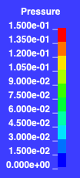

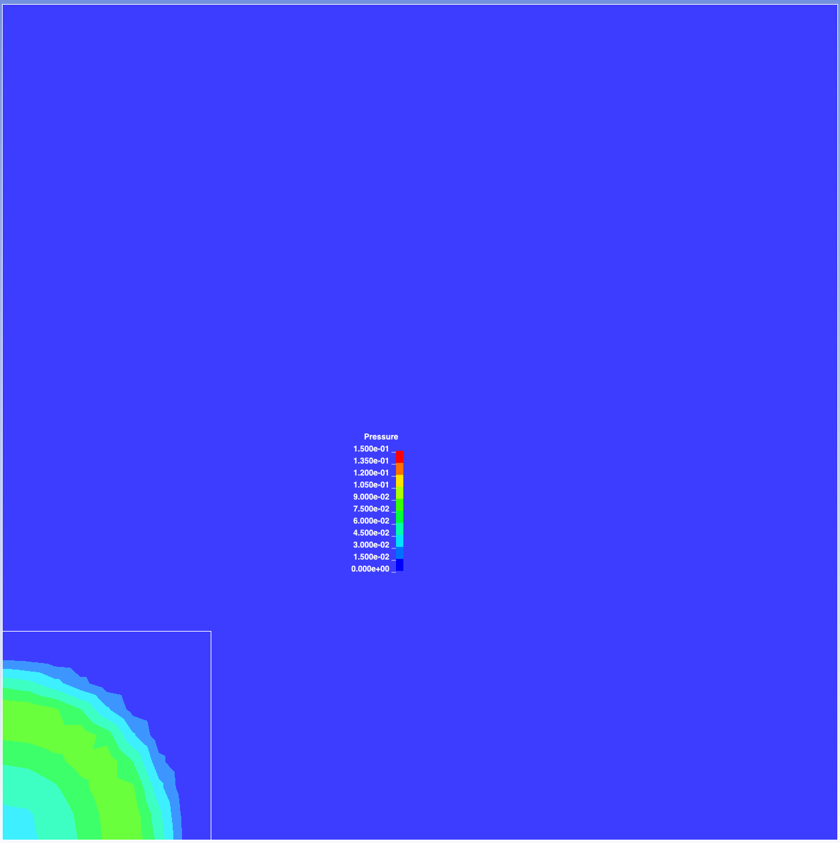

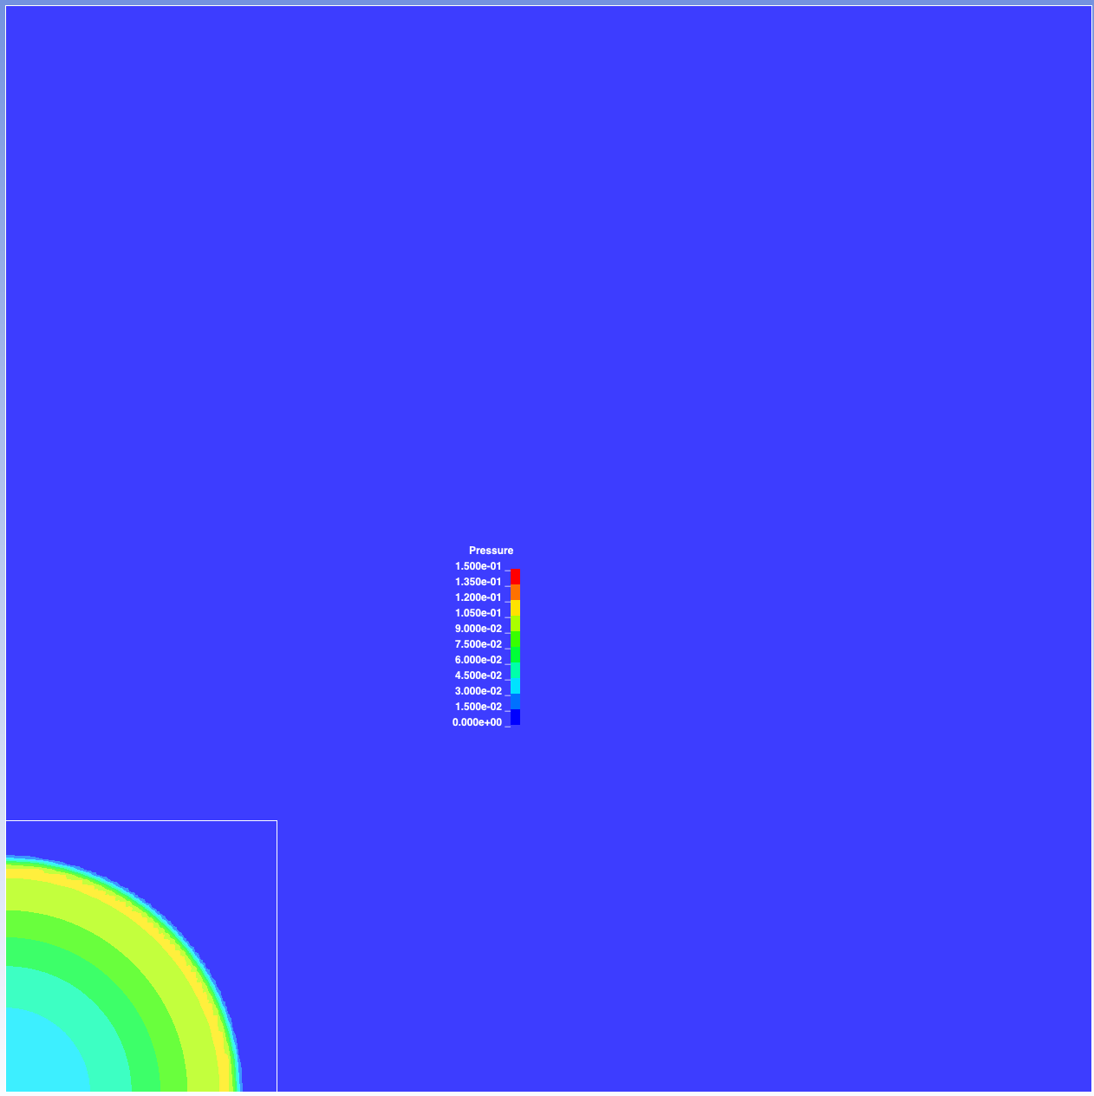
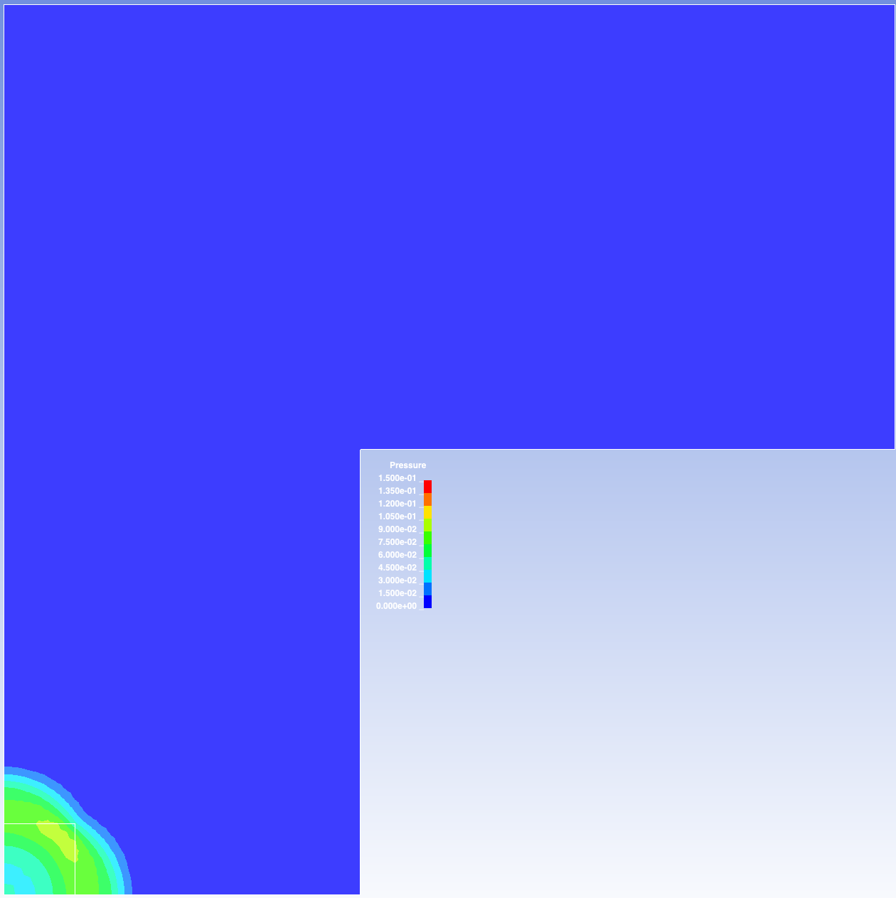
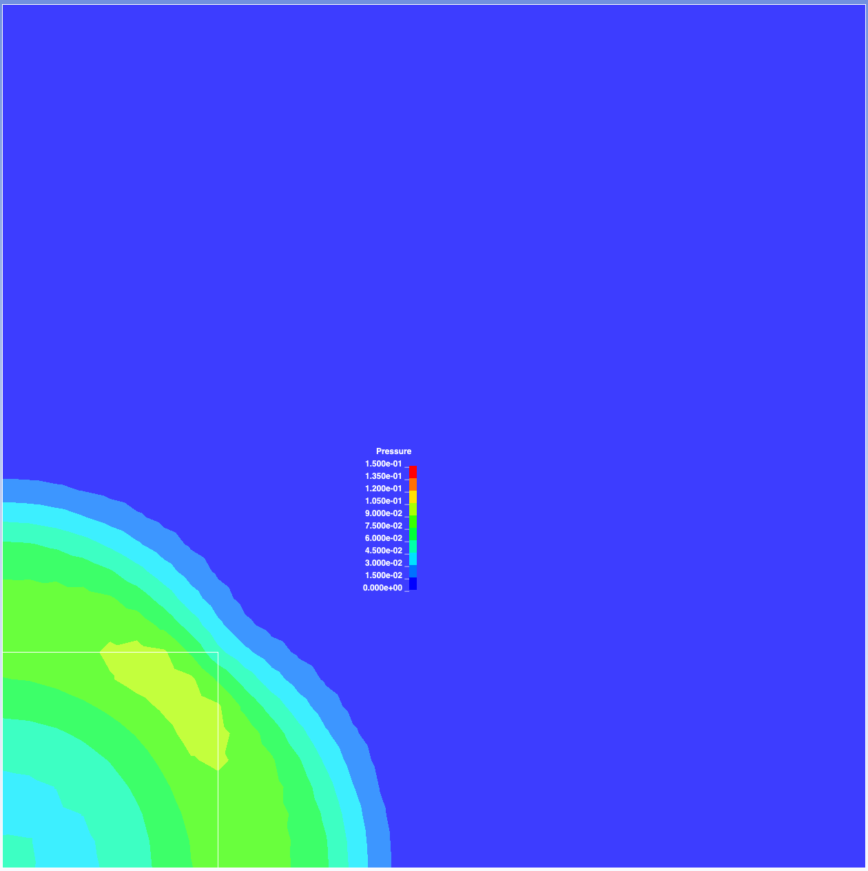
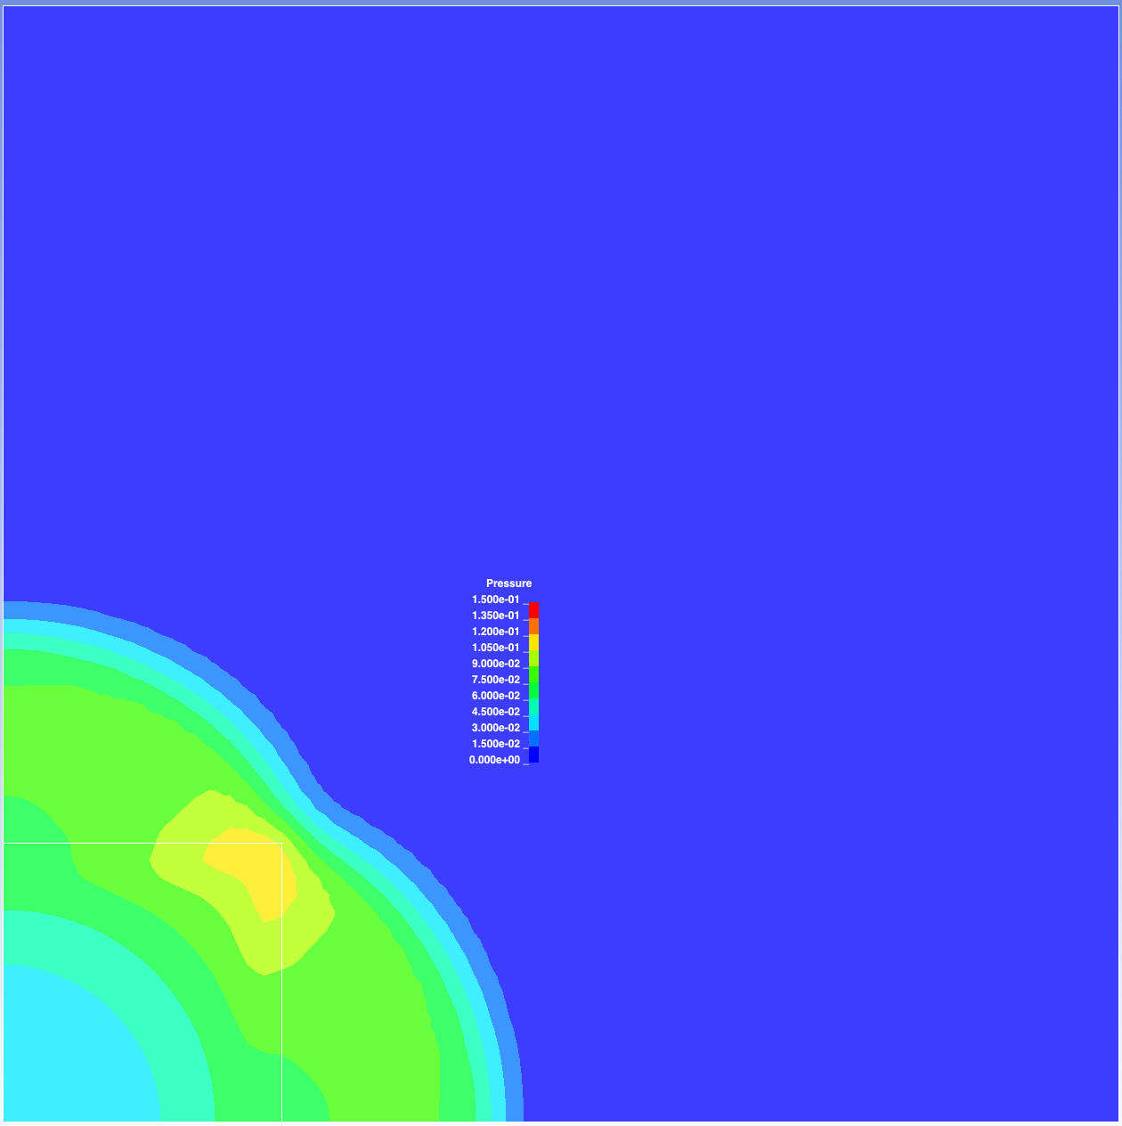
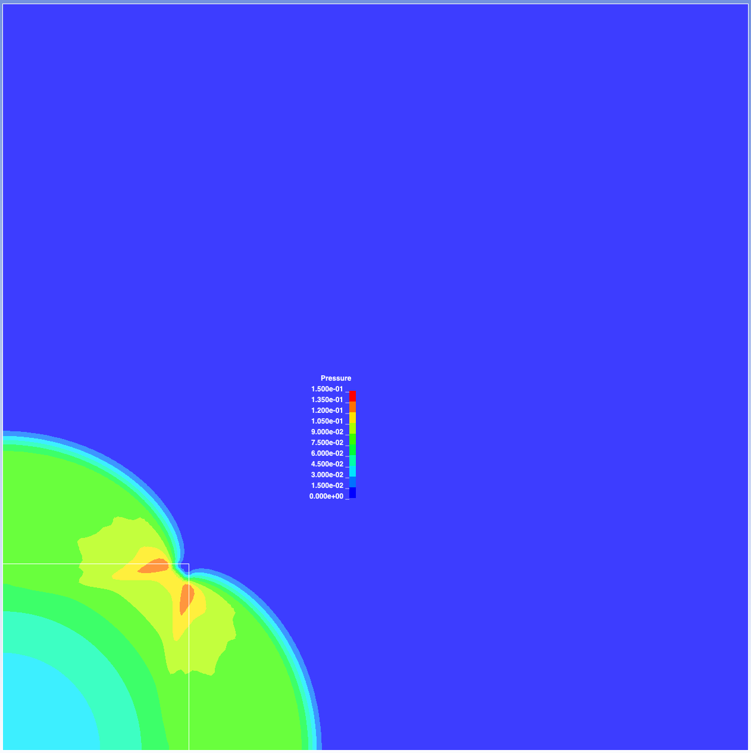
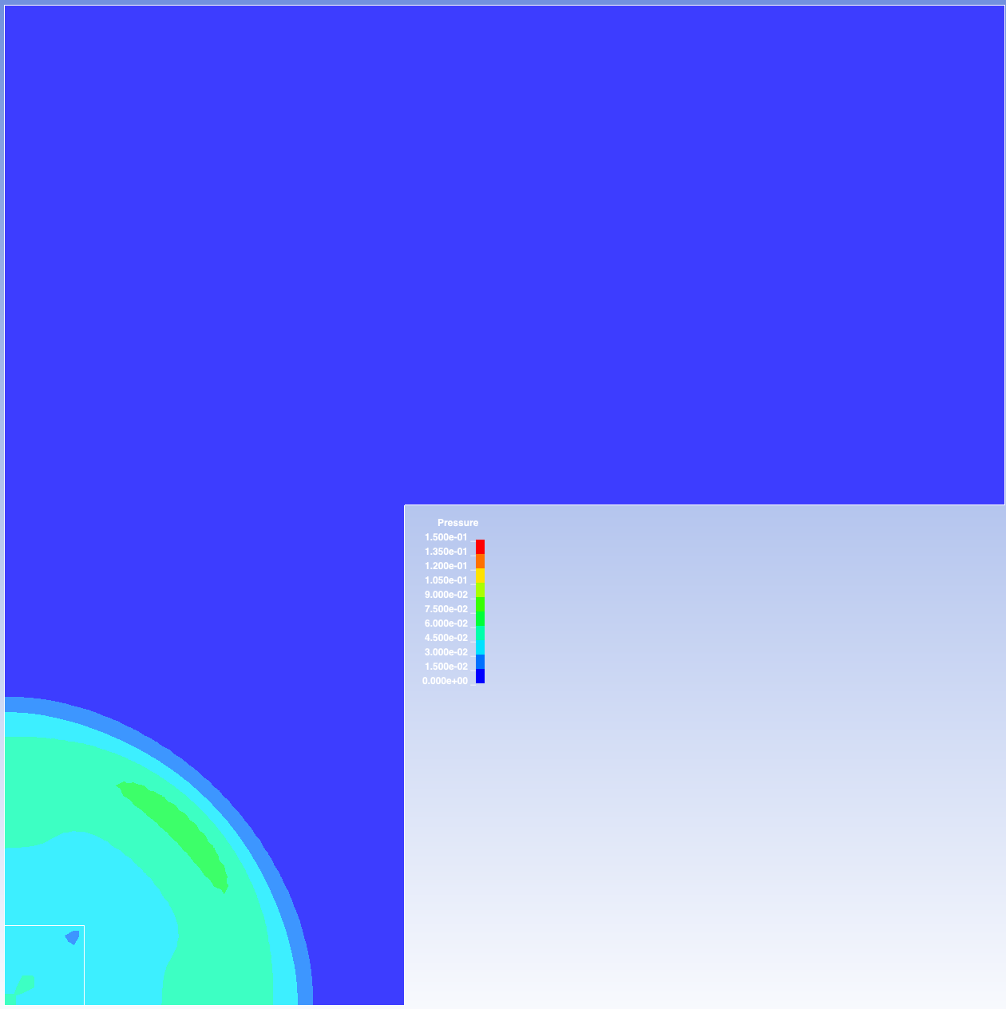
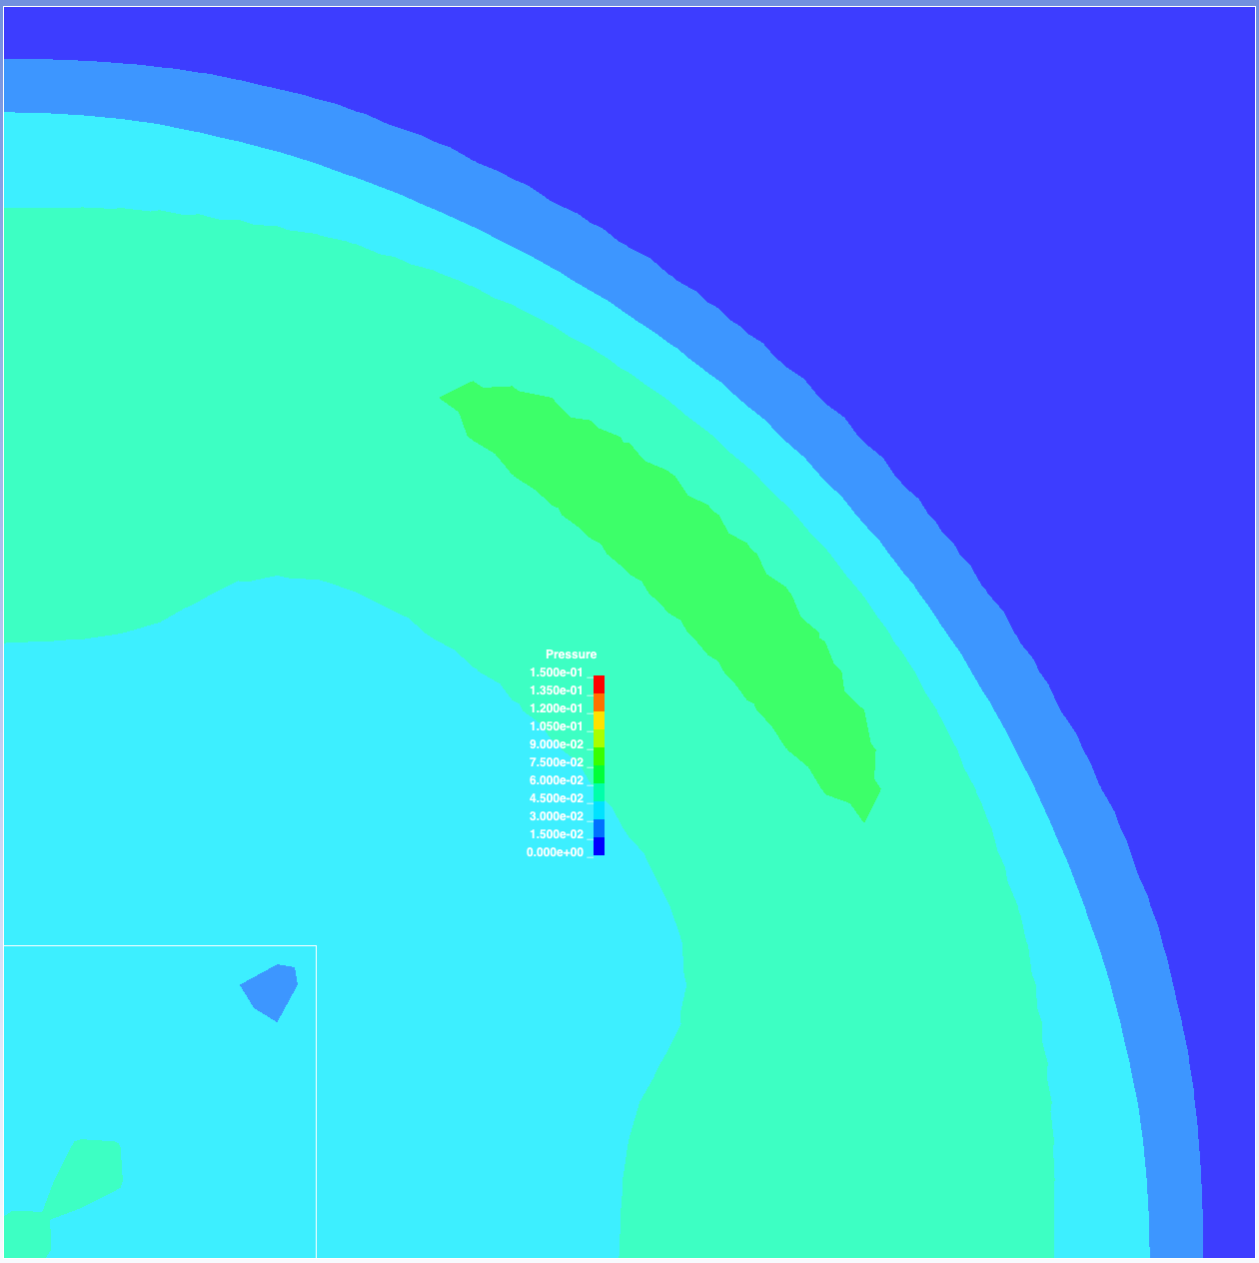
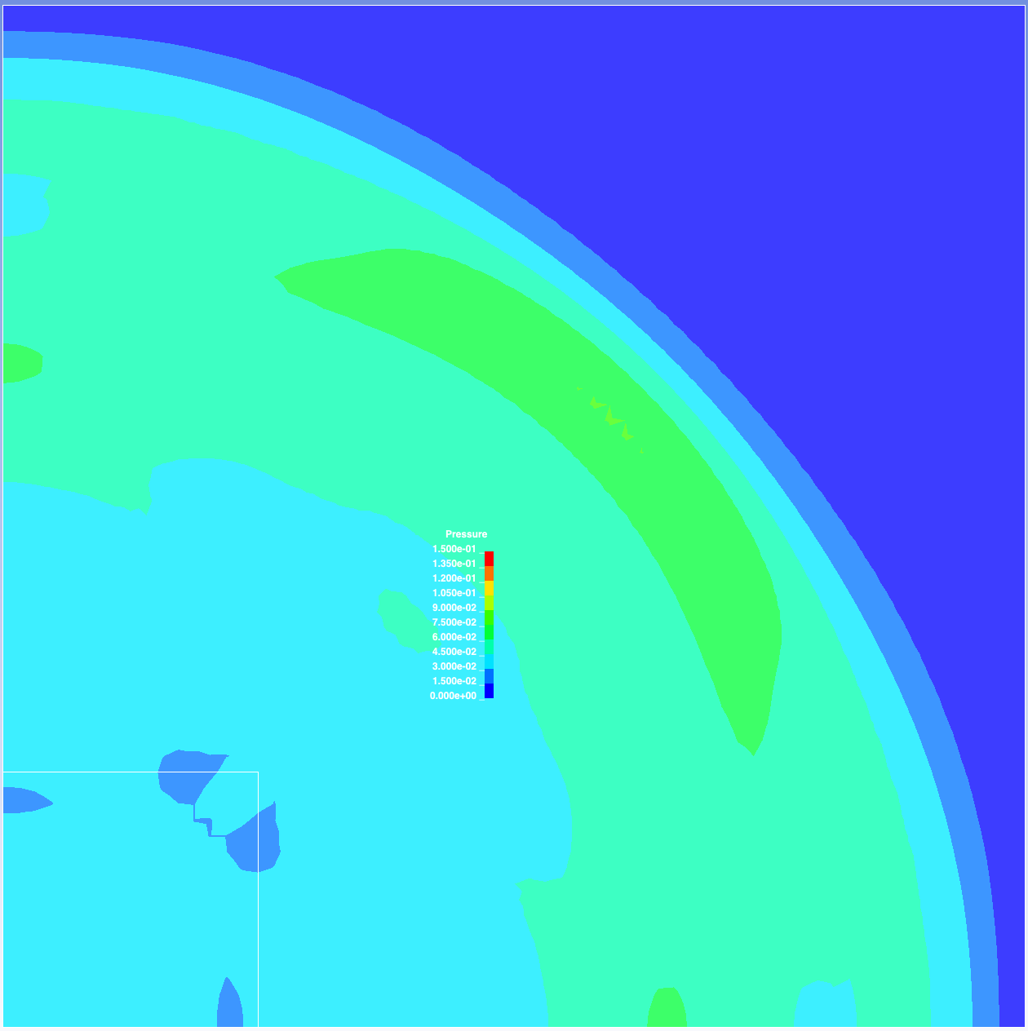
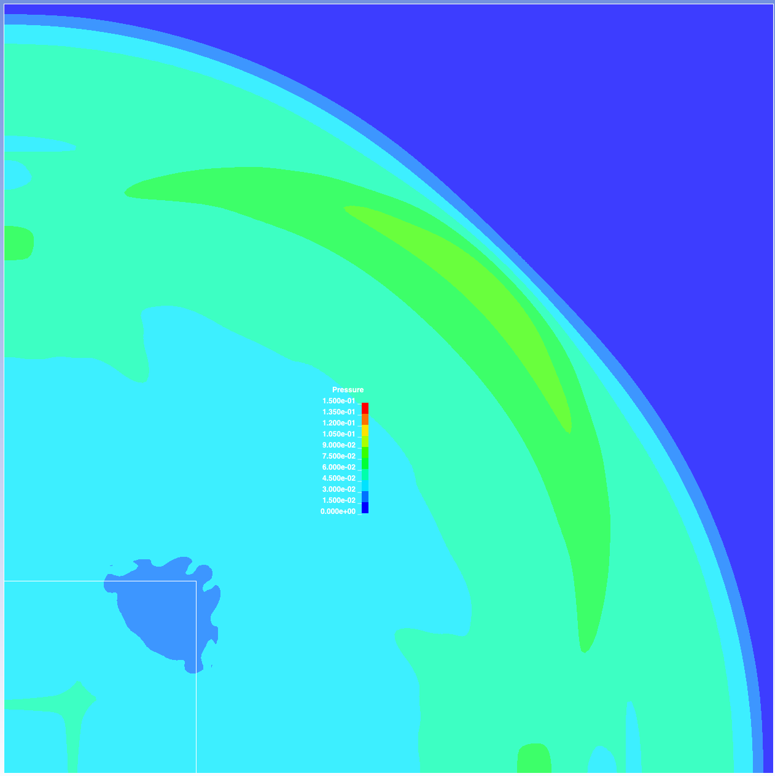
Pressure
Max p set to 0.15
LS-DYNA example
element size = 1
overall max p ~ 0.11
dimensions: 100x100x1
squareMesh32x32
element size = 1
overall max p ~ 0.11
dimensions: 32x32x1
refinedMesh05_32x32
element size = 0.5
overall max p ~ 0.14
dimensions: 32x32x1
refinedMesh016_32x32
element size = 0.16
overall max p ~ 0.19
dimensions: 32x32x1
Frame 10
Frame 16
Frame 27

Slide 3
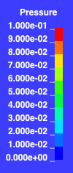
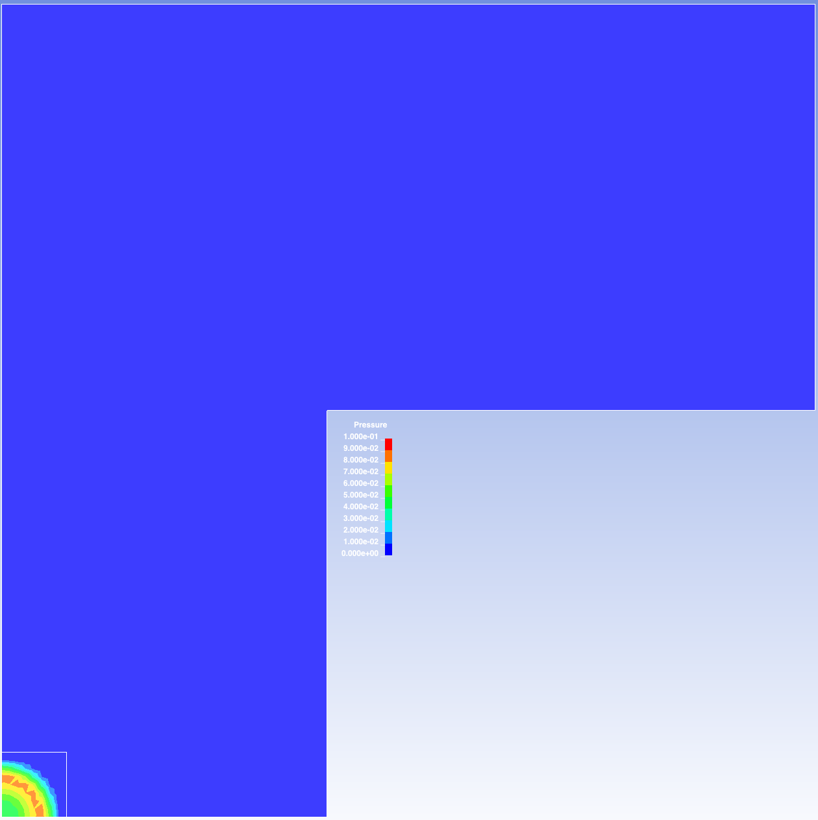

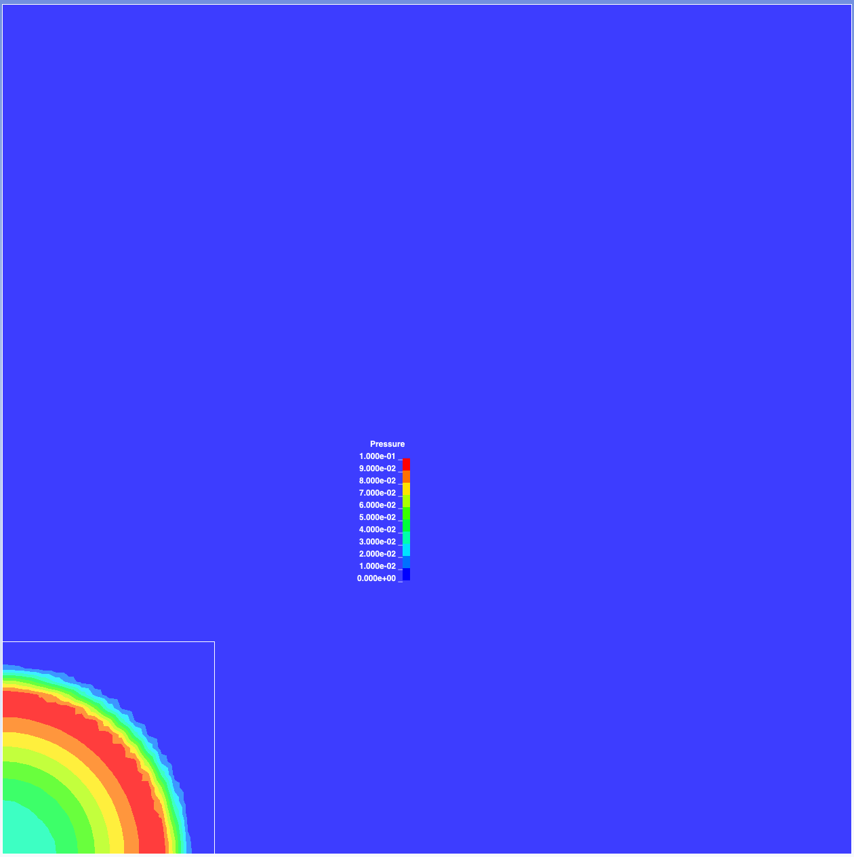
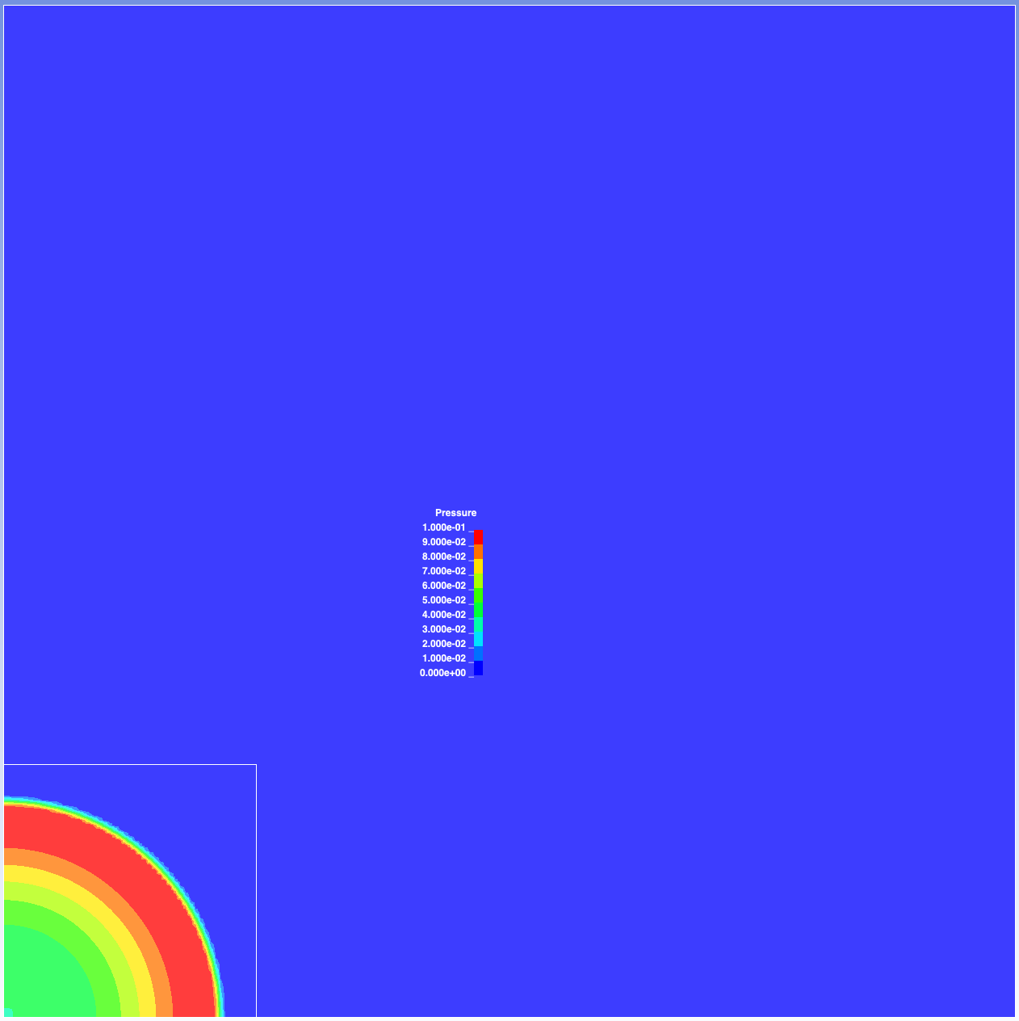
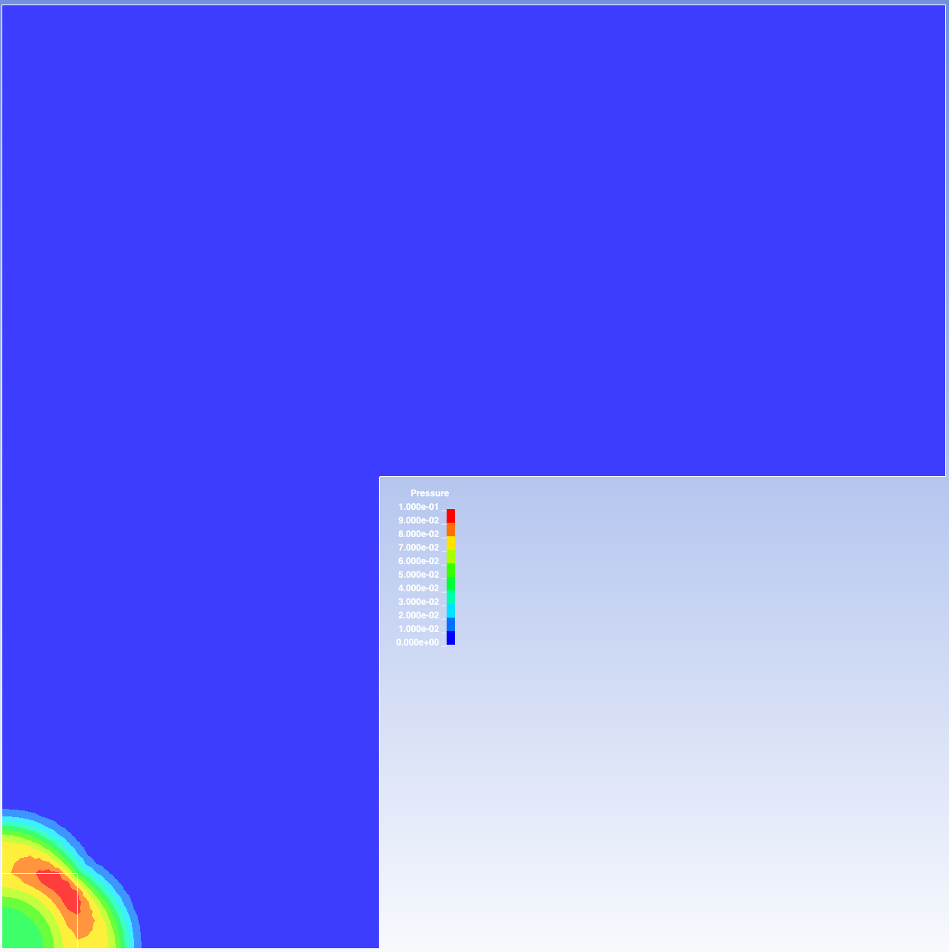
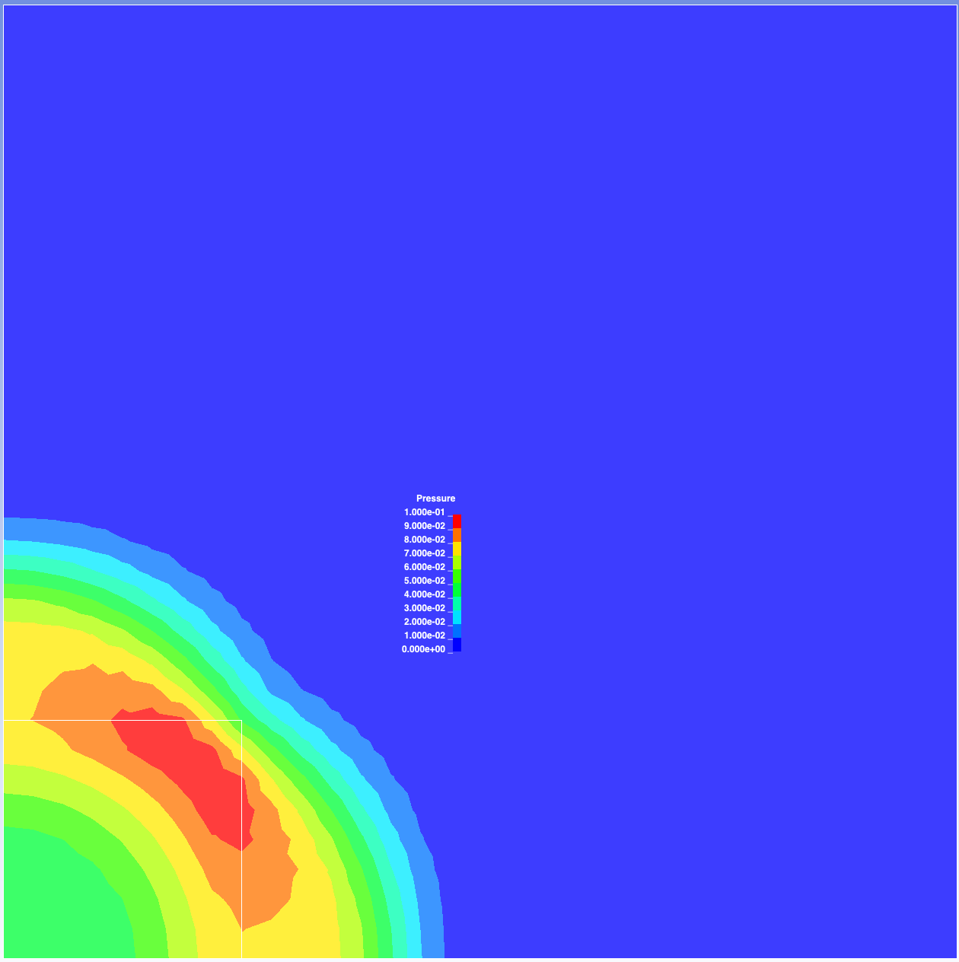
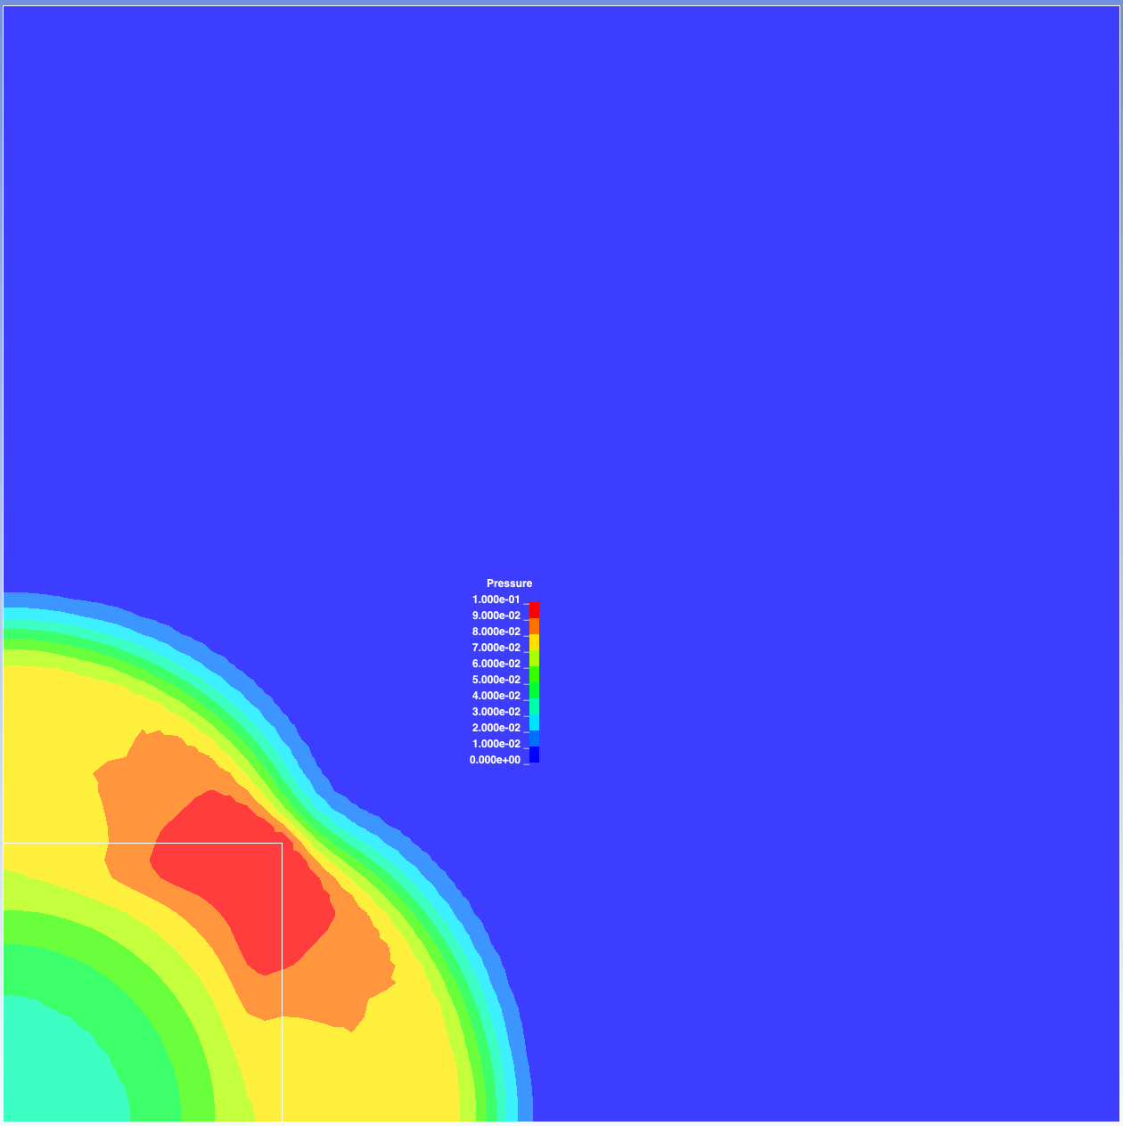
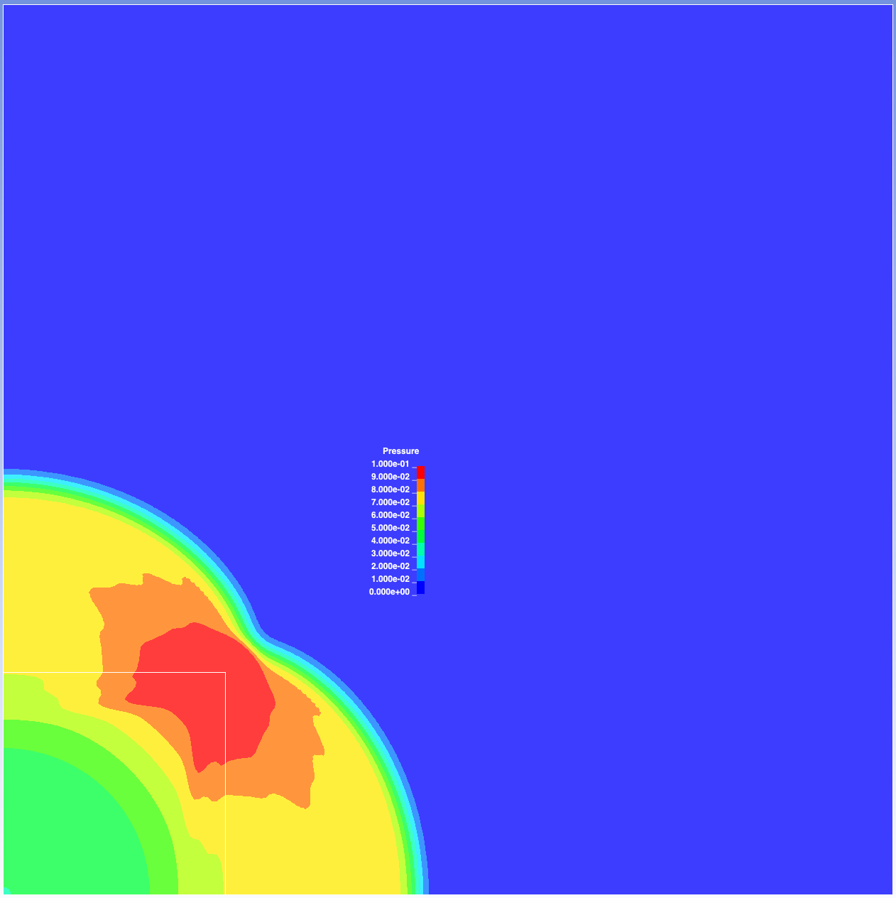
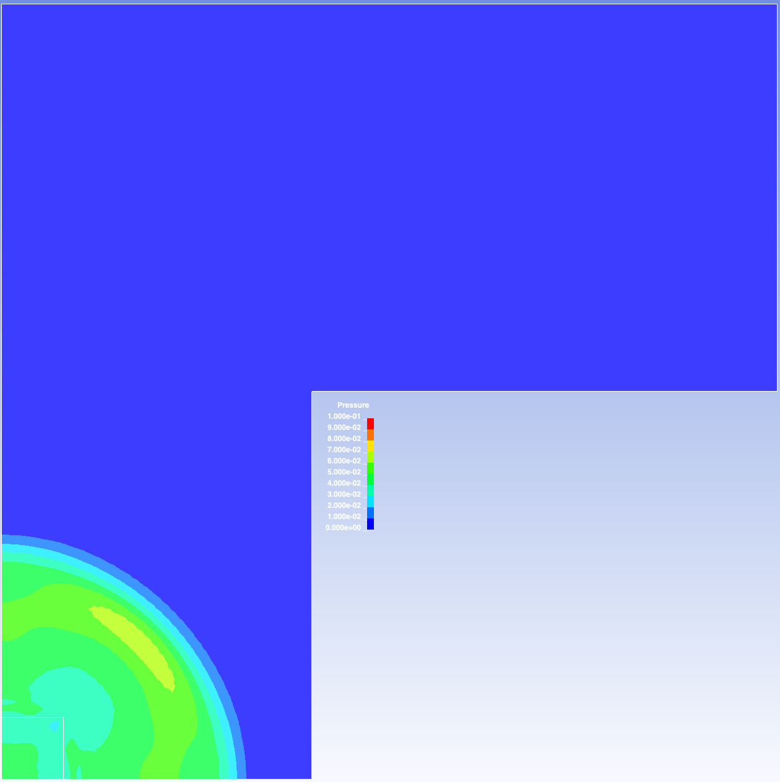
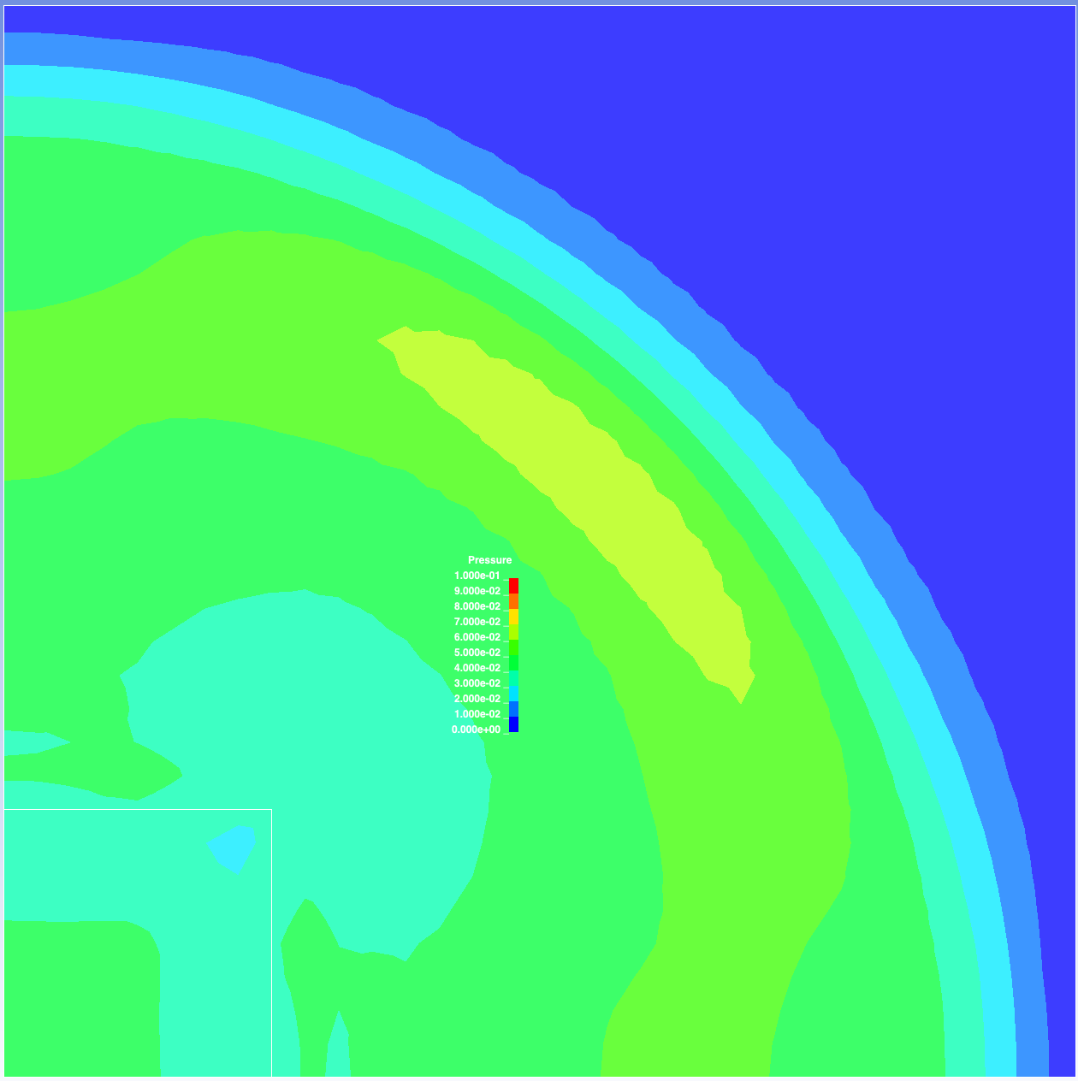
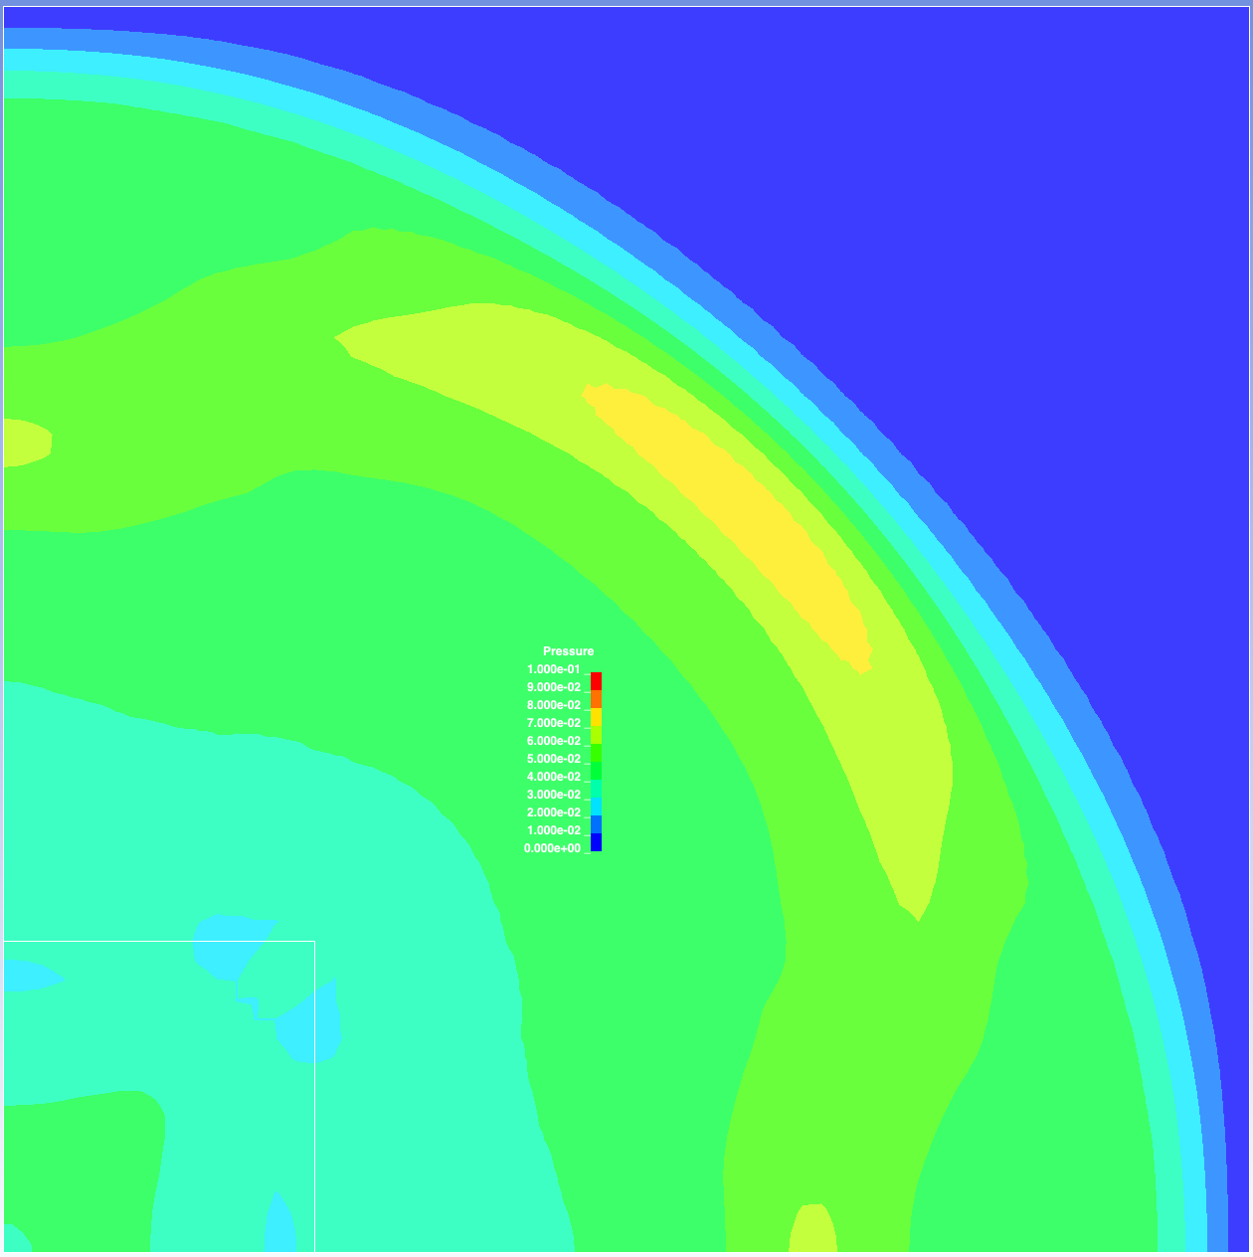
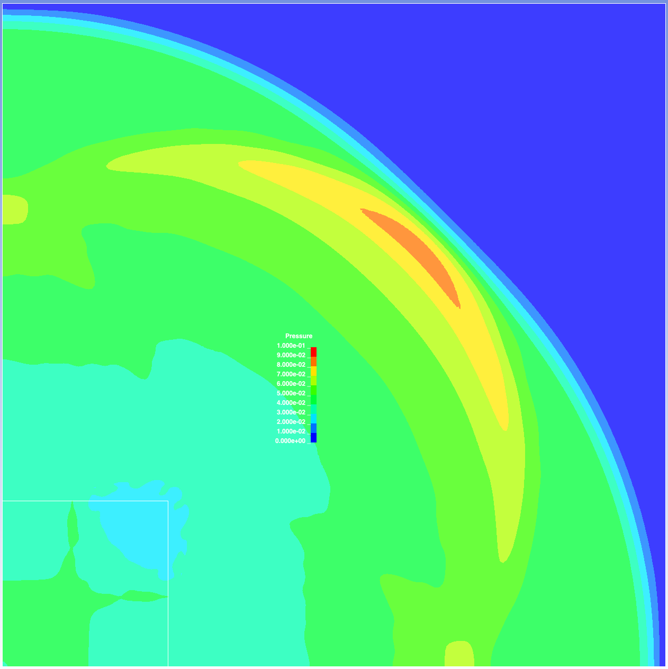
Pressure
Max p set to 0.1
LS-DYNA example
element size = 1
overall max p ~ 0.11
dimensions: 100x100x1
squareMesh32x32
element size = 1
overall max p ~ 0.11
dimensions: 32x32x1
refinedMesh05_32x32
element size = 0.5
overall max p ~ 0.14
dimensions: 32x32x1
refinedMesh016_32x32
element size = 0.16
overall max p ~ 0.19
dimensions: 32x32x1
Frame 10
Frame 16
Frame 27

Slide 4
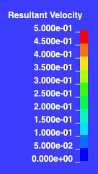
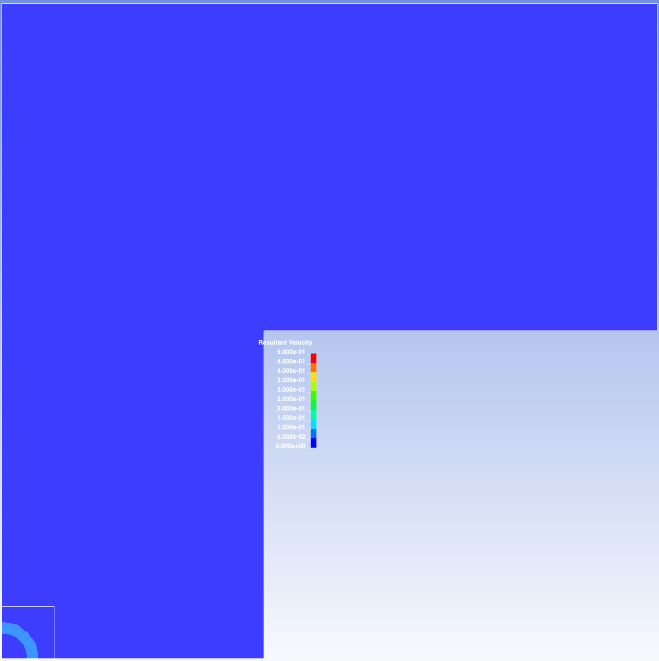
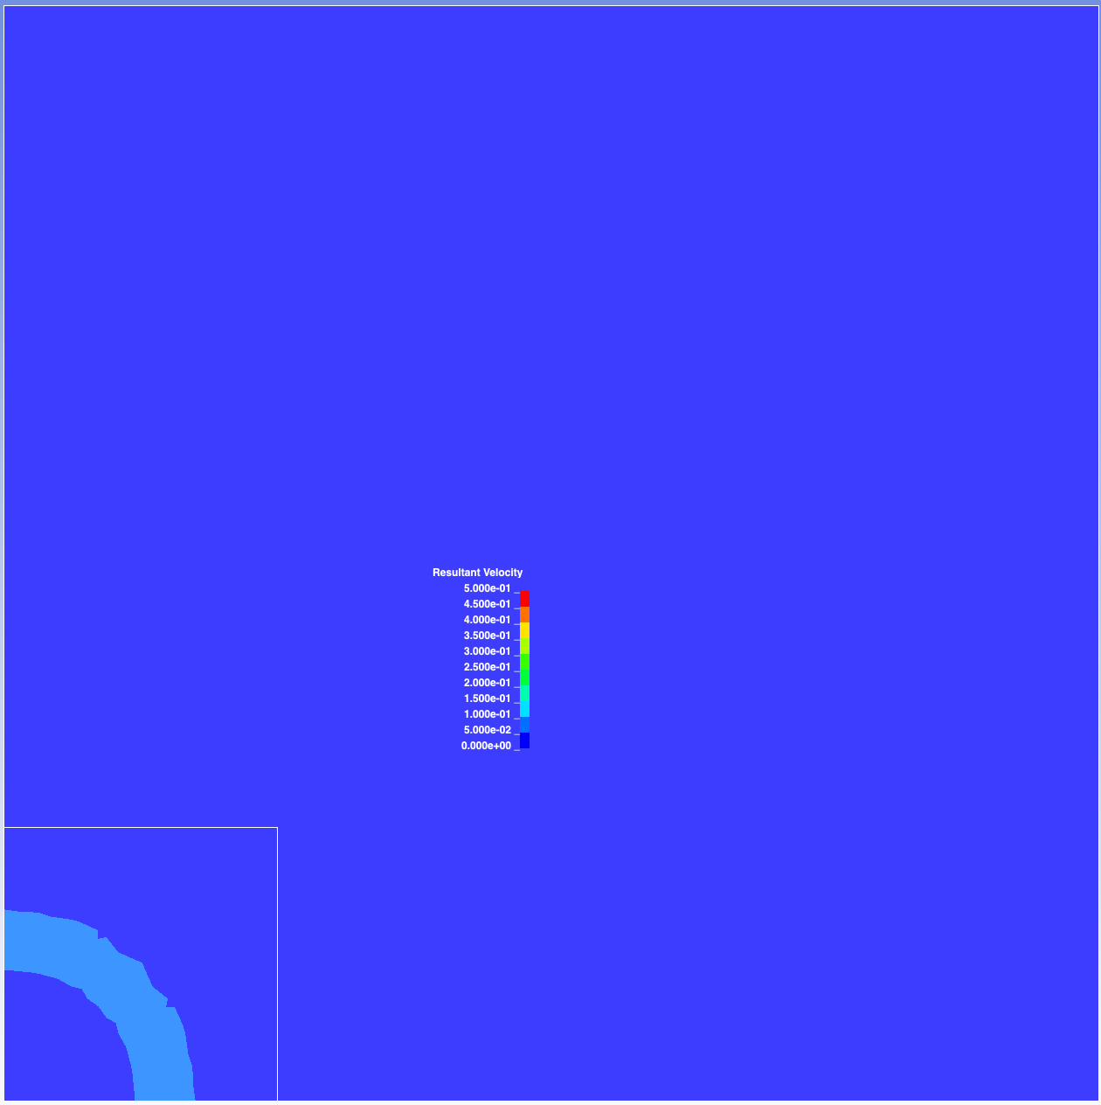
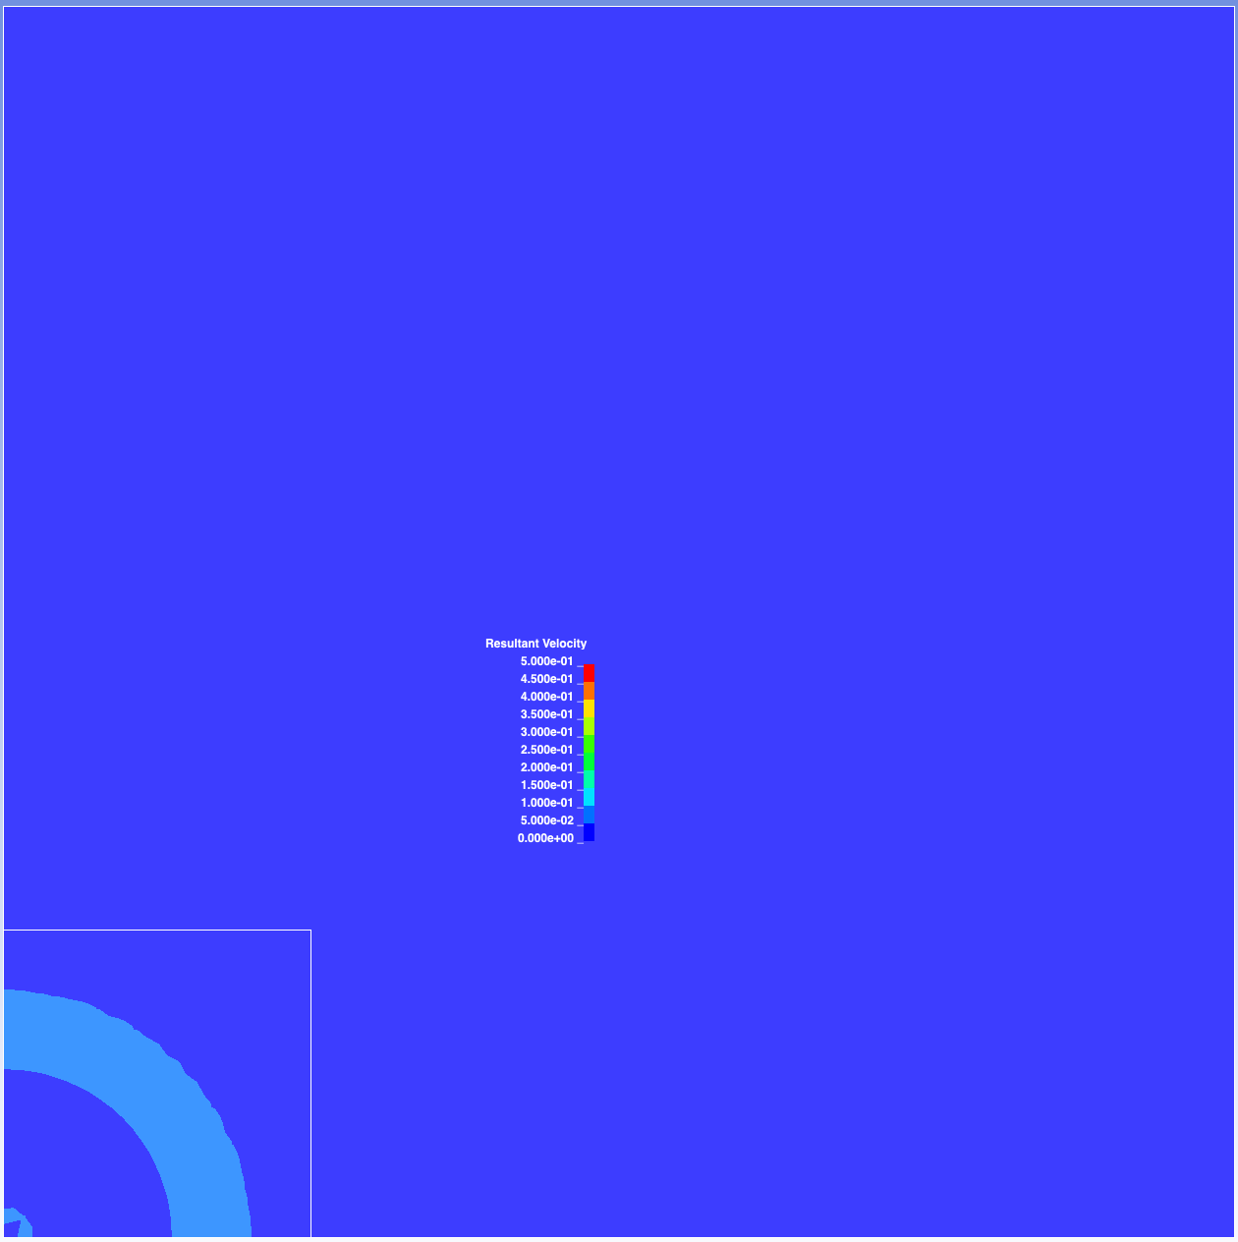
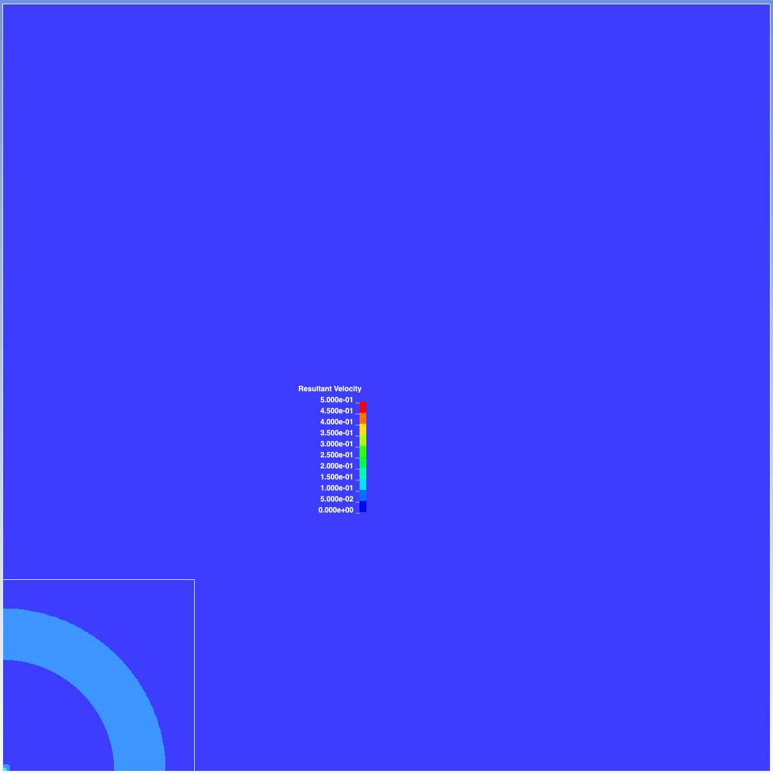
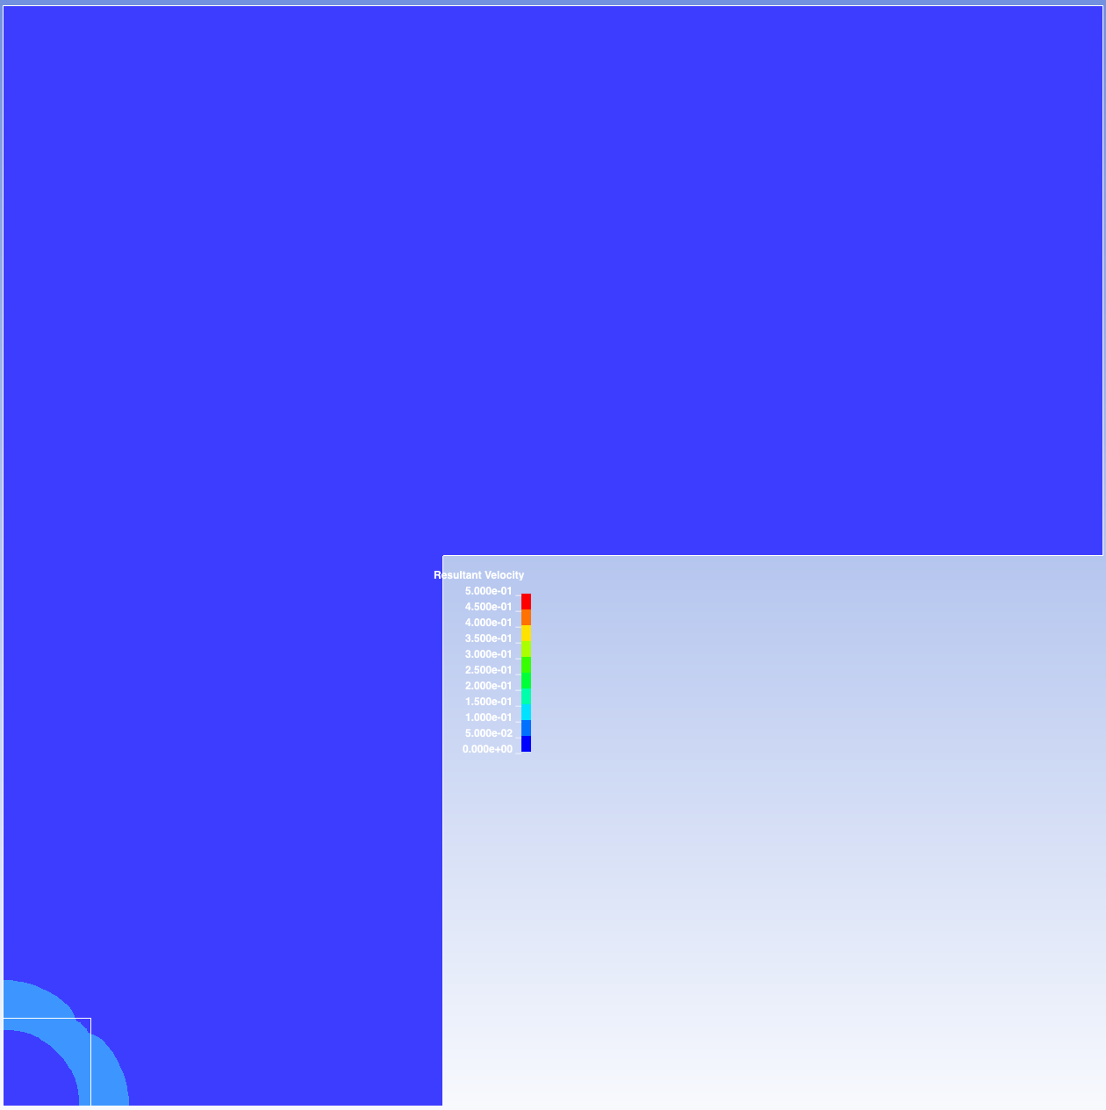
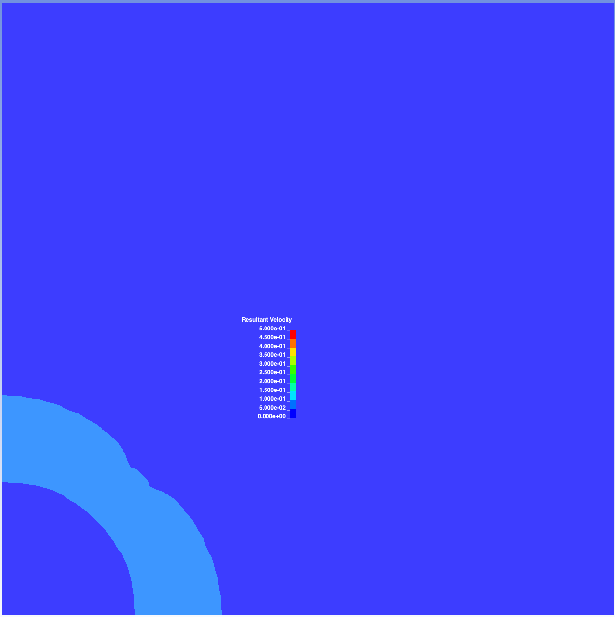
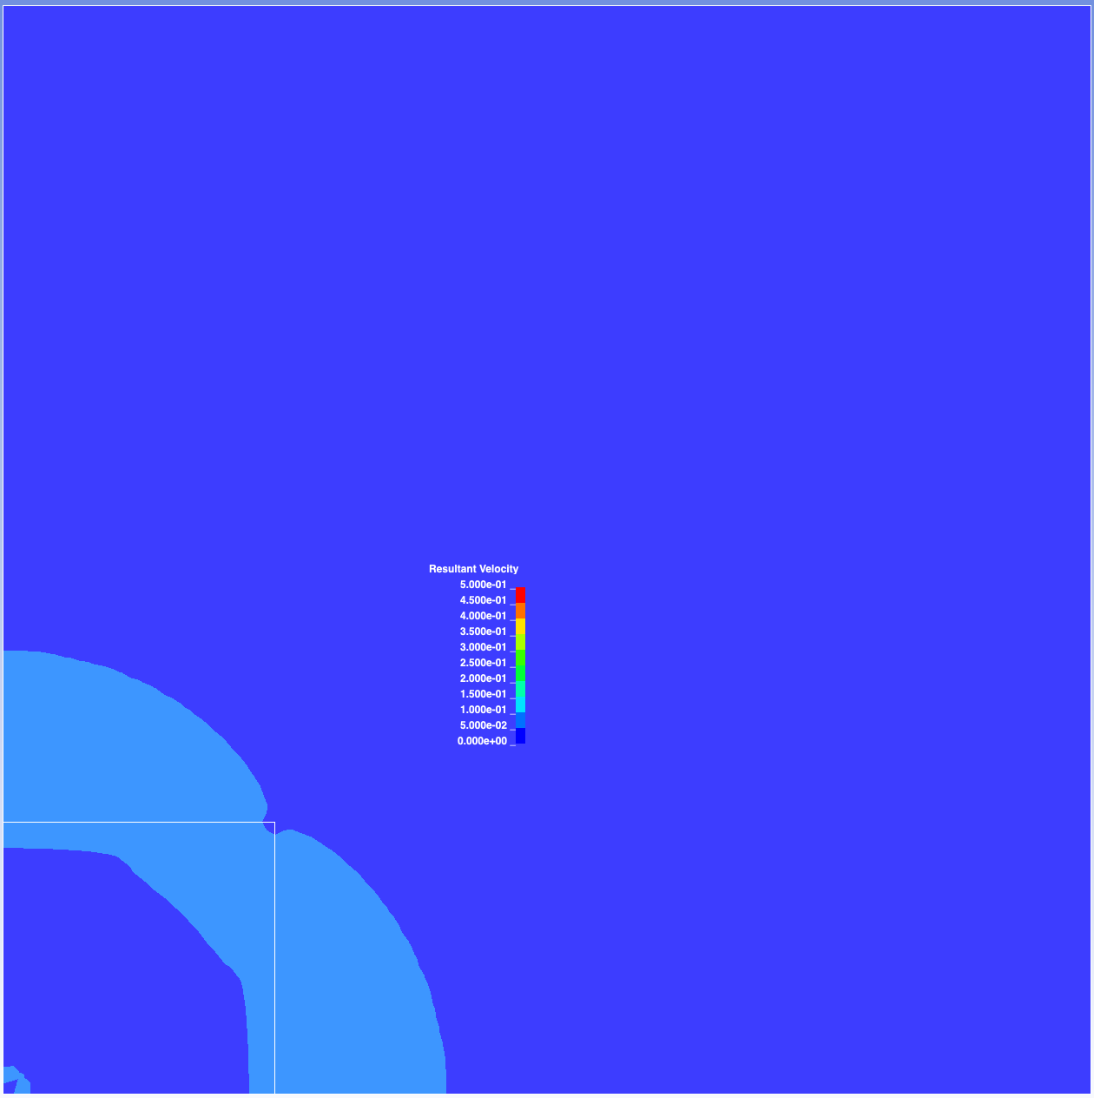
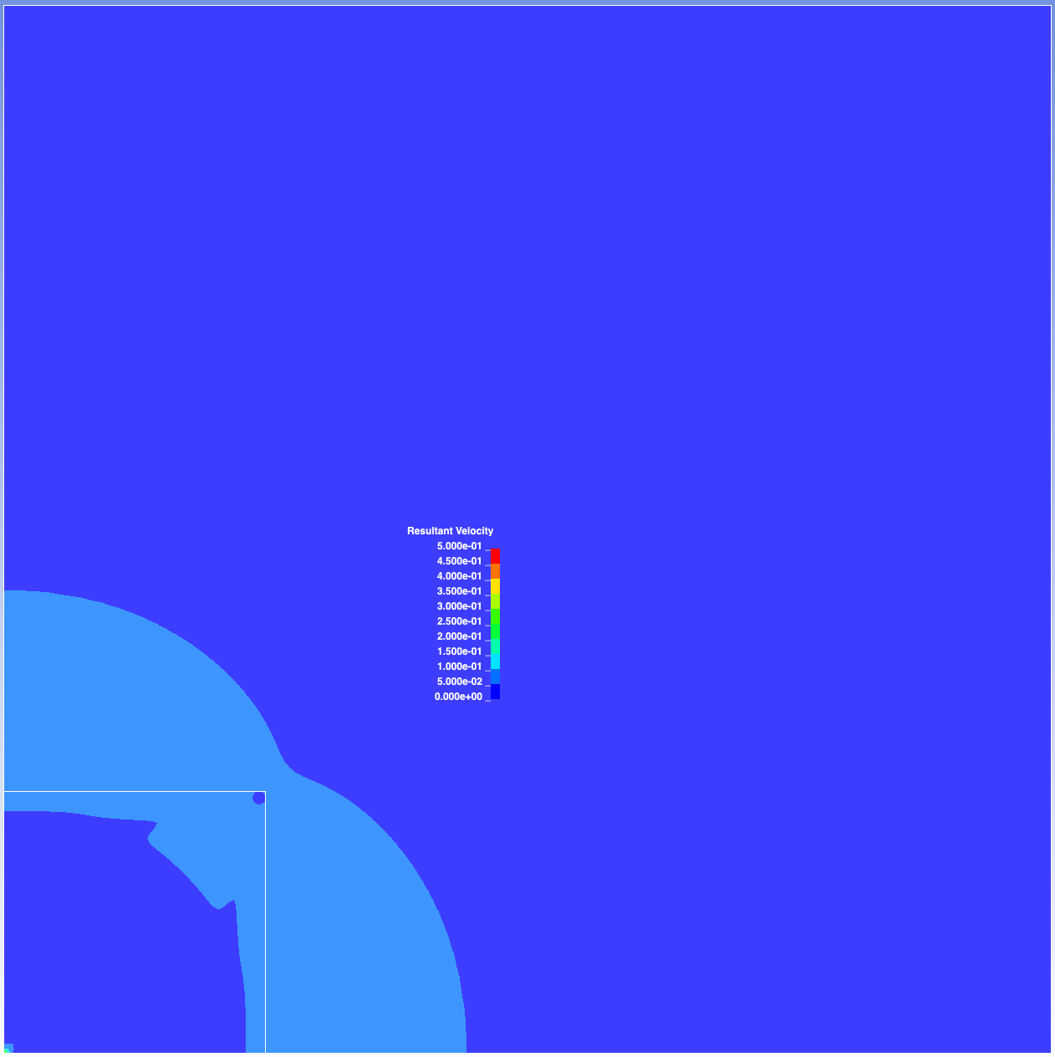

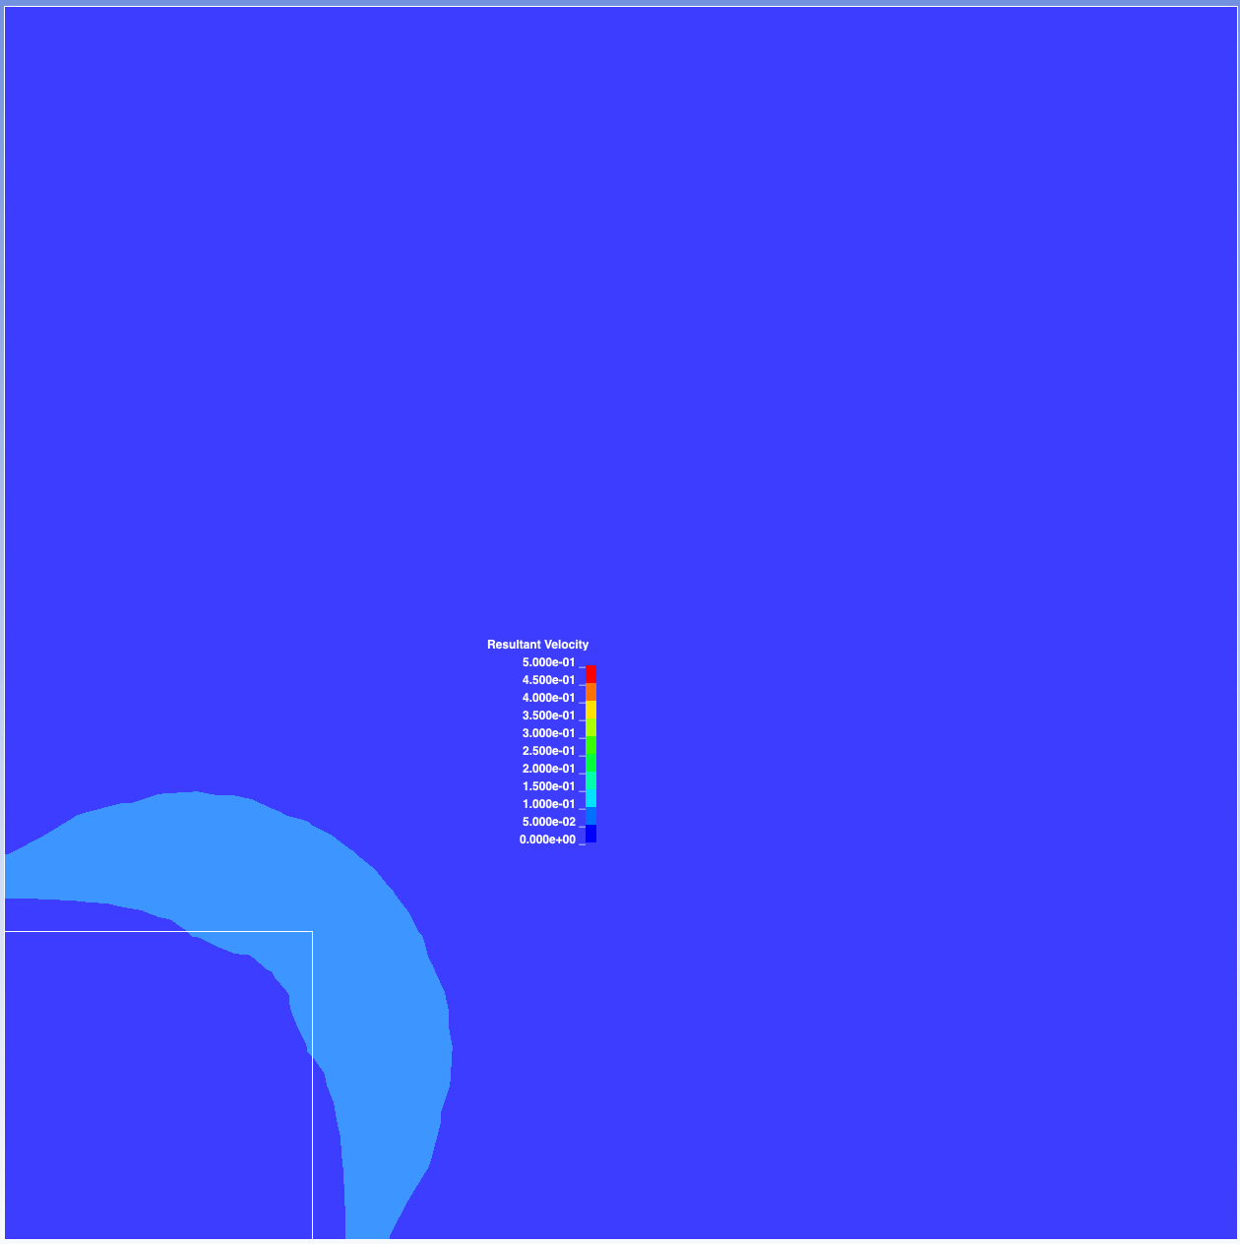
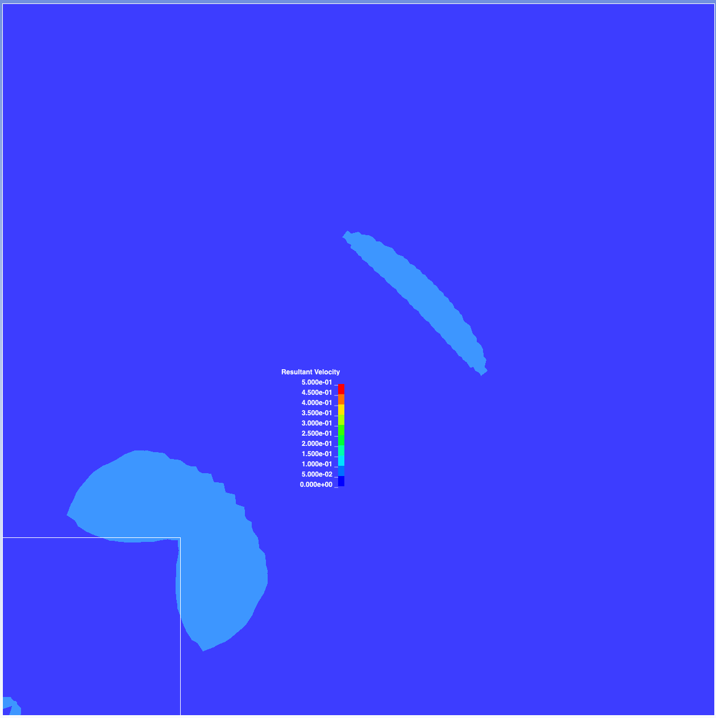
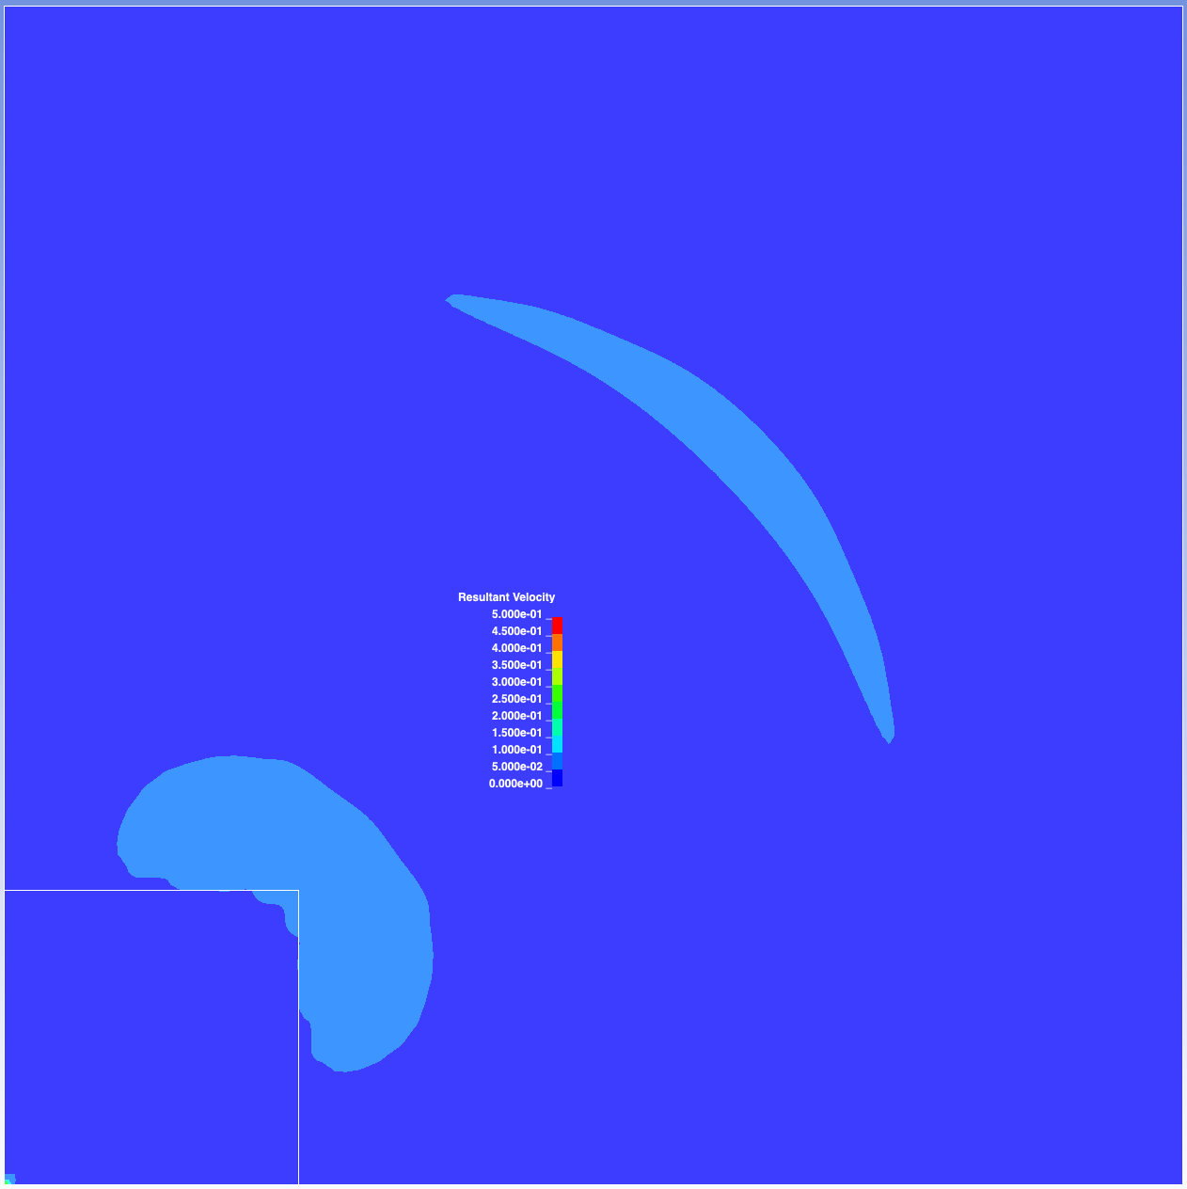
Velocity
Max vel set to 0.5
LS-DYNA example
element size = 1
overall max vel ~ 0.08
dimensions: 100x100x1
squareMesh32x32
element size = 1
overall max vel ~ 0.07
dimensions: 32x32x1
refinedMesh05_32x32
element size = 0.5
overall max vel ~ 0.48
dimensions: 32x32x1
refinedMesh016_32x32
element size = 0.16
overall max vel ~ 0.42
dimensions: 32x32x1
Frame 10
Frame 16
Frame 27

Slide 5
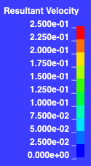
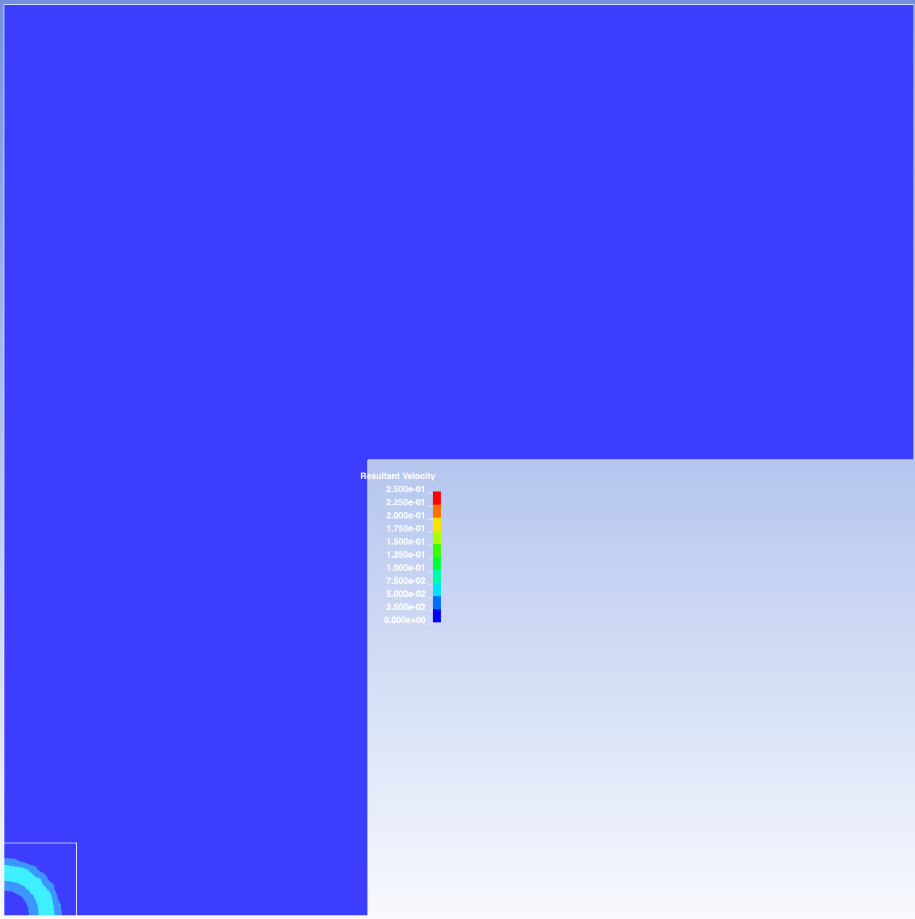











Velocity
Max vel set to 0.25
LS-DYNA example
element size = 1
overall max vel ~ 0.08
dimensions: 100x100x1
squareMesh32x32
element size = 1
overall max vel ~ 0.07
dimensions: 32x32x1
refinedMesh05_32x32
element size = 0.5
overall max vel ~ 0.48
dimensions: 32x32x1
refinedMesh016_32x32
element size = 0.16
overall max vel ~ 0.42
dimensions: 32x32x1
Frame 10
Frame 16
Frame 27

Slide 6













Velocity
Max vel set to 0.1
LS-DYNA example
element size = 1
overall max vel ~ 0.08
dimensions: 100x100x1
squareMesh32x32
element size = 1
overall max vel ~ 0.07
dimensions: 32x32x1
refinedMesh05_32x32
element size = 0.5
overall max vel ~ 0.48
dimensions: 32x32x1
refinedMesh016_32x32
element size = 0.16
overall max vel ~ 0.42
dimensions: 32x32x1
Frame 10
Frame 16
Frame 27

