Slide 1
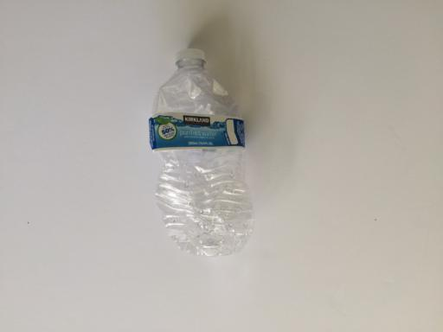
WasteSort
Basic AI and machine learning
Monday learning task
Goal Diggers
BCS34 October 21, 2026
01
Notes:
Good morning. We are Goal Diggers. Today we’ll explain the basic ideas behind our WasteSort project: artificial intelligence, machine learning, the main learning types, and how we use supervised image classification. Our task is to predict the material of one waste item from a photograph. This presentation focuses on the concepts behind that task.
Sources:
https://github.com/garythung/trashnet

Slide 2
Artificial intelligence and machine learning
ARTIFICIAL INTELLIGENCE
MACHINE LEARNING
The broad field of systems that perform tasks such as recognition and decision-making.
An approach within AI that learns patterns from data to make predictions.
Deep learning uses multilayer neural networks within machine learning.
02
Notes:
Artificial intelligence, or AI, is the broad field of building systems that perform tasks such as recognizing images and making decisions. Machine learning is one approach within AI. Instead of writing a separate rule for every possible image, we train a model using examples. A model is the learned mathematical system that makes a prediction. Deep learning is a type of machine learning that uses multilayer neural networks.
Sources:
https://www.ibm.com/think/topics/artificial-intelligence
https://developers.google.com/machine-learning/intro-to-ml/what-is-ml

Slide 3
Common learning types
Learning type | What the model learns from | Example
Supervised | Examples with known labels | Photo and its material label
Unsupervised | Data without target labels | Groups of similar customers
Reinforcement | Actions and reward feedback | Game-playing strategy
WasteSort uses supervised learning.
03
Notes:
In supervised learning, examples include known answers called labels. For WasteSort, a photo can have the label plastic. In unsupervised learning, the system looks for patterns without target labels, such as grouping similar customers. In reinforcement learning, an agent learns from rewards after actions, such as a game-playing system improving its strategy. WasteSort uses supervised learning because our training images already have material labels.
Sources:
https://developers.google.com/machine-learning/intro-to-ml/what-is-ml

Slide 4
Practical machine learning applications
Spam filtering
Predict an email category
Classification
Travel-time estimation
Predict a duration in minutes
Regression
Customer grouping
Find similar examples
Clustering
04
Notes:
Machine learning appears in several everyday tasks. A spam filter classifies an email into a category. A travel-time model predicts a number, so that task is regression. A clustering model groups similar examples without predefined target labels. WasteSort belongs to classification because its answer is a material category. Writing a category as a number in code does not turn the task into regression.
Sources:
https://developers.google.com/machine-learning/intro-to-ml/what-is-ml

Slide 5
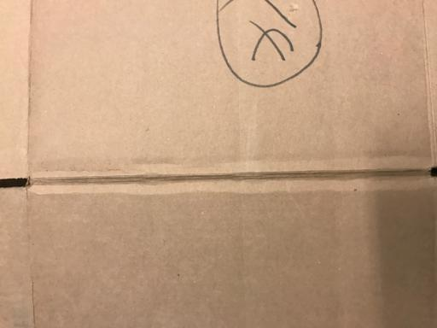

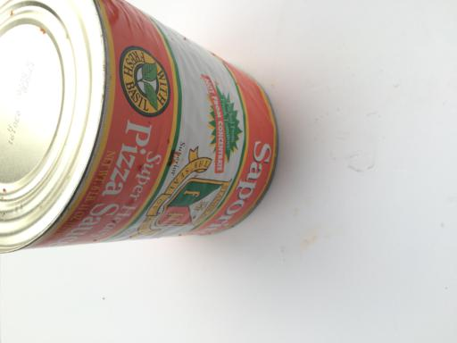
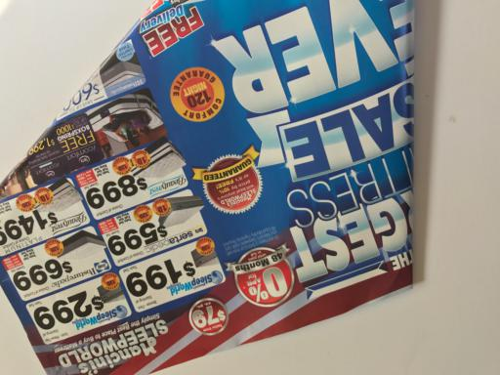
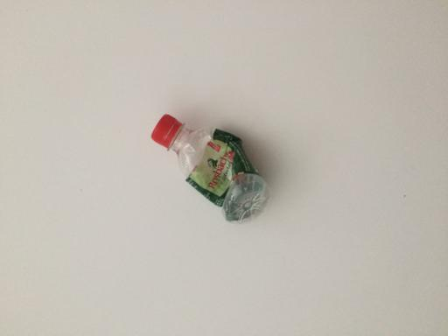
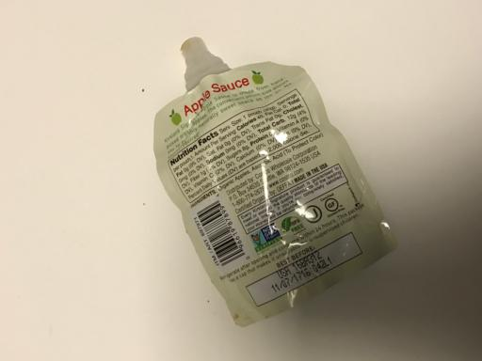
The WasteSort problem
One item photo. One predicted material category.
Cardboard
Glass
Metal
Paper
Plastic
Trash
TrashNet: 2,527 original labeled photos by Thung and Yang
05
Notes:
WasteSort accepts a photo containing one main waste item and predicts one of six materials: cardboard, glass, metal, paper, plastic or trash. We use TrashNet, a public dataset created by Gary Thung and Mindy Yang. Its original collection contains 2,527 labeled images. The pictures shown here are dataset examples. Similar-looking materials, such as glass and clear plastic, can make recognition difficult.
Sources:
https://github.com/garythung/trashnet

Slide 6
Supervised image classification in WasteSort
1 Training
Labeled photos teach the model patterns associated with each material.
2 Evaluation
Separate images help check whether the model can classify unseen examples.
3 Prediction
A saved model predicts a material for a new uploaded photo.
06
Notes:
During training, the system receives photographs together with their material labels. The model learns visual patterns that help distinguish those labels. Later, during prediction, it receives a new photo without the answer and outputs a material category. We use separate images to check whether it learned useful patterns. The app uses a saved model to classify an upload. Uploading a photo does not automatically retrain that model.
Sources:
https://developers.google.com/machine-learning/intro-to-ml/supervised
https://github.com/garythung/trashnet

Slide 7
What WasteSort can support
Recognize material appearance
A supervised model learns from labeled examples and predicts a category.
Use the result with care
Predictions can be wrong. Campus bin guidance requires verified local rules.
07
Notes:
WasteSort demonstrates how machine learning can assist with material recognition. Its prediction can be wrong, especially with cluttered backgrounds, mixed materials or unfamiliar objects. A material label alone does not decide whether an item is recyclable or which campus bin is correct. Those instructions depend on verified campus rules. The main idea is that labeled images allow a supervised model to learn a material-classification task. Thank you.
Sources:
https://github.com/garythung/trashnet
Supplied WasteSort proposal: scope and delimitations

