Slide 1
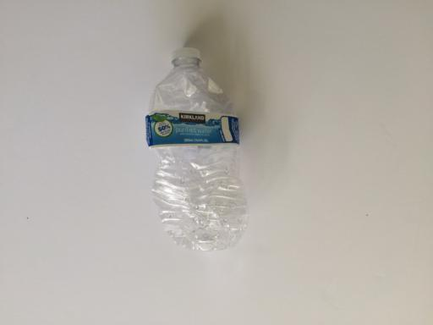
WasteSort: from dataset to prediction
Goal Diggers
Saturday demonstration
S-CSIS311 · BCS34
Six material classes
One uploaded photo
Measured results and limitations
Notes:
We are Goal Diggers. This demonstration connects our weekly learning activities: concepts, preparation, introductory classification, a separate regression exercise, evaluation and a working image classifier. AI assisted implementation and analysis through our shared chat.
Source: WasteSort repository protocol.json; reports/comparison.csv; reports/data_audit.json; reports/test_evaluation.json. Published local benchmark, not campus validation.

Slide 2
Prepare the data before training
Partition | Images | Role
Training | 1,774 | Fit parameters
Validation | 371 | Choose settings and model
Test | 376 | Evaluate the frozen choice
Six excluded files · 45 reviewed candidate pairs · seed 42
Notes:
TrashNet starts with 2,527 images. Six exact-pixel copies with conflicting labels are excluded. The remaining 2,521 images use seed 42 and grouped partitions. Candidate pairs stay together. The visual review records 28 likely same-item pairs, 11 visibly distinct pairs and 6 uncertain pairs; it does not retrospectively change the published split.
Source: WasteSort repository protocol.json; reports/comparison.csv; reports/data_audit.json; reports/test_evaluation.json. Published local benchmark, not campus validation.

Slide 3
Compare four primary approaches
Approach | Representation
SVM and Random Forest | 1,764 HOG features
Small CNN | 160 × 160 RGB images
MobileNetV2 | Pretrained image features
Exercises: KNN, Decision Tree and separate Linear Regression
Notes:
The primary comparison is HOG plus SVM, HOG plus Random Forest, a small CNN and MobileNetV2. KNN and Decision Tree teach introductory classification and use validation data only. Linear Regression uses a separate numerical dataset; it is not a material classifier.
Source: WasteSort repository protocol.json; reports/comparison.csv; reports/data_audit.json; reports/test_evaluation.json. Published local benchmark, not campus validation.

Slide 4
MobileNetV2 led the published comparison
Model | Validation F1 | Test accuracy | Test F1
HOG + SVM | 60.62% | 65.96% | 63.52%
HOG + Random Forest | 55.94% | 63.56% | 60.22%
Small CNN | 62.07% | 59.57% | 57.68%
MobileNetV2 | 84.74% | 84.57% | 81.22%
Macro F1 shown · one split and seed · weighted CNN is a separate ablation
Notes:
We chose the deployment model by validation macro F1 before examining test results. MobileNetV2 achieved 84.57 percent test accuracy and 81.22 percent macro F1. Macro F1 gives each class equal weight. These results describe one split and one training seed, so we do not claim statistically proven superiority or campus accuracy.
Source: WasteSort repository protocol.json; reports/comparison.csv; reports/data_audit.json; reports/test_evaluation.json. Published local benchmark, not campus validation.

Slide 5
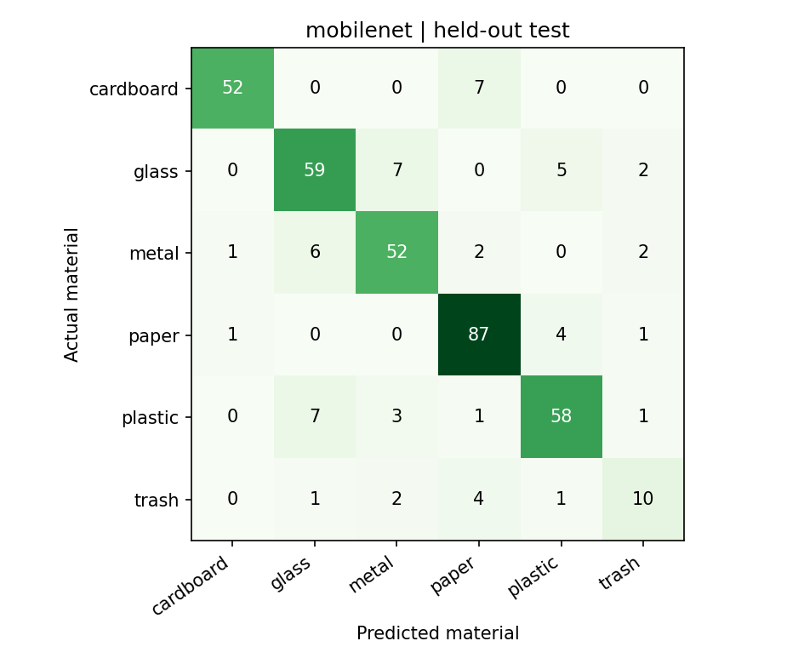
Overall accuracy hides missed trash items
10 / 18
trash images recognized
55.56% recall
Check errors by class,
not just total accuracy.
Notes:
Read the confusion matrix by actual class on the rows and predicted class on the columns. Correct classifications lie on the diagonal. Only 10 of 18 actual trash images were recognized by MobileNetV2, giving 55.56 percent trash recall. A good overall accuracy does not remove this weakness.
Source: WasteSort repository protocol.json; reports/comparison.csv; reports/data_audit.json; reports/test_evaluation.json. Published local benchmark, not campus validation.

Slide 6
Demonstrate the app and explain its limits
1 Start the app
2 Upload one clear item photo
3 Select Identify material
4 Explain and download the result
Before choosing a bin
Check posted campus rules.
No campus-photo accuracy claim.
Unrelated objects can receive a waste label.
AI-assisted group work · methodology changes documented for instructor review
Notes:
Start WasteSort, upload one clear JPEG or PNG, select Identify material, and explain the result and score. Download the JSON result as evidence. The score is not calibrated confidence. The app may classify unrelated objects and does not establish safety, recyclability or campus bin rules. This is a prototype demonstration. Colab execution records are reported separately from the original benchmark.
Source: WasteSort repository protocol.json; reports/comparison.csv; reports/data_audit.json; reports/test_evaluation.json. Published local benchmark, not campus validation.

