Slide 1

Real Time Emotion Recognition using
Convolutional Neural Networks
Prepared under the guidance of :
Dr. M.P.S. Bhatia
Submitted by :
Deepak Rathi(244/CO/14) Devesh Saini(247/CO/14) Harshil Yadav(258/CO/14)

Slide 2
Problem
Statement
The problem that we attempt to tackle in this project is Real time detection of Emotions using Convolutional Neural Networks (CNN).

Slide 3
Introduction
As humans, we classify emotions all the time without knowing it. Humans are well-trained in reading the emotions of others, in fact, at just 14 months old, babies can already tell the difference between happy and sad. But can computers do a better job than us in accessing emotional states?
Emotion is any conscious experience characterized by intense mental activity and a certain degree of pleasure or displeasure.Emotion is often intertwined with mood, temperament, personality, disposition, and motivation.
Emotion classification, the means by which one may distinguish one emotion from another, is a contested issue in emotion research and in affective science.

Slide 4
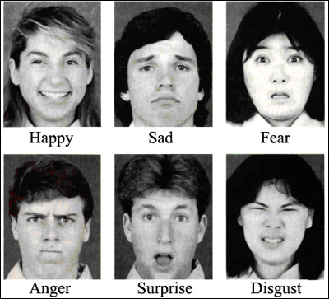
Basic Emotions
The six basic emotions we wish to classify are : anger, disgust, fear, happiness, sadness and surprise.

Slide 5
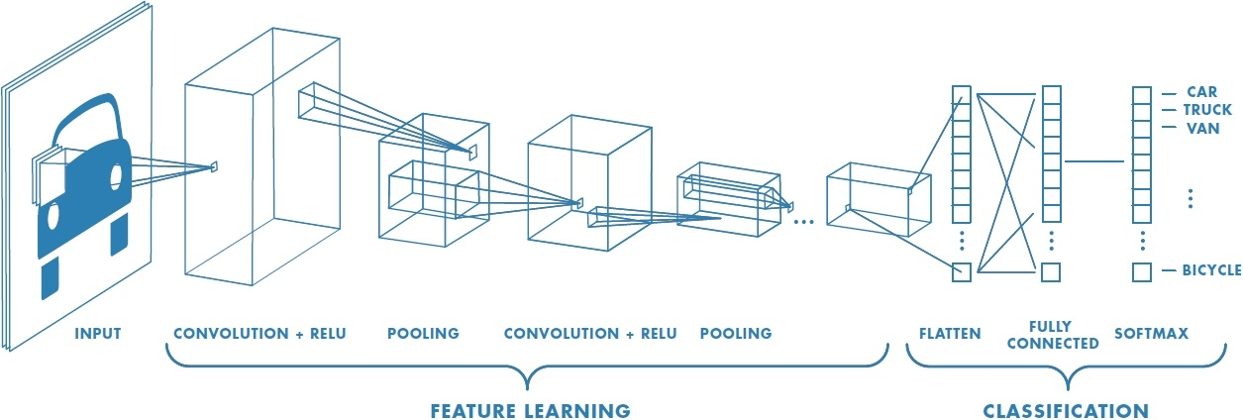
Convolutional Neural Networks
Convolutional Neural Networks (ConvNets or CNNs) are a category of Neural Networks that have proven very effective in areas such as image recognition and classification. ConvNets have been successful in identifying faces, objects and traffic signs apart from powering vision in robots and self driving cars.

Slide 6
Literature Review
Deep Convolutional Neural Network were used for Emotion Recognition on Kaggle Dataset [1].
Existing architectures such as AlexNet, VGG-16, Inception, and Inception-Resnet [2] were used to classify images and Saliency maps were used to analyse results.
AlexNet, GoogLeNet, and ResNet were used on the TinyImageNet dataset[3].
Bimodal Classification[4][6] studied.
Powell’s Direction Set Method[5] was used for back propagation on Cohn-Kanade dataset.

Slide 7
Objective
The main objective is to develop Emotion Recognition Application using the best architecture .
Achieve state of the art Convolutional Neural Network for emotion classification problem.
Perform emotion classification on the Kaggle ILSVRC2016 dataset with good accuracy.
Develop an application that should:
Take live video feed as input.
Process the video frame by frame using CNN and identify various relationships in the image.
The features extracted should be able to classify emotions in real time.

Slide 8
User Interface
User interface of the project is made using a web application. The web application is developed using Ruby as a language and Rails as the platform. Rails is a model–view–controller (MVC) framework, providing default structures for a database, a web service, and web pages. It encourages and facilitates the use of web standards such as JSON or XML for data transfer, and HTML, CSS and JavaScript for display and user interfacing.
Front-end consists of layout and buttons.
Back-end consists of routes, controller and process handling.

Slide 9
Demonstration

Slide 10
Implementation

Slide 11
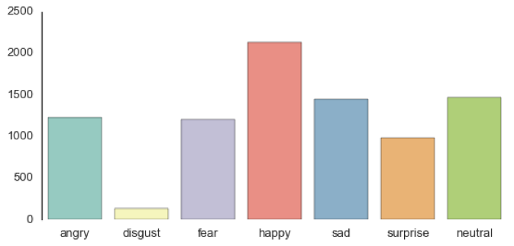
Dataset Collection
We used the dataset from the Kaggle challenge on Facial Expression Recognition, which gives 48x48 pixel grayscale images of faces.The dataset contains images that vary in viewpoint, lightning and scale. It consists of 35,887 images.

Slide 12
Data Preprocessing
The train.csv file contains three columns, "emotion", "pixels" and usage. The "emotion" column contains a numeric code ranging from 0 to 6, inclusive, for the emotion that is present in the image.
The "pixels" column contains a string surrounded in quotes for each image.
The contents of this string a space-separated pixel values in row major order.
The data set is split into training , validation and test set in the ratio 80:10:10.
The steps followed are shown in the next figure

Slide 13
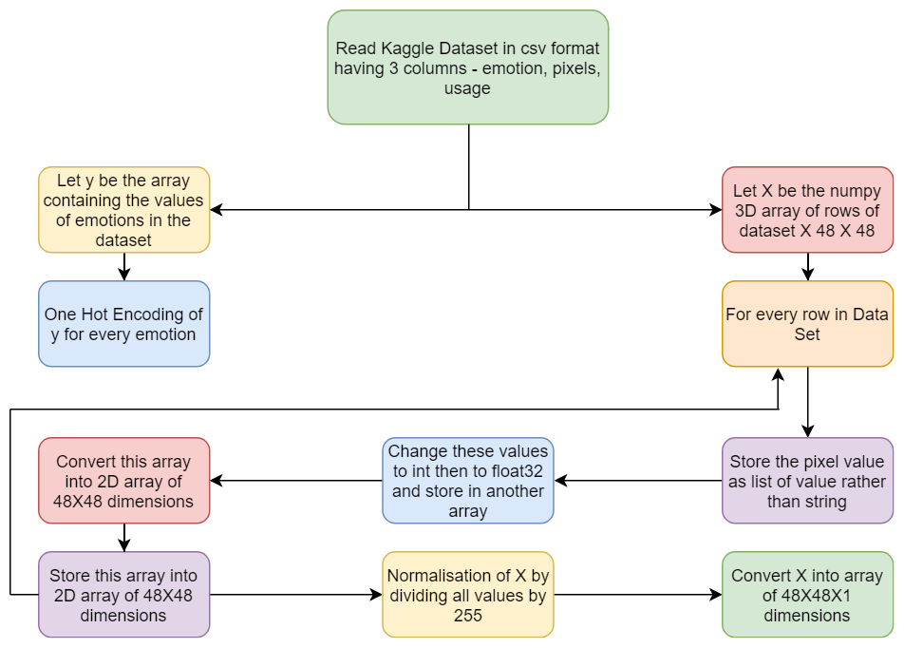
Steps in Data Processing

Slide 14
PROPOSED MODEL

Slide 15
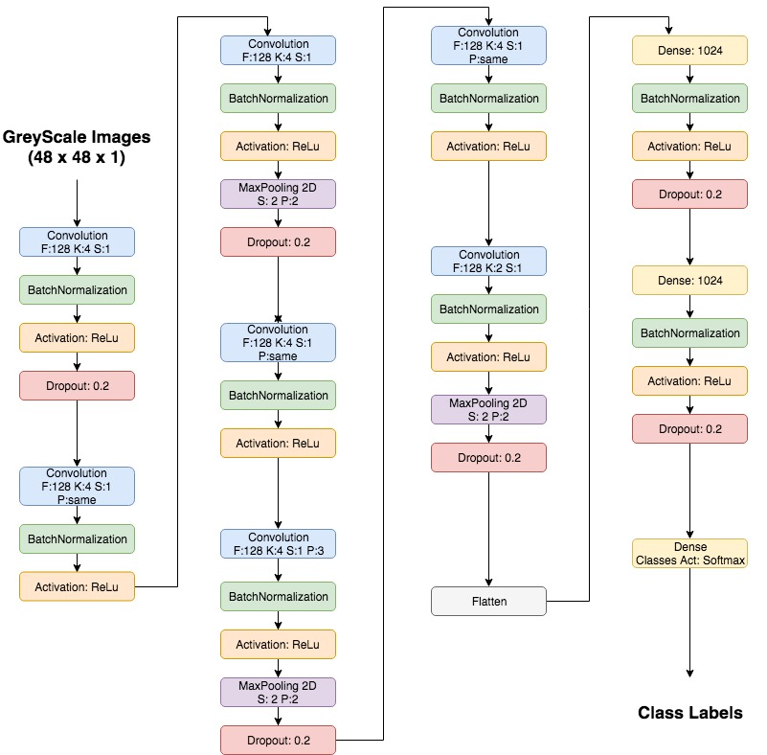
Model Used
The model was built entirely using Keras.
We would run each of our models for 16 epochs on the cloud after which the performance seemed to level off.

Slide 16
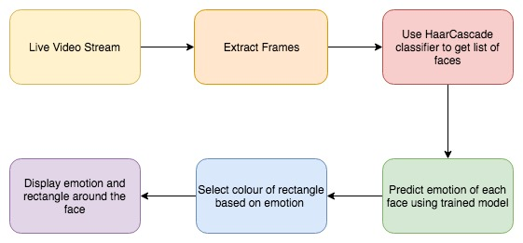
Video Processing

Slide 17
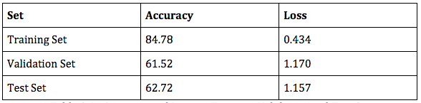
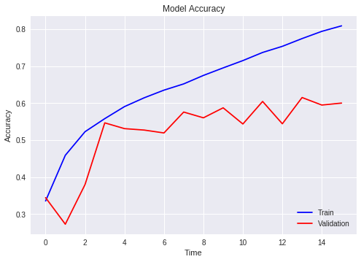
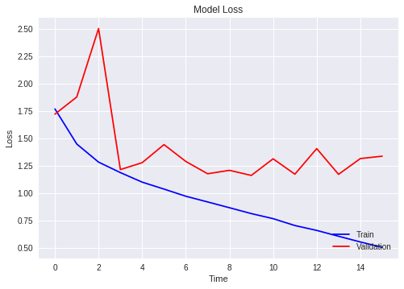
Result Visualization and Analysis
Training v/s Validation Accuracy Graph
Training v/s Validation Loss Graph

Slide 18
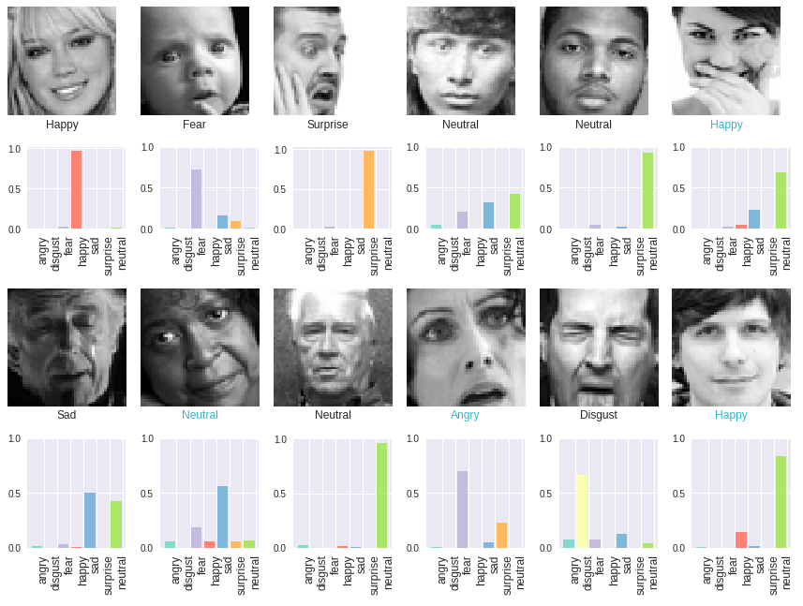
Model Predictions
on Dataset Images

Slide 19
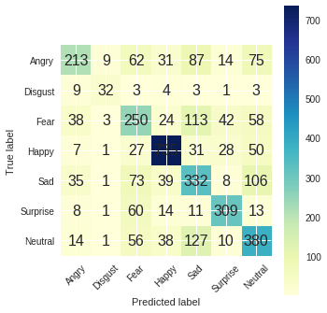
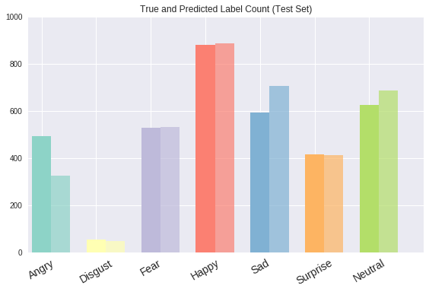
True and Predicted
Label Count in Test Set
Confusion Matrix

Slide 20
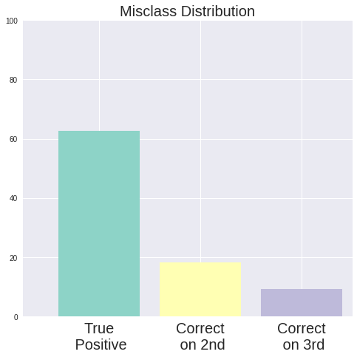
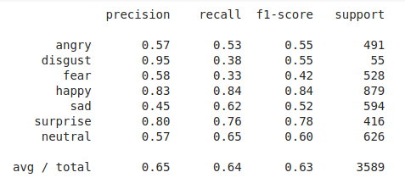
Classification Report

Slide 21
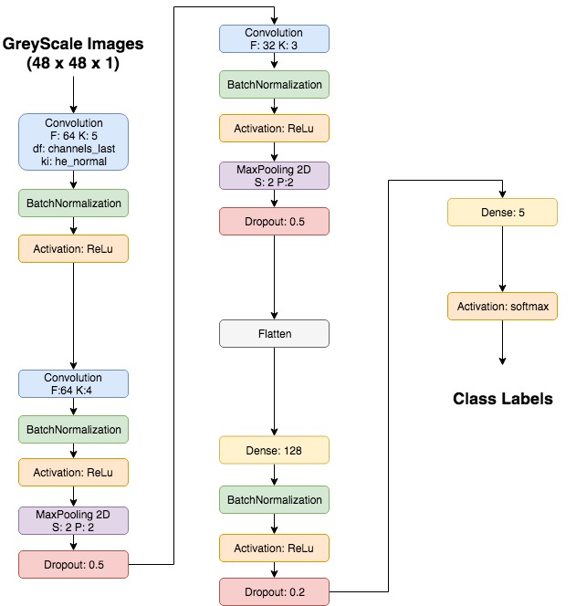
Model 2
Architecture of 5-classes Recognition Model

Slide 22
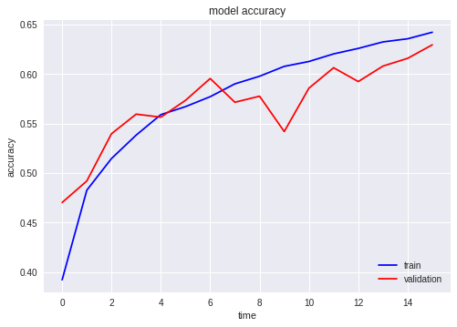
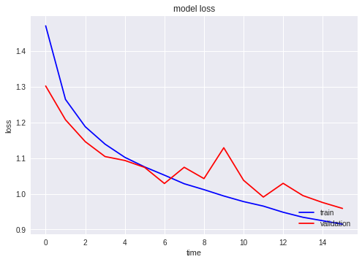
Accuracy and Loss Graphs of Model 2
Training v/s Validation Set Accuracy Graph
Training v/s Validation Set Loss Graph

Slide 23
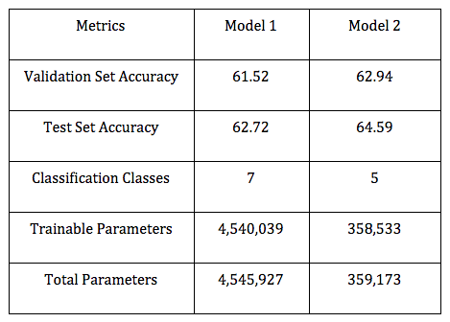
Result Comparison
Challenges in Representation Learning: Facial Expression Recognition Challenge was hosted on Kaggle.com in 2013. The best solution had an accuracy of 71% and top 10 submissions had an accuracy of 60%. We were able to achieve an accuracy of 64.59% on the test set by using model 2.

Slide 24
Conclusion
In this project, we sought to classify the image of a face into the seven basic human emotions. We developed and experimented with the architecture of a deep convolutional neural network ourselves, and performed a hyperparameter search to optimize our results. We compared different architectures to classify emotions and we were able to reach the state-of-the-art test accuracy of approximately 64.59%.
However, we believe if we addressed the overfitting of the training data, we could reach even higher test accuracies.
We also developed a web application to demonstrate our project and provide interactive interface to the user.
We have described a holistic, non intrusive approach to emotion detection, by checking for user’s facial expressions. These are powerful measures, even for low image resolution and in-the-wild circumstances such as bad illumination, facial expressions, non-frontality etc.

Slide 25
Future Work
Build a REST API and add functionalities to Website : REST API can be built that finds human faces within images and make prediction about each facial emotions. User must be able to paste the url of an image or drag-and-drop an image file.,have the API return with annotated faces and cropped thumbnail. The API must return probabilities and an unique ID for image in JSON format.
Extend to Bimodal Classification : Ensemble Learning can be used to obtain predictions by combining both audio and video. This will improve the accuracy of emotion detection.
Transfer Learning : It is storing knowledge gained while solving one problem and applying it to a different but related problem. Our model trained on ImageNet dataset can be fine tuned and results can be analyzed.

Slide 26
References
Touchy Feely: An Emotion Recognition Challenge Authors : Dhruv Amin Stanford University, Patrick Chase Stanford University, Kirin Sinha Stanford University
Facial Expression Recognition for wild images with analysis from Saliency maps Authors: Priyanka Rao ,Ling Li
Deep Convolutional Neural Networks for Tiny ImageNet Classification Hujia Yu Stanford University
Recognising Facial Expressions Using Deep Learning Authors : Alexandru Savoiu Stanford University, James Wong Stanford
Neural Networks for Emotion Classification by Yafei Sun
Analysis of Emotion Recognition using Facial Expressions, Speech and Multimodal Information Carlos Busso, Abe Kazemzadeh, Sungbok Lee, Ulrich Neumann , Shrikanth Narayanan

Slide 27
THANK YOU

