Slide 1
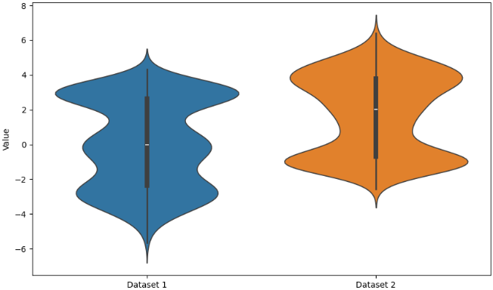
Default LLM service provider 1
GitHub / GitLab CI
Hi! I have data and would like to measure x.
H
LLM
I propose to try algorithm alg.
git-bob comment on how to do this with Python
Domain expert
gpt-4o
Certainly! Try this:
from algorithms import alg
x = alg(data)
boxplot(x)
H
LLM service provider 2
Data analyst
AI
LLM
For result visualization let’s better use a violinplot.
git-bob ask claude to try this!
claude
git-bob
I created a
notebook for
using alg and
drawing a
violinplot:
LLM service provider 3
LLM
That looks reasonable/correct!
gemini
Nice! Thanks!

