Slide 1
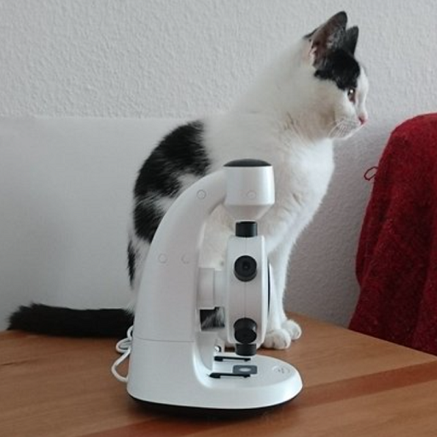
Cat and Microscope
The image shows a white and black cat sitting on a wooden surface next to a white microscope. The cat is sitting upright and looking to the right, while the microscope is positioned in front of it, with the eyepiece and objective lenses visible. The background is a plain white wall, and there is a red item, possibly a piece of cloth, on the same surface as the cat and microscope.

Slide 2
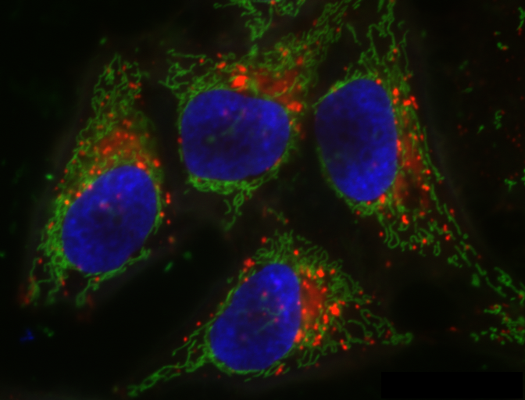
Fluorescence Microscopy of Cells
The image depicts a fluorescence microscopy view of cells. The large blue areas represent the nuclei of the cells, likely stained with a dye such as DAPI. Surrounding the nuclei, the green structures are indicative of the cell's cytoskeleton or other membranous structures, often stained with a fluorescent marker specific to proteins like actin or tubulin. The red spots likely indicate mitochondria or other organelles marked with a specific fluorescent dye. These colors help identify different cellular components and their distribution within the cells.

