Slide 1
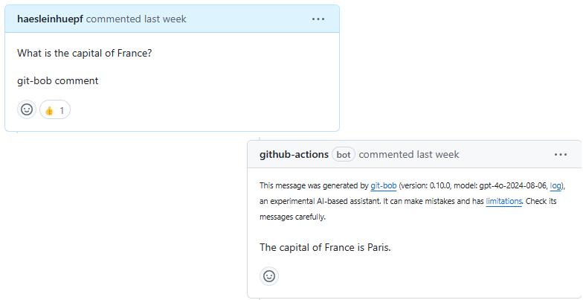
Research Data Management for Scientific Imaging
Managing scientific image data effectively is crucial for modern research. We'll cover best practices for organizing, documenting and sharing imaging data.

Slide 2
Why Data Management Matters
• Poor data management costs 4-6 hours/week searching for data
• Enables verification of research results
• Required by funding agencies
• Essential for research reproducibility
• Facilitates collaboration

Slide 3
File Formats & Organization
• Store raw data in open formats (OME-TIFF)
• Use descriptive folder names: YYYY-MM-DD_experiment-name
• Create README files in each folder
• Separate raw data from processed results
• Consistent file naming conventions

Slide 4
Metadata is Key
• Microscope settings (objective, pixel size, exposure)
• Sample preparation methods
• Treatment conditions and timepoints
• Calibration data and controls
• Use consistent metadata templates

Slide 5
Version Control
• Track changes to analysis code with Git
• Document processing in notebooks
• Record software versions used
• Keep scripts with datasets
• Regular commits and clear messages

Slide 6
Data Storage & Backup
The 3-2-1 Rule:
• 3 copies of data
• 2 different storage types
• 1 copy stored offsite
Use checksums to verify data integrity
Plan storage needs in advance

Slide 7
Data Analysis Pipeline
• Document step-by-step analysis workflow
• Use automation for reproducibility
• Save intermediate results
• Include example data
• Validate results with controls

Slide 8
Data Sharing
• Upload to appropriate repositories
• Get DOIs for datasets
• Include detailed metadata
• Consider access restrictions
• Link data to publications

Slide 9
FAIR Principles
Make your data:
• Findable - Use proper metadata and identifiers
• Accessible - Standard protocols for access
• Interoperable - Use standard formats
• Reusable - Clear documentation

Slide 10
Resources & Tools
Essential tools for scientific imaging:
• Bio-Formats - image conversion
• ImageJ/Fiji - analysis
• Git - version control
• Zenodo/BioImage Archive - sharing
Contact your library's data services team for support

