Slide 1
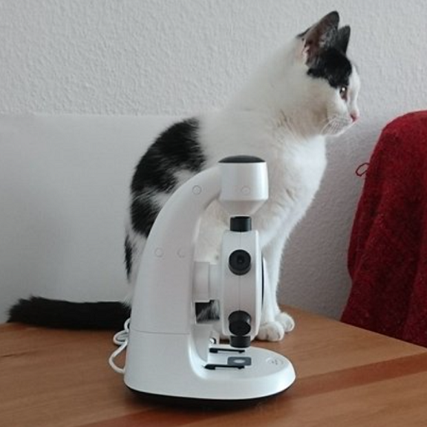
Cat and Microscope
• White and black cat on table
• White microscope in front
• Red cloth partially visible

Slide 2
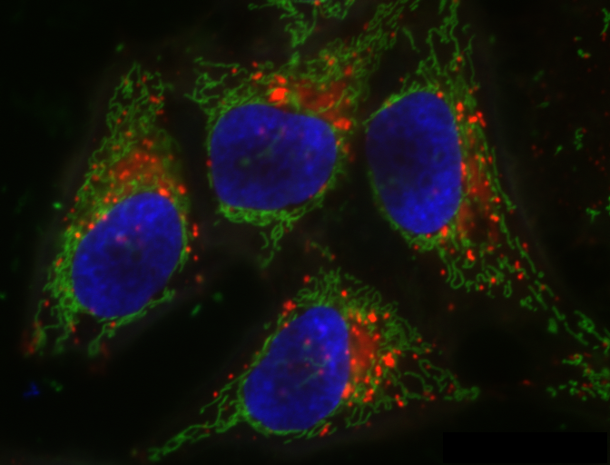
Fluorescence Microscopy
• Cells with multi-channel staining
• Blue nuclei, green cytoskeleton
• Bright red areas, different organelle

