Slide 1
Introduction to AI in Research
• Understanding AI: A Beginner's Guide
• Why good scientific practice is crucial

Slide 2
Defining Good Scientific Practice
• Integrity and honesty in all aspects
• Transparency and openness

Slide 3
Data Management and Ethics
• Ensure data integrity and quality
• Ethical use of data and consent

Slide 4
Designing Robust Experiments
• Clear hypotheses and objectives
• Use of control groups and reproducibility

Slide 5
Selecting Appropriate AI Models
• Choose models suited to your data and goals
• Avoid overfitting and ensure generalizability

Slide 6
Validating Model Performance
• Use metrics appropriate to your problem
• Continuous evaluation and improvement

Slide 7
Avoid Common Pitfalls
• Bias in models and datasets
• Over-reliance on AI without context

Slide 8
Ensuring Collaboration and Sharing
• Collaborate with domain experts
• Share findings and data responsibly

Slide 9
Documentation and Reporting
• Comprehensive documentation
• Transparent reporting for peer review

Slide 10
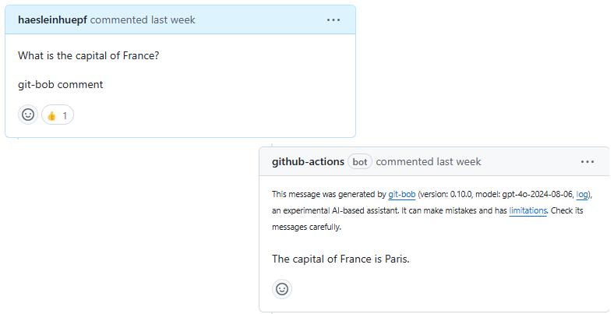
Conclusion
• Recap: Integrity, ethics, and collaboration

