Slide 1
Activation Functions in Deep Learning
git-bob (github-actions bot)

Slide 2
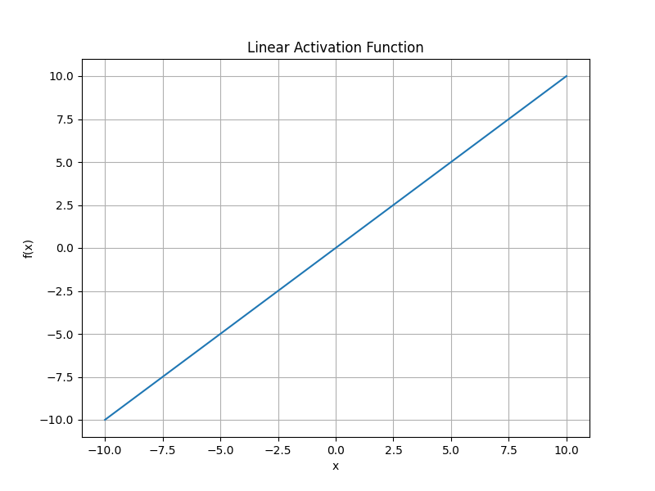
Linear Activation Function
• Simplest activation function: f(x) = x
• Outputs proportional to inputs
• Limited use in deep learning
• Doesn't help with non-linear relationships
• Main application: regression in output layer

Slide 3
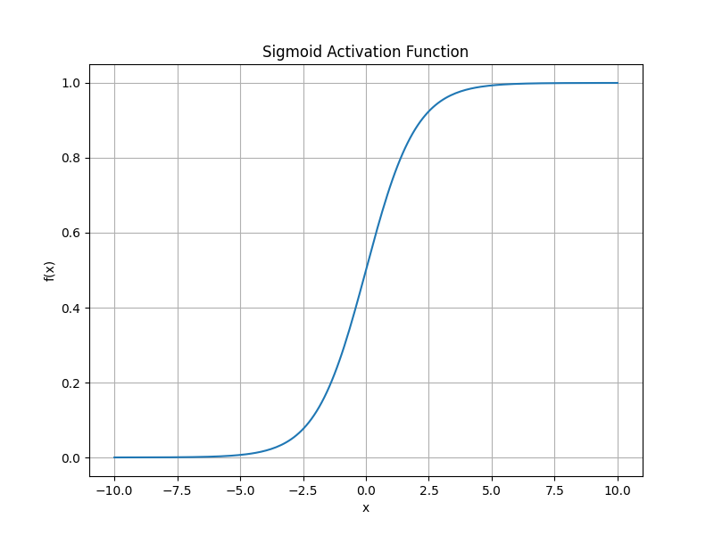
Sigmoid Activation Function
• Transforms input to range [0,1]
• Historically popular in neural networks
• Good for binary classification
• Suffers from vanishing gradient problem
• Outputs meaningful probabilities

Slide 4
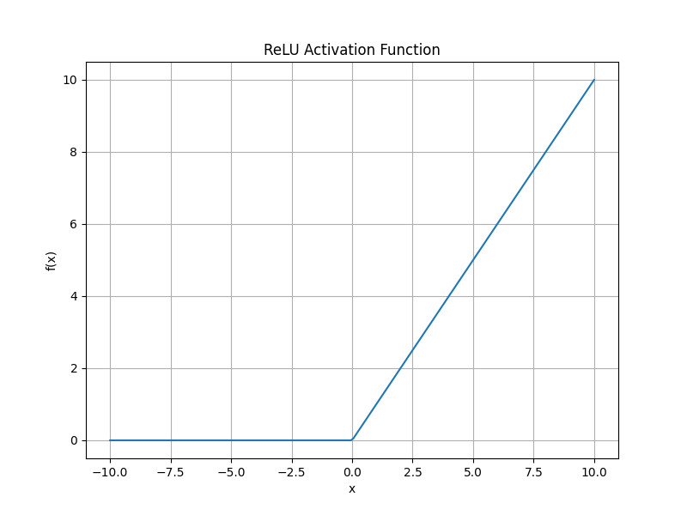
ReLU (Rectified Linear Unit)
• Most popular activation function today
• f(x) = max(0,x)
• Solves vanishing gradient problem
• Computationally efficient
• Helps with sparse activation

