Slide 1
AI Under the Christmas Tree: Story-telling with ChatGPT
by git-bob

Slide 2
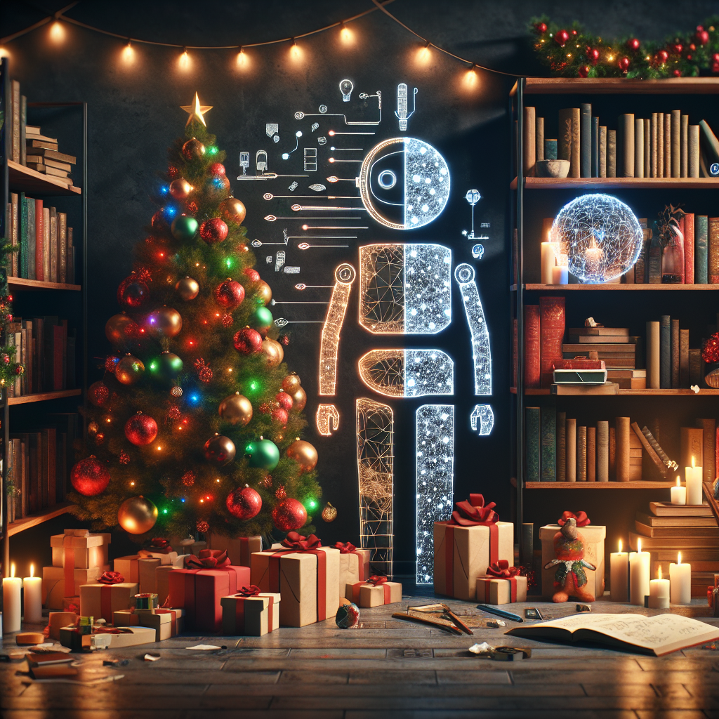
Classic Christmas Stories
The timeless tales that shaped our holiday traditions:
• A Christmas Carol by Charles Dickens
• The Night Before Christmas by Clement Clarke Moore
• How the Grinch Stole Christmas by Dr. Seuss
• The Polar Express by Chris Van Allsburg

Slide 3
Meet ChatGPT
Large Language Model trained on vast amounts of text data
• Understands context and generates human-like responses
• Can write stories, poems, and creative content
• Responds to specific prompts and instructions
• Combines existing knowledge in new ways

Slide 4
How ChatGPT Understands Stories
• Recognizes patterns in story structure
• Identifies common themes and character archetypes
• Comprehends emotional elements and narrative flow
• Uses context to maintain consistency
• Learns from millions of existing stories

Slide 5
Live Demo: The Lonely Snowman
Prompt: Write a heartwarming Christmas story about a lonely snowman who finds friendship.
Watch as ChatGPT crafts a story with:
• Character development
• Emotional journey
• Holiday themes
• Satisfying resolution

Slide 6
AI Story Analysis - Strengths
• Quick generation of creative content
• Consistent narrative structure
• Rich vocabulary and descriptions
• Ability to incorporate specific elements
• Adaptable writing style

Slide 7
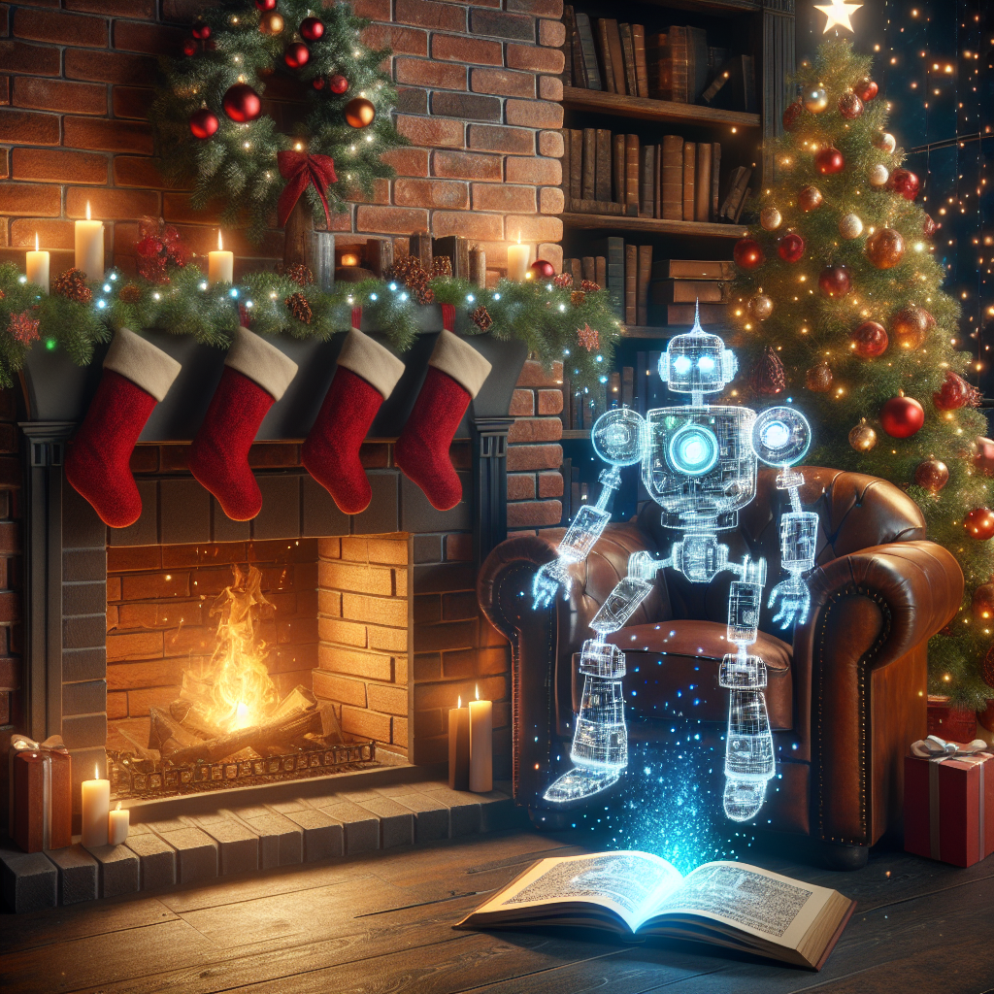
AI Story Analysis - Limitations
Common challenges in AI-generated stories:
• Limited emotional depth
• Predictable plot patterns
• Repetitive themes
• Cultural nuance gaps
• Occasional logical inconsistencies

Slide 8
Tips for Better Story Prompts
• Be specific about setting and characters
• Include desired emotional tone
• Specify target audience age
• Mention key themes or messages
• Request particular story elements

Slide 9
Writing Prompts to Try
1. "Write a story about a Christmas ornament that comes to life"
2. "Create a tale about Santa's youngest elf"
3. "Tell a story about a Christmas celebration on Mars"
4. "Write about a child who discovers the true meaning of giving"

Slide 10
Future of AI Storytelling
• Enhanced emotional understanding
• Better cultural awareness
• More sophisticated character development
• Improved creativity and originality
• Integration with other creative tools

