Slide 1
Research Data Management Basics
git-bob / github-actions bot

Slide 2
What is Research Data Management?
Research Data Management (RDM) is the systematic handling of research data throughout its lifecycle, from planning and collection to preservation and sharing.

Slide 3
1. Data Organization & Documentation
• Consistent file naming conventions and folder structures
• Clear metadata and documentation of methods
• Version control and change tracking
• Data dictionaries and codebooks
• Regular backups

Slide 4
2. Data Storage & Security
• Secure storage solutions with regular backups
• Access control and permissions management
• Data encryption for sensitive information
• Compliance with institutional policies
• Regular integrity checks

Slide 5
3. Data Sharing & Preservation
• FAIR principles (Findable, Accessible, Interoperable, Reusable)
• Selection of appropriate repositories
• Clear licensing and usage rights
• Long-term preservation strategy
• Citation and DOI assignment

Slide 6
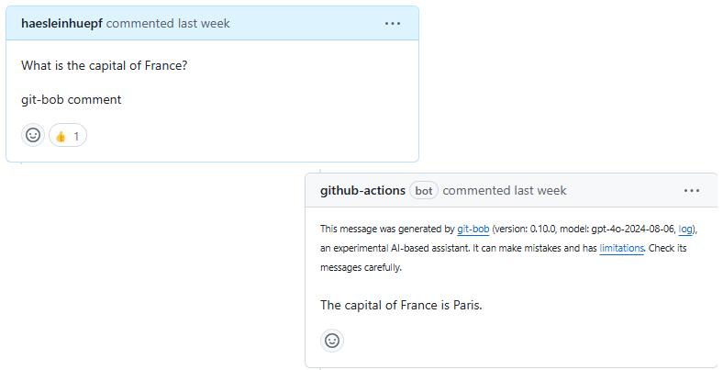
Summary
Good RDM practices ensure research integrity, reproducibility, and maximum impact of your research data.

