Slide 1
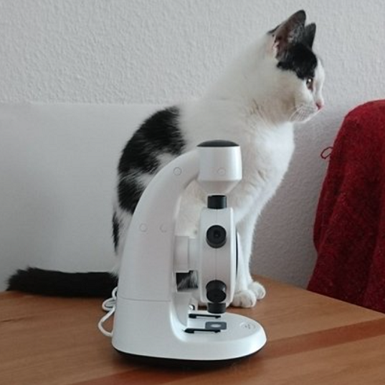
Slide 1: Cat and Microscope
This image shows a black and white cat sitting on a wooden surface next to a white microscope.
The cat is facing to the right, and the microscope is positioned such that the stage and lenses are visible.

Slide 2
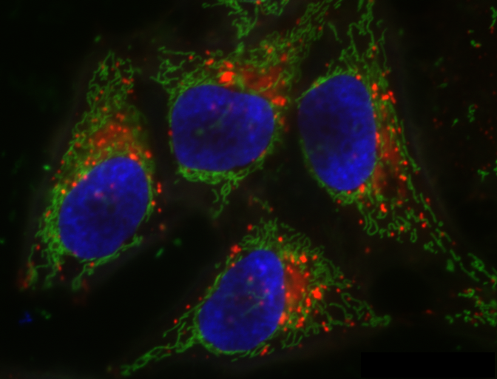
Slide 2: Cellular Components
The image shows four cells under a fluorescence microscope.
The cell nuclei are prominently stained blue, indicating the presence of DNA.

