Slide 1
Winter Celebration Time!
Story by: Your Friendly Storyteller

Slide 2
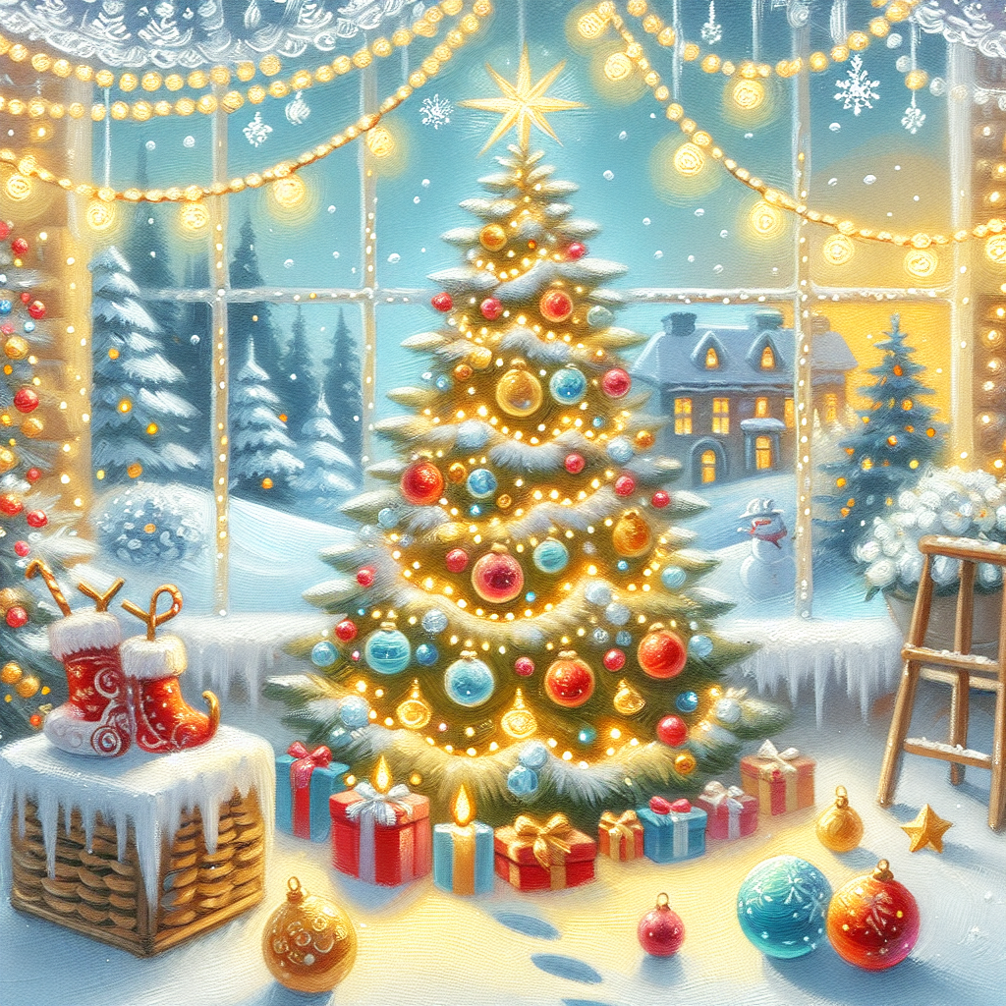
The Magic of Winter Trees
Did you know that trees can wear sparkly winter clothes?
• They dress up with twinkling lights
• Some wear colorful decorations
• People gather around them to sing songs
• They make everyone smile!

Slide 3
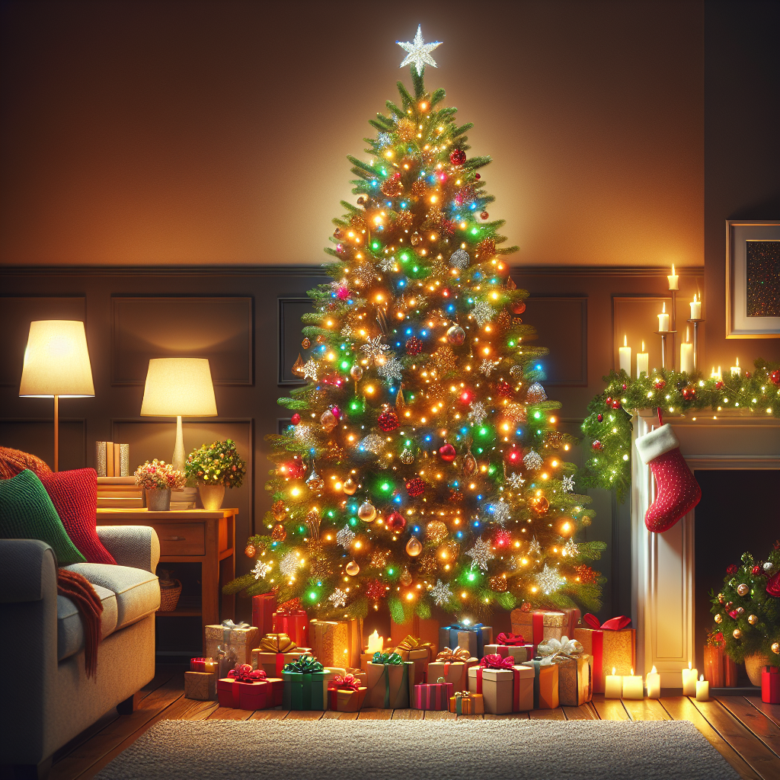
Celebrating Together
The best part of winter celebrations is being with family!
• Sharing warm hugs and big smiles
• Making yummy treats together
• Playing fun games indoors
• Opening presents and surprises

