Slide 1
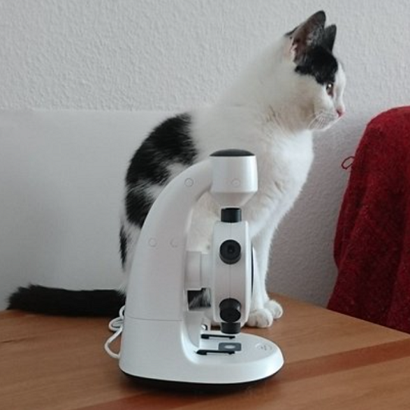
Cat and Microscope
The image shows a cat sitting on a wooden surface next to a white microscope. The cat is looking to the side and appears to have a white and black coat. The microscope is positioned in front of the cat, creating a playful juxtaposition between the two objects. The background is a plain white wall and part of a red textile is visible to the right.

Slide 2
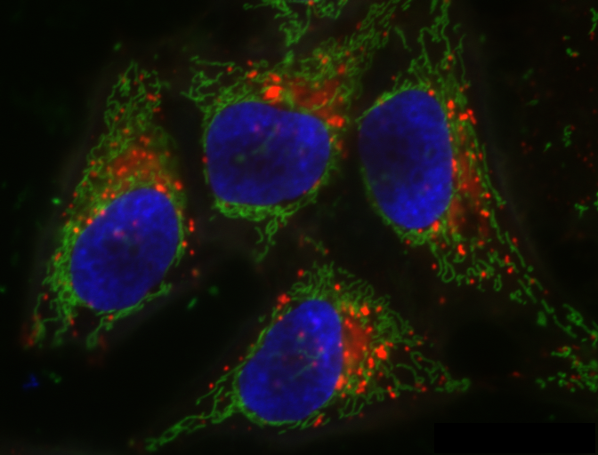
Fluorescent Microscopy Image
This image depicts a fluorescent microscopy image of four cells. The cell nuclei are stained blue, likely indicating the presence of DNA. The cell structure is outlined in green, possibly highlighting the cytoskeleton or cell membrane. Red spots within the cells may indicate specific organelles or proteins, such as mitochondria or tagged proteins. The overall image suggests a study focusing on cellular components and structures.

