Slide 1
Towards Transparency and Knowledge Exchange in AI-assisted Data Analysis Code Generation
Robert Haase

Slide 2
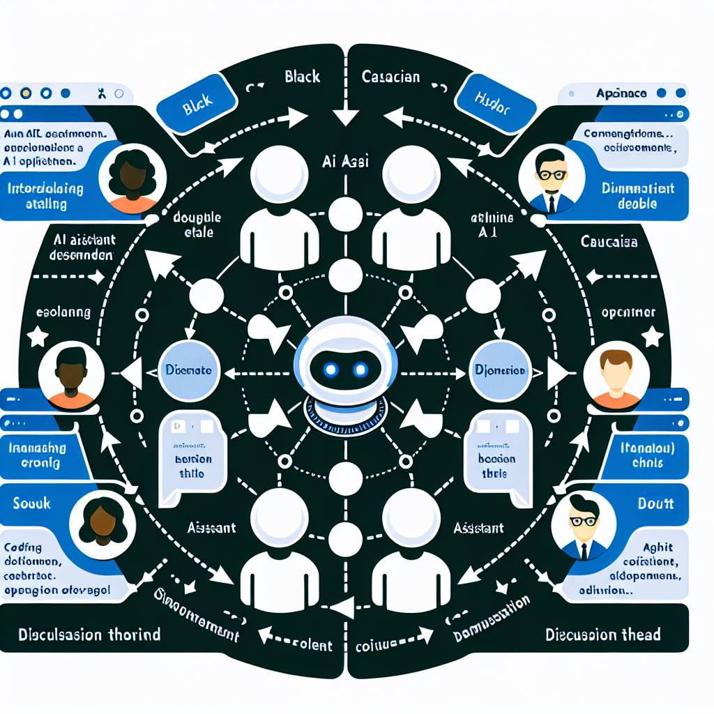
The Challenge
• LLMs are increasingly used in scientific data analysis
• Lack of transparency in AI-generated content
• No established system for documenting LLM-prompted code
• Missing professional peer-review system for AI contributions

Slide 3
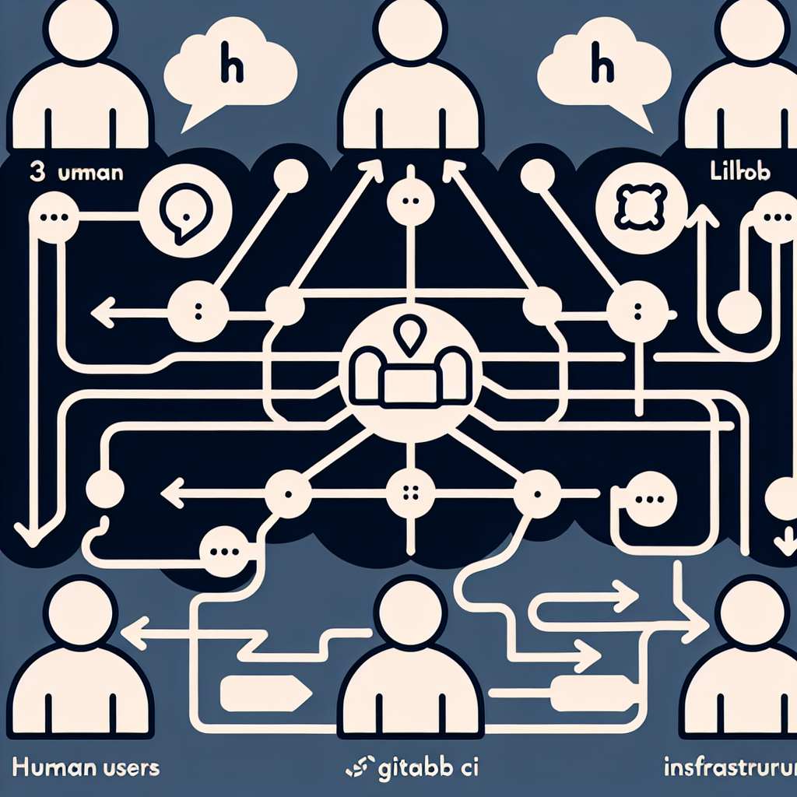
Introducing git-bob
• AI assistant integrated with GitHub/GitLab platforms
• Enables transparent collaboration between humans and AI
• Conserves all discussions and code modifications
• Open-source implementation with customizable prompts

Slide 4
Key Features
• Multiple humans can interact in one thread
• Supports various LLM providers (GPT4, Claude, Gemini)
• Generates and reviews code
• Assists in documentation and manuscript writing
• All interactions are publicly archived

Slide 5
Impact
• Promotes transparency in AI-assisted scientific work
• Facilitates knowledge exchange between domain experts
• Establishes good scientific practice for LLM usage
• Creates reproducible and documented AI interactions
• Bridges gap between humans and AI in scientific workflows

