Slide 1
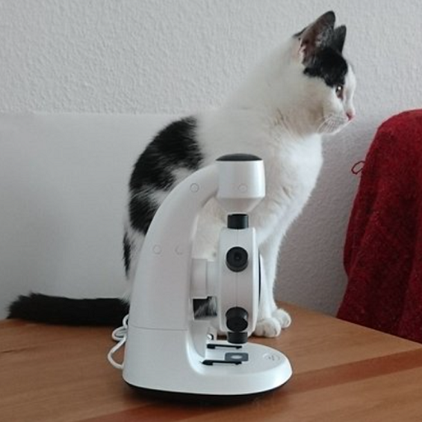
Slide 1: Cat and Microscope
The image shows a cat sitting on a wooden surface beside a white microscope. The cat has a white coat with black patches, and it is looking to the side. The microscope is modern-looking, with a sleek design, and both are positioned against a light-colored wall.

Slide 2
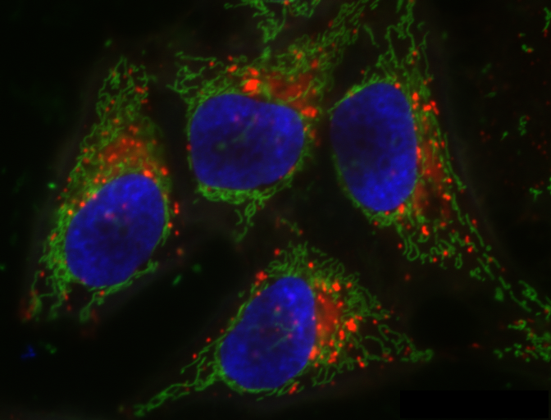
Slide 2: Fluorescent Microscopy Image
This is a fluorescent microscopy image showing four cells. The nuclei are prominently stained blue, indicating a DNA-specific stain such as DAPI. The surrounding cell structures are highlighted in green, likely representing components such as the cytoskeleton or mitochondria, commonly stained with fluorophores like GFP. Additionally, there are scattered red spots or regions, perhaps indicating another cellular component or organelle, like lysosomes or specific proteins, visualized using a red fluorescent marker.

