Slide 1
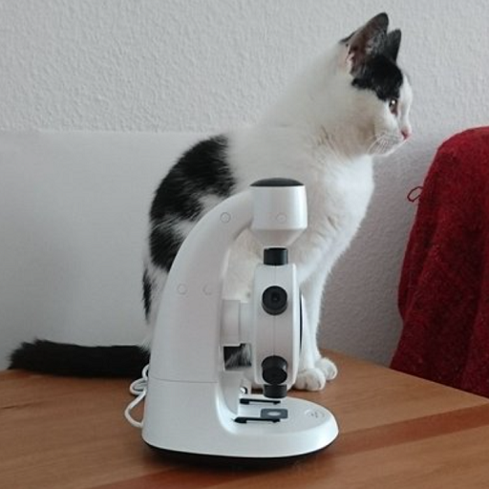
Slide 1: Black and White Cat
The image shows a black and white cat sitting next to a white microscope on a wooden surface. The cat appears to be looking out of the frame to the right. The background is a plain white wall, with part of a red cloth visible on the right side.

Slide 2
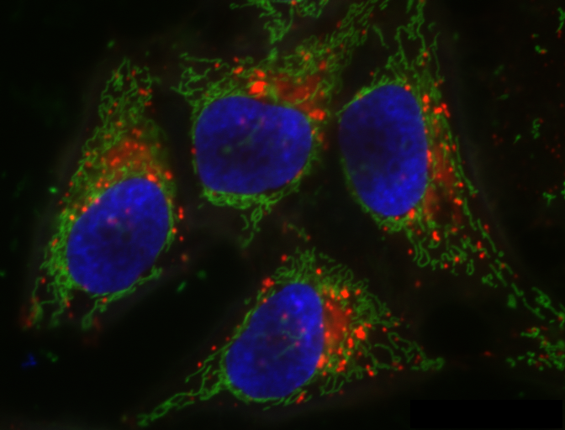
Slide 2: Fluorescence Microscopy Image of Cells
The image is a fluorescence microscopy depicting cells. It displays four prominent cell nuclei stained in blue, surrounded by intricate green structures likely representing the cell cytoskeleton. Red dots or patches are dispersed around the nuclei, indicating specific organelles tagged with a red fluorescent marker.

