Slide 1

Presentation on Images
A Visual Presentation of Images

Slide 2
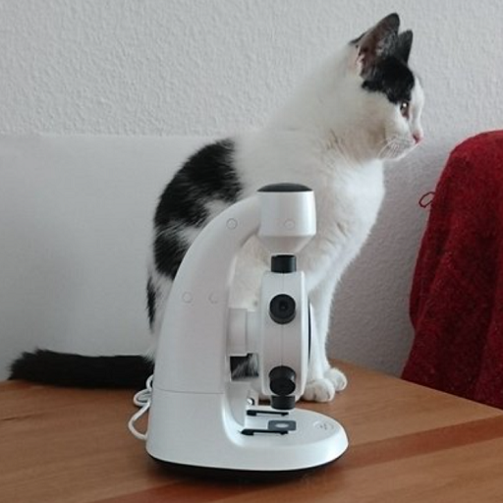
Image 1: Cat with Microscope
The image shows a cat sitting on a wooden surface next to a white microscope. The cat has a black and white coat and is positioned so that its body is parallel to the microscope. The background is a plain white wall, and there's a red textured fabric partially visible on the right side. The cat is looking off to the right, away from the camera.

Slide 3
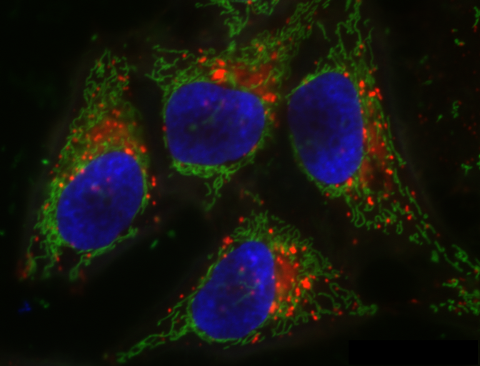
Image 2: Fluorescence Microscopy of Cells
This image shows a fluorescence microscopy view of cells. The most prominent features are the four oval-shaped nuclei, stained blue, located centrally in each cell. Surrounding the nuclei is a network of structures labeled in green, likely representing the cell cytoskeleton or cellular organelles such as mitochondria. Additionally, there are red-stained elements scattered around the cells, which could indicate other cellular components or proteins of interest. The image highlights the distinct cellular structures for biological analysis.

