Slide 1
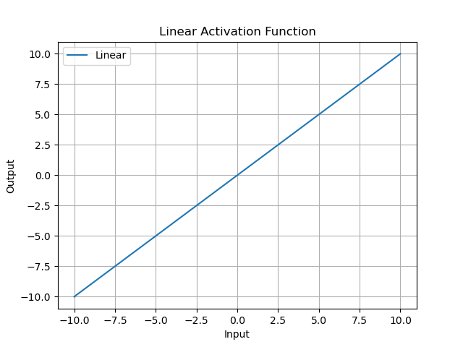
Linear Activation Function
The Linear activation function is a direct proportion relationship.
This means that the output is directly proportional to the input.
It is primarily used in output layers.

Slide 2
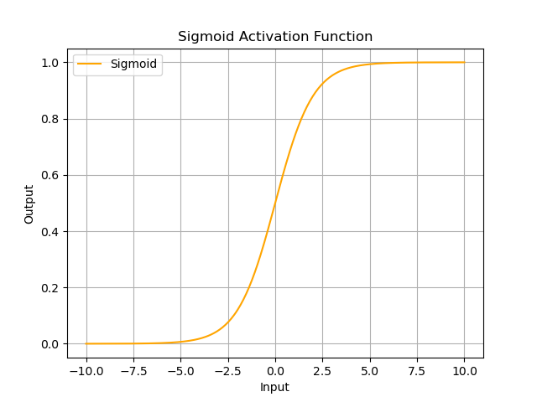
Sigmoid Activation Function
The Sigmoid activation function is represented by the S-shaped curve.
It maps input values to an output range between 0 and 1.
It is commonly used for binary classification problems.

Slide 3
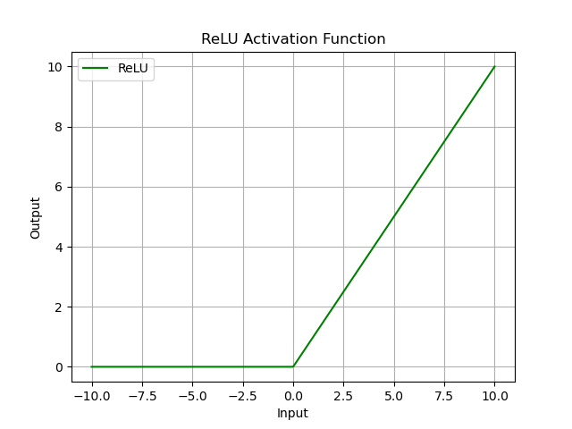
ReLU Activation Function
ReLU stands for Rectified Linear Unit.
It outputs zero for any negative input and the input itself for any positive input.
ReLU is widely used in hidden layers of deep neural networks.

