Slide 1
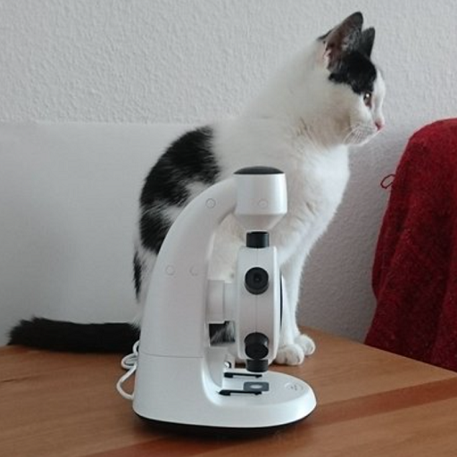
Slide 1
Here is the first image with its description.

Slide 2
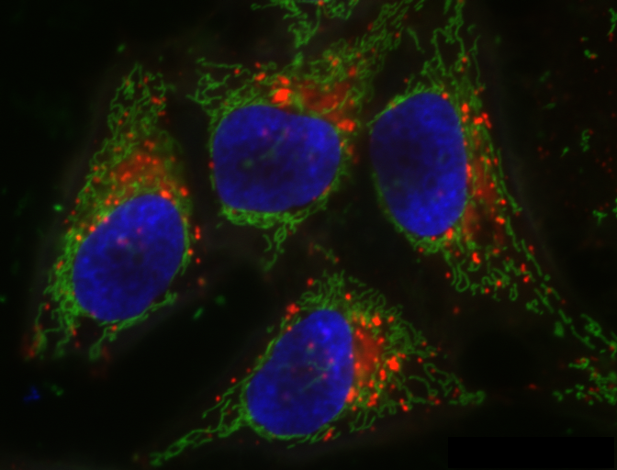
Slide 2
Here is the second image with its description.

