Slide 1
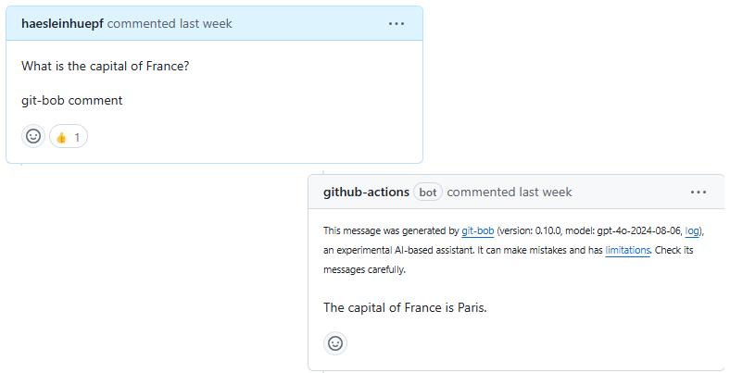
Training Computational Skills in the Age of AI
A guide to modern research infrastructure and AI-powered tools

Slide 2
Institutional Infrastructure: Research Computing
• Nextcloud: Secure file sharing and collaboration
• GitLab: Version control and CI/CD pipelines
• JupyterLab: Interactive computing environment
• SLURM Cluster: High-performance computing resources
Modern research requires robust computational infrastructure for data storage, analysis, and collaboration.

Slide 3
Institutional AI Infrastructure
• Local LLM Server: Secure, private language model deployment
• Blablador: Institution-specific conversational AI
• KISSKI: Knowledge Integration System
Private AI infrastructure ensures data security while leveraging modern AI capabilities.

Slide 4
Public Research Infrastructure
• GitHub: Global collaboration and version control
• Zenodo: Long-term research data archiving
• Integration enables automatic research output preservation
Public infrastructure promotes open science and reproducibility.

Slide 5
Cloud-based AI Tools
• Hugging Face: AI model repository and deployment
• Google Colab: Free GPU-powered notebooks
• Google Docs: Collaborative document editing
Cloud platforms democratize access to advanced AI tools and computing resources.

Slide 6
Documentation and Publishing
• GitHub.io: Free web hosting
• Jupyter Book: Beautiful documentation
• AI-generated documentation
• Automated publication workflows
Modern documentation tools combine automation with human expertise.

Slide 7
Learning with AI Assistants
• git-bob: Interactive AI teaching assistant
• Learning through discussion
• Real-time code review and feedback
AI assistants enhance learning through interactive guidance and immediate feedback.

Slide 8
Prompt Engineering Skills
• Crafting effective prompts
• Understanding AI capabilities and limitations
• Iterative refinement of results
• Documentation generation
Prompt engineering is becoming a crucial skill in the AI era.

