Slide 1
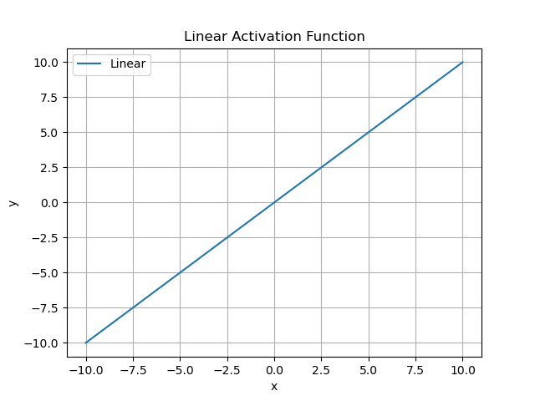
Linear Activation Function
The linear activation function is a simple identity function:
f(x) = x
It is used when the output of the neural network is unbounded.
Advantages: Simplicity and interpretability.
Disadvantages: Does not introduce non-linearity, so not used in hidden layers.

Slide 2
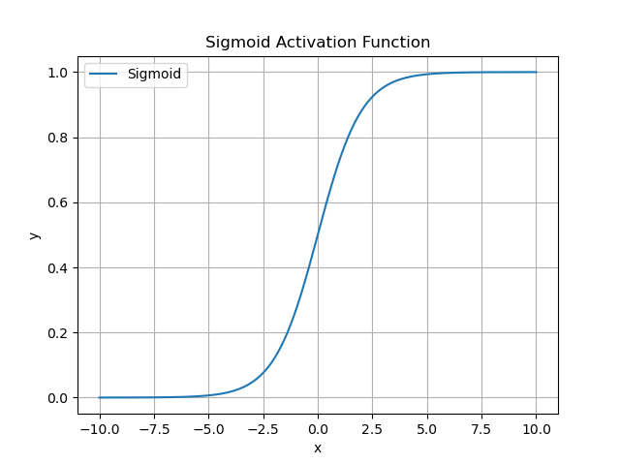
Sigmoid Activation Function
The sigmoid activation function outputs values between 0 and 1:
f(x) = 1 / (1 + exp(-x))
It is commonly used for binary classification problems.
Advantages: Smooth gradient, output bounds, clear predictions.
Disadvantages: Vanishing gradient problem, outputs not zero-centered.

Slide 3
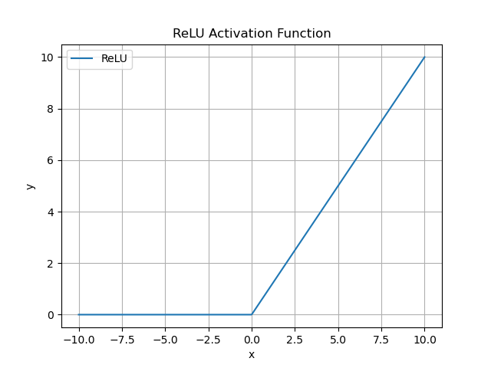
ReLU Activation Function
ReLU (Rectified Linear Unit) is defined as:
f(x) = max(0, x)
Widely used in hidden layers of neural networks for its simplicity and efficiency.
Advantages: Computationally efficient, mitigates vanishing gradient problem.
Disadvantages: Can encounter dying ReLUs where neurons become inactive.

